Slide 1
The CEOS Ocean Variables Enabling Research and Applications for GEO (COVERAGE) Initiative:
Committee on Earth Observation Satellites
Status Overview
Drs. Eric Lindstrom, Vardis Tsontos & Jorge Vazquez
NASA
SIT Tech Workshop 2017 Agenda Item #21
VC-WG Day
CEOS Strategic Implementation Team Tech Workshop
ESA/ESRIN, Frascati, Italy
13th-14th September 2017

Slide 2
COVERAGE Project Activities
Advisory Board Formulation
Terms of Reference developed, Letters of Invitation dispatched, Acceptances received
Composition representative of stakeholder groups with an interest in COVERAGE
Cross-CEOS Agency, Ocean VCs, WGISS, GEO-ocean projects, GOOS
Next step: Kick-off telecon (TBD)
Board Member | Affiliations & Applicability to COVERAGE
Andrew Mitchell | NASA/EOSDIS | CEOS-WGISS/FDA
Philippe Escudier (interim, 6 months) | CNES | CEOS-OST VC
Paul DiGiacomo | NOAA | GEO-Blue Planet CEOS-OCR VC
Tony Lee | NASA/JPL | CEOS-OSVW VC NASA OSST-
Helen Beggs | Aus.Met.Bureau | CEOS-SST VC IMOS
Frank Muller-Karger | USF | GEO-MBON CEOS-OCR VC
Tim Moltmann | UTas | IMOS GOOS
David Freestone | SSC | COVERAGE Sargasso Sea pilot study
EU Copernicus Marine - TBD
EUMETSAT - TBD

Slide 3
COVERAGE Project Activities
Stakeholder Engagement since April 2017
Blue Planet – meetings at 3rd BP symposium, 31 May-2 June
SST-VC – GHRSST meeting, June 5-9: discussions with VC co-chairs
IMOS – telecon on 29 June with T. Moltmann
NASA/EOSDIS – meeting at JPL, 2 Aug. with A. Mitchell
CNES – meeting at JPL, 11 Aug. with P. Escudier, T. Guinle, J. Lambin
MBON – meeting at MBARI, 10 Aug. F. Muller-Karger (USF) & G. Canonico (NOAA/IOOS)
SSC - telecon on 1 Sep. with Sargasso Sea Commission Secretariat (D. Freestone)
Presentations
3rd Blue Planet Symposium (Maryland, USA) – E. Lindstrom
GHRSST XVIII Science Team Meeting (Qingdao, China) – J. Vazquez
NOAA Coastwatch Annual meeting (California, USA) – V. Tsontos & J. Vazquez
IOOS-Animal Telemetry Network (ATN) meeting (California, USA) - V. Tsontos
Upcoming: Copernicus Marine Week American Geophysical Union 2017 Fall Conference Ocean Sciences 2018

Slide 4
COVERAGE Project Next Steps
Project Initiation
COVERAGE Phase A project funded with NASA PO-program support (3-yr commitment)
Project core team assembled
Project management & documentation infrastructure implemented leveraging ECC
Workshop series proposal in process in collaboration with Sargasso Sea Commission
Phase A work plan key elements (6 months):
Detailed technical scoping, use case gathering & requirements analysis
Inventory of target datasets, providers, interfaces
COVERAGE system technical architecture, including CEOS and data provider interoperability considerations
Collaborative arrangements
Ongoing stakeholder engagement

Slide 5
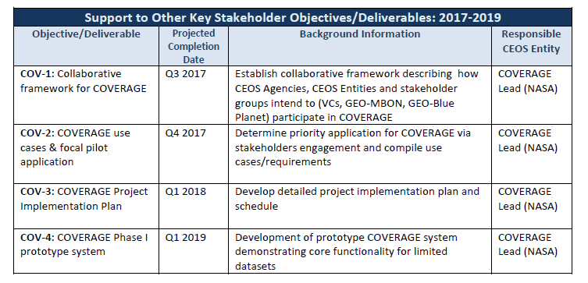
Draft Implementation Plan
COVERAGE has a 4-part development concept:
Phase A - preliminary arrangements & detailed scoping (6 months)
Phase B - implementation for limited COVERAGE prototype system (1 year)
(focus on data streams of co-located gridded data sets from the 4 ocean VCs)
Phase C - development of full COVERAGE system (1 year)
Phase D - integration & testing, deployment & evaluation of finalized COVERAGE system (6 months)
Preliminary COVERAGE milestone timeline from CEOS 2017-2019 Work plan document (May 2017)

