Slide 1
IPCC Guidelines and Way Forward
Committee on Earth Observation Satellites
Osamu Ochiai, JAXA
CEOS 2018 SIT Technical Workshop
Session and Agenda Item 2.6
EUMETSAT, Darmstadt, Germany
13 – 14 September 2018

Slide 2
Road to IPCC Guidelines
Support coordination with IPCC
IPCC Guidelines
（to be refined in 2019）
D
Engagement with International Bodies
CEOS Review
Methodology document
Satellite-based GHG Data
C
Develop methodology document to support for national statistician to use GHG data for the accuracy of the greenhouse gases inventory.
Provide high accurate data set and documents (ATBD)
Calibrations and validation for quality control
MOE/NIES “Methodology Document”
B
WGCV
CEOS
AC-VC
Quality Control and Accuracy of GHG Data
Provide and share GHG data
A
Space Agencies
Ministry of Environment/NIES
Ministry of Education, Sports, Culture, Science and Technology
JAXA
GOSAT/
GOSAT-2(*)
NASA
OCO-2
GeoCarb
ESA
Sentinel-5p,
FLEX
CNES
IASI, MicroCarb, MERLIN
DLR
MERLIN
CMA
TanSat
Engagement with Space Agencies
*GOSAT/GOSAT-2 are joint projects by Ministry of Environment, NIES and JAXA .

Slide 3
Progress of Road to IPCC Guidelines
JAXA and NIES concluded the agreement with ESA, CNES, and DLR respectively for provision of reliable and consistent satellite GHG data and promotion of satellite GHG data utilization.
JAXA and NASA have been conducting Inter-Comparison between GOSAT & OCO-2
AC-VC GHG White paper will be finalized at CEOS Plenary 2018 for an endorsement.
MOE/NIES released “Guidebook on the use of satellite GHG observation data to evaluate and improve GHG emission inventories” in March 2018.
JAXA, together with GEO and the other partners, hosted 3 side events related to GHG at COP23 in Germany.
D
C
B
A
*GOSAT/GOSAT-2 are joint projects by Ministry of Environment, NIES and JAXA .

Slide 4
Timeline for Guidelines Refinement
29 – 31 Aug 2016 @Minsk | Scoping Group meeting
17 – 20 Oct 2016 @Bangkok | IPCC decision on outline
Feb 2017 | Decision on selection of Authors
7 – 14 Jul 2017 @Bilbao | First Lead Author Meeting (LAM1)
25 – 28 Sep 2017 @Victoria Falls | Second Lead Author Meeting (LAM2)
4 Dec 2017 - 11 Feb 2018 | First Order Draft (FOD) Expert Review
10 - 13 Apr 2018 @Cairns | Third Lead Author Meeting (LAM3)
June 25 2018 | Literature Cut-off
2 July - 9 Sep 2018 | Second Order Draft (SOD) Government & Expert Review
4th week of Oct 2018 | Forth Lead Author Meeting (LAM4)
14 Jan – 10 Mar 2019 | Final Government Distribution (FGD) Government Review
May 2019 @Japan | IPCC adoption/acceptance

Slide 5
Progress of IPCC Guidelines (SOD)
Second Order Draft (SOD) of IPCC GHG Guidelines was released in July 2018 for government and expert review. GHG monitoring by satellites are referred in volume 1, Chapter 6 “Quality Assurance/Quality Control and Verification”
Major Progresses
Small chapters and subheads related to satellite observation are added.
Satellite retrievals are recognized to cover large area of the atmospheric column as in-situ data has limitation of coverage.
SOD cited the projects and papers which showed potential for estimating or qualifying GHG emissions by satellites. Specific satellites cited are;
GOSAT (4)
OCO-2 (2)
SCIAMACHY (1)

Slide 6
Progress of IPCC Guidelines (SOD)
Challenge and Expectation
SOD recognizes that verifying GHG inventories by satellites with inverse models still have technical (and financial) challenges and in the experimental stage.
Capabilities and a number of observations are expected to be enhanced by future missions (TROPOMI, GOSAT-2, GeoCarb, and TanSat are referred).
SOD expects such an enhancement will improve the quality of GHG emission estimates.

Slide 7
Opportunities for Review
First Order Draft (FOD) – closed
Review period is closed on 11 February 2018.
JAXA submitted comments coordinating with CEOS chair.
Second Order Draft (SOD) – closed
Review period is closed on 9 September 2018.
JAXA submitted comments.
Final Government Distribution (FGD)
Review period is 14 January – 10 March 2019.
Only governments may submit comments.
CEOS agencies may have paths to input comments via their government

Slide 8
Quality Control and Accuracy of GHG Data
For operational use of satellite retrieval with inverse model after the IPCC guidelines refinement in 2019, CEOS should play an important role of calibration and validation for current and future missions.
Current Missions:
GOSAT, OCO-2, Tansat, Feng Yun 3D, Sentinel 5p, Gaofen 5
Future Missions:
GOSAT-2, OCO-3, MicroCarb, MERLIN, GeoCarb, Sentinel 5A, 5B, 5C
AC-VC also mentioned at SIT-33 that “Rigorous pre-launch and on-orbit measurement calibration and product validation methods that evolve to meet emerging needs” are necessary.
These activities will be led by AC-VC or WGCV?

Slide 9
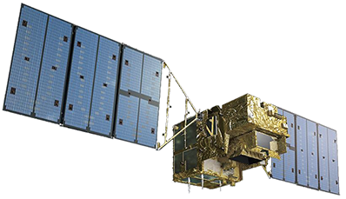
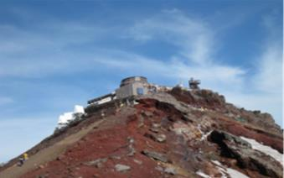
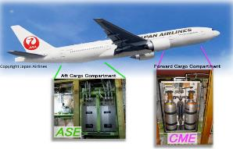
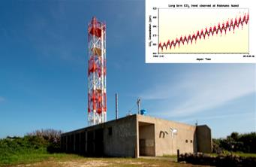
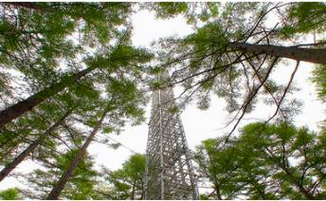
Way Forward (Integrated Observation)
Better GHG observation network has developed by integrating high temporal resolution data by in-situ observation, vertical data by aircraft observation, and high resolution spatial data by satellite observation.
Mountains
Aircrafts
Satellites
GHG Monitoring “System of Systems”
CONTRAIL Project
http://www.cger.nies.go.jp/contrail/
Mt. Fuji Sta. @NIES
Forest
Ground Station
Hateruma Sta. @NIES
Ship
New Century 2 @NIES
Fuji Hokuroku Sta. @NIES

Slide 10
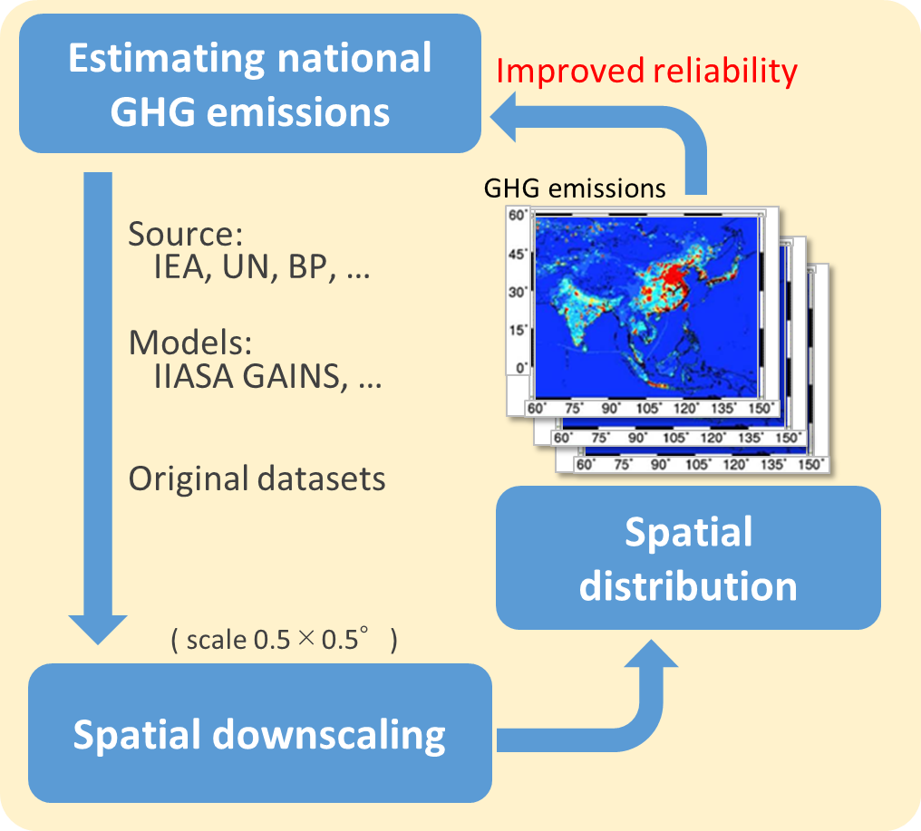
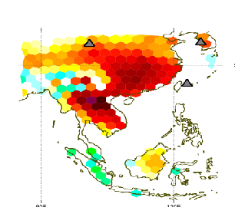
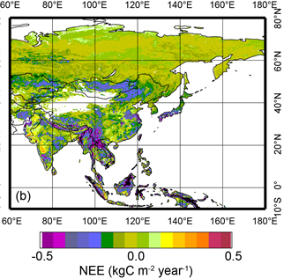
Way Forward (Integration with Model)
Estimating GHG emissions in Asia
ERTDF 2-1701 “Development of an integrated observation and analysis system for monitoring greenhouse gas sources and sinks” (FY 2017-2019)
by NIES, MRI, JAMSTEC, Chiba Univ.
Evaluation of discrepancies in spatial distribution
Inverse modeling
Flux upscaling

Slide 11
Way Forward (GOSAT-2)
GOSAT-2 to be launched on 29 October 2018

