Slide 1
Session 4 Introduction User Engagement Activities
Committee on Earth Observation Satellites
Steve Volz, NOAA, CEOS SIT Chair
CEOS 2018 SIT Technical Workshop
Session 4, Agenda Item 4.1
EUMETSAT, Darmstadt, Germany
13 – 14 September 2018

Slide 2
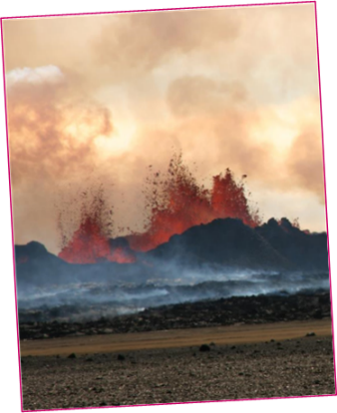
Session 4 – User Engagement Activities Agenda
4.1, 10 min: Session Introduction (Steve Volz)
4.2, 15 min: Support to SDGs (Marc Paganini)
4.3, 15 min: Observations for Disasters (Simona Zoffoli)
4.4, 15 min: Observations for Forests (Osamu Ochiai)
4.5, 15 min: Observations for Agriculture (Brad Doorn)
4.6, 25 min: Discussion (All)
Bardarbunga erupting in 2014.
Photo credit: M Parks

Slide 3
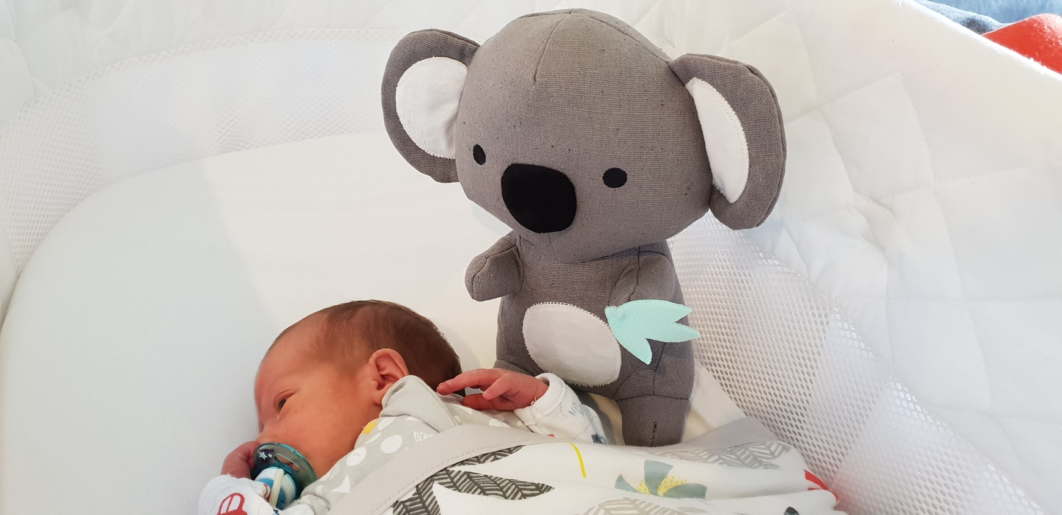
CEOS Executive Officer 2050
Martin

