Slide 1
OCR-VC
Committee on Earth Observation Satellites
Ewa Kwiatkowska (EUMETSAT), Paul DiGiacomo (NOAA), Craig Donlon (ESA)
OCR-VC Co-chairs
CEOS 2018 SIT Technical Workshop
Session 5: Oceans and Freshwater, Item #5.6
EUMETSAT, Darmstadt, Germany
13 – 14 September 2018

Slide 2
OCR-VC and CEOS Work Plan linkages
3.1 Climate Monitoring, Research, and Services (contributions to GEO)
Revision of OCR Essential Ocean Variables for GOOS (observational requirements)
Planned update of OCR ECVs for the next GCOS IP (based on data record importance & availability)
Lake ECVs under development (SIT-33-08 Feasibility study for Water Quality measurements)
Recommendation for update of WGClimate OCR ECV inventory to include missing datasets during the cycle 2 gap analysis
3.2 Carbon Observations, Including Forested Regions
Recommendation for stronger emphasis on aquatic biology, biogeochemistry, ecology and harmonization with “CEOS Strategy for Carbon Observations from Space”
“Aquatic Carbon From Space” special journal issue under discussion at IOCCG
3.5 Observations for Water
IOCCG recent report “Earth Observations in Support of Global Water Quality Monitoring”
IOCCG reports – contribution to “CEOS Strategy for Water Observations from Space” and “CEOS Feasibility Study on Satellite Missions/Instruments Focused on Water Quality Measurements”
3.7 Capacity Building, Data Access, Availability and Quality
IOCCG Summer Lecture Series - 25 June - 6 July 2018 (Villefranche)
IOCS-2019 Symposium development underway – 9-12 April, Busan, South Korea (NASA OCRT meeting 8 April 2019)
Recommendation for COVERAGE to include variables beyond chlorophyll & increase spatial res<0.25⁰

Slide 3
OCR-VC action SIT-33-08
SIT-33-08 | OCR-VC and LSI-VC | Review the CEOS Feasibility Study on Satellite Missions/Instruments Focused on Water Quality Measurements and report to SIT TW on any implications for their work, including opportunities to address the recommendations that may be on the horizon. | SIT TW 2018
 | Rationale: Measurements identified in the study are of direct relevance to OCR-VC and LSI-VC data coordination.
Feasibility Study is harmonized with IOCCG reporting “Earth Observations in Support of Global Water Quality Monitoring”, A.Dekker, P.DiGiacomo, S.Greb (GEO-AquaWatch chairs)
Relevance with the joint meeting of GloboLakes and AquaWatch, 29-31 Aug 2018
GloboLakes – 5-year program, the state of lakes and their response to climatic/environmental change
AquaWatch – the GEO water quality initiative and community of practice
Strong requirement for consistent quality of EO data →
Analysis Ready Datasets (ARD) available from many sources, e.g. Copernicus, USGS-Google Earth Engine, ESA, Calimnos (Globolakes) Open DataCube, UNESCO WQ Portal
In situ measurements for validation and product development are critical, from Fiducial Reference Measurements (FRM) to citizen science-based in situ data
Strong requirement for education, training, capacity building →
The Feasibility Study has impact on OCR observational and mission requirements, particularly for dedicated radiometric quality, spectral coverage, and spatial resolution
Looking for coordination with other VCs / EO communities to harmonize observational requirements and develop joint mission requirements
Ongoing IOCCG/OCR-VC activities
Ongoing IOCCG/OCR-VC activities
e.g. PACE - OCR and aerosol/cloud communities;
Copernicus S3 – OCR and land, aerosol communities

Slide 4
OCR-VC deliverable VC-09
International Network for Sensor Inter-comparison and Uncertainty Assessment (INSITU-OCR)
INSITU-OCR
White Paper
 | Recommendations
Space Sensor Radiometric Calibration, Characterization and Temporal Stability | R1.1 Comprehensive pre-launch instrument calibration/characterization
 | R1.2 Open access to calibration and characterization data
 | R1.3 Permanent working group on satellite sensor calibration
 | R1.4 Vicarious calibration
 | R1.5 Support for calibration teams
 | R1.6 Assess and correct for instrument degradation
Development and Assessment of Satellite Products | R2.1 Distribution of calibrated and uncalibrated data
 | R2.2 Permanent working groups on algorithm topics
 | R2.3 Product uncertainties
 | R2.4 Regional bio-optical algorithms
 | R2.5 Open access to source codes for processing algorithms
 | R2.6 Long-term field measurement programs
 | R2.7 Validation protocols
 | R2.8 Level-3 data products generation
 | R2.9 Ancillary data
 | Recommendations
In Situ Data / Fiducial Reference Measurements | R3.1 Improving traceability of in situ measurements
 | R3.2 Continuous consolidation and update of measurement protocols
 | R3.3 Uncertainty budgets
 | R3.4 Quality Assurance of in situ data
 | R3.5 Archival of in situ data
 | R3.6 Community processor for in situ data
 | R3.7 Priority for variables to be collected
 | R3.8 General coordination of field campaigns
Information Management and Support | R4.1 Accessibility and distribution of large volumes of data
 | R4.2 Processing capabilities for calibration and validation activities
 | R4.3 Accessibility to documentation
 | R4.4 Data formats
 | R4.5 Support for open source data processing and visualization

Slide 5
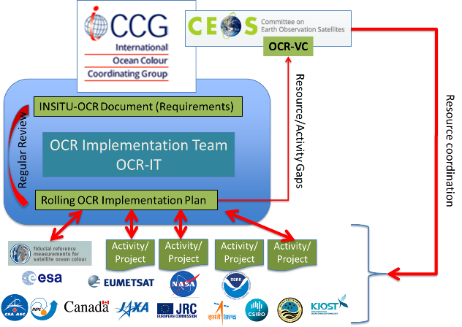
OCR-Implementation Team
Modular implementation of the White Paper
System Vicarious Calibration
Coordinated cross-agency activities:
NASA – completing 3-year/US$8M investment in first phase of SVC development, 3 projects (UV-SWIR)
NASA – preparing for follow-on in situ SVC competition
ESA – FRM4SOC SVC workshop in Feb 2017
ESA – FRM4SOC radiometry protocols under IOCCG review, final workshop 4-5 October 2018
ESA / CNES – continuous operations of BOUSSOLE NOAA – continuous operations of MOBY
NOAA – MOBY Technology Refreshment on-going
JRC – peer-review publications, OC-SVC requirements
EUMETSAT – “Requirements for Copernicus OC-SVC Infrastructure” under IOCCG review
EUMETSAT – “Preliminary design of Copernicus OC-SVC Infrastructure” to be started soon
R1.4
Task Force on Satellite Sensor Calibration
Collaboration on space instrument accuracy and stability to maximize the quality of OCR data records
regular coordination at IOCS meetings
interest in WGCV/GSICS lunar model activities
R1.3, 1.1, 1.5, 1.6

Slide 6
Modular implementation of the White Paper
Revision and development of in situ measurement protocols
Coordination of In Situ Measurement Protocols
R3.1, 3.2, 3.3, 3.4
Support and promotion of geostationary activities:
KIOST-GOCI – first demonstration geoOCR benefits
Early geoOCR activities at various agencies, e.g. CNES OCAPI, NASA GEO-CAPE, report on accomplishments/lessons learned
Relevance to CEOS Strategic Directions: Geostationary Applications & Combined Products
Looking for coordination with other VCs/EO-communities for harmonization of observational and mission requirements
Geostationary OCR capabilities
R2.2, 2.4
Exploration of measurements beyond the passive multi-band radiometry
R2.2, 2.4
Coordinated cross-agency activities on examining advantages of other measurements for aquatic biological / biogeochemical / ecological retrievals:
Hyperspectral spectroscopy – e.g. NASA PACE
Lidar – white paper in preparation, initial demonstrations with CALIPSO
Polarimetry – white paper in preparation, POLDER experience, PACE
Looking for coordination with other VCs/EO-communities for harmonization of observational requirements and development of joint mission requirements, e.g. atmospheric communities (aerosols and clouds)

Slide 7
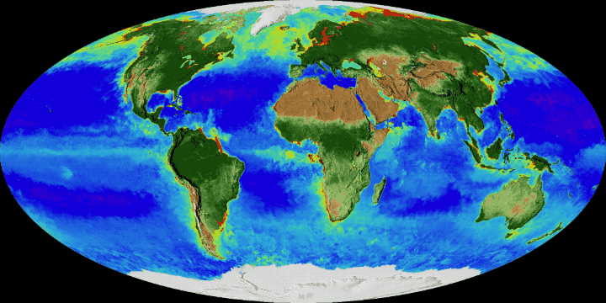
OCR-VC Questions?

