Slide 1

CEOS Resources Utilization
Committee on Earth Observation Satellites
Steve Volz, NOAA, CEOS SIT Chair
CEOS 2018 SIT Technical Workshop
Session 6, Agenda Item 6.2
EUMETSAT, Darmstadt, Germany
13 – 14 September 2018

Slide 2
Did you know…
…CEOS Members have agreed to continue to informally coordinate their current and planned systems for Earth observation from space through CEOS?
…Participation in the activities of CEOS will not be construed as being binding upon space-based Earth observation system operators, or as restricting their right to develop and manage Earth observation systems according to their needs and policies?
…CEOS now focuses on validated requirements levied by external organizations?
…Projects that do not demonstrate progress against milestones, do not provide valuable outcomes, or that lack Agency interest or committed resources should be refocused or discontinued?
CEOS Terms of Reference and CEOS Strategic Guidance - 2013
Presented at SIT-33

Slide 3
SIT Action 33-01
ACTION: Assess whether the CEOS Governance and Processes Document should be updated. Report to SIT Technical Workshop including (if required) a recommendation to be presented for decision at CEOS Plenary.
RATIONALE: The document is now five years old, and we should consider if we need updates to CEOS structure, operations, and processes in order to address the evolving goals of the organization.
CEOS Governance and Processes document can be amended or modified only after review and careful consideration by the CEOS Agencies. This review should also examine other CEOS guiding documents that will be affected by the amendment or modification to ensure that all of the guiding documents are consistent and mutually supporting. The specific amendments or modifications must be reviewed at a CEOS SIT Meeting and approved at the subsequent CEOS Plenary.

Slide 4

Governing Documents
The CEOS Governance and Processes document provides guidelines on the structure, operations, and processes CEOS employs to achieve its goals (~5 years). (November 2013)
Discussion Seed
Over the next 6 months, assess and make a determination at SIT Technical Workshop and Plenary if we need to update Governance and Processes Document.
Introduction and Background
Organizational Roles and Responsibilities
Decision-making Process
Major Meetings
Membership and Participation
Presented at SIT-33

Slide 5
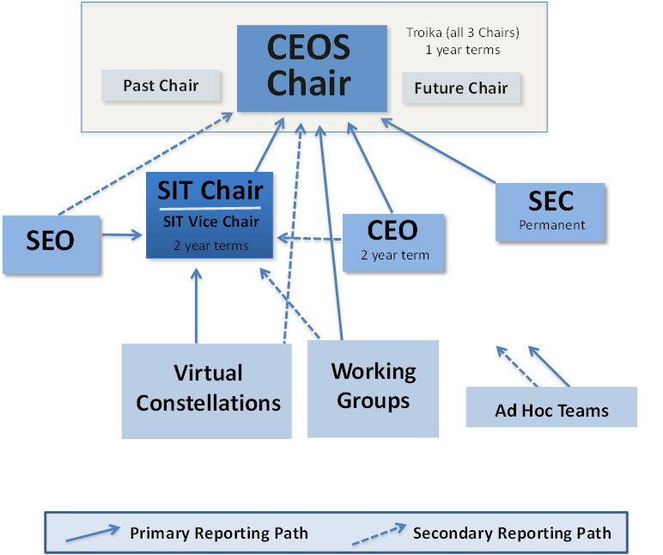
CEOS Organizational Roles and Responsibilities
Does this organizational structure still meet the needs of CEOS and our external partners?
Terms of Reference – CEOS Chair, Strategic Implementation Team (SIT) Chair, CEOS Executive Officer (CEO), CEOS Secretariat, and Systems Engineering Office (SEO)
Process Papers – Working Group, Virtual Constellations, and New Initiatives

Slide 6
Decision-Making Process
To assure a successful organization, CEOS must select the appropriate set of new activities to pursue and consistently meet its current commitments.
Recent requests from GFOI, GEOGLAM, CBD, LDN
New Initiatives Process Paper
Consideration of current activities

Slide 7
SIT Action 33-05
ACTION: Provide an analysis of possible measures to:
  Improve consistency in processes across CEOS entities
  Identify whether further tangible contributions to the CEOS Work Plan are possible
  Ensure sustainment of resources across the groups
RATIONALE: SIT Chair has challenged CEOS to identify whether top-down contributions to the CEOS WP are required and possible in addition to the bottom-up population of the WP.

Slide 8
Governing Documents
The CEOS Work Plan (3-year rolling) sets forth near-term actions to achieve the goals outlined in the CEOS Strategic Guidance document. (March 2018)
Realize the CEOS Work Plan
The document identifies our agencies’ commitments to working as members of CEOS
Track the CEOS working elements to consistently track their progress on the Work Plan tasks (good effort this week at the SIT TW 2018)
Adjust VC and WG contributions based on results of questionnaire and Agency review of commitments

Slide 9
Insights from VCs, WGs, and AHTs

Slide 10
History of VCs
VCs were created to address gaps in missions and inform agencies on how to plan for future missions and maintain continuity of measurements and climate records.
“The interim goal of a Constellation is to demonstrate the value of a collaborative partnership in addressing a key observational gap; the end goal is to sustain the routine collection of critical observations. Implementation of Constellation activities is ultimately dependent on the coordination of formal agreements among participating agencies.”
- Virtual Constellations Process Paper 2013
Four Prototype VCs created at SIT-19 (Sep 2006) to “give balance across different domains and geographies with an eye on leverage of international linkages to support continuity of funding for missions at the time which were under some threat”
  Ocean Surface Topography (NOAA and EUMETSAT)
  Atmospheric Composition (NASA)
  Land Surface Imaging (USGS)
  Precipitation (JAXA and NASA)

Slide 11
VC, WG, AHT Conversations
July Tag-ups – Virtual Constellations
How do VCs support and enable Agencies to make right decisions?
  CEOS does not have a budget, agencies do
CEOS is looking for translation and integration activities from VCs
  Are CEOS leaders asking the right questions of the VCs?
Tenure for individual VC Co-leads – assess the feasibility of proposing a formal VC Co-Lead Rotation scenario
  Could rotation of Co-leads increase buy-in from community and encourage engagement? Or create same recurring difficulties in identifying WG leadership?
Consistency of climate variables and consistency across measurements – key coordination opportunity for CEOS
  CEOS as a data integrator
  Director, GEO SEC stated last week that space agencies have ceased to be the most important providers of data to GEO – now the data aggregators are more important; more important than getting the latest image from a space agency

Slide 12
VC, WG, AHT Conversations
July Tag-ups – Working Groups
Subsuming of AHTs to permanent WGs (FDA AHT as example)
Expansion of scope of ARD to observations beyond land – where would ARD be best housed?
Increased coordination with other external partners such as CGMS; WGCapD is interested in collaborating with CGMS because of maturity in capacity building activities

Slide 13
VC, WG, AHT Conversations
July Tag-ups – Ad Hoc Teams/Working Groups
Ad Hoc Teams/Ad Hoc Working Groups
Current focus on user requirements for different communities
Need to focus on space coordination for the identified requirements
  Cross-agency, cross-sensor coordination
  Responsibility of Agency representatives participating in AHTs/AHWGs/and VCs to ensure sufficient connection to their agency colleagues to accomplish coordination tasks; all should be supported by Agency Principals
Definition of AHT success and plan for a sustainable existence are critical
  See Presentation 6.3
Requests from GFOI and GEOGLAM communities for commitments of CEOS support
CEOS-level assessment/mapping of which VCs/WGs/AHTs are/could address each of the EO-relevant SDGs and the sustainability of efforts

Slide 14
How Does CEOS Report on Workplan Progress?

Slide 15
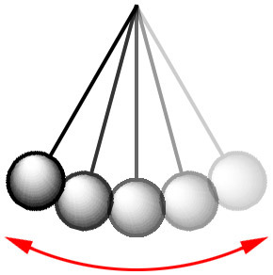
Tracking and Reporting of CEOS Actions and Deliverables – a History
c. 2007
Hands-on Deep Dive of Actions/
Deliverables status, reporting, and confirmed Agency commitments
c. 2015
More hands-off approach with less reporting and updates; no firm commitments from Agencies
More Tactical
More Strategic
Tour de Tables with Agencies confirming support for Actions at SIT meetings
Remapping of CEOS support to GEO Tasks – direct connections/correlations
Annual CEOS-GEO Actions Workshops – five Workshop 2008-2013
Reporting on status of ALL Actions (Deliverables) at SIT Meetings – tedious

Slide 16
Genesis of the “Actionable” CEOS Actions – Remapping
November 2007
  Following endorsement of the annual update of the GEO 2007-2009 Work Plan, the SIT Chair started a large consultation within CEOS to define a set of CEOS Actions supporting the Tasks of the Work Plan
  Collaborated with GEO Secretariat
February 2008
  Workshop organized by SIT gathering CEOS Virtual Constellation Co-Leads, Working Group Chairs, CEOS SBA Coordinators, SEO, CEO
  Defined first list of 147 “actionable” actions
2007
Each CEOS Agency identified as the Lead Agency for these Actions committed the resources necessary for the accomplishment of the Actions

Slide 17
Tour de Table Process
Each Agency will be taken in turn, alphabetically
One (sometimes two) slides for each Agency highlighting that Agency’s identified Lead Agency Category 1 actions
Each Agency can provide a brief status of their Category 1 actions (emphasis on the “brief”)
Each Agency will then confirm commitment to accomplishing their actions
2008

Slide 18

CEOS-GEO Actions Figures (March 09)
In 2009, CEOS activities are related to 36 GEO 2009-2011 Tasks (out of 115)
93 GEO Actions (related to 36 GEO Tasks) + 59 “GCOS” Actions (related to CL-06-01c “Key Climate Data from Satellite Systems” )
  From 2008 to 2009, number of Actions roughly divided by 2
  47 in Cat. 1 (top priority; significant outcomes or to be completed before Nov. 09)
  26 in Cat. 2 (other top priority)
  38 GCOS top priority Actions (21 from 2008 + 17 started in 2009
2009

Slide 19
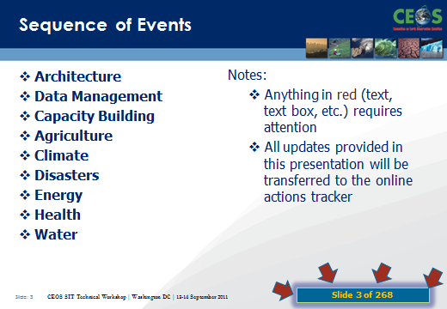
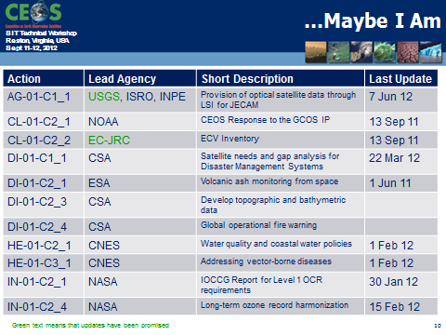
Action History
2011
2012
Issue
2011
81 Slides with full review of each of the 46 Actions
2012
2 Slides of public shaming of 16 “unaccounted for” of 50 Actions
And what is in store for 2013?

Slide 20

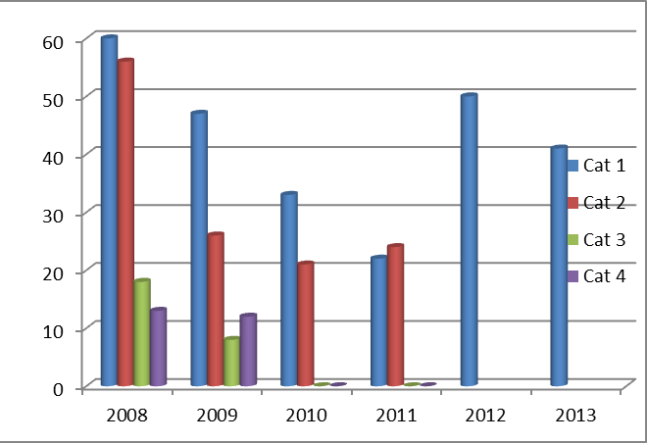
Current Status of CEOS-GEO Actions
47 Actions for 2013
4 CLOSED
Of the 43 remaining open Actions, 35 have been updated within the past two months
2013

Slide 21

CEOS 2014-2016 Work Plan
The Three-Year Work Plan – Year One
  Focus on objectives and deliverables associated with timescales and assigned responsibilities
  Provide sound and shared basis for measuring our progress in a multiannual perspective
  Will be updated annually by the CEO under the guidance of the CEOS Chair, and in consultation with the CEOS Strategic Implementation Team Chair, CEOS Secretariat, CEOS Working Groups, Virtual Constellations, Ad Hoc Teams, the CEOS membership at large, and CEOS’s external stakeholders
  Shall be consistent with and mutually supporting of other CEOS guiding documents
2014
Just three months ago
  2014-2016 CEOS Work Plan released on 5 June 2014
Eighty (80) Objectives/Deliverables for 2014-2016
Notes:
But there are technically 94 Objectives/Deliverables because some occur multi-year.

Slide 22
How are we tracking?
 |  | Due by Q4 2015 | Due by Q4 2016
 | Completed or on track | 39 | 14
 | Material delays | 9 | 2
 | No progress or other issues | 1 | 3
 | No update | 2 | 1
2015
Updates will be provided under relevant topics. We won’t steal their thunder.

Slide 23
Delivery
 |  | Ongoing | Due by Q4 2016 | Due by Q4 2017
 | Completed or on track | 9 | 31 | 13
 | Material delays | - | 7 | 2
 | Not started / other issues | - | - | 6
 | No update | - | 6 | -
2016
* As at 19 October. Subject to review.

Slide 24
Delivery
Completed | 19
On track | 48
Substantial Delay | 13
Unknown | 2
Not started | 5
DRAFT
2017

Slide 25
Potential Adjustments to Procedure
Define clearer guidelines for the Work Plan development, including:
  Ensure traceability within the Work Plan (source of request, lead CEOS entity, supporting CEOS and partner entities, expected resources and sponsors, anticipated results/deliveries, etc.
  Include opportunity for integration of Agency-driven top-down requests into relevant CEOS groups and the CEOS Workplan
Improve Work Plan tracking and annual reporting
Add terms to leadership for all standing CEOS bodies, VCs as well as WGs
  Fixed Terms, not term limits. Nothing prohibits organizations or individuals from serving for multiple terms, but the process drives routine revisits of leadership and engagement.
Improve clarity of CEOS activities (e.g., initiatives which are not showing up in the structure, such as ODC or CDC)
Define the duration/sustainability lifecycle for AHT – Session 6.3

Slide 26
Guidelines for Work Plan Development
Using the WP to improve work traceability
Better define WP deliverables
  Who: CEOS entity (+ nominative), Contributing agencies (+names), Resource estimations
  What: More detailed deliverable descriptions and breakdown into milestones
  When: Temporal information on milestones/resources
… gradual implementation/upgrading of deliverable tracking tools.
Agency-driven top-down requests
During WP development - open call to CEOS agencies to propose new CEOS deliverables
  Requirement for deliverable to be carried by a CEOS entity
  Need for consultation with responsible CEOS entity prior to submission to WP

Slide 27

Work Plan Reporting Takeaways
CEOS Work Plan report to Plenary is inconsistent, with virtually no year to year traceability, with significant intra-SIT Chair/CEO variability
A consistent approach from year to year would considerably improve our ability to monitor progress on WP deliverables, bringing inter-annual information and long term trends.
Action on CEO to propose a standard approach to CEOS WP progress report to plenary and “test drive” it this year
Reporting metrics would include all WP Deliverables
Plenary focus would be on adjustments needed based
on performance against plans:
    Those which do not report progress
    Those which do not follow defined timeline
  Ideally, including some assessment of the rationale for the performance shortfall (resources, change in direction, external factors, …)

Slide 28
Establish Leadership Terms for all CEOS Standing Elements
Suggest updating virtual constellations reference paper to incude governance, including leadership selection

Slide 29
Backup

