Slide 1
Proposed 2019 CEOS chair initiative
Committee on Earth Observation Satellites
Anh Tuan Vu, VNSC, CEOS incoming chair team
CEOS 2018 SIT Technical Workshop
Work planning and Closing #8.6
EUMETSAT, Darmstadt, Germany
13 – 14 September 2018

Slide 2
Background
VNSC/VAST will be chair agency in 2019
The first priority should be to ensure the identified priorities and initiatives will be continued
Land Surface imaging and its applications through LSI-VC activities including Analysis ready data (ARD),
CEOS support to GFOI and GEOGLAM,
CEOS open DataCube (CDC) activities,
Laying the foundation for an international CO2 and GHG emission monitoring system to make a fundamental contribution to monitoring CO2 and other GHG emissions globally,
Following the recommendations on Future Data access and analysis Architectures (FDA).

Slide 3
Background
EO data free, open and sustained
Less complexity and difficulty of handling large and technical datasets
Analysis Ready Data,
Open Data cube
Copernicus Data Information Access Services
...
Vietnam DataCube (VDC)
National scale
Data and application from CEOS member
Application: local oriented such as forest monitoring, rice monitoring and Water quality monitoring
The VDC is asking to be expanded to Mekong river scale

Slide 4
Proposed initiative
Regional application of EO data
Objective: to enhance contribution and cooperation of the CEOS agencies in the region, to identify potential Earth Observation users and to respond effectively to their needs by achieving integration across the full range of Earth Observations, by promoting the sharing of CEOS agency data, and by improving access to and use of such data.
Region: Mekong basin region
Downscaling and bring the existing global system to regional scale

Slide 5
Proposed initiative
The regional approach:
Demonstration for space climate observatories for key global programs and initiatives as well as demonstration of how to downscale from global to regional to local applications;
Incorporation of regional datasets (space-based and in situ) from regional observing systems and inclusion of national and regional users downstream who are not directly part of the CEOS community (e.g., AOGEOSS)

Slide 6
Proposed initiative
Thematic (application topic)
Carbon Observations, including forested regions: to coordinate EO observations to support the effective monitoring and management of the forests in the region, through its Ad Hoc Space Data Coordination group for GFOI, in support of the development of national forest monitoring and measurement, reporting and verification (MRV) systems
Observations for Agriculture: in line with the CEOS Ad Hoc WG on GEOGLAM, and within the GEOGLAM Asia-Rice regional network, a key focus will be addressed on the practical use of CEOS data, especially SAR for rice crop monitoring in Asia.

Slide 7
Proposed initiative
Related activities
Training and Capacity Building activities in the region: support of the Working Group for Capacity Building and Data Democracy (WPCapD) will be required. For the initial idea, the training and capacity building will be focused on SAR data processing and land applications
Build Regional Observatory: ready application built-in such as forest monitoring and rice monitoring for Mekong river area. The Regional Observatory can be considered as downscaling of Global approach applications and as a regional ODC where concerning people can find they suitable satellite data as well as applications

Slide 8
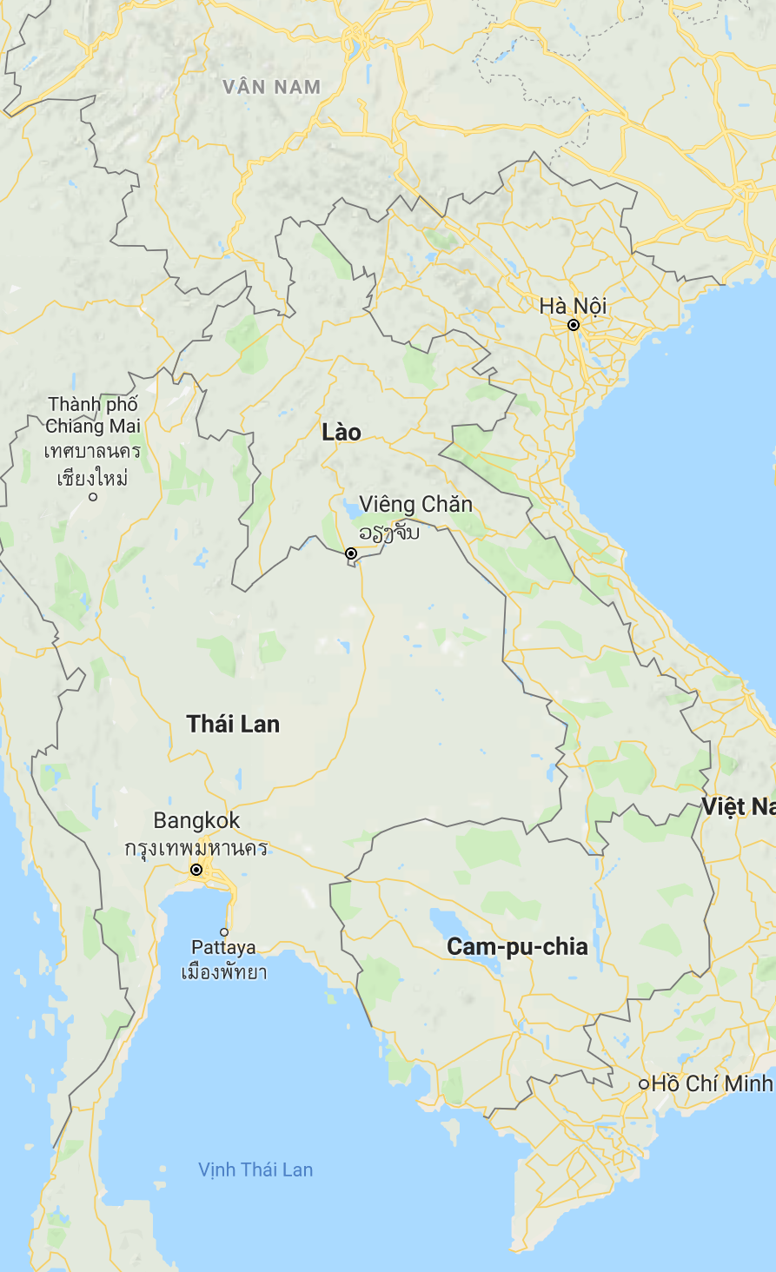
Summary
S-1 ARD
GEORice
ALOS ARD
CARD4L/LSI
NovaSAR ARD
ODC
Other ARD.. Landsat +
Mekong River Commission
SDCG
Forest Pilot (GFOI)
GA/CSIRO SARCube
VDC
(Vietnam DataCube)
2019 outcomes for VNSC & CEOS
Rice Pilot (GEOGLAM)
Long-term benefits
SEO
ARD pilots/collation
SAR capacity building
AOGEOSS, Paris, SDGs
Infrastructure
Activities
Expected outcomes

Slide 10
Content Guidance
Per CEOS Governance and Processes, the meeting objectives of the SIT Technical Workshop are to: report on the status of the CEOS Work Plan and actions to be implemented; prepare for CEOS participation and outreach at ministerial-level and other major events at the end of the calendar year, such as GEO Plenary, UNFCCC COP and SBSTA meetings; and to prepare the necessary information to make appropriate decisions at the CEOS Plenary.
Reporting on meetings is discouraged, except in support of discussion.
Background materials (e.g., meeting minutes and discussion summary, content, presentations) should be provided for linkage on the SIT TW website for pre-reading and background reference.
The focus is on the status of deliverables, including those identified at SIT-33, in the CEOS Work Plan, and SIT-33 actions that are due at SIT TW or coming due at Plenary.
Contributions to GEO should be highlighted, e.g., where are the connections and how do the VCs, WGs, and AHTs see themselves as contributing to GEO (including and also beyond what is listed in the GEO Work Programme).
Items that need to be taken to Plenary need to be highlighted for discussion.
Please review “STRATEGIC DIRECTIONS AND PARTNERSHIPS FOR CEOS DISCUSSION PAPER” prepared by the NOAA SIT Chair Team for SIT-33, and reflect on the meeting objectives when preparing your materials. (here).
The focus of the SIT Technical Workshop will be not only on status reporting but more importantly, on encouraging discussion among the Workshop participants.

Slide 11
Submission Guidance
Presenters should name their files using the following convention:
AgendaItemNumber_LastName_Subject_Version.pptx (e.g., CEOS SITTW2018_1.5_Holloway_Communications_v2.pptx)
Supporting documentation or links to be posted online is welcome
Materials should be sent to george@symbioscomms.com and kerry.sawyer@noaa.gov
Materials deadline: no later than Wednesday 5th September
Presenters should bring a copy of their presentation (e.g., on a USB key) in case a last minute update is required
Materials will be placed online
http://ceos.org/meetings/2018-sit-technical-workshop/

