Slide 1
SIT Chair Closing Remarks
Committee on Earth Observation Satellites
Steve Volz, NOAA, CEOS SIT Chair
CEOS 2018 SIT Technical Workshop
Session 8, Agenda Item 8.8
EUMETSAT, Darmstadt, Germany
13 – 14 September 2018

Slide 2
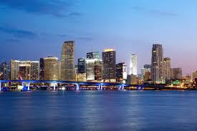
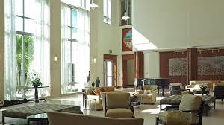
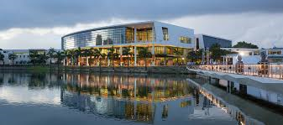
SIT-34
Host: NOAA, SIT Chair Team
Location: University of Miami, Miami Florida
Norman Alumni Center
Dates: Week of April 1-5, 2019

