Slide 1

Data Cubes
Committee on Earth Observation Satellites
Brian Killough, NASA, CEOS SEO
CEOS 2018 SIT Technical Workshop
Session 3, Agenda Item 3.6
EUMETSAT, Darmstadt, Germany
13 – 14 September 2018

Slide 2
Relevant CEOS Deliverables
FDA-02: Collaborative Data Cube Development ... the initiative has made significant progress with support from several agencies. More in this presentation ...
AGRI-08: Vietnam Data Cube ... Now operational due to support from CSIRO
AGRI-09: GEOGLAM Rangelands (RAPP) Data Cubes ... Demo in place in Kenya (with Livestock Institute). Continued testing of application algorithms.
CARB-18: Colombia Data Cube ... Now operational and being used as part of their forest monitoring workflow and UNFCCC reporting.
SDG-03: Contribution of EO to SDGs ... The Data Cube team is developing 3 algorithms to specifically address SDGs for demo at the GEO Plenary.
VC-31: CARD4L Evaluation ... Data Cubes are routinely using ARD (based on CARD4L requirements) and providing feedback to LSI-VC on such use.

Slide 3
What is ODC and CDC?
ODC = Open Data Cube (www.opendatacube.org)
Started by several “ODC Partner” organizations in Jan 2017 as an open source data management solution with a community of contributors and users.
The “ODC Partners” are ... GA, CSIRO, NASA-SEO (with AMA), USGS, and
UK-Catapult. They meet monthly (via telecon) and have a detailed work plan.
The “ODC Steering Council” manages the technical development and open source code repository (https://github.com/opendatacube)
CDC = CEOS Data Cube
An ”extension” of the ODC goals to demonstrate data cubes around the world and maximize the impact of CEOS satellite data
Focused on ARD, user needs, and global capacity building
Significant interest from the new GEO leader (Gilberto Camara)

Slide 4
49 countries in 20 months
9
6
34
Operational
Under Development
Under Review or Expressed Interest
Operational: Australia, Colombia, Switzerland, Taiwan, Kenya, Tanzania, Ghana, Sierra Leone, Senegal

Slide 5
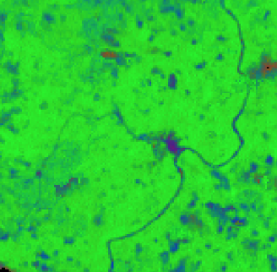
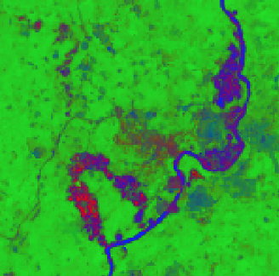
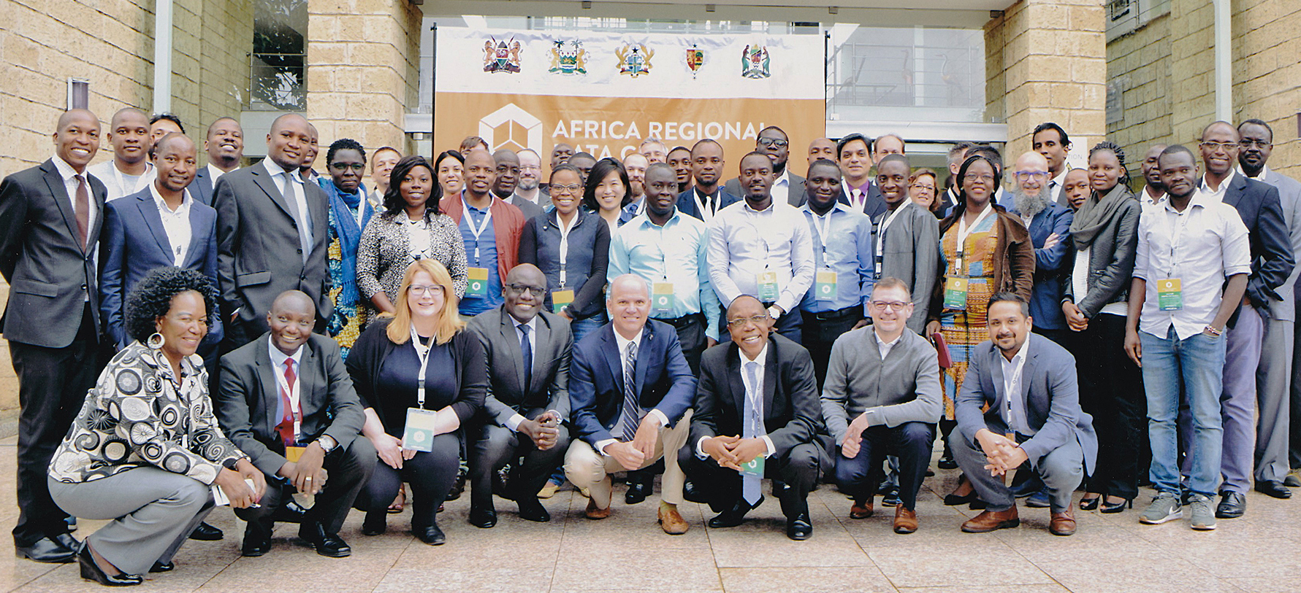
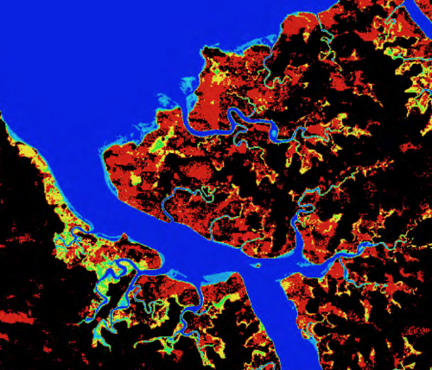
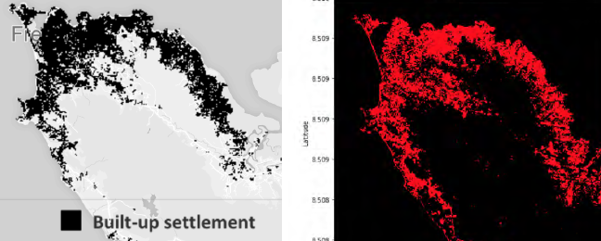
Africa Regional Data Cube
  Launched in May 2018 for 5 countries (Kenya, Tanzania, Sierra Leone, Senegal, Ghana). Initially based on Landsat ARD, with S1, S2 and ALOS coming soon!
  Supported by Amazon (donated cloud services) and GPSDD (training)
  Recent web-based remote training for Ghana (July 31), Tanzania (August 16), and Sierra Leone (Aug 24). More training planned for late 2018.
  Initial support has been focused on algorithms to support desired use-cases for each country. These include ...
  Kenya: Dadaab Refugee Camp expansion, deforestation and vegetation extent, livestock rangelands
  Tanzania: Chenene Forest Reserve deforestation and agriculture phenology
  Ghana: Illegal mining (on right)
  Sierra Leone: Flooding and urbanization (below)

Slide 6

Digital Earth Africa
A new Data Cube initiative ...
Digital Earth Africa is a new initiative undergoing initial planning to develop a full-continent EO program based on the Open Data Cube.
The effort is led by Stuart Minchen (Geoscience Australia) and Steven Ramage (GEO)
A new Steering Committee has been formed to serve as an advisory body to provide inputs and recommendations on institutional arrangements, stakeholder engagement and operational plans.
The Steering Committee includes representatives from GA (lead), GEO, World Economic Forum (WEF), SANSA and CEOS.
They have specifically requested that Brian Killough (NASA SEO) be the CEOS representative on the Steering Committee due to relevant experience with the Africa Regional Data Cube (ARDC). This is seen as a prototype to Digital Earth Africa. NASA supports this role.
* CEOS Decision for Principals

Slide 7
Thoughts on ARD
Analysis Ready Data (ARD) is no longer a desire of global users, but is now becoming a requirement and an expectation
The Data Cube pilots are an ideal way to prove the benefits of ARD, as every pilot is using ARD. Most global users (not scientists or commercial groups) DO NOT desire, or feel comfortable, making their own ARD, but want it provided.
There is a growing interest in radar data, but few users understand its benefits or know how to use this data. Data Cube pilots are a great place to demonstrate open source radar algorithms on ARD.
CEOS needs to make it easier for global users to get ARD. Landsat is easiest. ALOS is a bit harder, but the ARD is only annual mosaics. Sentinel-1 is even harder, as few users (outside Europe) understand the choices in the S1 Toolbox and lack application algorithms. The hardest is Sentinel-2, as few users (outside Europe) understand how to apply the Sen2Cor algorithm for pre-processing and also lack application algorithms.

Slide 8
More Data Cube Use-Cases
Data Cubes with CEOS ARD is having a global impact ...
Switzerland is using their Data Cube to develop new snow detection algorithms and develop time series snow coverage maps.
UK-Rhea (commercial company) is using the Data Cube to develop a drought monitoring system for Uganda
UK-Catapult is leading the “Common Sensing Project” to monitor climate change resilience in the Pacific Islands using a Data Cube.
Taiwan is using the Data Cube to monitor forest and vegetation restoration in landslide areas. They are also developing an algorithm for the detection of Pine Beetle outbreaks.
Uruguay Is using the Data Cube to adjust their water sampling approach to coincide with satellite overpasses in order to improve water quality data in their reservoirs.
The Gates Foundation is using water extent time series data from the Lake Chad Data Cube to compare with their population density maps to strategically supply polio vaccines to small villages around the lake. Many of these villages become "isolated" during the rainy season and are only accessible for a small portion of the year.

Slide 9
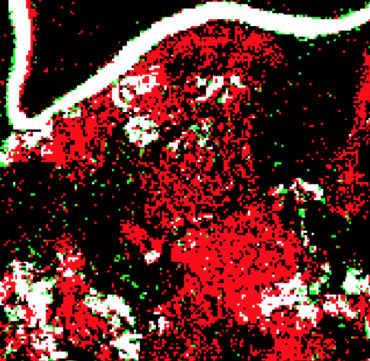
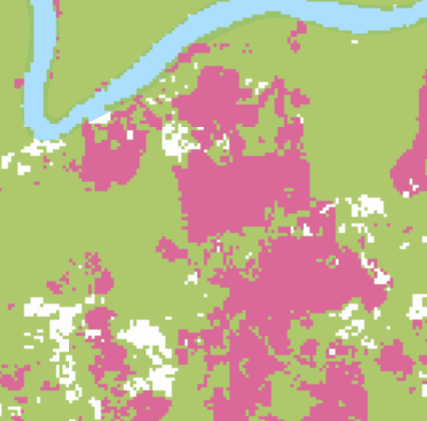
ALOS ARD in Data Cubes
Open Data Cube Results
Land Change from 2010 to 2016 using an HV band threshold algorithm
RED = Forest Loss
GREEN = Vegetation Increase
WHITE = Non-forest
BLACK = No significant change
Global Forest Watch Results
Deforestation from 2010 to 2016
GREEN = Forest mask
RED = Forest Loss
WHITE = Non-forest

Slide 10




More Data Exploitation Platforms
Data Cubes are NOT the only choice for exploiting CEOS data ...
GEOSS Common Infrastructure (GCI) is a GEO foundational task to discover and access GEOSS datasets and services
ESA’s Thematic Exploitation Platforms (TEPs) utilize a theme-based collaborative virtual environment with EO data and tools.
The European Commission’s new Copernicus Data and Information Access Services (DIAS) platform will allow users efficient access to Sentinel data and computing resources. The ODC team (thru Geoscience Australia) is investigating options with several vendors to install the ODC technology on DIAS and run algorithms with Sentinel data.
Google Earth Engine ... The ODC team is working with Google to take advantage of their ARD datasets and COG formats. Integrating GEE community algorithms are next. The issues with GEE are ... commercial dependency, limited analyses and datasets, unorganized algorithms, not for commercial use.

