Slide 1

CEOS Ad Hoc Working
Group for GEOGLAM Update
Committee on Earth Observation Satellites
Bradley Doorn, NASA
Philippe Maisongrande, CNES
Co-Chairs
CEOS 2018 SIT Technical Workshop
Session and Agenda Item 4.5
EUMETSAT, Darmstadt, Germany
13 – 14 September 2018

Slide 2
Content Guidance
Per CEOS Governance and Processes, the meeting objectives of the SIT Technical Workshop are to: report on the status of the CEOS Work Plan and actions to be implemented; prepare for CEOS participation and outreach at ministerial-level and other major events at the end of the calendar year, such as GEO Plenary, UNFCCC COP and SBSTA meetings; and to prepare the necessary information to make appropriate decisions at the CEOS Plenary.
Reporting on meetings is discouraged, except in support of discussion.
Background materials (e.g., meeting minutes and discussion summary, content, presentations) should be provided for linkage on the SIT TW website for pre-reading and background reference.
The focus is on the status of deliverables, including those identified at SIT-33, in the CEOS Work Plan, and SIT-33 actions that are due at SIT TW or coming due at Plenary.
Contributions to GEO should be highlighted, e.g., where are the connections and how do the VCs, WGs, and AHTs see themselves as contributing to GEO (including and also beyond what is listed in the GEO Work Programme).
Items that need to be taken to Plenary need to be highlighted for discussion.
Please review “STRATEGIC DIRECTIONS AND PARTNERSHIPS FOR CEOS
DISCUSSION PAPER” prepared by the NOAA SIT Chair Team for SIT-33, and reflect on the meeting objectives when preparing your materials. (here).
The focus of the SIT Technical Workshop will be not only on status reporting but more importantly, on encouraging discussion among the Workshop participants.

Slide 3
Submission Guidance
Presenters should name their files using the following convention:
  AgendaItemNumber_LastName_Subject_Version.pptx (e.g., CEOS SITTW2018_1.5_Holloway_Communications_v2.pptx)
Supporting documentation or links to be posted online is welcome
Materials should be sent to george@symbioscomms.com and kerry.sawyer@noaa.gov
  Materials deadline: no later than Wednesday 5th September
  Presenters should bring a copy of their presentation (e.g., on a USB key) in case a last minute update is required
Materials will be placed online
  http://ceos.org/meetings/2018-sit-technical-workshop/

Slide 4

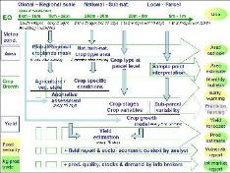
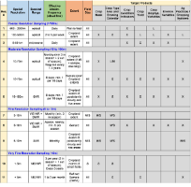
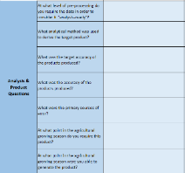


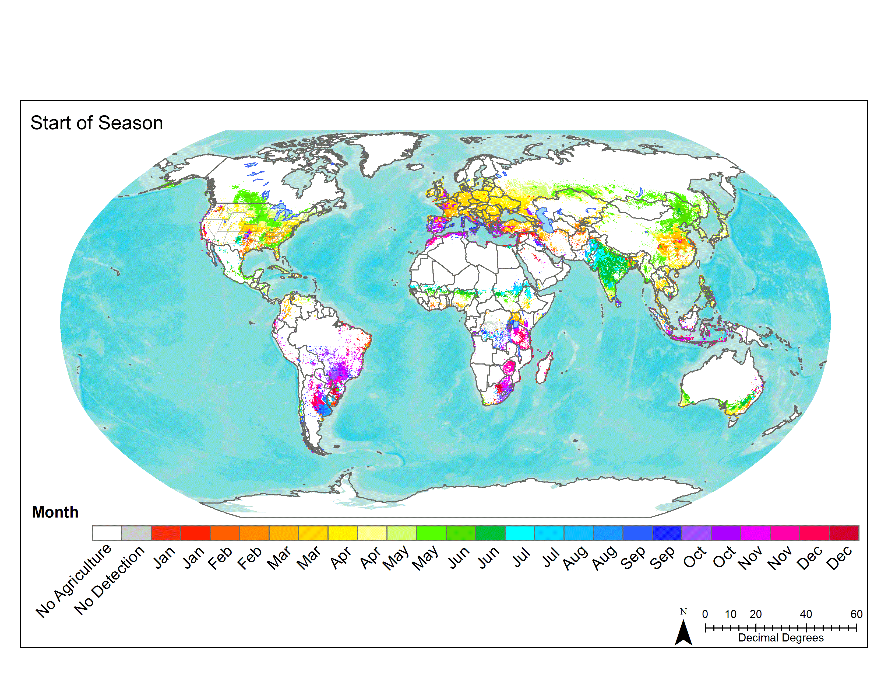
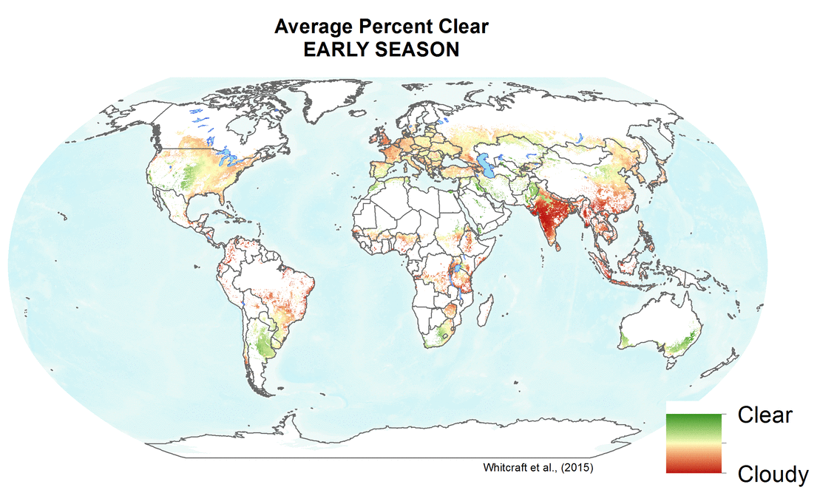
Requirements Summary: Timeline
2010 Defourny Diagram
2012-2014 GEOGLAM Reqs v1
2016-2017
R&D-driven Refresh
2017
CEOS Meeting
2018
Ispra Meeting
  Conceptual requirements
  Spatially explicit requirements by product/variable and by sensor type
  Question template to R&D sites
  New variables
  Minimum vs. preferred
  Discussion of R&D results, recognition of need for operational perspective
  State of use unknown
  Survey deployed
  National Users
  Regional Users
  Global Users
  Platforms for Use

Slide 5
Requirements Reboot:
Sources of Information
Original Requirements Document (2012-2014)
Requirements Template sent to JECAM & Asia-RiCE sites (2016)
GEOGLAM Requirements Survey (2017-2018)
  Survey responses were not sufficient to update requirements
  Extended the survey and planned a Workshop to finish requirements
Ispra-JRC Requirements Meeting (April 2018):
  Presentation Templates
  Collective Discussion + breakout groups
Sanya, China Meeting in September 2018 on ICT, Data Management, and Knowledge Hub
  Future concepts (e.g. Training, Best Practices)

Slide 6
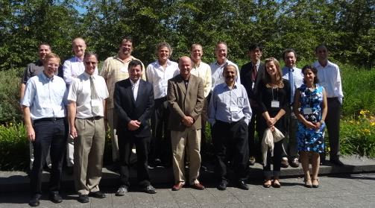
GEOGLAM Workshop on Operational User Reqs
CSA
Montreal July 10-11, 2012
Original Req. Group
16 participants
Global Agriculture Monitoring Experts and Major Data Providers

Slide 7
Original Requirements Table
(2012-2014)

Slide 8
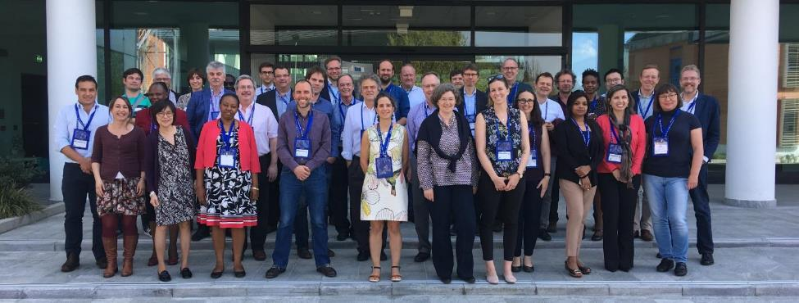
GEOGLAM Workshop on Operational User Reqs
EC JRC, DG GROW Support
Ispra 17-18 April 2018
The New Req. Group
40 participants
More diverse, greater numbers –
representative of growing community
priorities and visibility of EO in key decision making processes

Slide 9
New Requirements Table
(2014-2018)
Notes:
Addendum Optical: 700-1400 nm (VIS NIR) + 1400-3000 nm (SWIR) + 8000-14000 nm (thermal)
Optimal bandwidths and channel locations to-be-articulated; 1900, 2000, 2100 broadly useful for soil classification (applications in precision management)
Passive Microwave: emphasis on continuity (SMAP, AMSR-E, SMOS, TRMM) SAR: C-band is highest priority, followed by X and L-band
** Field Sizes (indicated in gray section) X = All sizes S = < 1.5 ha M = 1.5 - 15 ha L = > 15 ha
*** General Guidance Latency: <2 days for most products and applications Pre-processing levels: all to a minimum of terrain-corrected surface reflectance Cirrus band must be included for atmospheric adjustment + bands for efficient cloud screening

Slide 10
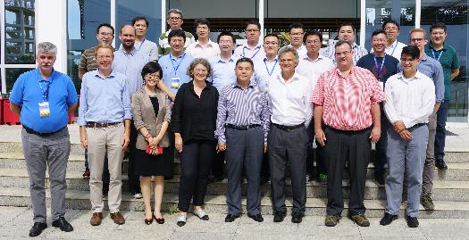
GEOGLAM Workshop on Cloud Computing and Knowledge Management
29-31 August 2018; Sanya, China (Host: RADI-CAS)
Cloud Computing is enabling big data analysis for agricultural monitoring (e.g. GEE, AWS, Alibaba, DIAS, Data Cube)
Increased volumes of accessible data in the cloud
Proliferation of tools
Increasing number of satellite-based products generated
Community requirement for guidance on best practices and coordinated data sharing.
Selected Workshop Outcomes:
Task Force established for coordinating cloud computing– focus on developing country capacity building
Community Algorithms and Tools to be shared via a GEOGLAM TEP (Thematic Exploitation Platform)
  EU targeting ESA funding
Document and report archives through Knowledge Management Hub (GEOGLAM Sec)
  GEOGLAM Best Practices documentation given priority (Fund being established at GEOSec)
Community Research Agenda in development (NASA Harvest with JECAM EC/Canada)

Slide 11
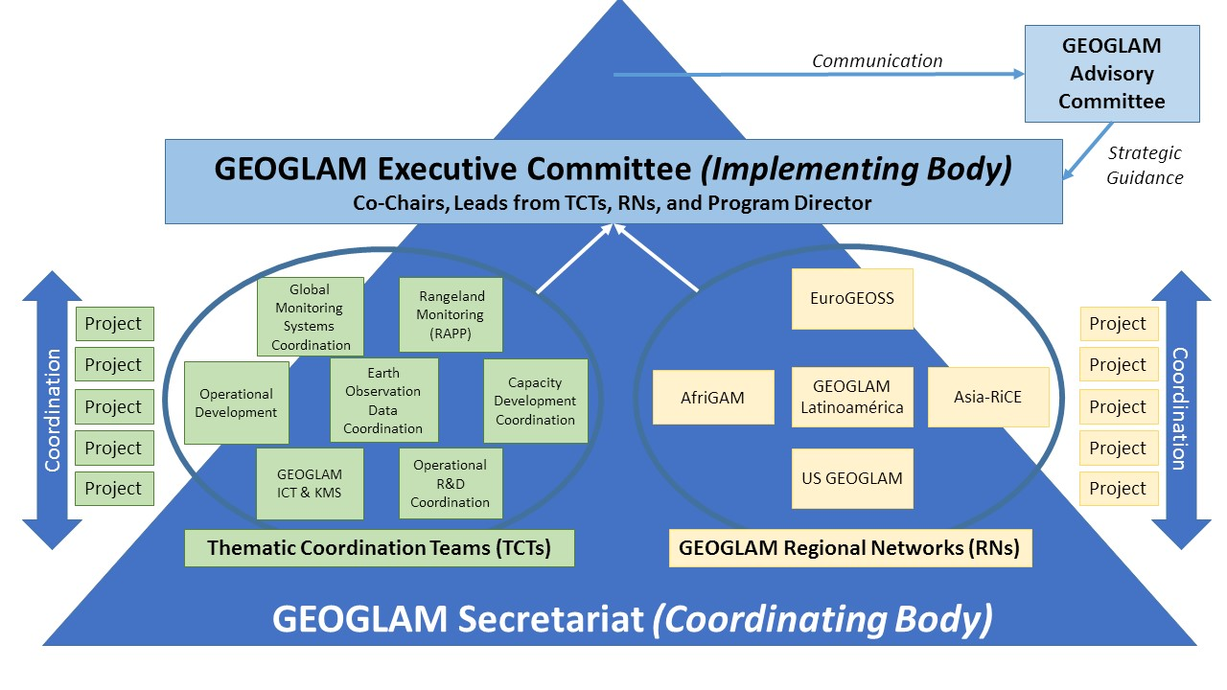
GEOGLAM Actions in Response to Growing Requirements:
EO Data Coordination and Management TCT
Establish an active EO Data Coordination and Management Thematic Coordination Team (TCT) – within GEOGLAM
  Currently seeking leadership within GEOGLAM for the “management” TCT
Next Steps on ARD+ and EAVs
  Task force established by GEOGLAM, within TCT
Established connection with
with CEOS

Slide 12

CEOS AHWG on GEOGLAM:
2018-2019 Work Plan
CEOS Strategic Response to GEOGLAM’s new requirements
  Initial feedback from AHWG to GEOGLAM:
    Add latency and traceability requirements,
    Review and provide feedback on CEOS “ARD+”, and
    Provide full description of GEOGLAM Essential Agriculture Variable (EAVs) concept
Plenary Decision: 1 year extension on CEOS AHWG on GEOGLAM
  CEOS Strategic Response to updated requirements and
  Options/Decision on future of CEOS support of GEOGLAM post-Plenary 2019

Slide 13

Timeline of Meetings, Actions, and Decisions on the question of the future of the
CEOS Ad Hoc Working Group on GEOGLAM
Sep-18 Oct-18 Nov-18 Dec-18 Jan-19 Feb-19 Mar-19 Apr-19 May-19 Jun-19 Jul-19 Aug-19 Sep-19 Oct-19
Telecon
Annual Meeting
CEOS Plenary
Core Group Meeting on Future Options
CEOS SIT
CEOS SIT TWS
CEOS Plenary
Meetings
Respond to Req. v.2 and Evaluate AHWG future Options
Present Update on Req. v.2 Response and Fut. AHWG Options to SIT
Present Req. V.2 Response and Future AHWG Recome-ndations to SIT
Final Present-ation to Plenary
Actions
Develop Draft of Response to Req. v.2 and Develop Options for Future AHWG, including interactions with other groups in CEOS
Evaluate Req. v.2 Response and Future AHWG Options, with SIT comments.
Feedback from CEOS on GEOGLAM AHWG
Finite Set of Options Developed
SIT feedback on Req. v.2 Response and AHWG Options
SIT Assess Req. v.2 Resp. and select a Future AHWG Option
Approve Req. v.2 Resp. and Future AHWG Final Decision
Decisions

