Slide 1
CEOS and the Global Ocean Observing System
The Global Ocean Observing System
goosocean.org
Albert Fischer
GOOS Office Director, IOC/UNESCO
CEOS 2019 SIT Technical Workshop, 11 Sep 2019

Slide 2
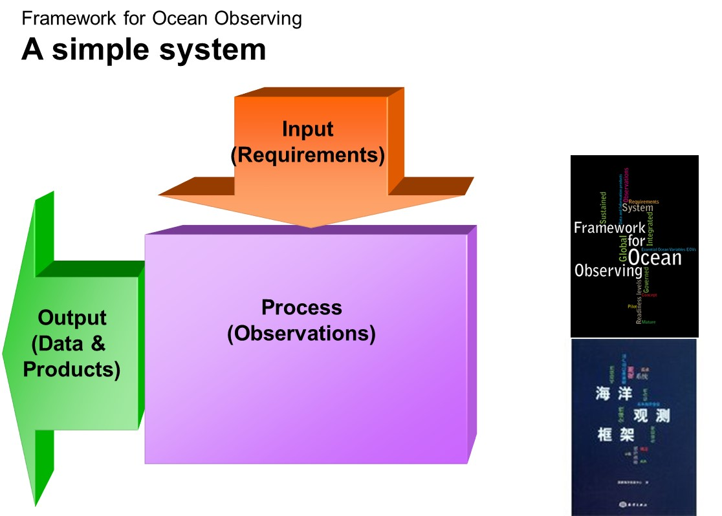
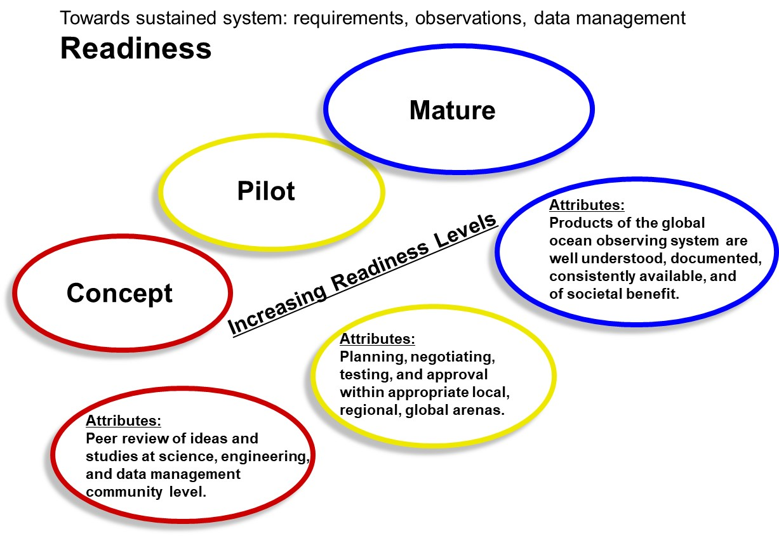
A legacy of OceanObs’09 The Framework for Ocean Observing has guided GOOS

Slide 3
3 Key application areas Operational services Climate Ocean health
with ocean forecasting community
and WMO as sponsor
with GCOS and shared panel OOPC

Slide 4
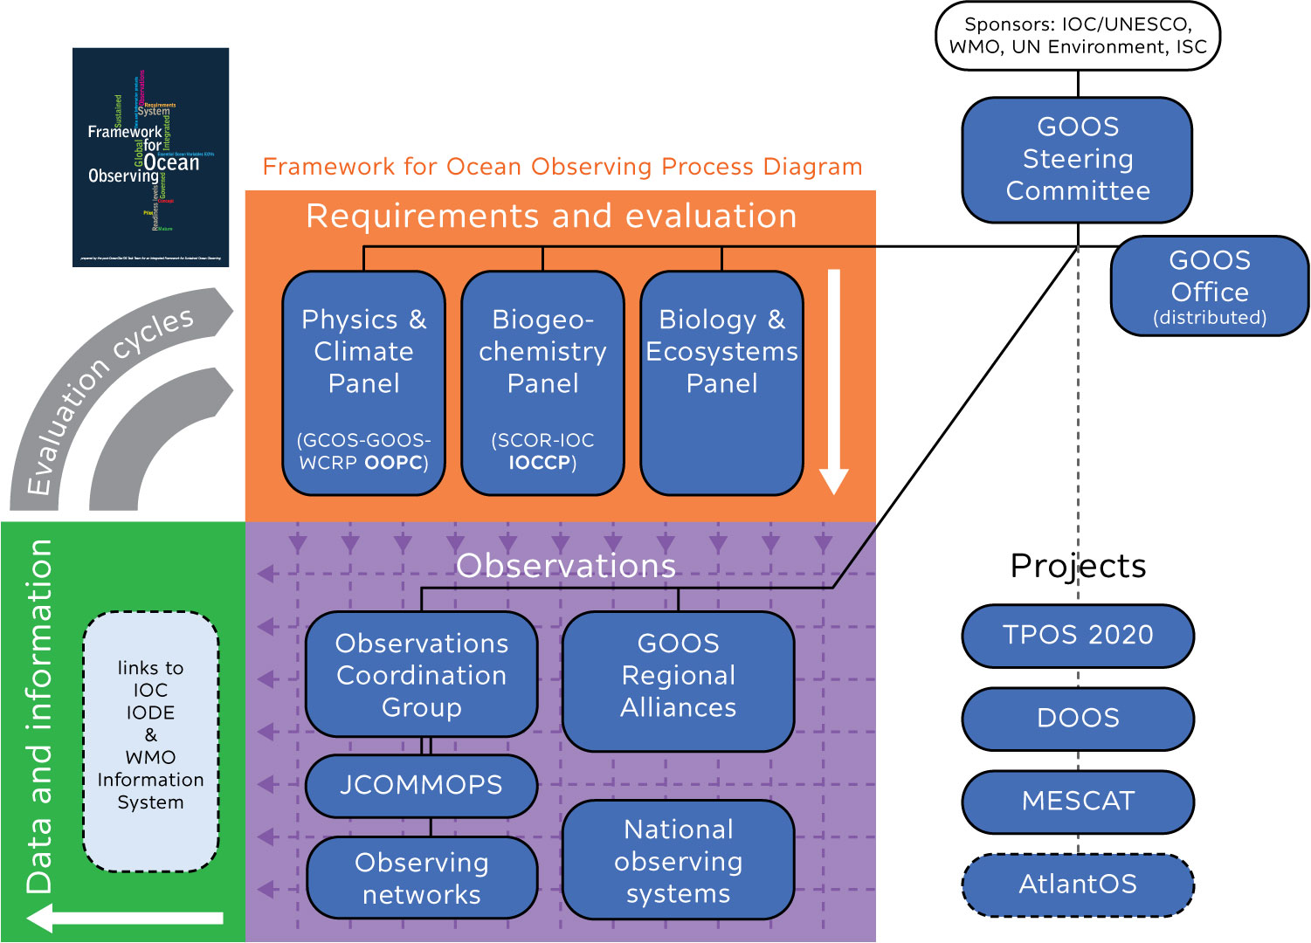
GOOS structure 2019

Slide 5
jcommops.org/
reportcard2019

Slide 6
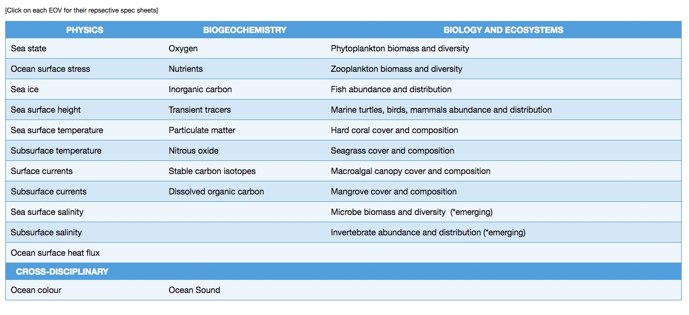
EOVs (and ECVs)
goosocean.org/eov
CEOS VCs and satellite Science Teams
other EOVs that use satellite observations, for direct measure or inference

Slide 7
Requirements can be approached from multiple angles

Slide 8
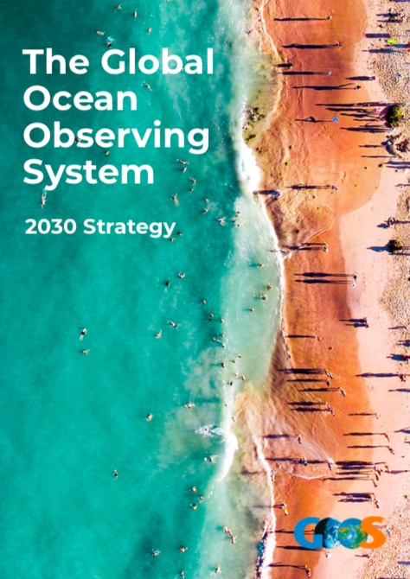
Our vision
A truly global ocean observing system that delivers the information needed for our sustainable development, safety, wellbeing and prosperity
goosocean.org/2030strategy

Slide 9
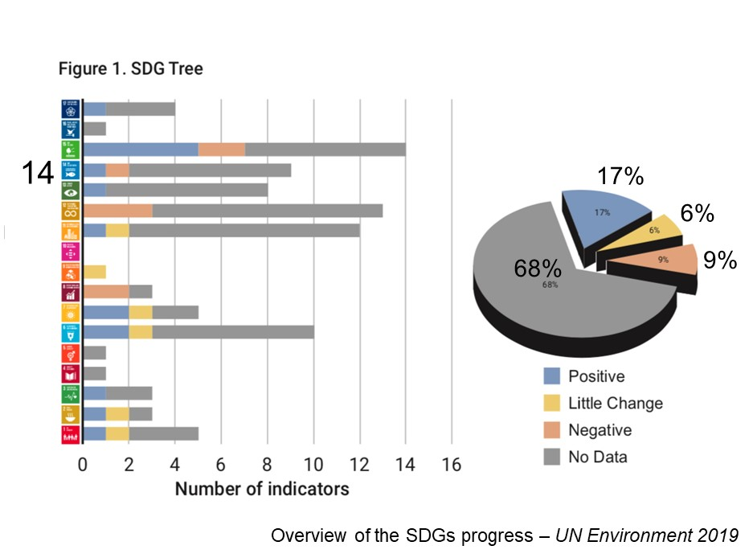
Why an improved Ocean Observing System
Greater knowledge based on continuous ocean observations will be needed to better understand climate change & variability, and ocean, weather and environmental hazards

Slide 10
We need a step change in ocean observing
We will need:
Growing integrated observing capacity
Proliferation of output systems
Improved connection from observations to users
We struggle to get the recognition and support required to build and sustain the ocean observing, data and information system the world needs.
“Since linkage between VCs and CEOS Working Groups, which engage with stakeholders to respond to their requests, is currently not strong and visible, efforts to strengthen interactions between them is highly recommended.”
-CEOS Ocean Virtual Constellation Merger Study Team Assessment (v1.1)

Slide 11
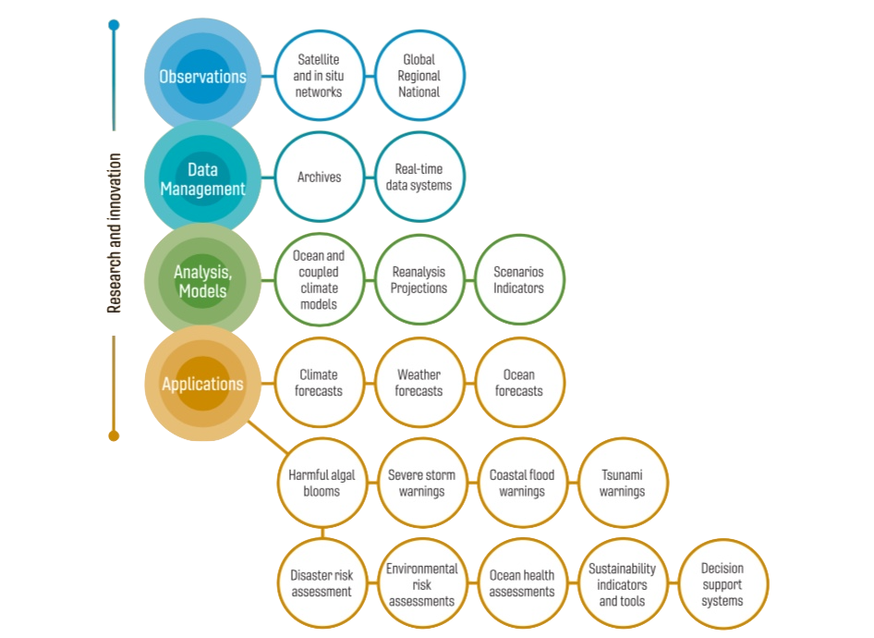
GOOS and CEOS
The GOOS Mission
To lead the ocean observing community and create the partnerships needed to grow and integrated, responsive and sustained observing system

Slide 12
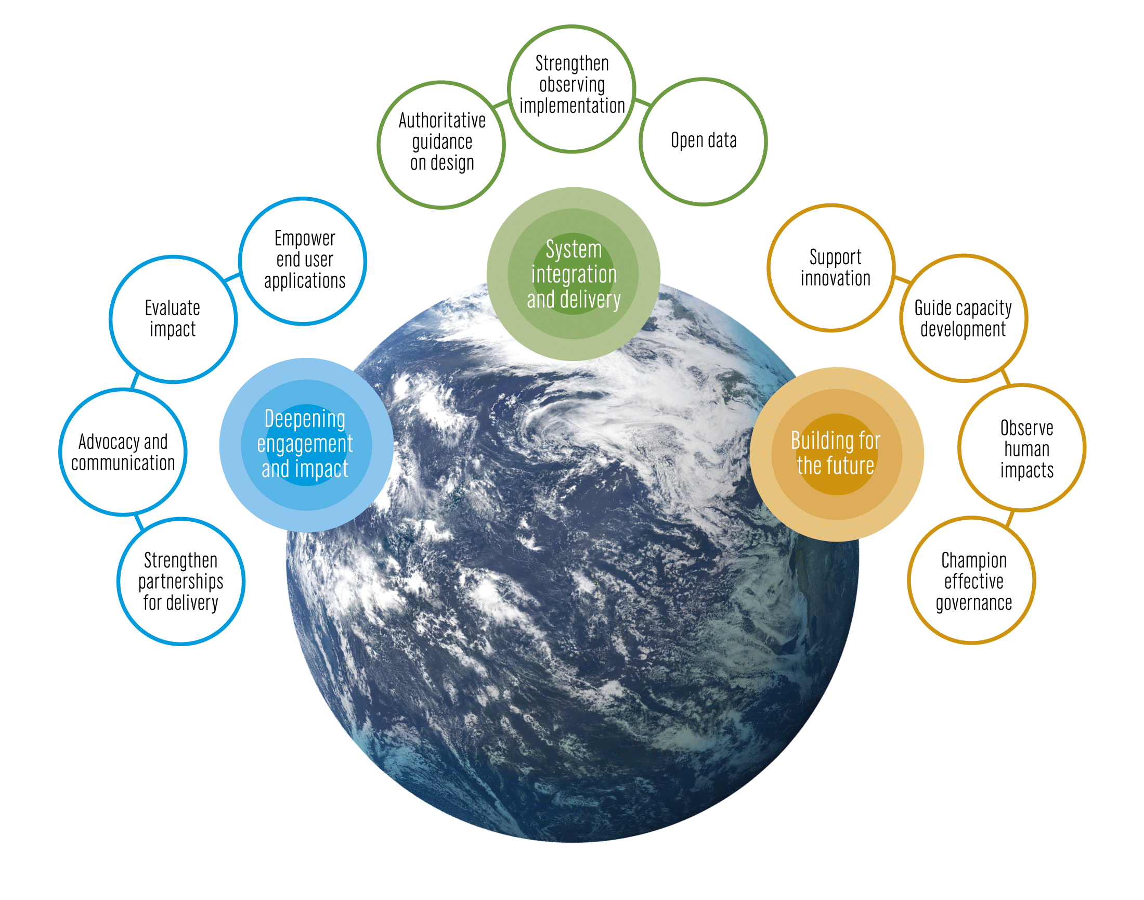
Strategic Objectives
System integration and delivery
Deepening engagement and impact
Building for the future

Slide 13
Working together for a better future
The Strategy is grounded in building effective partnerships for delivery
GOOS is developing an implementation framework needing broad partner engagement

Slide 14
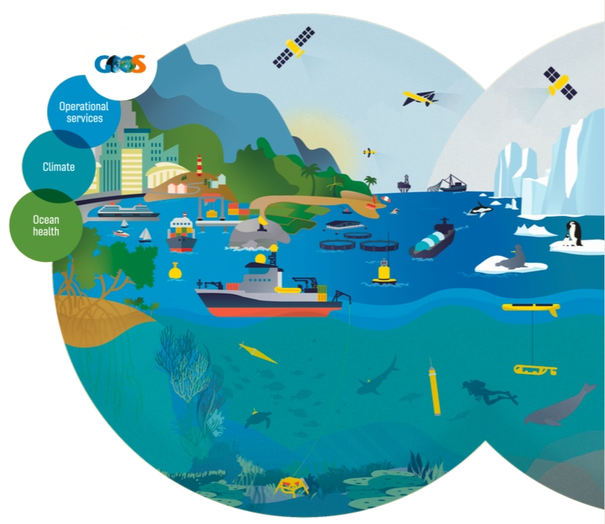
goosocean.org
GOOS and CEOS SIT
From the perspective of responding to requirements expressed against EOVs and ECVs:
the link between VCs and Science Teams has been valuable in the experience of GOOS (particularly OOPC)
the VCs have been important in getting concerns about continuity of missions expressed
responding to requirements needs thinking beyond variables, to applications
From the perspective of shared vision and objectives
interest in activity in partnering down the value chain for better delivery
a more integrated and responsive observing system

Slide 15
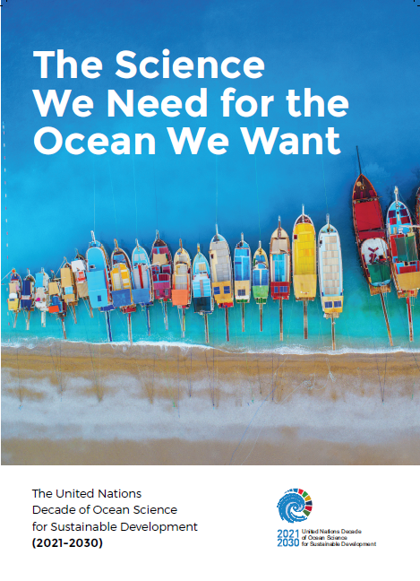
oceandecade@unesco.org Follow all Decade news: http://oceandecade.org
The United Nations Decade of Ocean Science for Sustainable Development (2021-2030)
IocUnesco
IocUnesco
ioc_unesco
Towards The Ocean We Need
for the Future We Want
v.ryabinin@unesco.org
Notes:
Are you interested in working toward the Ocean We Need for the Future We Want?
Visit our website, read our brochure and let us know and we will keep you informed of all future developments.

