Slide 1
GHG Roadmap
Mark Dowell (EC Joint Research Center) and David Crisp (Jet Propulsion Laboratory, California Institute of Technology)
September 11, 2019
© 2019 California Institute of Technology. Government sponsorship acknowledged.

Slide 2
The CEOS Architecture for Monitoring Atmospheric CO₂ and CH₄ Concentrations
The CEOS Atmospheric Composition Virtual Constellation (AC-VC) white paper defines a global architecture for monitoring atmospheric CO₂ and CH₄ concentrations from instruments on space-based platforms
166-page document, 88 authors from 47 organizations
Executive Summary (2 pages)
Body of report (75 pages)
Technical Appendices (42 pages)
DOI: 10.2760/468219
http://ceos.org/document_management/Virtual_Constellations/ACC/Documents/CEOS_AC-VC_GHG_White_Paper_Publication_Draft2_20181111.pdf

Slide 3
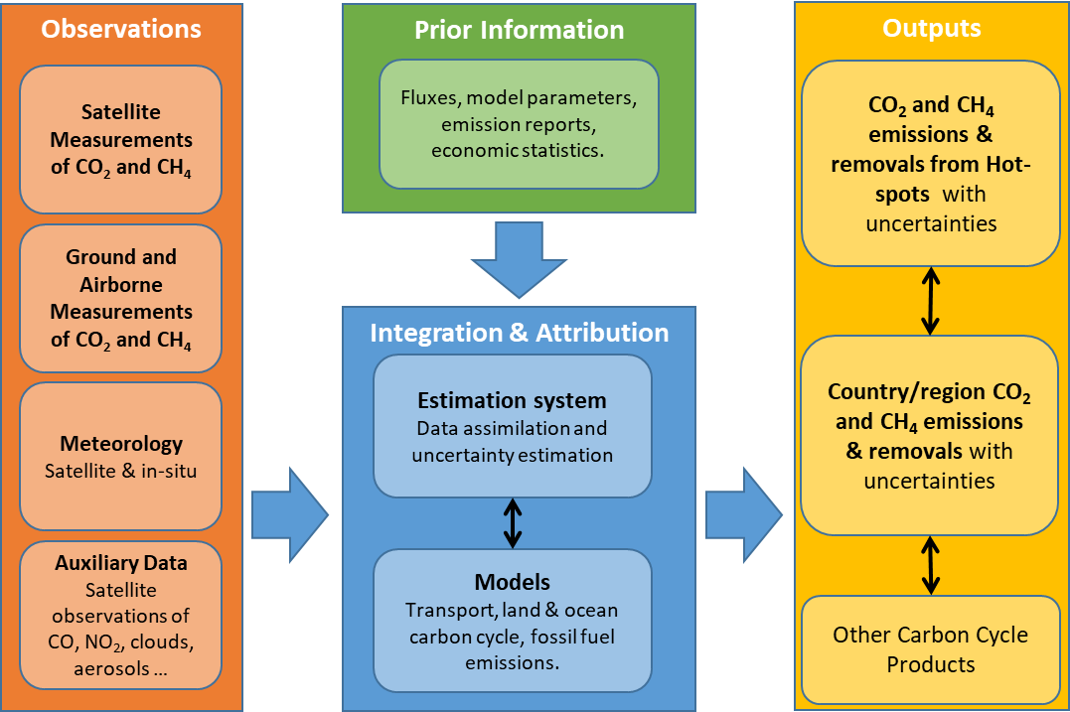
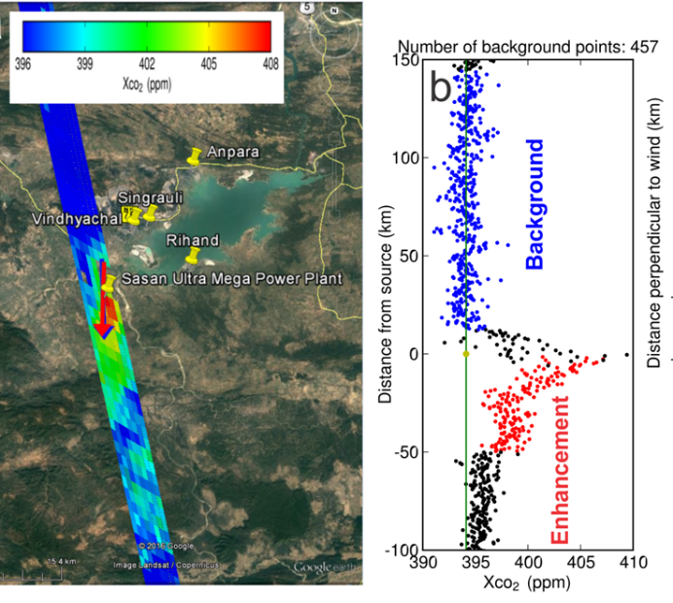
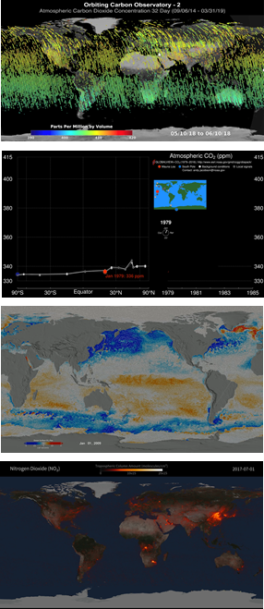
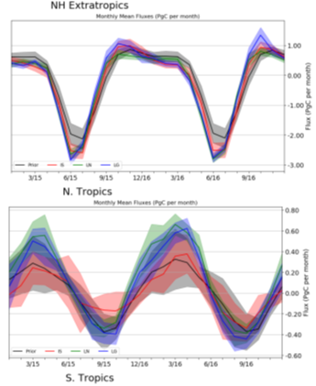
Role of Space-based Measurements in an Atmospheric GHG Inventory System

Slide 4
Developing Atmospheric GHG Inventories
The CEOS AC-VC GHG White Paper recommends the following approach:
Refine requirements for atmospheric flux inventories
  Foster collaboration between the space-based and ground-based GHG measurement and modeling communities and the bottom-up inventory and policy communities
Produce a prototype atmospheric CO₂ and CH₄ flux inventory that is available in time to inform the bottom-up inventories for the 2023 global Stocktake
  Coordinate ongoing missions and atmospheric inversion efforts to produce a best-effort inventory
Use lessons learned from the prototype flux inventory to refine requirements for
  A future, purpose-built, operational, atmospheric inventory system
  Improved atmospheric GHG inventories to support the 2028 global Stocktake.

Slide 5
Endorsement and Next Steps
Exploit ongoing efforts within WGClimate, WGCV, and AC-VC to meet goals of GHG Whitepaper
WGClimate Task Team on GHG monitoring
  WGClimate commissioned to form a dedicated task group on GHG monitoring, with resources and activities designed to address the actions identified in the White Paper
  WGCV was enlisted to support the definition of the calibration and validation needs
  AC-VC was enlisted support GHG constellation development and synergistic GHG and atmospheric composition observations and modelling efforts
WGCV
ACSG
GSCIS
Atmospheric Composition - VC
The first step in this process is to write a comprehensive Roadmap for the GHG activities to be conducted by WGClimate, WGCV, and AC-VC

Slide 6
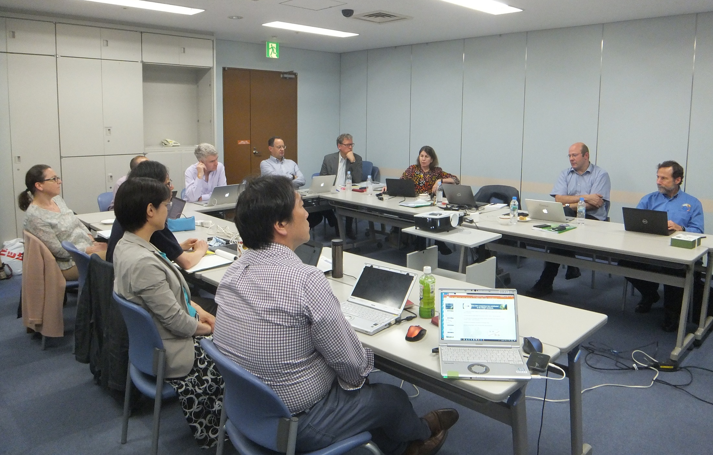
CEOS/CGMS GHG Roadmap Report Outline
SCOPE AND OBJECTIVE OF ROADMAP
CONTEXT
APPROACH
CEOS AND CGMS IMPLEMENTATION ENTITIES AND THEIR ROLES
  Role of Joint WGClimate GHG Task Team
  Role of CEOS Atmospheric Composition – Virtual Constellation
  Role of WGCV/ACSG and GSICS
  Role of other entities in CEOS and CGMS
ROADMAP ACTIONS TO 2021 AND 2025
  Actions for Joint WGClimate GHG Task Team
  Actions for Atmospheric Composition – Virtual Constellation
  Actions for WGCV/ACSG and GSICS
EXPECTED OUTCOMES
RESOURCE IMPLICATIONS
HIGH-LEVEL TIMELINE
CEOS GHG Roadmap Meeting, hosted by JAXA in Tokyo, Japan June 9, 2019

Slide 7
Primary Products of the GHG Roadmap Activity
Prototype Atmospheric inventory requirements (→ 2020)
  Collaborate with the space-based and ground-based GHG measurement and modeling communities and the bottom-up inventory and policy communities to refine requirements and implementation plans for atmospheric flux inventories
Prototype Inventory (→ 2021)
  Coordinate ongoing efforts by CEOS agencies to produce a prototype atmospheric CO₂ and CH₄ flux inventory in time to inform the bottom-up inventories for the 2023 global Stocktake
Architecture for an Operational GHG System (→ 2023 → 2026 → )
  A future, space-based, operational CO₂ and CH₄ constellation that more fully addresses the requirements of the inventory process in time to support the 2028 global Stocktake
  A system for integrating space-based measurements with in situ data and modeling tools to produce improved atmospheric inventories for use in the 2028 and future emission Stocktakes

Slide 8
Roadmap Timeline
Paris Agreement
Global Stock
Take 1
Global Stock
Take 2
using inventories through 2021
using inventories through 2026
2015
2017
2019
2021
2023
2026
2028
CEOS GHG Whitepaper
Prototype
atmospheric
CO₂/CH₄
inventory
Refined
atmospheric
GHG
inventory
Initial
Operational
GHG
Constellation
Deployment
Prototype
Inventory
requirements
Refined
atmospheric
GHG
requirements

Slide 9
Summary of Primary Roles and New Actions
WGClimate GHG Task Group
  Create a roadmap to implement actions proposed in the AC-VC white paper
  Establish primary user interface to Users (Inventory and Policy) and ensure feedback on prototype products
  Provide a system engineering tool to track requirements, capabilities, and deliverables
  Identify additional resource needs and relevant CEOS Agencies to dedicate appropriate resources
WGCV ACSG
  Identify best practices for prelaunch calibration of CO₂ and CH₄ concentration sensors and facilitate the exchange and harmonization of approaches and reference standards
  Identify best practices for on-orbit calibration of GHG sensors and disseminate standards including solar, lunar, and surface vicarious validation sites
AC-VC GHG Team
  Coordinate ongoing agency activities to implement a prototype atmospheric GHG inventory system that incorporates products from a virtual constellation of sensors by 2021
  Coordinate efforts to perform OSSEs to support trade studies on constellation architecture
  Coordinate development of a more complete atmospheric GHG inventory for the 2028 Stocktake

Slide 10
Resource Implications (1/2)
Three broad categories of resources are envisaged and requested for consideration by Agencies:
  Staff resources from CEOS members and external experts supported through Agency programmes & grants
  Support for travel and hosting of workshops, networking activities with inventory community (including inviting inventory experts to some CEOS meetings)
  [On longer-term] Through internal funding mechanisms support research, development and infrastructure for priorities identified by GHG Task Team and Roadmap Implementation (annual updates will be provided to Agencies)

Slide 11
Resource Implications (2/2)
On Staff resources specifically, the following guidance is provided:
Agencies are asked to continue/increase support to the GHG relevant staff (time & travel) contributing to the technical implementation tasks in AC-VC and WGCV
For the WGClimate GHG Task Team, the following specific “profiles” are required:
    Core team ensuring linkages to internal CEOS/CGMS entities (i.e. WGClimate – Dowell/Von Bargen, AC-VC – Crisp, WGCV – Kuze)
    Agency staff representing GHG missions/programmes
    Agecy staff from “operational” agencies to ensure operational transition
    Agency Staff/Experts with links to Inventory Community
    Agency Staff/Experts involved in modelling aspects
We envisage that the GHG Task Team would include ~12 members, typically dedicating 1PM/yr of effort each with those leading specific activities dedicating closer to 2PM/yr. Support should include necessary travel budgets for attending meetings/workshops.

Slide 12

Thank you

Slide 13
Backup

Slide 14
Iterative Versioned Approach Adopted for Developing and Delivering Roadmap Products
Integrated GHG System
Function
Milestone
Product
System
Deliver-able
Driver: Version delivery requirements
associated delivery schedule and capability
Each version includes
  an architecture,
  potential contributors,
  main open points/challenges with potential impact on system,
  decision logic for version clarification, apportionment of requirements to components, and a schedule
The approach can be applied to each step but also to each role
Deliverables (CO₂ & CH₄ fluxes)
Functions (integrated system)
Products (prototype, operational)
Milestones (2023, 2028)
Timeline

Slide 15
WGClimate Roles
WGClimate coordinate the joint effort between CEOS and CGMS to monitor GHGs
Organize and coordinate overall GHG and CEOS Carbon Strategy
Strengthen interactions with stakeholders (SBSTA, GCOS) and established links to users (GEIA) to define GHG inventory requirements through iterative feedback
Maintain a roadmap to implement actions proposed in the AC-VC white paper and the outputs from the JRC GHG workshop (draft outline presented to SIT-34 and CGMS-47)
Establish appropriate links and cross-representation with AC-VC and the WGCV Atmospheric Composition subgroup (plan presented at SIT-34 and CGMS-47)
Provide a system engineering tool to track requirements, capabilities, and deliverables
Perform system level simulation exercises to identify gaps in capability
Track the implementation of the changes needed for the transition from science to operations
Identify relevant CEOS Agencies to dedicate appropriate resources (present draft at SIT-TW, finalize at 2019 CEOS Plenary)

Slide 16
WGCV Roles
To identify best practices in prelaunch and on-orbit calibration of GHG concentration sensors and flux product validation, WGCV will work with GSICS to define:
Identify available standards and calibration techniques to
  Calibrate space based GHG sensors prior to launch
  Calibrate and cross-calibrate GHG sensors on orbit (lunar, solar, vicarious)
Define approaches to cross validate retrieved XCO₂ and XCH₄ concentrations
  Identify available standards and techniques that can be used to cross-validate space based estimates (TCCON, AirCore …) (Rec#11)
Work with AC-VC and GSICS to define best practices and facilitate exchange and harmonization of approaches for instrument cross-calibration (Rec#10)
Identify approaches for validating surface GHG flux products and reference standards
New Activities Ongoing Activities

Slide 17
AC-VC Roles
Coordinate ongoing agency activities to implement a prototype atmospheric GHG inventory system that incorporates products from a virtual constellation of sensors by 2021 (Rec#1)
Define a dedicated operational constellations of sensors for GHGs as part of the backbone for the Climate Monitoring Architecture (Rec#2)
  Track implementation and operations of space-based GHG sensors (Rec#14)
  Facilitate exchange of expertise and support in defining mission requirements (Rec#7)
Work with WGCV ACSG and GSICS to define best practices and facilitate exchange and harmonization of approaches for instrument cross-calibration (Rec#10)
Coordinate efforts to perform OSSEs to support trade studies on constellation architecture (Rec#8)
  Coordinate discussion on auxiliary observations enhancing data quality (e.g., aerosol properties for light path correction) (Rec#15)
  Discuss possible role of an active mission as flying standard in a GHG constellation (Rec#14)
Coordinate the development of a more complete atmospheric GHG inventory for the 2028 Stocktake
Work with WGClimate to identify and propose solutions for observational gaps (Rec#14)
New Activities Ongoing Activities

Slide 18
The Role of CGMS – Creating an Operational System
CGMS will play a continuous role in the Task Team, but are expected to provide unique insights into:
Overall system requirements for an operational system
Delivery latency requirements for products (Timeliness)
Reliability and robustness of the end-to-end system
Reprocessing, preservation, and archiving systems
Traceability of products in a configuration-controlled environment
Rigorous quality assurance
Continuously monitoring and reporting of calibration and validation
User support and capacity building
International coordination and long-term planning

Slide 19
Expected Outcomes and Impact
Space agencies have a «window of opportunity» to make a substantive impact on the implementation of the Paris Agreement through the Global Stocktakes and Enhanced Transparency Framework
  The timeline is very ambitious and demanding – but feasible.
The output of our joint efforts would support the international community in verifying and iteratively improving their emission estimates whilst providing multi-scale perspective to address mitigation option at regional, national and continental scales
Numerous agencies are developing missions & programmes, but there is systematic recognition that international coordination is a fundamental requirement
The CEOS/CGMS GHG Constellation Architecture provides the baseline for the development and implementation or activities

Slide 20
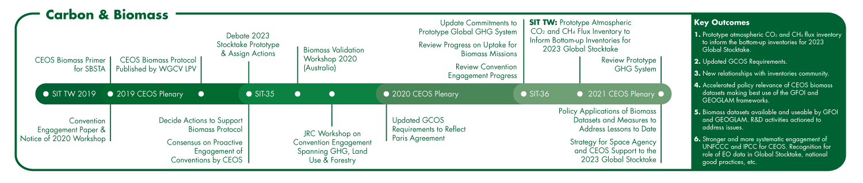
2020-2021 CSIRO/GA Australian SIT Chair Priorities – Role of Carbon and GHG
Carbon and GHGs are one of 3 CEOS Chair Priorities for 2020-2021
Supporting the GHG Roadmap process – escalating, elevating, and accelerating progress towards major milestones, including for 2023 Global Stocktake. 2021 prototype flux products.
Reflecting $4Bn+ investment (2018-2024) in Above-Ground Biomass missions and seeking to accelerate the policy relevance of these new data (GFOI, GEOGLAM…)
Encouraging stronger and more systematic engagement by CEOS of convention frameworks – building on IPCC outreach

Slide 21
Near-term Meeting Opportunities
9-12 September – CEOS SIT Technical Workshop, Fairbanks, AK
  Plan Roadmap approved by the SIT, and promoted to Plenary for endorsement
14-16 October – CEOS Plenary, Hanoi, Vietnam
  Endorsement of Roadmap by CEOS Plenary
6-8 November - 19th GEIA: Global Emissions InitiAtive (GEIA) Conference, Santiago, Chile
  Preceded by workshop to encourage interactions of national statistical and atmospheric GHG inventory communities
3 December – COP-25 Earth Information Day, Santiago, Chile
2-9 December – SBSTA-51, Santiago, Chile
Summer 2020 – Atmospheric inventory/National inventory community workshop, JRC, Ispra, Italy

