Slide 1
Whitepaper ‘Geo-AQ Validation Needs’ Prepared by the Atmospheric Composition Virtual Constellation (AC-VC) Jay Al-Saadi (NASA) & Ben Veihelmann (ESA), AC-VC co-chairs
Committee on Earth Observation Satellites
CEOS Plenary 2019
Agenda Item 6.6
Ha Noi, Viet Nam
14 – 16 October 2019

Slide 2
Overview
Background
Geo-AQ Constellation
Purpose of the Whitepaper ‘Geo-AQ Validation Needs’
Contributors to the Whitepaper
Structure / Table of Content
Recommendations
Requests for Endorsement and Way Forward

Slide 3
Background
Several countries and space agencies are currently preparing geostationary satellites with a strong focus on Air Quality (AQ). The ‘Geo-AQ Constellation’ consists of
the Korean Geostationary Environment Spectrometer (GEMS), launch early 2020;
the Copernicus mission ‘Sentinel-4’, launch 2023;
the Tropospheric Emissions: Monitoring of Pollution (TEMPO), launch early 2022;
and is complemented by a number of LEO missions with strong AQ capabilities.
Responding to the CEOS Work Plan Action VC-3, AC-VC prepared a whitepaper ‘Geostationary Satellite Constellation for Observing Global Air Quality: Geophysical Validation Needs’. Status:
Final review during AC-VC-15, June 2019, Tokyo, Japan
Presented at CEOS 2019 SIT Technical Workshop, September 2019, Fairbanks, Alaska
Ready for endorsement by CEOS

Slide 4
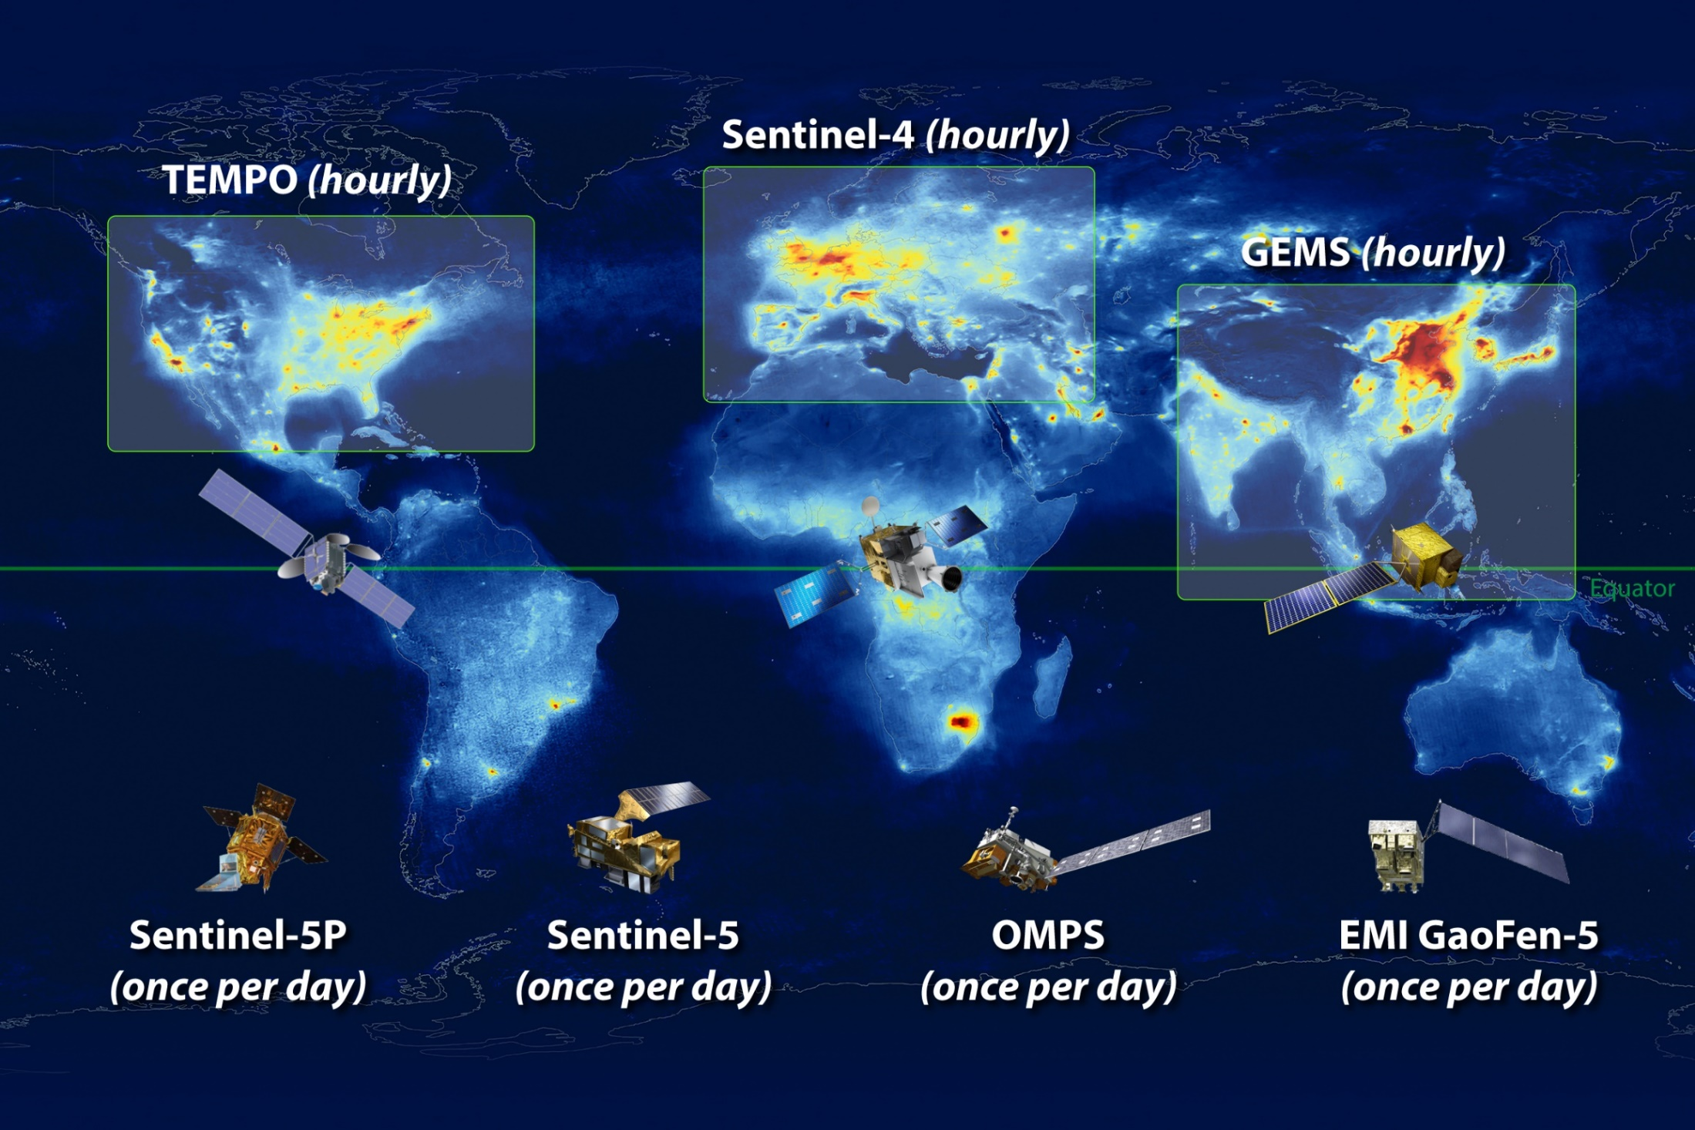
Geostationary Air Quality (Geo-AQ) Constellation
bb

Slide 5
Purpose of the ‘Geo-AQ Validation Needs’ Whitepaper
Elaborate the validation needs of the Geo-AQ Constellation: focus on
new challenges for geostationary atmospheric composition missions (new wrt LEO heritage)
enhancing the success of the missions when seen as element of a constellation
Identify ‘Constellation Products’
common to the Geo-AQ missions
enhanced value by establishing and monitoring inter-mission consistency
Set quantitative inter-mission consistency targets for the Constellation Products
taking into account individual product performances and the accuracy of validation methods
Identify activities needed to assess and establish this consistency
Activities to be performed consistently for each mission
Activities addressing new Geo-AQ challenges and inter-mission consistency
Coordination and continuity
Make specific and actionable recommendations

Slide 6
Contributors to the Whitepaper
The Whitepaper has been written by the science teams of the GEMS, Sentinel-4, and TEMPO missions and validation experts including
Al-Saadi, Jay (NASA, USA; AC-VC)
Cede, Alexander (Luftblick, AT, AC-VC)
Chance, Kelly (SAO, USA; AC-VC)
Flynn, Lawrence E. (NOAA, USA, AC-VC; GSICS)
Kim, Jhoon (Yonsei University, Korea; AC-VC)
Kim, Sang-Woo (Seoul National University, Korea, AC-VC)
Koopman, Rob (ESA, EU)
Lambert, Jean-Christopher (IASB-BIRA, Belgium; AC-VC; WGCV)
Lindstrot, Rasmus (EUMETSAT, EU)
Munro, Rose (EUMETSAT, EU; AC-VC; GSICS)
Van Roozendael, Michel (IASB-BIRA, Belgium; AC-VC; WGCV)
Veihelmann, Ben (ESA, EU; AC-VC)
Wang, Jun (University of Iowa, USA; AC-VC)
Yoon, Jongmin (National Institute of Environmental Research)

Slide 7
Structure / Table of Content of the Whitepaper
Executive Summary (1/2 page)
Summary of all Recommendations (1 page)
Geo-AQ Missions and Related LEO Missions
Product Consistency Across the Constellation
Validation Needs
Activities That Need to be Performed Consistently for Each Mission
Recommendations for Activities Addressing New Geo-AQ Challenges and Inter-mission Consistency
Coordination and Continuity
Reference Documents, List of Acronyms, Contributors, Annex: Geophysical Validation Infrastructure
40 pages without Annexes

Slide 8
Recommendations formulated in the Whitepaper
Consistently perform intensive campaigns dedicated to the validation of the capability of the Geo-AQ missions to observe the diurnal cycle of the target species (several supersites within each Geo-AQ mission domain).
Conduct joint validation campaigns with exchange of reference airborne and ground-based instruments.
Further develop and eventually apply approaches to the radiometric inter-calibration of the Geo-AQ missions. These activities should be pursued within the frame of the WMO GSICS initiative.
Further develop and eventually apply approaches to the inter-calibration of the Level-2 products of the Geo-AQ missions.
Systematically process the Level-2 Constellation Products of the Geo-AQ missions, using one selected common algorithm per Constellation Product.
Further pursue the harmonization of the reference data used for validation and inter-mission consistency verification of Level-2 products.
Implement a data centre for storage and exchange of all validation data collected for the Geo-AQ missions, accessible to the entire community involved in the validation of the Geo-AQ mission products, very soon after acquisition.
Implement a coordinating unit for ensuring the consistency of the approach and the metrics used for validating the Geo-AQ mission products and their inter-mission consistency.

Slide 9
Recommendations formulated in the Whitepaper
Consistently perform intensive campaigns dedicated to the validation of the capability of the Geo-AQ missions to observe the diurnal cycle of the target species (several supersites within each Geo-AQ mission domain).
Conduct joint validation campaigns with exchange of reference airborne and ground-based instruments.
Further develop and eventually apply approaches to the radiometric inter-calibration of the Geo-AQ missions. These activities should be pursued within the frame of the WMO GSICS initiative.
Further develop and eventually apply approaches to the inter-calibration of the Level-2 products of the Geo-AQ missions.
Systematically process the Level-2 Constellation Products of the Geo-AQ missions, using one selected common algorithm per Constellation Product.
Further pursue the harmonization of the reference data used for validation and inter-mission consistency verification of Level-2 products.
Implement a data centre for storage and exchange of all validation data collected for the Geo-AQ missions, accessible to the entire community involved in the validation of the Geo-AQ mission products, very soon after acquisition.
Implement a coordinating unit for ensuring the consistency of the approach and the metrics used for validating the Geo-AQ mission products and their inter-mission consistency.
May require resource commitments from CEOS member agencies.
Best practices for consistent implementation by mission teams. Benefit from ongoing CEOS interaction and coordination

Slide 10
Request for Endorsement
and Way Forward
Action VC-03 ‘Air Quality (AQ) Constellation Coordination’ addressed:
Whitepaper ‘Geostationary Satellite Constellation for Observing Global Air Quality: Geophysical Validation Needs’ prepared by AC-VC
Delivered to CEOS
Plenary invited to
Endorse/accept the VC-03 white paper
SIT and Executive leadership and next work plan
Evolve VC-03 Deliverable to implementation

