Slide 1
Updates from OSVW-VC
Raj Kumar (ISRO), Paul Chang (NOAA)
and Stefanie Linow (EUMETSAT)
CEOS 2019 SIT Technical Workshop
5.4 OSVW-VC
Fairbanks, Alaska, USA
11 – 12 September 2019

Slide 2
OSVW-VC Strategic Objectives
OSVW-VC fosters the availability of best quality ocean surface wind vector data for applications in short, medium and decadal time scale in the most efficient manner through International collaboration, scientific innovation, and rigour.
Improve coordination, consolidation, and development of the collective OSVW capability
Maintain a strong and mutually supportive relationship with the International Ocean Vector Winds Science Team (IOVWST)
Provide an interface to CEOS for the IOVWST
Develop recommendations on the driving requirements to create, validate, and sustain the development of an international ensemble of Essential Climate Variable (ECV) measurements
Provide advice on and advocate to the international community for the importance of OSVW measurements
Develop and consolidate training on the use of scatterometer winds for different applications, as well as outreach to the general public to demonstrate the societal benefit of these data

Slide 3
OSVW-VC Summary
Currently, the OSVW Constellation is mainly anchored by the scatterometer missions of EUMETSAT and ISRO, with a large number of upcoming Chinese scatterometer missions.
The CEOS OSVW-VC advocates:
Open and near real-time data access
Coordination of orbits to optimize temporal sampling
Cross calibration of missions
Cal/Val and data product standards
Outreach and education
Additional information including Terms of Reference can be found at http://ceos.org/ourwork/virtual-constellations/osvw/

Slide 4
Wind Vector Constellation Status
ASCAT (METOP-A, B and C)
Open and near real-time data access
METOP-C launched on 7 November 2018
SCA (ASCAT Follow-On, EPS-SG, from ~2022 / 23)
ASCAT available through the EPS-SG/SCA launch
Decision yet to be made: Orbit phasing of METOP-B and METOP- C
SCATSAT Sept 2016 (injected into ~9:45 am local crossing time and presently ~8:45 am)
Open and near real-time data access (since April 24, 2017)
OSCAT follow-on (OceanSat-3) ~first quarter of 2020;Oceansat-3A ~Last Quarter
CMA will be providing OSVW measurements starting with their FY-3E launch (late 2019?)
NSOAS HY2 series:first tests to provide NRT data via EUMETCast, HY2B launched 25 Oct 2018
CFOSAT (launched on 29 October 2018), data distribution pending agreements

Slide 5
CEOS OSVW-VC current status and outlook
16 | 17 | 18 | 19 | 20 | 21 | 22 | 23 | 24 | 25 | 26 | 27 | 28 | 29 | 30
ASCAT / Metop-A (launch 19.10.2006)
Meteor-MP N2
ASCAT / Metop-B (launch 17.09.2012)
Meteor-MP N1
Meteor-MP N3
ASCAT / Metop-C
C-band
SCA / Metop-SG B1 + B2 + B3
WindRad / FY-3H
C and Ku-band
WindRad / FY-3E
WindRad / FY-3H
Scatsat-1
HY-2F / HY-2G
HY-2A
HY-2B
HY-2H
(launched 2011)
HY-2C
HY-2D / HY-2E
Operational
Approved
SCAT + SWIM/ CFOSAT
SWIM+SCAT / CFOSAT follow-on
Developed
Planned
Oceansat-3
Considered
Ku-band
Oceansat-3A
Source: CEOS / WMO OSCAR database, 08/2018
Note: Near real-time and open data access not assured for all missions listed
Operational
= on orbit but does not distinguish between research and operational mission
5

Slide 6
Local time coverage assessment (ground track)
 | 16 | 17 | 18 | 19 | 20 | 21 | 22 | 23 | 24 | 25 | 26 | 27 | 28 | 29 | 30
00:00
01:00
02:00
03:00
04:00
05:00
06:00
07:00
08:00
09:00
10:00
11:00
12:00
Operational
Approved
Developed
Planned
HY-2A
HY-2B / E
HY-2H
Considered
WindRad / FY-3E
WindRad / FY-3H
SWIM+SCAT / CFOSAT
SWIM+SCAT / CFOSAT follow-on
descending node crossing time
Source: CEOS /WMO OSCAR database, 08/2018
Scatsat-1
ASCAT / Metop-A
SCA / Metop-SG B1 + B2 + B3
ASCAT / Metop-C
ASCAT / Metop-B
Drifting Orbits:
ASCAT-A (since 2018)
HY-2C (2019-2024)
HY-2D (2020-2025)
HY-2F/G (2022-2027)
Oceansat-3 / 3A
6 hour WMO minimum observation cycle requirement. Note: OSCAT and ASCAT with only 2.5 hour separation shown to have impacts in NWP data assimilation

Slide 7
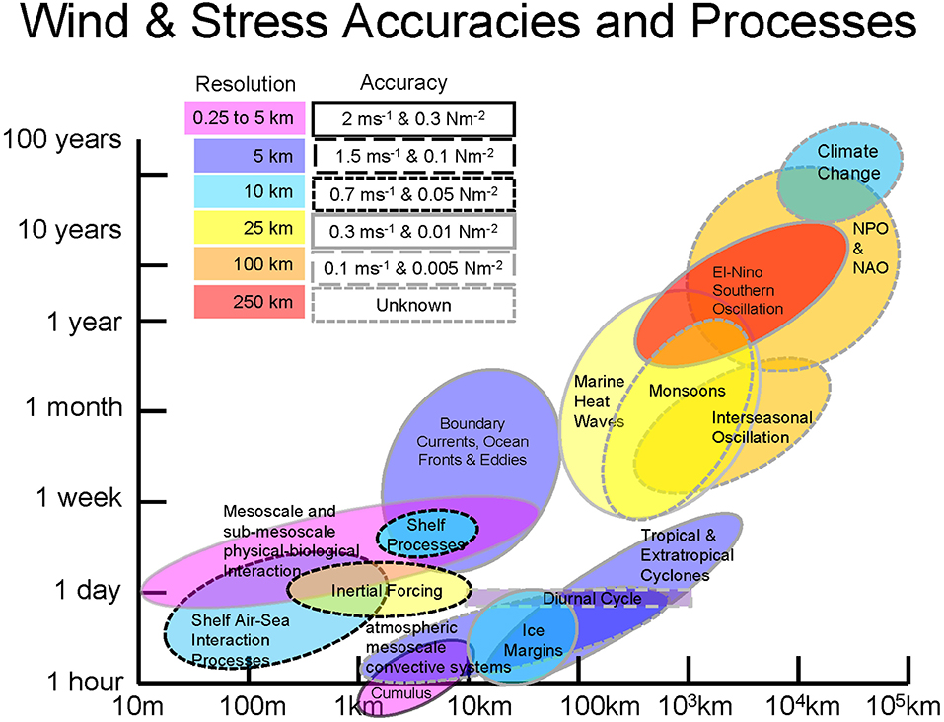
Community Activities
Figure: OceanObs’19 White Paper
Discussion of observing system requirements for accuracy and resolution:
Observation requirements vary greatly depending on the spatial and temporal scales of phenomena that need to be captured in a model.
Sampling requirements in space and time are driven by the need to capture the variability
At least 3 scatterometers in orbits designed to roughly meet WMO requirements (observations every 6 hours)
One instrument in a non-sun-synchronous orbit for sampling the diurnal cycle, better mid-lattitude sampling and provide inter-calibration

Slide 8
Cross-calibration of missions, Cal/Val
and data product standards
Discussions continuing within the IOVWST on the quality assessment of data products and wind retrievals, which include:
Wind retrievals during extreme winds
GMF development and validation
Comparison of wind retrieval algorithms
Assessment of rain effects in the tropics (particularly relevant for Ku-band instruments / radiometers)
Spatial scaling effects
Generation of a quality-controlled wind reference dataset linking dropsondes / buoys / SFMR (plane-based measurements) / SAR data

Slide 9
Requirements for the OSVW Constellation
Spaceborne scatterometers (C-, Ku-band) become the standard to provide global ocean surface wind vector data. However, other remote sensing techniques have demonstrated varying capabilities at retrieving the ocean surface winds and include
Microwave radiometers
Multi-frequency Polarimetric L-band
Synthetic Aperture Radar (SAR)
GNSS-R
HF radars (regional coverage but frequent temporal refresh)
How do these other techniques compare with microwave scatterometry and where do they fit within the OSVW observing system portfolio?

Slide 10
Requirements for the OSVW Constellation
To effectively answer this question properly, we need to view from the OSVW applications perspective. The applications include:
Weather forecasting (Nowcast and short range)
Climate observing/analysis (seasonal, inter-annual and longer time scales) Ocean dynamics...
A proper comparison requires utilizing a standard set of metrics and validation methodologies. These comparisons include
Global statistical analyses
Geographical distribution analyses
Temporal sampling analyses
Performance in the extremes (low (< 3m/s) and strong wind speeds (> 30m/s))
Dependency on ancillary data

Slide 11
Future Course of Actions
Objective: A report objectively assessing the requirements of an OSVW constellation from the applications perspective and the ability of current observing systems capability to address these requirements
How: A workshop to be planned end of 2019 or early 2020
Include experts from the measurement and applications communities
Outcome: A report with the backing of the IOVWST objectively assessing observing system capabilities of ocean surface wind retrievals from the measurement and downstream applications perspectives

Slide 12
Questions?

