Slide 1
Sea Surface Temperature – Virtual Constellation
Kenneth S. Casey, NOAA, SST-VC co-chair
Anne O’Carroll, EUMETSAT, SST-VC co-chair
CEOS 2019 SIT Technical Workshop
Session 5 and Agenda Item 6
Fairbanks, Alaska, USA
11 – 12 September 2019
Notes:
Presenters should name their files using the following convention:
AgendaItemNumber_LastName_Subject_Version.pptx (e.g., CEOS SITTW2019_1.5_Holloway_Communications_v2.pptx)
Supporting documentation or links to be posted online is welcome
Materials should be sent to george@symbioscomms.com and kerry.sawyer@noaa.gov
Materials deadline: no later than Thursday, 5 September
Presenters should bring a copy of their presentation (e.g., on a USB key) in case a last-minute update is required
Materials will be placed online
http://ceos.org/meetings/2019-sit-technical-workshop/

Slide 2
Team Achievements and Planned Outputs
SST-VC continues to focus on narrow group of objectives, completing activities of the last few years and transitioning to new focus area. Membership is strong, with active participation and leadership rotations in place. SST-VC operating well as a SST-only focused VC.
Eighth CEOS SST-VC meeting held in Frascati, 7th June 2019, following the annual GHRSST Science Team meeting
SST-VC contributions to the global observing architecture and national planning purposes
Community White paper for OceanObs ‘19, “Observational needs of Sea Surface Temperature”, recently published: https://www.frontiersin.org/articles/10.3389/fmars.2019.00420/
Constellation White paper (action VC-19)
98 standardized GHRSST products, spanning 7.48 million CF/ACDD netCDF data files, 167 TB, from Sep 1981 – Aug 2019
CEOS operations in the global community!!
This Photo by Unknown Author is licensed under CC BY-NC

Slide 3
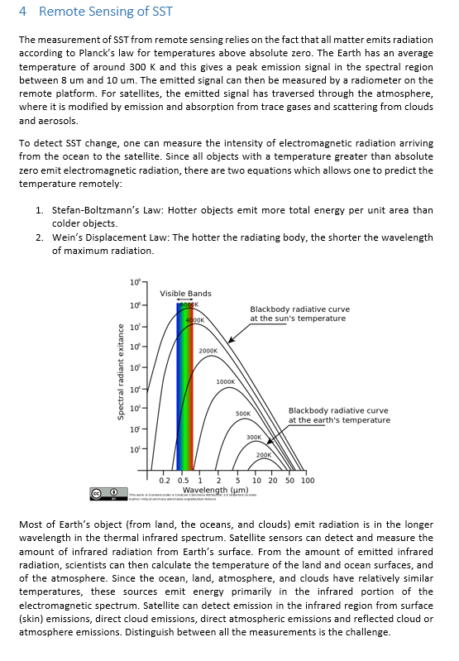
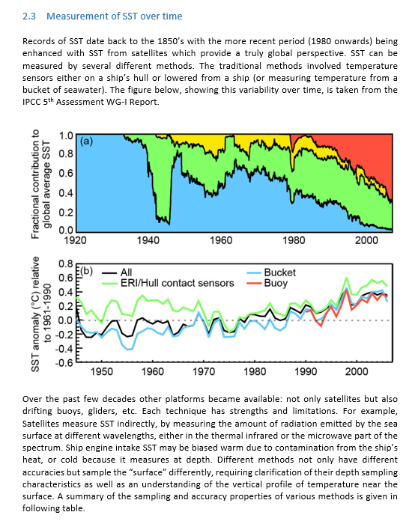
SST Constellation White Paper
White paper on next generation SST constellation now completed and the finished draft is currently under final review by SST-VC members
The white paper is expected to be ready to distribute next month

Slide 4
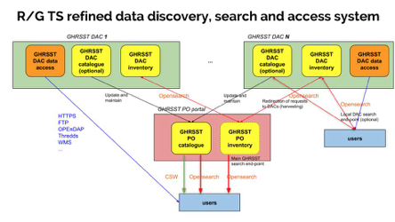
CEOS Operations in the Global Community – R/GTS Evolution
GHRSST Regional / Global task sharing (R/GTS) framework evolution continues, toward implementation of a federated distribution architecture
Draft report on R/GTS evolution prepared, final consolidation completed with the GHRSST science team in June 2019, release of final version next quarter
Pilot phase in progress, demonstrating federated catalogue at IFREMER capable of consolidating discovery from NASA and NOAA
Implementation phase to follow in 2020/2021

Slide 5
Impact of RFI on Sea Surface Temperature
Increasing concern from SST community regarding increasing impact of Radio Frequency Interference (RFI) and 5G networks on the quality of Sea Surface Temperature retrievals and therefore downstream applications
We have already experienced RFI on 6.9 and 10.65 GHz channels, which are essential to SST retrievals (see following examples). Introduction of nearby frequency channels shows possible mitigation of RFI effect (e.g. 6.9/7.3 GHz in AMSR2)
5G networks may cause RFI in 23 and 36 GHz channels as well, which are also important to SST retrievals in order to estimate influence from water vapor and clouds
SST-VC and GHRSST are compiling an inventory of evidence of RFI impacts on SST products and applications
New passive microwave sensors (e.g. CIMR) being studied with RFI mitigation built in, but data will not be available till mid-late 2020’s
Examples follow, and We would like to raise the issue to CEOS SIT and stimulate discussion

Slide 6
Previously shown examples of RFI (from 2016)

Slide 7
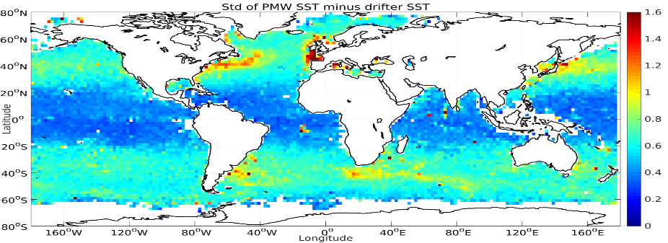
Recent Examples of RFI Impact / Mitigation
Example of masking and filtering for RFI investigated by ESA CCI CDR construction for AMSR-E and AMSR-2 and the effects on the performance.
Uses 3σ-filter of two algorithms excluding 10/18GHz respectively.
Geographical distribution of gridded standard deviation of baseline PMW SST minus in situ SST:
-> Without application of the RFI/QC filter.
[J. Hoeyer et al, submitted to RSE, 2019]
-> With application of the RFI/QC filter.

Slide 8
CEOS SST-VC Membership and Leadership Rotation
SST-VC: very active and motivated team, current membership:
NOAA, NASA, EUMETSAT, ESA, BoM/CSIRO, UKSA, CMA, KMA, ISRO, JAXA, SANSA
Ed Armstrong (NASA) to replace Ken Casey (NOAA) – October 2019
Christo Whittle (representing SANSA) to replace Anne O’Carroll (EUMETSAT) – October 2020
New leadership brings opportunity to refocus on new challenges, given successful completion of recent activities.

Slide 9
Potential Key Activities for SST-VC from 2019 and Beyond
Engaging early career scientists and how to encourage them to participate in GHRSST / SST-VC
Improved search relevancy/decision tree based GHRSST product search
Possibility an integrated SST / sea-ice temperature dataset, southern ocean
Integrated cross-VC products, to advance ARD concepts
An SST “CEOS Data Cube”
Assessing and monitoring of RFI impacts
More explicit collaboration with the other VCs
Improving and standardizing SST granule quality documentation and descriptions
…

Slide 10
Questions?

