Slide 1
Land Surface Imaging
Virtual Constellation (LSI-VC)
Steve Labahn, USGS, LSI-VC Co-Lead
CEOS 2019 SIT Technical Workshop
Session 5.7
Fairbanks, Alaska USA
11-12 September 2019

Slide 2
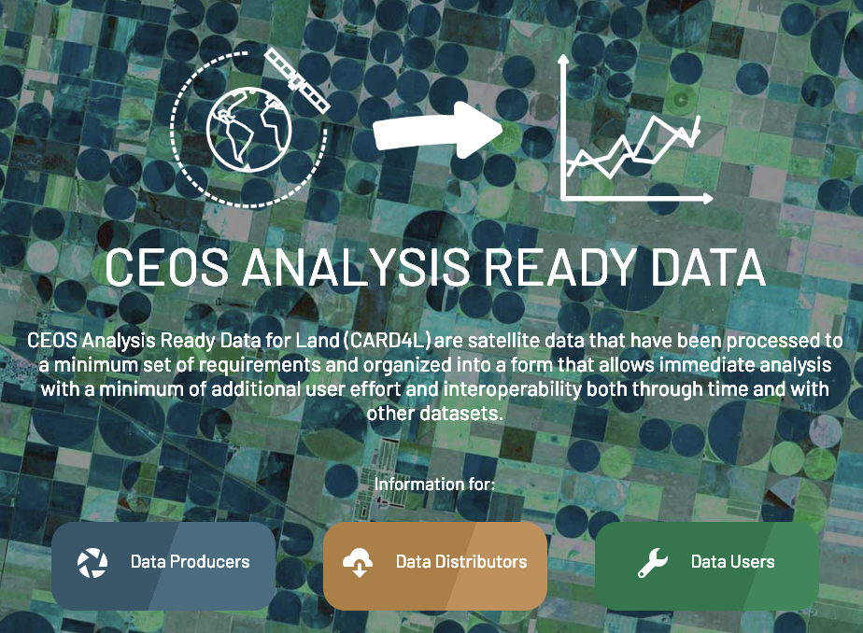
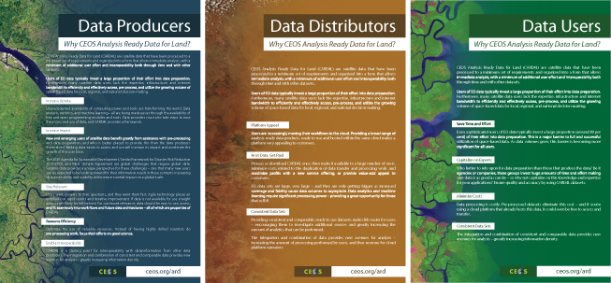
CARD4L
CEOS Analysis Ready Data for Land (CARD4L) are satellite data that have been processed to a minimum set of requirements and organized into a form that allows immediate analysis with a minimum of additional user effort and interoperability both through time and with other datasets.
CARD4L offers numerous benefits for data producers, data distributors, and data users.
Data Producers Increase Uptake Increase Impact Stay Relevant Increase Efficiency Enable Interoperability | Data Distributors Platform Appeal Consistent, High- Quality Data Sets | Data Users Save Time and Effort Capitalize on Experts Minimize Costs Consistent, High- Quality Data Sets
More info: http://ceos.org/ard/

Slide 3
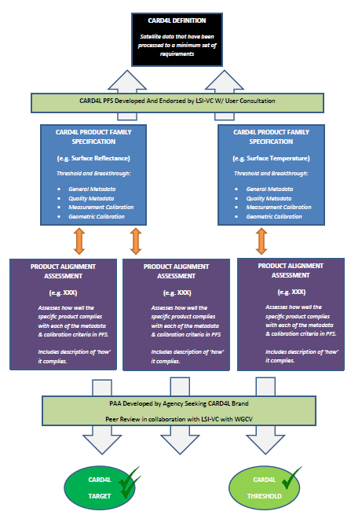
CARD4L Framework http://ceos.org/ard/
CARD4L Definition
Product Family Specifications (PFS)
Optical Surface Reflectance (CARD4L-OSR)
Surface Temperature (CARD4L-ST)
Normalized Radar Backscatter (CARD4L-NRB)
* Additional radar PFSs are under consideration
Providers self-assess how well their products meet the specifications
Providers submit self-assessment to CEOS WGCV for peer review
CARD4L-compliant stamp!

Slide 4
LSI-VC-8 / SDCG-16 / GEOGLAM Joint Meeting
4-6 September 2019
Anchorage, AK USA http://ceos.org/meetings/lsi-vc-8-geoglam-sdcg-16-joint-meeting/
3rd joint meeting of LSI-VC with CEOS forest (SDCG-GFOI) and agriculture (CEOS-GEOGLAM)
Continued progress on CARD4L
  USGS, JAXA, and ESA progressing CARD4L self-assessments. Expect these to begin WGCV peer review shortly.
  WGCV CARD4L peer review process presented at WGCV-45 was agreed. An initial pool of reviewers were also identified. WGCV is now in a position to peer review the CARD4L self-assessments when requested. Thanks to WGCV for their support!
  Discussed CARD4L promotion and pilots with thematic groups (SDCG-GFOI and CEOS-GEOGLAM)
  KARI joined for the first time. Assessing their products against CARD4L and producing some initial ARD based on CARD4L with sub-10m data from KOMPSAT (for use with Open Data Cube)
Initiated discussions around LSI-VC contributions to SIT Chair 2020-2021 CEOS ARD priorities
  CEOS-Industry ARD Workshop
  Connecting with WGCV and WGISS on various topics including CEOS Interoperability Terminology Report
Joint session with WGClimate with goal of rebooting LSI-VC requirements and gap analysis
  LSI-VC plans to undertake two actions from the WGClimate Coordinated Action Plan -> LST CDRs and continuity
  Discussed biomass measurements as a priority across CEOS (SDCG, GHG, etc.) -> CARD4Lidar concept
New LSI-VC Co-lead nomination

Slide 5
LSI-VC Co-Lead Nomination
During LSI-VC-8, Dr. Zoltan Szantoi (European Commission) was nominated to succeed Dr. Susanne Mecklenburg (ESA) as an LSI-VC Co-lead
Nomination consistent with LSI-VC’s goal to promote leadership diversity by sharing the three Co-lead responsibilities across major geographic regions
Nomination was unanimously approved at LSI-VC-8 meeting on 6 September
Nomination is contingent on final approval by the European Commission

Slide 6
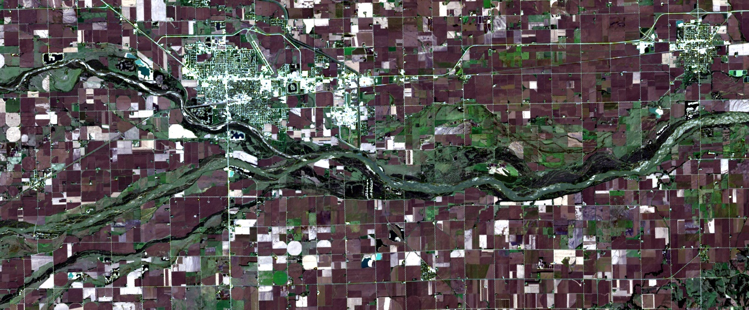
USGS Collection 2
Landsat 8 Level-2 Surface Reflectance
Path 29 / Row 31
October 8, 2016
True-color RGB (4/3/2)
LPGS v15.2.0 (7/22/2019)
LaSRC 1.4.1 (SR)
Single-Channel 1.3.0 (ST)

Slide 7
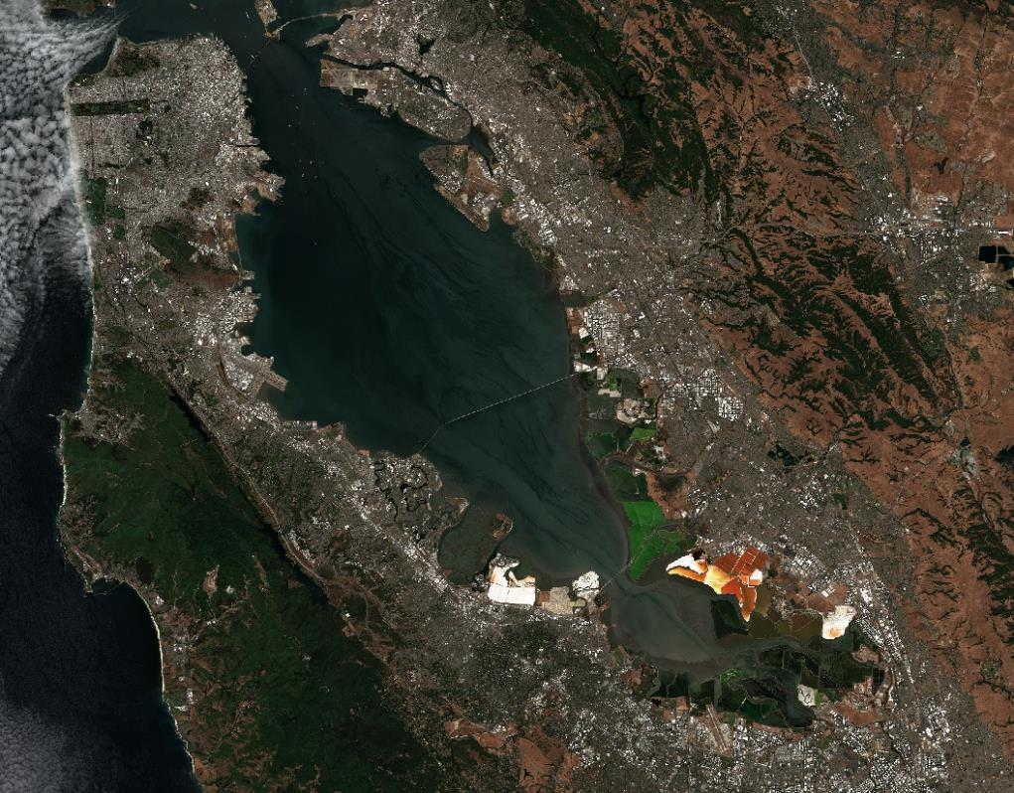
ESA Sentinel-2
Level-2A
Surface Reflectance

Slide 8
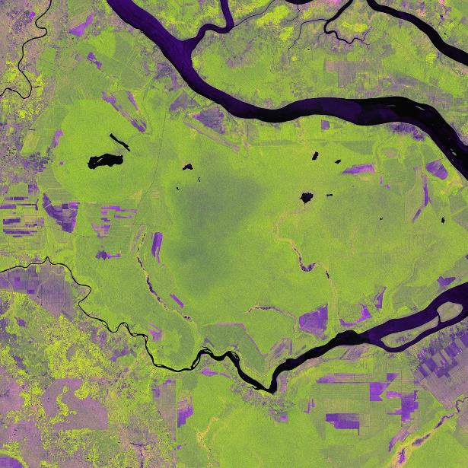
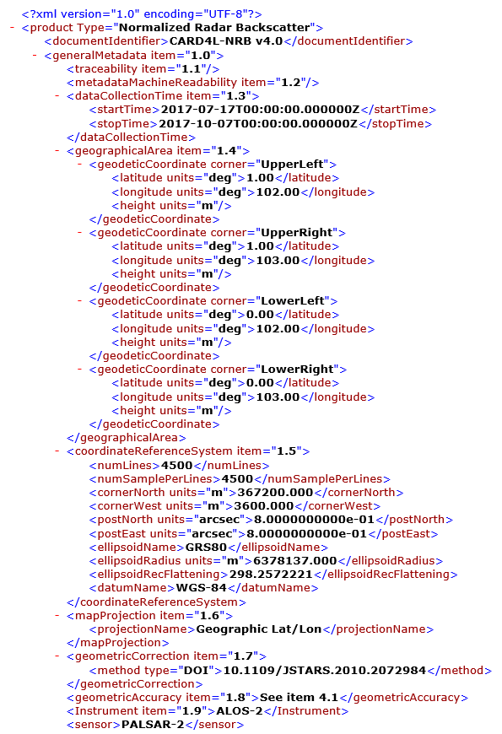
JAXA ALOS-2 PALSAR-2
Normalised Radar Backscatter

Slide 9
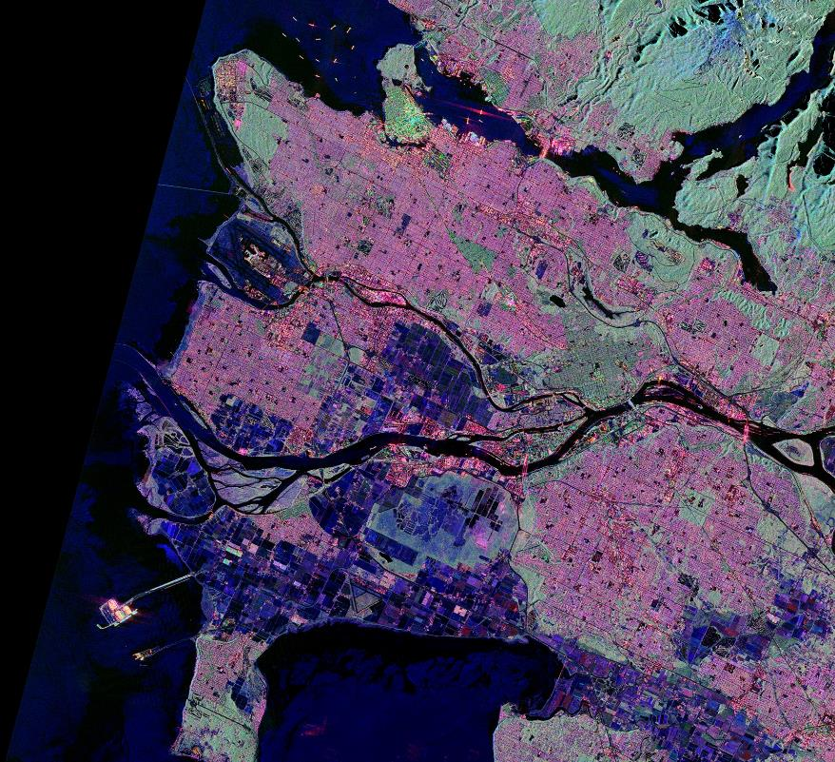
JAXA ALOS-2 PALSAR-2
Polarimetric Decomposition

Slide 10
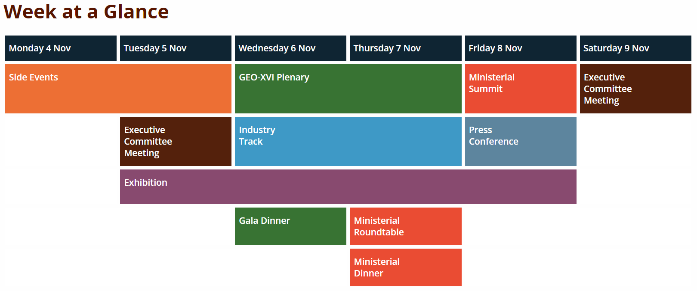

GEO Week 2019 http://www.earthobservations.org/geoweek19.php
Ministerial Summit / GEO-XVI Plenary / Industry Track / Exhibition / Side Events
4-9 November 2019
Canberra, Australia

Slide 11
2020 CEOS ARD Workshop
Details forthcoming…
We very much look forward to continued engagement and
collaboration with the entire EO community!
For further information, please contact:
Matt Steventon, Symbios, LSI-VC Secretariat, matthew@symbioscomms.com
Adam Lewis, GA, LSI-VC Co-Lead, Adam.Lewis@ga.gov.au
Steve Labahn, USGS, LSI-VC Co-Lead, labahn@usgs.gov

Slide 12

Questions?

Slide 13
Deliverables
Task | Title | Associated Actions
VC-31 | Evaluate CARD4L supply and user access trials via pilot activities (e.g., with SDCG for GFOI, GEOGLAM) | – SDCG led trial for GFOI utilising Digital Earth Africa – LSI/CEOS Agencies to trial production and supply of CARD4L (including to third party data hosts/analysis platforms) (USGS + others) – Investigation into COGs and STAC for CARD4L usability and discoverability and impact on PFS (USGS + others) – GEOGLAM/JECAM CARD4L Pilot
VC-33 | Complete Annual Update of the CARD4L Product Family Specifications (PFS) | – Andreia tracking updates necessary in next cycle – SAR Definition Team developing new SAR PFS
VC-37 | CEOS Information Tool Improvements | – Identify potential modifications to existing CEOS information tools that can be made to help improve their value for (LSI) gap analyses – Act as a beta tester for the MIM DB API – Provide requirements/need for a MIM API web UI for gap analyses – Develop initial version of a MIM web application (for custom timeline queries) (MIM team) – SEO to make specific changes to the COVE tool based on feedback from (1)
VC-39 | Formally define terms used in the context of the Moderate Resolution Interoperability (MRI) Initiative | – MRI terminology document COMPLETE – Steve/Ferran socializing with the rest of CEOS – Matt to post online version once approved
VC-40 | Complete Initial CARD4L Product Assessments | – ESA and USGS to trial SR and ST self-assessments COMPLETE – JAXA to trial NRB self-assessment – Andreia to coordinate WGCV peer review of self-assessments – ... – Approve the first official CARD4L datasets
VC-41 | Pursue CEOS ARD promotion | – Communication Package (information notes, current PFS, CARD4L website, introduction statement) COMPLETE – Zolti following up the EARSC and DIAS provider promotion angle (there was no space in the upcoming EARSC meeting, however, we will work with them on a later date) – LSI-VC to communicate actively with the commercial sector using the communication package and networks – Andreia to coordinate CARD4L representation at major conferences and meetings (and maintain calendar). All to contribute to opportunities. – Matt to promote CARD4L datasets via the CEOS ARD website stocktake page ON HOLD – Promote CARD4L datasets via WGISS systems – USGS to coordinate participation in the second Planet ARD workshop and try to influence agenda and target outcomes – Encourage other CEOS Agencies to adopt CARD4L PFS and start generating CARD4L products (preferably as standard mission products)
VC-42 | Open-source library for surface reflectance product generation | – Define the library, what it will include, where it is to be hosted, and what contributions are needed to complete it – ESA is in the process of making Sen2Cor open source – ESA awarding contract to develop Sen2Like – first version expected by end-2019 – ESA will promote VC-42 at the Planet workshop in August

Slide 14
Definitions
In the context of Earth remote sensing, the terms Analysis Ready Data (ARD), interoperability, and harmonisation are often used and, to a large extent, used inconsistently
As it relates to Earth observation products, interoperability represents a continuum of potential compatibility for products to work in numerous information technology systems and with other like-prepared data products
  Ultimate product interoperability (i.e., a fully harmonised dataset) is achieved when products have a fully consistent spectral, radiometric, geometric, metadata, and file format implementation where applications can interact fully with the data interchangeably, automatically, and without modification
Specifically, 5 terms have been defined:
  Analysis Ready Data (ARD)
  CEOS ARD for Land (CARD4L) Products
  Interoperable Products
  Harmonised Products
  Fused Products

