Slide 1
GEO Preparations
Steven Hosford, ESA/CNES, CEOS Executive Officer
CEOS 2019 SIT Technical Workshop
Agenda Item # 7.4 & 7.5
Fairbanks, Alaska, USA
11 – 12 September 2019

Slide 2
Summary
GEO Plenary preparations
Changes to CEOS representation to GEO

Slide 3
GEO Plenary Preparations
CEOS delegation submitted in June and update for the last time on 23/08
CEOS Delegation consists of
Head of Delegation: Rajeev Jaiswal, CEOS Chair team
Alternate Head of Delegation: Adam Lewis, CEOS SIT Chair
Delegate: Alex Held, CEOS SIT Chair
Delegate: Brian Killough, CEOS SEO
Delegate: David Green, CEOS WG Disasters Chair
A CEOS booth will be arranged by SEO.

Slide 4
Current CEOS reps to GEO
CEOS currently participates in
GEO Programme Board:
CEOS Rep: SIT Chair (Kerry Sawyer)
CEOS Alternate: CEOS Executive Officer (Steven Hosford)
Participating Organisation Observer to GEO ExCOM
CEOS Rep: SIT Vice Chair (Alex Held)

Slide 5
Proposal on CEOS reps to GEO (after 33rd Plenary)
For GEO Programme Board:
CEOS Rep: SIT Chair (Andreia Siquiera)
CEOS Alternate: SIT Chair (CSIRO TBD)
CEOS Alternate: Open to nominations until 24th September
For one of 3 observer positions to GEO ExCOM from Programme Board POs
Self-nominate to continue as a PO observer to GEO ExCOM
Encourage other POs to fill the observer role
Participate in PB discussion

Slide 6
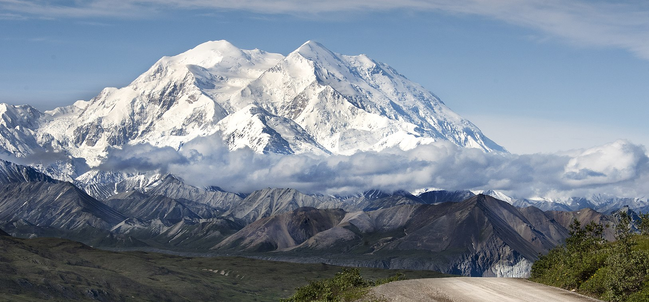
Questions?

