Slide 1
Session 2 Discussion
Committee on Earth Observation Satellites
CEOS 2019 SIT Technical Workshop
Session 2, Agenda Item 2.7
Fairbanks, Alaska, USA
11 – 12 September 2019

Slide 2
Essential “X” Variables
ECVs – Essential Climate Variables
EOVs – Essential Ocean Variables
EWVs – Essential Water Variables
EBVs – Essential Biodiversity Variables
Essential Ecosystem Services Variables
EAVs – Essential Agricultural Variables
“…to address data requirements including ARD and ARD+”
EMVs – Essential Mountain Variables
EUVs – Essential Urban Variables
RE-EVs – Renewable Energy Essential Variables
EVs for Managing Mineral and Non-Renewable Energy Resources
ESDGVs – Essential SDG Variables
GEO Essential Variables Initiative
“Concept of “essential variables” (EVs) is increasingly used in Earth observation communities to identify those variables that have a high impact, high feasibility and relative low cost of implementation.”

Slide 3
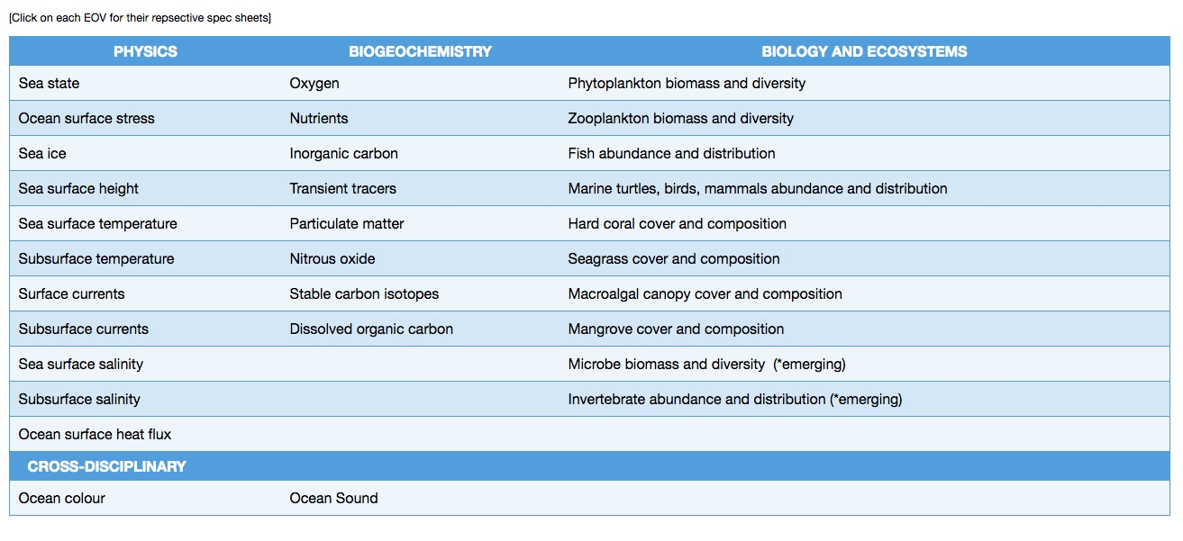
EOVs (and ECVs)
CEOS VCs and satellite Science Teams
goosocean.org/eov
other EOVs that use satellite observations, for direct measure or inference

