Slide 1
Working Group Climate
Jörg Schulz, EUMETSAT, WGClimate Chair
Albrecht von Bargen, DLR, WGClimate Vice-Chair
CEOS 2019 SIT Technical Workshop
Session 4, Agenda Item 4.1
Fairbanks, Alaska, USA
11 – 12 September 2019

Slide 2
Achievements since SIT - 34
CGMS-47, Sochi, Russia:
Achieved formal endorsement for WGClimate leadership change;
Achieved formal endorsement of the greenhouse gas monitoring constellation white paper;
Achieved formal endorsement of WGClimate GHG Task Team and updated TOR;
Closed all open actions on CGMS side. Reminded CGMS agencies to participate in WGClimate;
Aligned and synchronised CGMS HLPP with CEOS work plan;
Achieved formal endorsement of the Resolution on Progress on Implementation of the Architecture for Climate Monitoring from Space at WMO Congress-18;
Finalised and delivered the space agency statement to SBSTA-50, Bonn, Germany;
Participated in dialogue on Systematic Observations with the SBSTA chair that also included IPCC, WMO and WCRP (outcomes still to be delivered by the UNFCCC Secretariat);
Worked hard on population and verification of ECV Inventory #3, launched gap analysis but are behind schedule…
Published an article on WGClimate in the CEOS newsletter.
Notes:
Noting the significant progress that has been made in observing the Earth globally and synoptically with higher temporal, spectral and spatial resolutions, which before the advent of satellites was all but impossible,
Noting also the essential nature of combining space-based observations for climate monitoring with ground-based observations in an integrated observing system,
Convinced of the pivotal role of satellite data to contribute to scientifically sound, evidence-based policy- and decision-making for sustainable development,
Noting that space-based observations will be vital for the successful implementation of the Paris Agreement,
Having assessed progress made on the implementation of the Architecture for Climate Monitoring from Space (hereafter/thereafter referred to as “Architecture”) as provided in the Annex to the present resolution,
Taking note that the Architecture provides an overall framework for assuring that the space-based component of the WMO Integrated Global Observing System will provide vital observations and products for climate monitoring in line with user requirements,
Noting further that the Architecture has been reviewed by GCOS, CEOS, CGMS and by the Joint CEOS/CGMS Working Group on Climate,
Appreciates the progress made with the implementation of the Architecture and confirms its importance,
Considers favourably the significant contributions made by CEOS and CGMS satellite operators in the implementation of the Architecture,
Endorses the approach taken for the implementation of the Architecture;
Requests the Secretary-General to take appropriate action through the WMO Space Programme and in partnership with WMO Members for the further implementation of the Architecture including through its effective integration in the development of the Global Framework for Climate Services;
Urges CEOS and CGMS satellite operators to maintain their efforts towards full implementation of the space-based climate observing system component in accordance with the Vision for WIGOS in 2040.

Slide 3
Case Studies for the Climate Architecture
Addressed CMRS-13: Development and Promotion of Case Studies;
Based on earlier 13 case studies published in 2015, WGClimate is developing a new much bigger set of case studies promoting the use of CDRs in applications supporting policy and decision making;
WMO has agreed to lead a report with a target publication date in the second half of 2020;
WMO GFCS and GCOS (being cosponsors of the first report) send supportive messages but won’t engage due to lack of resources;
Several agencies have provided use case headlines (>20) ranging from scientific to service type applications using CDRs;
It is common understanding that use cases shall provide information suitable for the WGClimate web presence which is under redevelopment;
Not all case studies will be ready for the 2020 report, but will become available via the web.

Slide 4
ECV Inventory and Gap Analysis
http://climatemonitoring.info/ecvinventory
Successful round of inputs:
Inputs on previous gaps in ECVs: above-ground biomass, sea-surface salinity, lightning (previous gaps), and permafrost (new ECV);
Significant amount of newly planned CDRs from ESA CCI+ and EC-Copernicus Climate Change Service;
New / stronger contributors: KMA / JAXA and JMA;
Worked with ~200 responders (64 + 6 replacements newly registered).
Total number of data records worked on |  | Available data records for gap analysis
1396 records | 976* inherited (#2) | 943 | 649 existing | 1300 records
 |  |  | 294 planned
 | 420 new (#3) | 357 | 172 existing
 |  |  | 185 planned
*(913 published + 63 non finished/verified from Cycle #2)

Slide 5
ECV Inventory and Gap Analysis
ECV Inventory contains:
72% CDRs
28% ICDRs
CDR length:
27% < 10 years
73% >= 10 years
33% >= 20 years
18% >= 30 years
Maximum length possible: ~50 years.

Slide 6
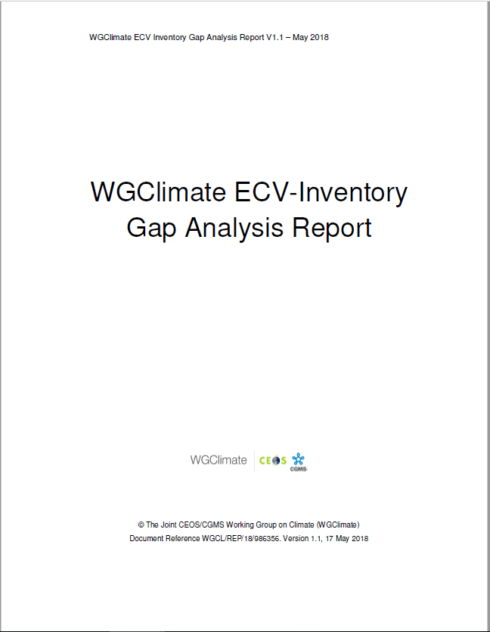
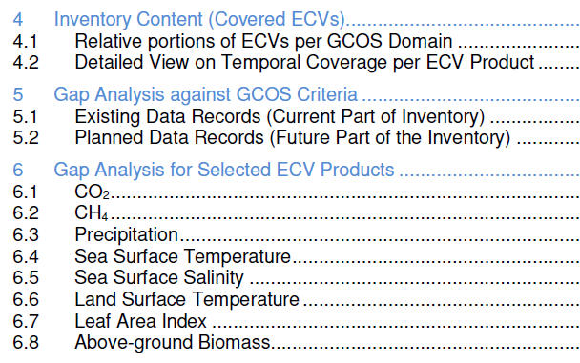
ECV Inventory and Gap Analysis
Automatic assessment
Statistical analysis tools and graphical display
Statistical analysis tools and graphical display on the web interface ;
Analysis of delta to version #2;
Detailed analysis per ECV / ECV Product:
Assesses progress for 8 ECVs addressed last year;
Selected 13 additional ECVs (5 atmosphere, 5 land, 3 ocean) not addressed before that are specifically part of 2016 GCOS-IP actions;
Postponed 2 land (FAPAR, Glaciers) and may need to postpone 2 atmosphere (surface wind, lightning) due to missing support.
Notes:
Revisit set of ECVs / ECV Products targeted by the previous gap analysis (CO2, CH4, Precipitation, Land Surface Temperature, Leaf Area Index, Above-Ground Biomass, Sea Surface Temperature, Sea Surface Salinity) and assess evolution, cross-referencing with the Recommendations and Actions

Slide 7
Schedule for Gap Analysis and Coordinated Action Plan
November
Q3.2019
Q4.2019
December
January
Q2.2019
February
March
Preparation (piecewise continuous)
Data collection and Verification (continuous)
Analysis and Reporting (annually)
Update of web interface (Responders, Admin, GA Experts), development of new tools (all users, statistical outputs, reporting)
Registration of new Responders and population of the database: update of pre-existing entries (contacts, URLs, deletion of obsolete/redundant content – e.g. new approach to ICDR-like data records, conversion planned > existing) + input of new entries
2019 Gap Analysis
2019 GA Report and Coordinated Action Plan
Verification of submitted contents for completeness and consistency, in preparation for publication and Gap Analysis
Will present the gap analysis report and updated coordinated action plan at 2019 CEOS Plenary but ask CEOS/CGMS Plenaries for virtual endorsement in Q4/2019 after extensive review of documents by agencies.
1st deadline for the cut-off of data collection for v3.0
Final cut-off date of data collection for v3.0
Intermediate results at the CGMS Plenary
Publication of ECV Inventory v3.0
Submission of Reports to CEOS Plenary
WGClimate #10

Slide 8
Needed support for ECV Inventory and Gap Analysis
Observed decline in support to population, verification and gap analysis for ECV Inventory #3 within CEOS/CGMS agencies and bodies;
Estimated support to the ECV Inventory work is ~ 6.5 PY per annum assuming 220 working days:
~2.0 PY, EUMETSAT support;
~0.5 PY, WGClimate members coordinating individual agency contributions;
~3.5 PY, ~150 responders in agencies populating and verifying the ECV Inventory (5 working days is assumed for each responder);
~0.7 PY, ~30 individuals supporting the gap analysis (two stages (i) closeness of processes to GCOS guidelines, ii) analysis of individual GCOS ECVs including future need for measurements and missed opportunities) (5 working days is assumed for each person);
It is of high importance that the inventory only contains verified information on which we base recommendations and actions;
Agencies are asked to continue/enhance their support to the ECV Inventory related work and to award full appreciation to engaged contributors within their agencies.

Slide 9
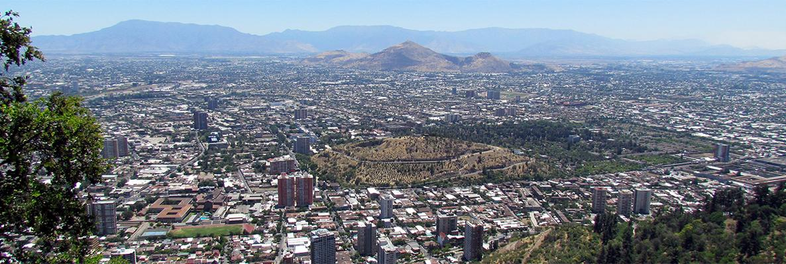
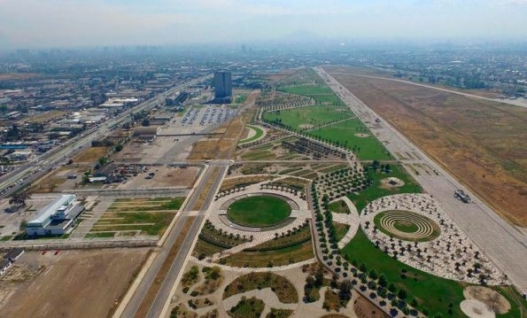
COP-25/SBSTA-51
The Santiago Climate Change Conference will take place in Parque Bicentenario Cerrillos in Santiago de Chile, Chile from 2 to 13 December;
COP 25 will take place from 2-13 December 2019;
SBSTA 51 will take place 2-9 December 2019.

Slide 10
COP-25/SBSTA-51 Space Agency Statement
Joint statement from CEOS/CGMS;
Statement needs to be delivered to UNFCCC Secretariat one week ahead of SBSTA-51, i.e., 22 November 2019. It is read out on day-1 of SBSTA-51 (1-2 minutes) if not cancelled;
Content is space agency contributions relevant to the UNFCCC:
Systematic observations of the Earths’s Climate System – Implementation of the Architecture;
Progress on implementation of the GHG constellation architecture and potential usage of outputs;
IPCC guidelines on use of satellite data for GHG Inventories;
Forest monitoring and Above Ground Biomass missions;
Evolution of CEOS carbon strategy;
WGClimate Chair will draft statement and coordinate with involved entities;
Statement will be presented for endorsement at 2019 CEOS Plenary;
Statement will be delivered by India (Party to the Convention of incoming CEOS Chair ISRO) or WGClimate Chair via observing organisation EUMETSAT.

Slide 11
COP-25/SBSTA-51 Earth Information Day
SBSTA-50 agreed to perform an Earth Information day for which UNFCCC send broad outline:
Update state of the global climate (WMO);
Global Earth Information: Observation of ECVs (atmosphere, land, ocean, biosphere) and data platforms to support mitigation and adaptation by Parties (GCOS, CEOS/CGMS, IOC…);
Regional/national Earth Information: Regional/national examples developments and opportunities to support decision making on risk assessment, adaptation and mitigation.
Individual contributions will be discussed with UNFCCC Secretariat early November;
Event allows to present information to Parties for their subsequent consideration during negotiations, so we can focus on clear messaging, e.g., how to use GHG products for improvement/verification of emission inventories;
Will contribute to an information note for the event on behalf of the SBSTA chair (summary on latest relevant activities as in space agency statement;
Work with UNFCCC on input to RSO conclusion emphasizing CEOS/CGMS progress on implementing the Architecture for Climate Monitoring from Space, the development of the constellation architecture for GHG, and the use of the information for actions of the Parties.

Slide 12
Interactions within CEOS
GHG Task Team enables full interactions with WGCV and AC/VC;
Work with WGISS on:
Metadata alignment for IDN registration of ECV data records;
WGISS Carbon Portal and how to use and further evolve it;
May work together on analysing automation potential for ECV Inventory population;
Joint meeting with LSI VC discussing implementation of Coordinated Actions on Climate;
Work plan 2020-2022:
Propose to add standing action for all VCs to support annual gap analysis process of WGClimate;
Propose to add actions to VCs on coordinated climate actions currently uncovered. We will discuss with each VC what is feasible and affordable to put into the work plan;
See potential for work with WCapD on case studies promoting use of CDRs following a similar approach as used in CGMS.

Slide 13
WGClimate Leadership
Until November 2020
Chair: Jörg Schulz (EUMETSAT)
Vice Chair: Albrecht von Bargen (DLR)
November 2020 – November 2022
Chair: Albrecht von Bargen
Vice Chair: asking for proposals by Agencies
In the alternating chair position the next term is for CGMS. Nevertheless we will issue a call for nomination to both CEOS and CGMS after CEOS Plenary.

Slide 14
Questions?

