Slide 1
Working Group on Information Systems and Services (WGISS)
Committee on Earth Observation Satellites
Mirko Albani, ESA, WGISS Chair
CEOS 2019 SIT Technical Workshop
Session 4: Reports from Working Groups Agenda Item #4.4
Fairbanks, Alaska, USA
11 – 12 September 2019

Slide 2
WGISS Structure
WGISS
Chair, Mirko Albani, ESA
Vice-Chair, Robert Woodcock, CSIRO
WGISS Principals
CAS/AOE: Guangyu Liu
CAS/RADI: Lizhe Wang
CSA: Paul Briand
CNES: Richard Moreno
CONAE: Homero Lozza
CSIRO: Robert Woodcock
DLR: Katrin Molch
EC: Astrid Koch
ESA: Mirko Albani
EUMETSAT: Michael Schick
GA: Simon Oliver
HSO: Gabor Remetey
INPE: Lubia Vinhas
ISRO: Nitant Dube
JAXA: Yousuke Ikehata
NASA: Andrew Mitchell
NOAA: Kenneth Casey
NRSCC: Chuang Liu
ROSCOSMOS: Tamara Ganina
USGS: Kristi Kline
UKSA: Esther Conway
WGISS Secretariat
(Michelle Piepgrass)
Data Preservation and Stewardship Interest Group
(Mirko Albani, ESA)
Discovery and Access - WGISS Connected Data Assets System Level Team (Yonsook Enloe, NASA)
- IDN (Michael Morahan, NASA)
- FedEO (Mirko Albani (ESA)
- CWIC (Yonsook Enloe, NASA)
- OpenSearch II (Olivier Barois, ESA)
Interoperability and Use Interest Group
(Robert Woodcock, CSIRO; Richard Moreno, CNES)
- Future Data Architectures (Robert Woodcock, CSIRO)
- Carbon Portal (Kenneth Casey, NOAA; Liping Di, NOAA)
- Data Analytics Software and Tools (Mirko Albani, ESA)
Technology Exploration Interest Group
(Chris Lynnes, NASA; Yousuke Ikehata, JAXA)

Slide 3
Outline
Data Preservation and Stewardship
Data Discovery and Access
Interoperability and Use (including FDA)
Technology Exploration
Cooperation within and outside CEOS
CEOS 2019 – 2021 Work Plan Action Items

Slide 4
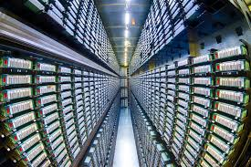
Data Preservation and Stewardship
WGISS accomplishes its Data Preservation and Curation efforts through the Data Stewardship Interest Group (DSIG)

Slide 5
Data Stewardship Best Practices Document Tree
EO Data Stewardship Cooperative Framework
Policy Documents
CEOS Agencies EO Space Data Sets
Applied to
Recommended for
application
Data Purge Alert Procedure & White Paper
Recommended / Reference
Individual organizations' policies (stewardship, access, ...)
Recommended /
Reference
Technical Documents
Reference Model for Data Stewardship
Glossary of Acronyms and Terms
General guidelines and best practices
Input to GEO Data
Management Principles
Support
Preservation Workflow
EO Data Preservation Guidelines
Preserved Data
Set Content
Associated Knowledge Preservation
WGISS Maturity Matrix
Persistent Identifiers Best Practice
Guidelines and best practices on specific topics
Technical implementation procedures
EO Data Set Consolidation Process
…
Image Source: http://eastenders.wikia.com/wiki/File:Under-construction.png

Slide 6
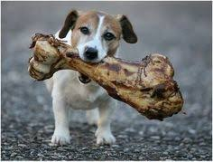
Discovery & Access
WGISS accomplishes its Data Discovery and Access efforts through the WGISS Connected Data Assets System Level Team (SLT)

Slide 7
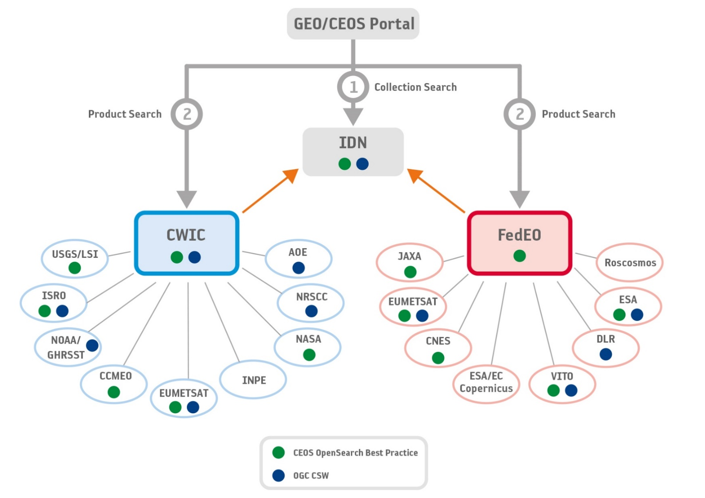
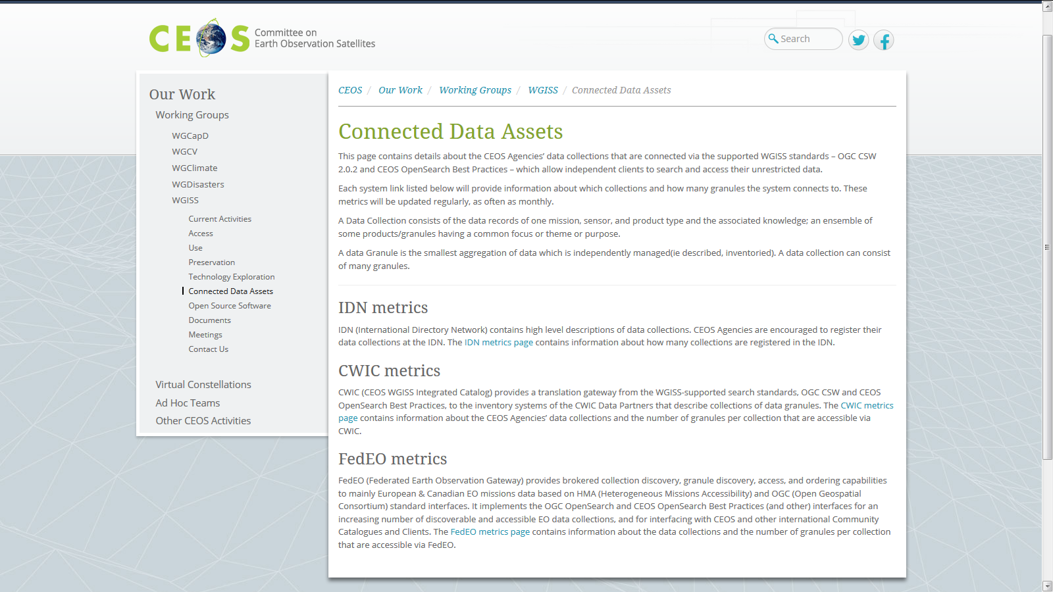
WGISS Connected Data Assets (CDA)
Relying on IDN/CWIC/FedEO components, provides a single entry point for external clients to discover and access CEOS agencies data
Search over 33,000 collections in IDN & Access over 5,000 collections with associated over 300+ million granules (granule search)
Harmonized CEOS Branding
CEOS Service
DATA-2: Full representation and accessibility of CEOS Agency datasets through WGISS Standards and Connected Data Assets Infrastructure (i.e. IDN, CWIC, FEDEO). Q2 every year

Slide 8
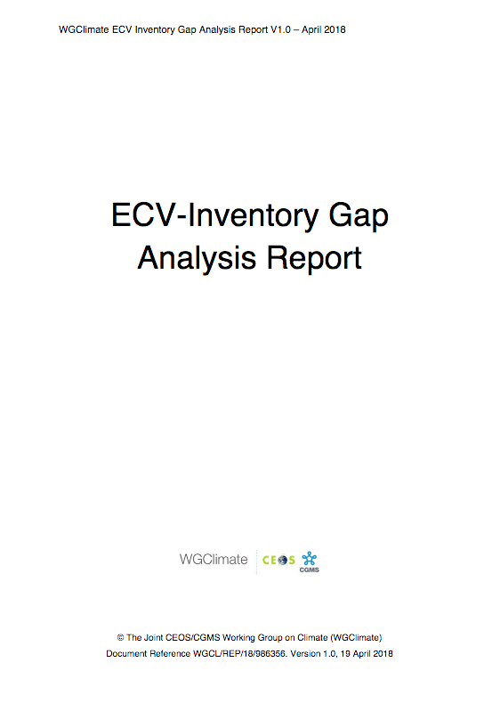
ECVs/CDRs Discovery and Access through WGISS CDA
ECV Inventory V2 describes 913 CDRs (496 existing, 417 planned): about 200 existing CDRs not registered in IDN (not accessible through WGISS CDA);
→ 1st batch being registered by WGISS SLT
→ 2nd batch addressed during ECV inventory update
ECV Inventory V3, under finalization by WGClimate, contains all information needed for CDRs registration in IDN:
→ Information formatting/vocabulary being refined with WGClimate
→ FedEO (WGISS CDA) will harvest ECV V3 metadata, encode selected fields in DIF-10 format and import in IDN for discovery/access at collection level
→ ECV inventory update automation under analysis
DATA-9: ECVs/CDRs Discovery and Access through WGISS Systems. Q4 2019

Slide 9
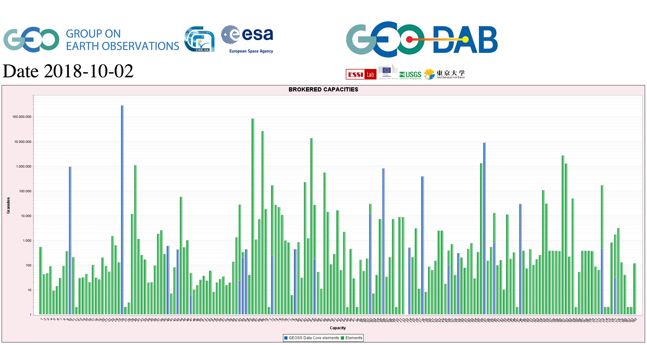
CEOS data in GEOSS
GEOSS PLATFORM DISCOVERABLE DATA PRODUCTS
CWIC
FedEO
DATA-16: CEOS data holdings reported and accessible in GEO and other international relevant contexts. Q4 2019

Slide 10
Support from data providers
Please register your
data in the CEOS IDN

Slide 11
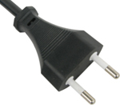
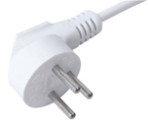
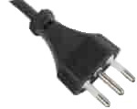
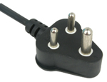
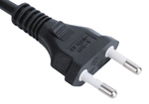
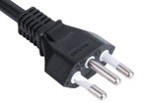
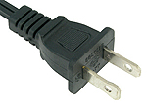
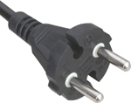
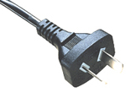
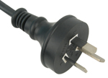
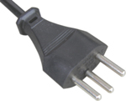
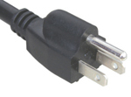
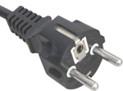
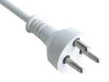
Interoperability and Use (including Future Data Architectures)
WGISS accomplishes its interoperability and data use efforts through the Interoperability Interest Group.

Slide 12
FDA activities in WGISS
Proceeding along several lines
Making FDA services/tools/elements discoverable through WGISS CDA (FDA-9, FDA-10, FDA-14), and agency services catalogue harvesting/registration
Pursuing interoperability between FDA elements through a manageable number of possibly standardized interfaces (FDA-8)
Data Cubes interoperability (ODC / HMDC / DCFS)
Follow-up standardization activities in OGC
Showcase FDA Elements and how they can support CEOS/GEO Initiatives:
Data Cubes for WGCV – two versions, ESA and ODC DEA
GEOhazards TEP in support to WGDisasters
etc
Outreach and awareness raising on FDA in cooperation with WGCapD

Slide 13
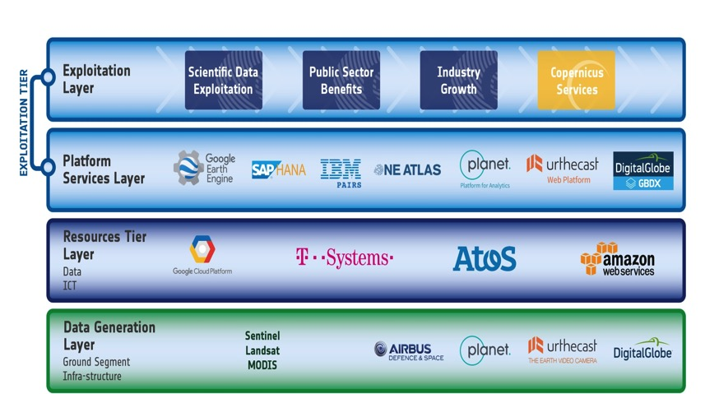
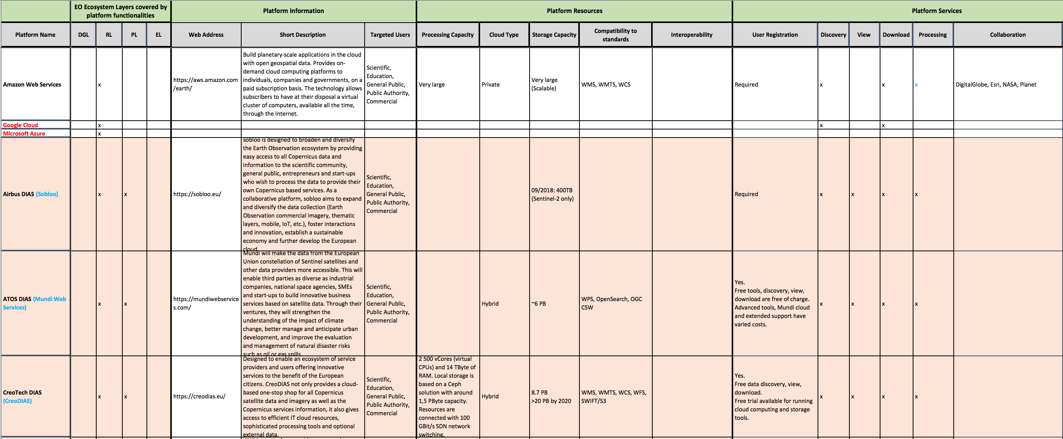
Future Data Architectures (FDA)
FDA-8: Establish a common description of Future Data Architectures functional blocks and identify interfaces and interoperability approaches. Q3 2019
FDA-9: Inventory and characterize existing FDAs operated by both public and private entities. Q4 2019
Closed
FDA Elements inventory V1 finalized and circulated in WGISS; it will be maintained up to date and used as input for further FDA related activities in WGISS (e.g. action FDA-14).
First draft of common description and building blocks document under finalization

Slide 14
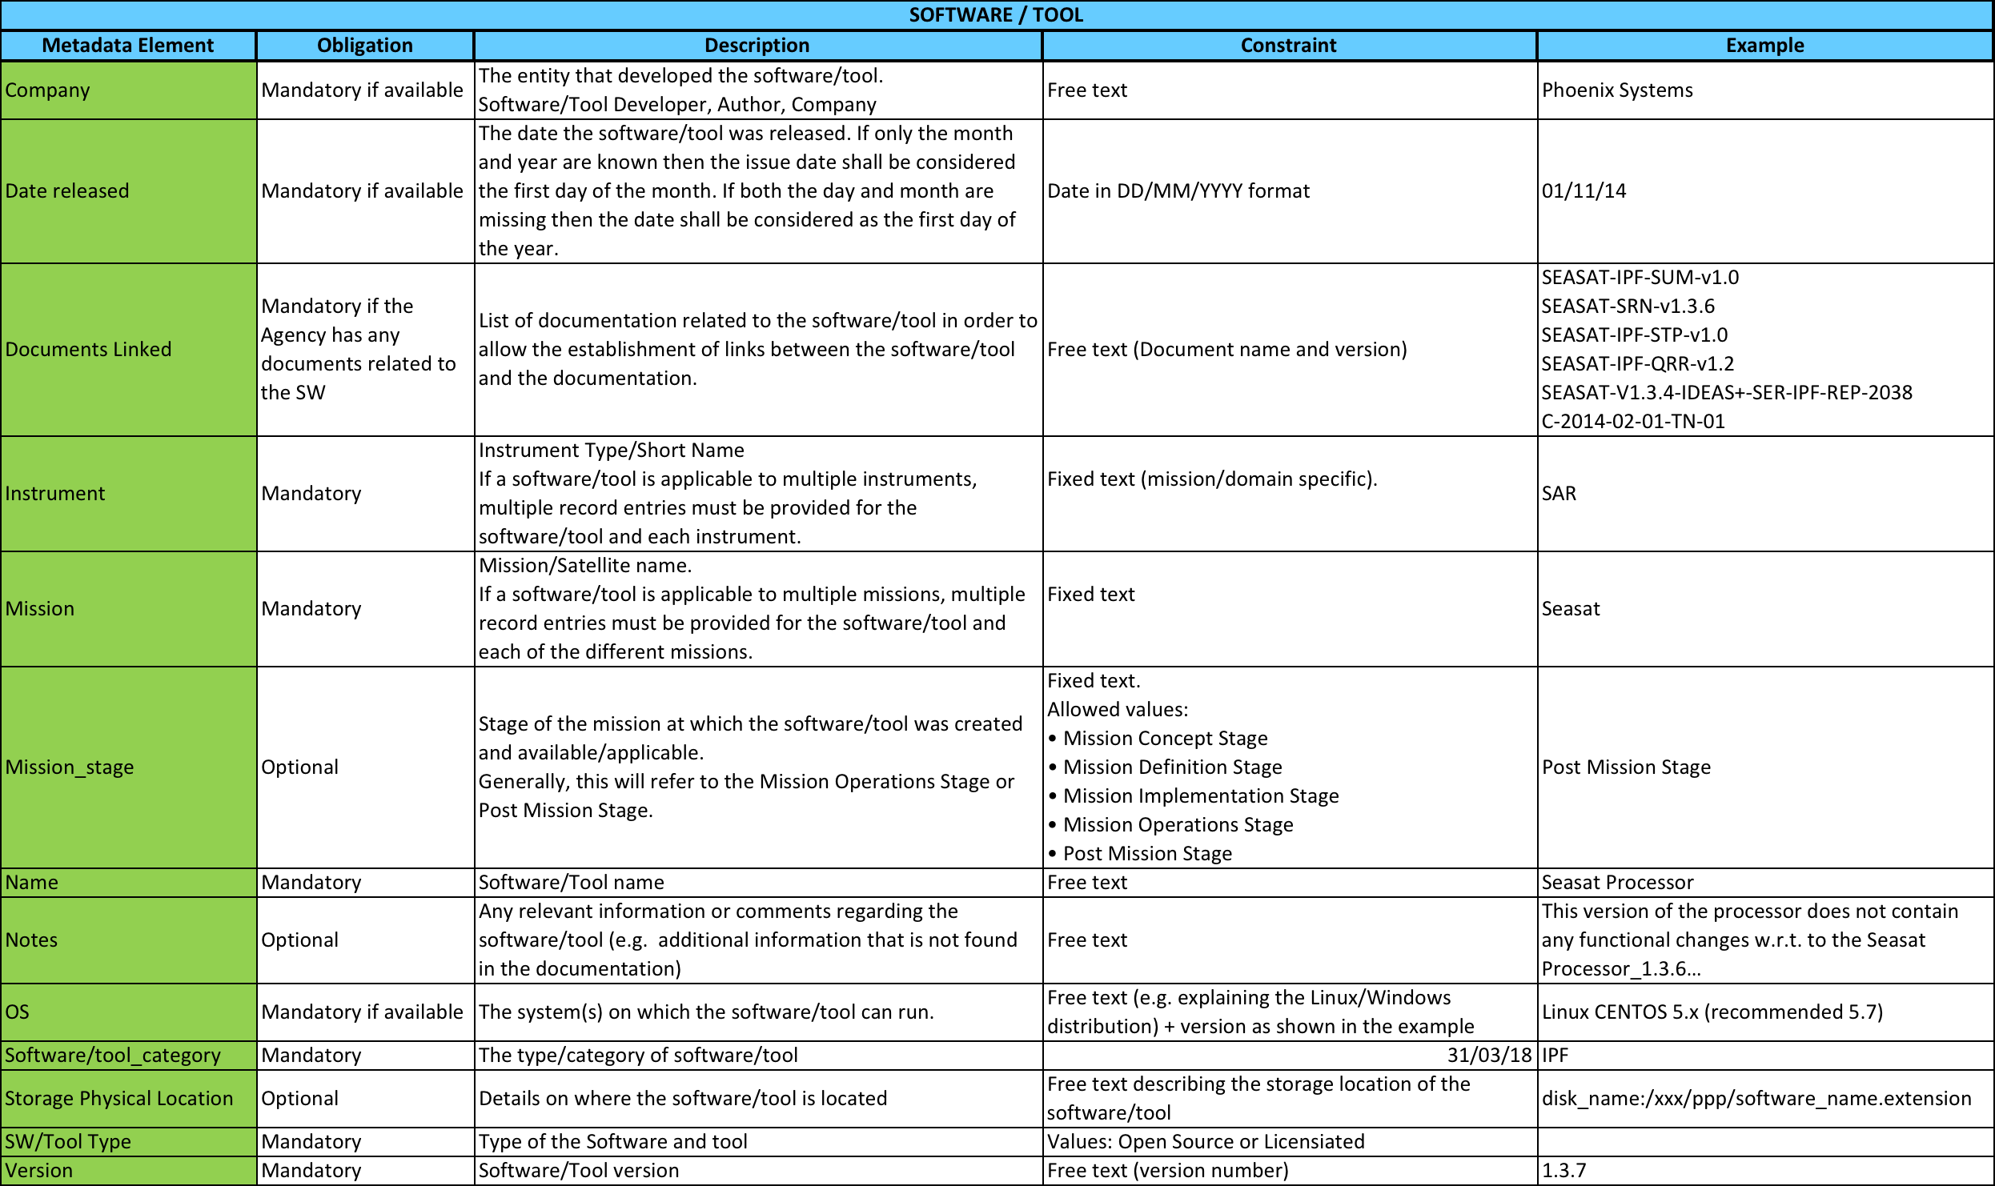
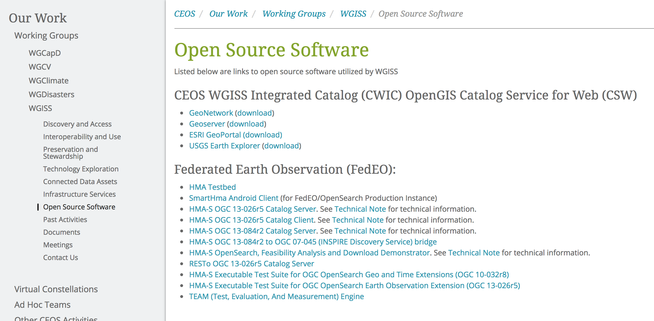
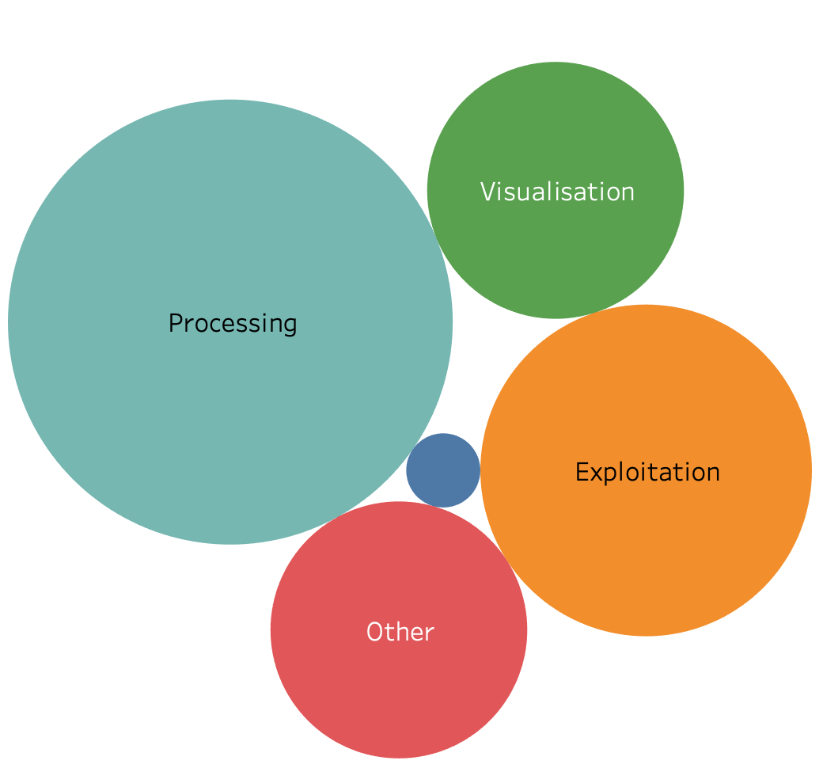
SW Tools and Services Discovery and Access through WGISS CDA
Finalized inventory of Open Source SW and Tools (V1) available at CEOS agencies;
Discovery/access through web page in WGISS web-site being implemented in cooperation with SEO team.
FDA-10: Finalize inventory of CEOS agencies (Open Source) Software and Tools and implement a mechanism for discovery and access. Q3 2019
Discovery/access of FDA elements available at CEOS agencies through:
Step 1: web page on WGISS web-site by Q4 2019
Step 2: WGISS Connected Data Assets (linked to CEOS Agencies data) by Q4 2020
FDA-14: Facilitate discovery and access for end users to data analytics and processing tools and services through WGISS Connected Data Assets Infrastructure. Q4 2020

Slide 15
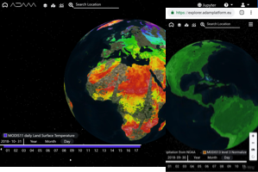
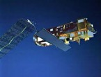
ACIX/RadCalNet Inter-Comparison Exercise
Web based GUI
Jupyter Notebook
Data Preparation: in-situ and EO Level 2 data are indexed and registered in the data cube, preserving both radiometric and geometric properties
Data Access: DAS shall offer access to both EO and In-situ data via unified interface (i.e. WCS)
Data Processing: Jupyter allows the users to perform inter-comparison scripts, sharing the code with authorise users, and accessing always the same data via WCS server.
PROs
Centralised data repository, replacing scattered ftp servers
Harmonised and standardised online data access interface, permitting data download
Reproducibility of inter-comparison exercises (via Jupyter notebook), restricted to authorised users
Easy sharing of algorithms and results
DAS
OGC WCS Server
Landsat-8/Sentinel-2
Data
In-Situ: ACIX and
RadCalNet

Slide 16
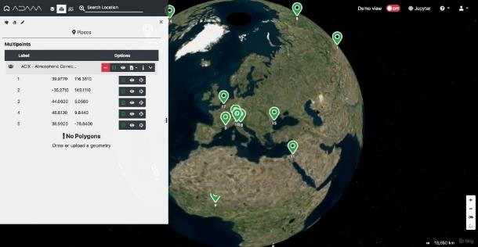
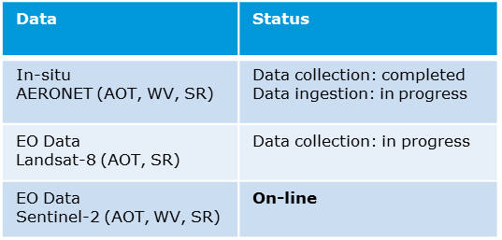
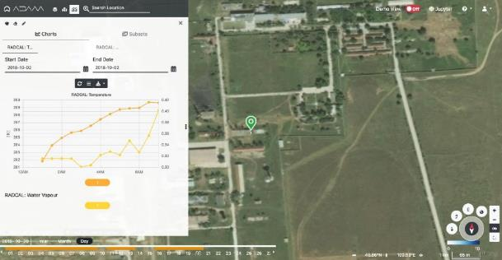
Data Cubes for WGCV
ESA PDGS Data Cube - https://preops.eodatacube.eu/
Use cases defined and implemented in cooperation between WGISS and WGCV
Provides Discovery/Visualization/Pixel Access to Radiometric Calibration Network (RadCalNet) In-Situ data and Atmospheric Correction Inter-Comparison Exercise (ACIX) (In-situ and S-2/L-8) data.
Provides Jupyter notebooks to reproduce ACIX use cases: http://calvalportal.ceos.org/results
Web based GUI
Jupyter Notebook
Pre-configured list of sites
Data Discovery
DAS
OGC WCS Server
Direct access to the selected site
In-situ Data Visualization and pixel access;
Landsat-8/Sentinel-2
Data
In-Situ: ACIX and
RadCalNet
Notes:
Atmospheric Correction Inter-Comparison Exercise (ACIX)
ACIX II-land: 115 sites selected, one-year measurements with 7000 images acquired by Sentinel-2A, -2B and Landsat-8;
ACIX-Aqua exercise: Phase I, compare processors over coastal waters and Phase II, processors over inland waters
Radiometric Calibration Network (RadCalNet) Support post-launch TOA radiometric calibration and validation of optical EO data

Slide 17
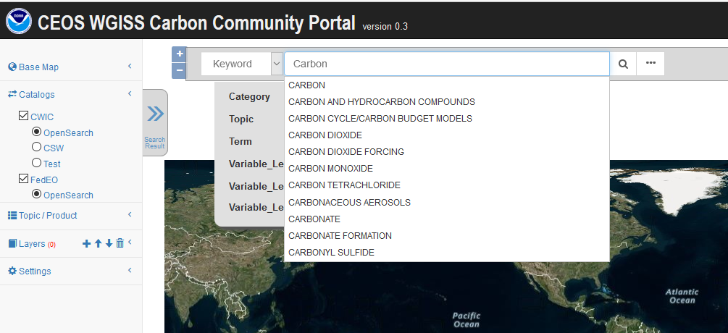
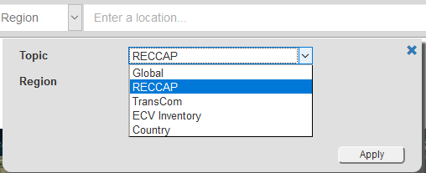
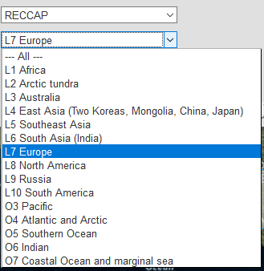
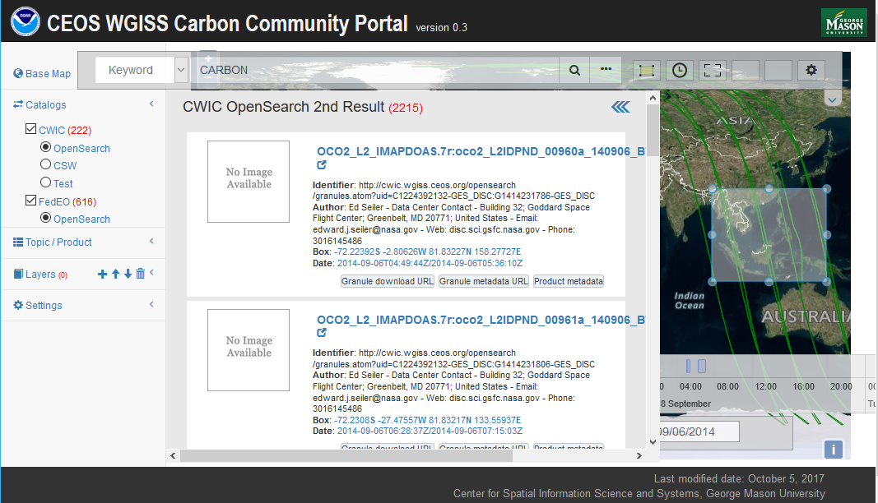
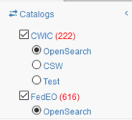
WGISS Carbon Community Portal
Led by NOAA and GMU
Search: Special Regions, Temporal, Pre-defined Carbon topics/datasets, Keywords
Returns records from both CWIC and FedEO
Issued in Q2 2019 and available on-line for users. Next release at WGISS-48.
https://gis.csiss.gmu.edu/carbon/cwicport
Closed
CARB-15: Carbon Data Portal prototype. Q2 2019
Discussions ongoing with CEOS Chair Team to evaluate possible use in support to Chair Initiative in the Mekong area, and with WGClimate for possible use in the next phase of CEOS Carbon Strategy
Notes:
The goal of the CEOS WGISS Carbon Science Community Portal (called the Carbon Portal, or simply the Portal hereafter) is to support Carbon Science Mission in CEOS and other communities/organizations and demonstrate the usage of CEOS WGISS Connected Assets by providing easy discovery of and access to carbon-related data resources in CEOS member agencies.
Search in Special Regions: Global, RECCAP, TransCom, Country Names, ECV Inventory)
Temporal Searches: support for time range and specific date
Pre-defined Carbon topics/datasets: (Atmospheric, Ecosystem, Ocean, Mixed-Theme)
Keywords (auto-completion with IDN Science Keywords)
Return records from both CWIC and FedEO

Slide 18
Technology Exploration
The Technology Exploration interest group serves as a forum for exchange of technical information and lessons-learned experience about current and trending technologies, services and other WWW / Internet related software technologies.

Slide 19
Technology Webinars
Joint webinars and advertising with:
WGCapD
GEO (e.g NextGEOSS, GEOSS Evolve)
Federation of Earth Science Information Partners (ESIP)
http://ceos.org/ourwork/workinggroups/wgiss/technology-exploration/
DATA-11: Data and Technology Exploration webinars and workshops. Q4 2019
FDA-5: Promote awareness of FDAs (with SEO and WGCapD). Q3 2019
Notes:
Relevancy Ranking of Data Search Results
14th of March 2017
Stefano Nativi (GEOSS EVOLVE)
Chris Lynnes and James Norton (NASA)
Data Cubes for Large Scale Data Analytics
19th of June 2017
Rob Woodcock (CSIRO)
Brian Killough (CEOS SEO)
Burgeoning Role of Python for Earth Observation Data Analysis
22nd of August 2017
Syed Rizvi (Open Data Cube)
Rich Signell (USGS)
Alber Sanchez (INPE)
The OGC Coverage Standards Suite: Introduction and Overview
19th of January 2018
Dr Peter Baumann (Rasdaman)
Scrum and scale agile methods
31st of July 2018
Ms. Dana Shum (Raytheon NASA)

Slide 20
Technology Exploration
Draft Single Sign-On white paper generated and currently being reviewed by WGISS
Ad-hoc sessions on Artificial Intelligence and Machine Learning held at WGISS-46 and WGISS-47
DATA-13: Develop a White Paper on Single Sign-On (SSO) authentication. Q2 2019
DATA-15: Explore emerging trends and disrupting technologies for adoption in EO. Summarize as white papers. Q4 2020

Slide 21
WGISS Cooperation

Slide 22
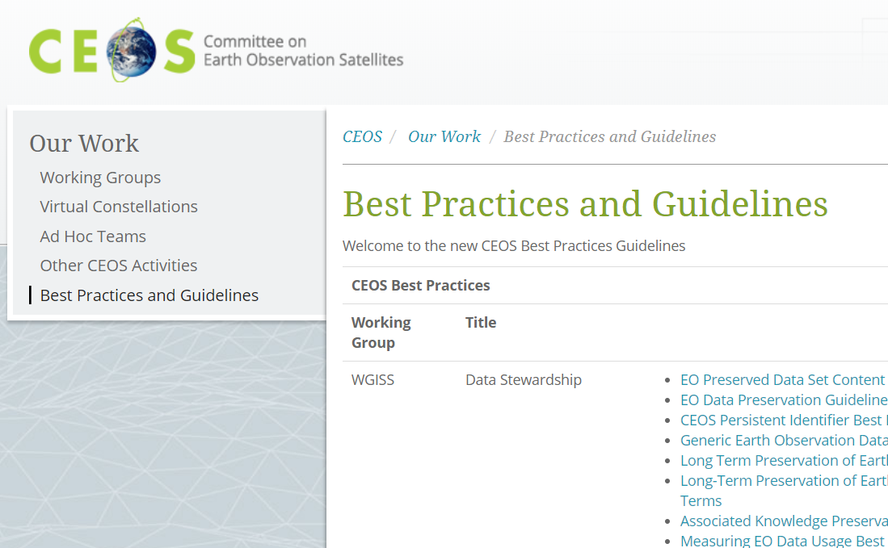
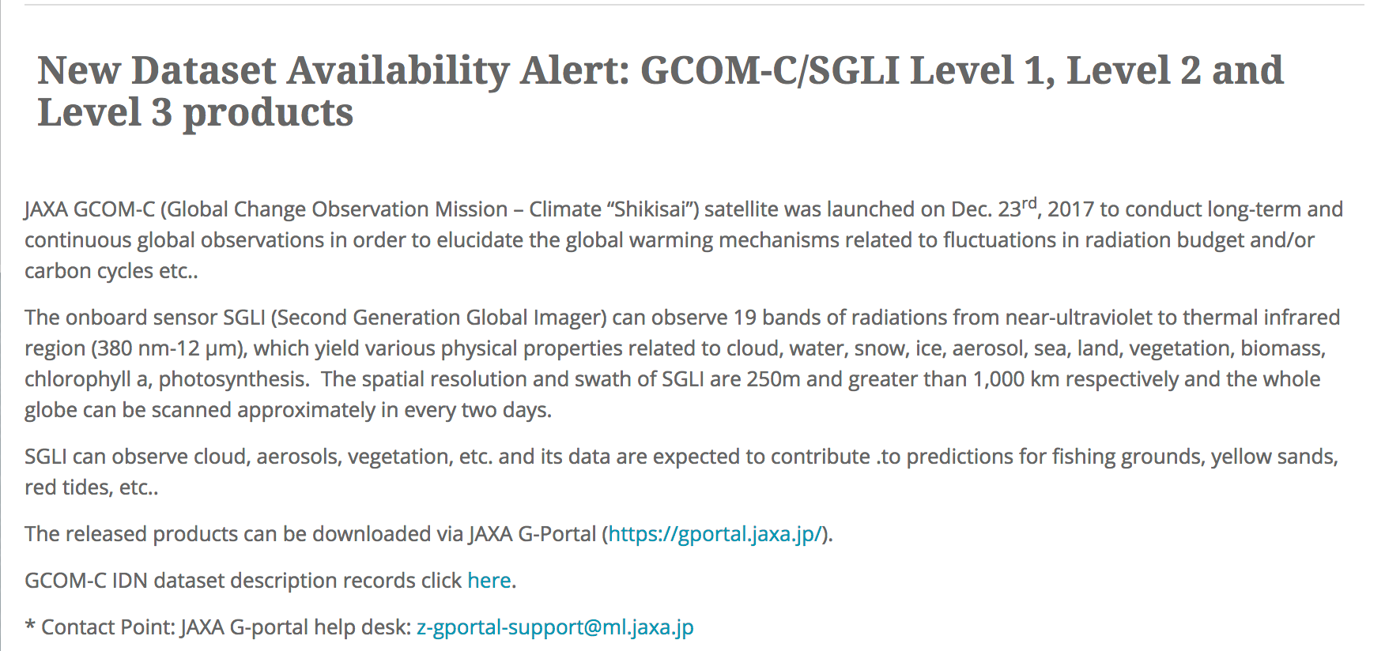
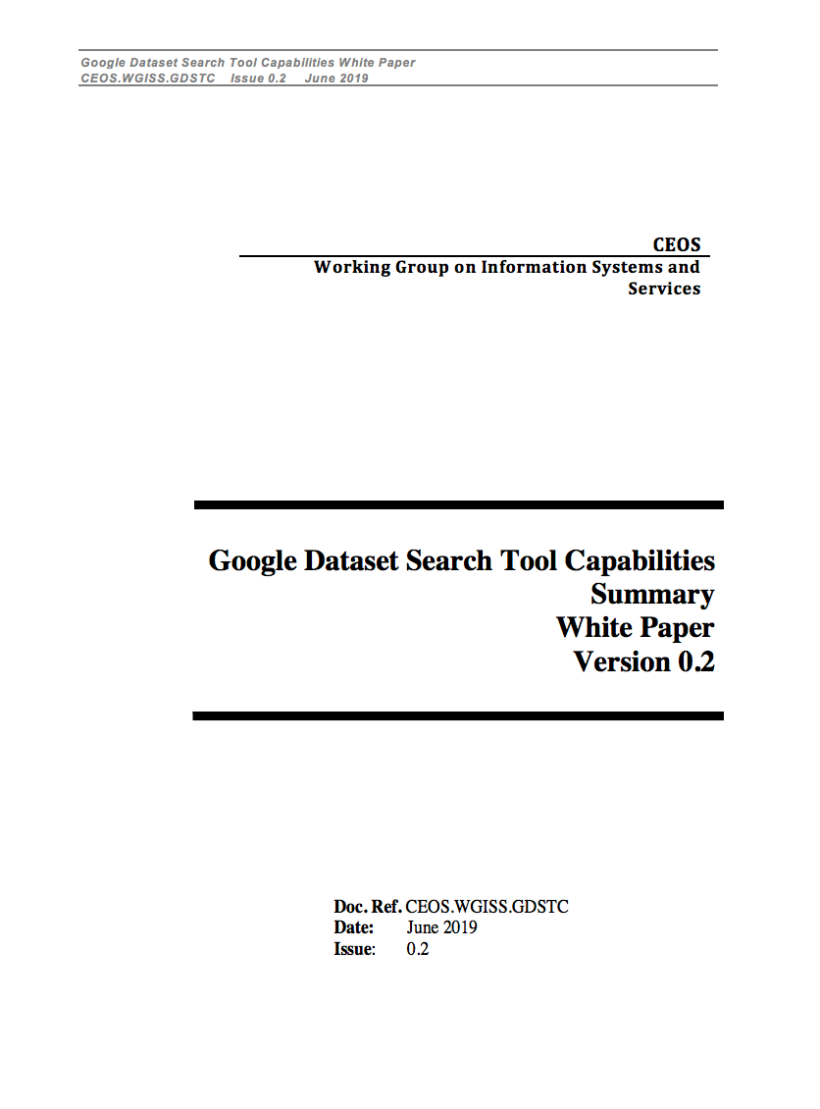
Additional Achievements
Web-page initiated and maintained on the CEOS website under "Our Work” to facilitate discovery and access to Best Practices and Guidelines developed by CEOS WGs; WGISS coordinating population in cooperation with SEO team.
New Data Set Availability Alert Procedure defined and implemented with SEO team to publicize new available data.
Google Data Search Tool report compiled with inputs from NASA, DLR, NOAA, ESA. It describes how the tool allows discovery of CEOS agencies data.
→ Under review by WGISS, will be circulated by end September.

Slide 23
Synergies Among CEOS Teams
CEOS Carbon Team/WGClimate - Carbon Portal development and possible use for next phase of carbon strategy, ECV/CDRs registration in IDN, ECV inventory update automation.
WGDisasters - possible cooperation on generic recovery observatory.
WGCV - Data cube prototypes (ESA and GA/CSIRO) supporting CAL/VAL activities through providing access to ACIX (16 sites), RadCalNet (4 sites) and LPV (3 sites) cal/val data; CEOS Data Maturity matrix.
Virtual Constellations - inventory of VC data to be updated to review discoverability/accessibility through WGISS CDA infrastructure.
WGCapD - joint organization of technology webinars and FDA events.
SEO - COVE tool harvesting WGISS metadata, data cubes coordination, implementation of web pages for tools/SW discovery.
SDG AHT - discovery of SDG indicators relevant data via WGISS CDA.

Slide 24
WGISS contribution to GEO
Past/Current
GEOSS Platform accessing CEOS data via WGISS CDA
WGISS contribution to GEOSS-EVOLVE initiative, GEO Expert Advisory Group (EAG) and GEO Technology Workshops
WGISS represented in NextGEOSS Advisory Board and working on federated authentication technology
GEO Sec reporting during WGISS meetings; Joint Workshops on GEOSS-WGISS interoperability and FDA at WGISIS-43/46, GEO Knowledge Hub side event at SIT-34
Future
Contribution to GEOSS Data, Information and Knowledge Resources Task to advance Data Management Principles
Data Sharing and Mgm Working Group → M.Albani (ESA), R.Moreno (CNES)
Contribution to GEOSS Infrastructure Development Task to facilitate CEOS agencies data access via WGISS CDA and to contribute technologies and solutions for GEOSS Infrastructure Evolution
GEOSS Infrastructure Development Task Team → R.Woodcock (CSIRO)
GEOSS Infrastructure Evolution Working Group → M.Albani (ESA), A.Mitchell (NASA) - TBC
Coordination with GEO Sec for joint meetings and workshops

Slide 25
Sustainable Commitment
Interagency coordination working well, very good cooperation spirit
Healthy participation to meetings (average 20 people)
Some members attending all meetings (e.g. NASA, NOAA, USGS, CNES, ESA, CSIRO, JAXA, CAS/RADI, CAS/AOE, HSO)
Others attending only some meetings depending on location and discussed topics (e.g. CSA, EUMETSAT, ROSCOSMOS, INPE, CONAE, DLR, UKSA, ISRO)
Additional agencies contacted expressed interest in WGISS activities with potential future participation (e.g. GISTDA, VNSC/VAST, ASI)
Chairmanship after 2019 Plenary:
WGISS Chair: Robert Woodcock (CSIRO)
WGISS Vice Chair: Makoto Natsuisaka (JAXA)

Slide 26
Next meeting hosted by VNSC/VAST, 8-11 October
You are all invited to join WGISS-48 in Hanoi!

Slide 27
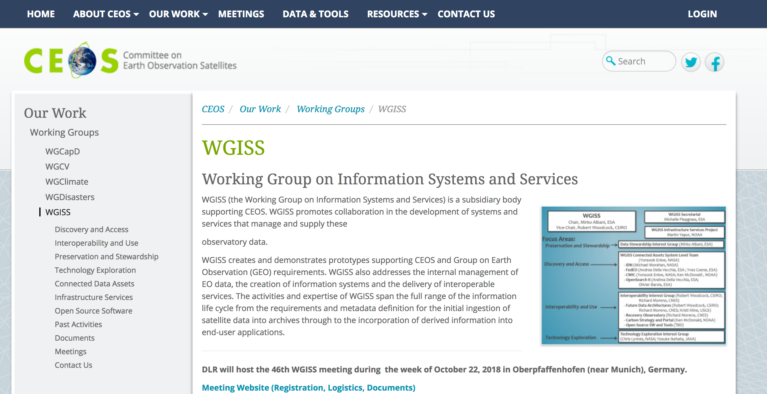
WGISS Information
http://ceos.org/ourwork/workinggroups/wgiss/

Slide 28
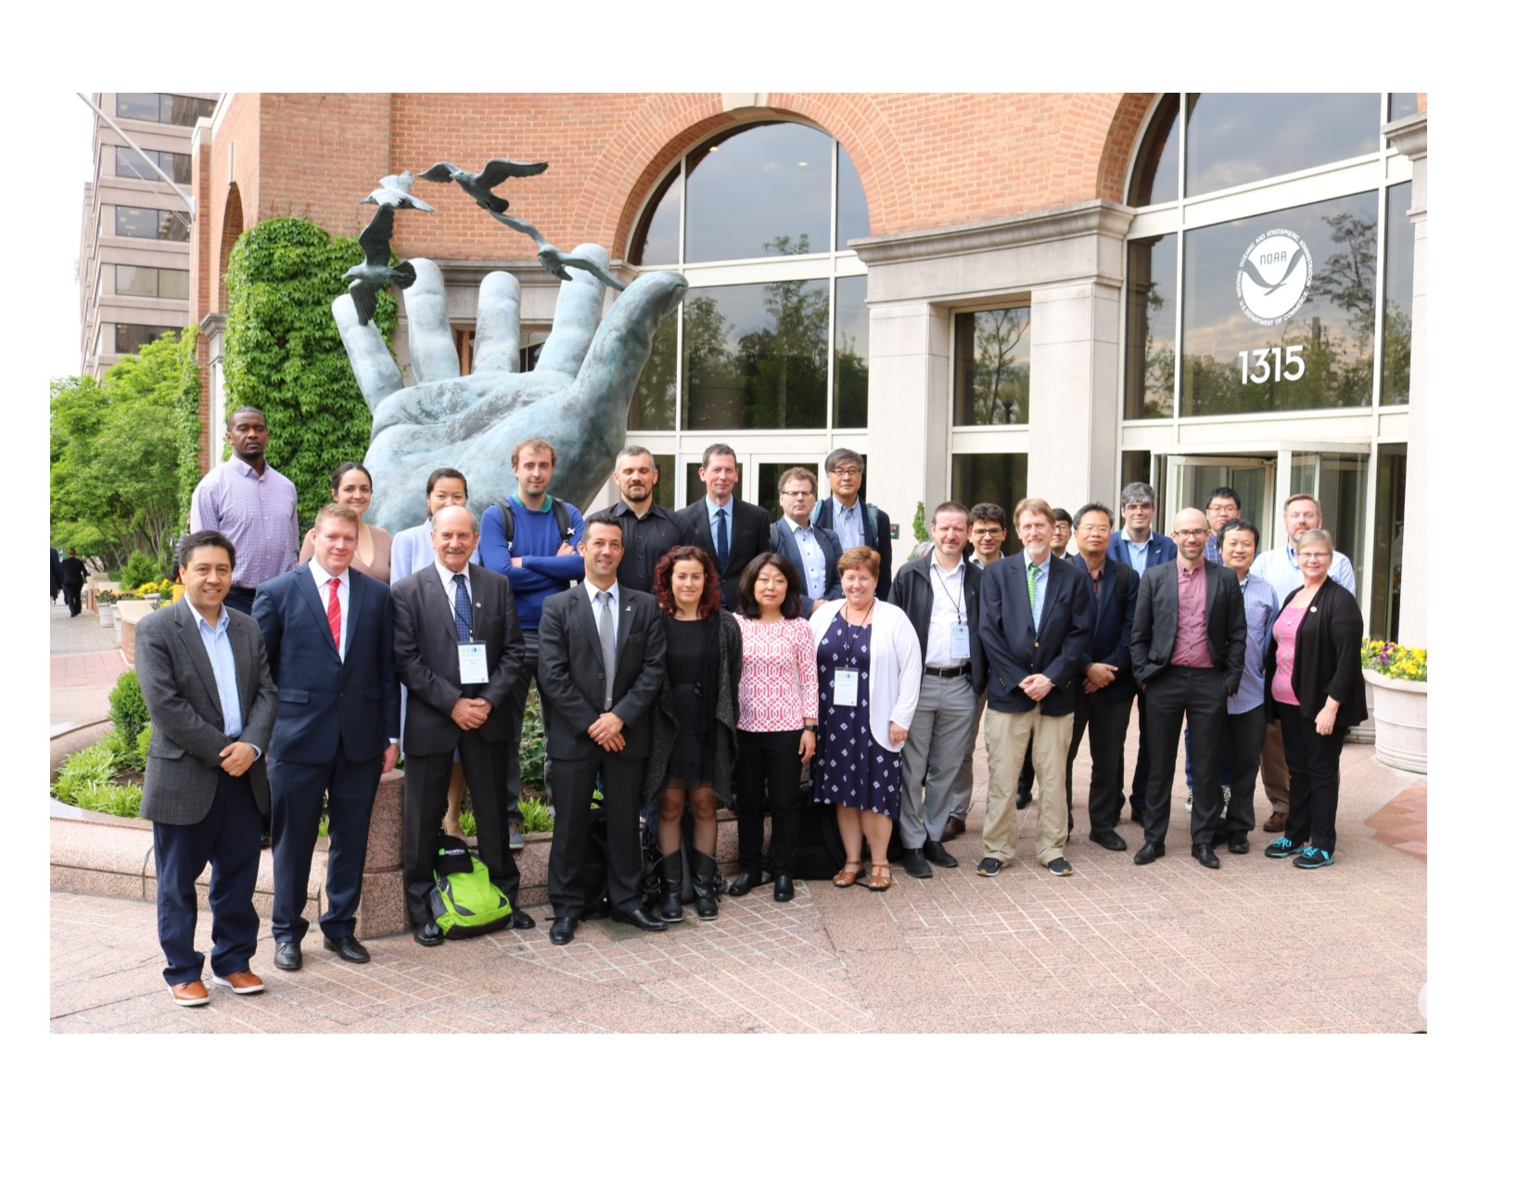
Questions?
WGISS-47, NOAA – Silver Spring, 29 April – 2 May 2019

