Slide 1
Recent Activities of the OST-VC
Remko Scharroo (EUMETSAT) Annick Sylvestre-Baron (CNES)
CEOS 2019 SIT Technical Workshop
Session 5, Item 5.3
Fairbanks, Alaska, USA
11 – 12 September 2019

Slide 2
Altimetry, OST-VC and CEOS (1)
OST-VC links the agencies, altimetry user community, and CEOS
Ocean Surface Topography Science Team
Inter-agency cooperation on current missions
CFOSAT: CNSA, CNES, EUMETSAT (NRT distribution)
Jason-2/3: NASA, CNES, EUMETSAT, NOAA
SARAL: ISRO, CNES, EUMETSAT (NRT distribution)
Hy-2A: CNSA, CNES
Sentinel-3: EU, EUMETSAT (ocean), ESA (land)
Other current missions
CryoSat-2: ESA

Slide 3
Altimetry, OST-VC and CEOS (2)
Inter-agency cooperation on future missions
CRISTAL: EU, EUMETSAT (ocean), ESA (land)
Hy-2B/C/D: CNSA, CNES
Sentinel-3 Next Generation: EU, EUMETSAT (ocean), ESA (land)
Sentinel-6: EUMETSAT, ESA, EU, NASA, NOAA, CNES
SWOT: NASA, CNES, CSA, UKSA
WISA: ESA, CNES
Other future missions
COMPIRA: JAXA
OST-VC suited to discuss constellation-wide programmatic issues
From virtual to actual coordinated constellation
Update of Constellation URD
OST-VC representative in COVERAGE initiative

Slide 4
OST-VC Members
After 2+ years without a co-chair from CNES, the OST-VC now has again two chairs:
Annick Sylvestre-Baron (CNES)
Remko Scharroo (EUMETSAT)
Other members
Craig Donlon (ESA)
Eric Leuliette (NOAA)
Eric Lindstrom (NASA) (soon to retire)
Gregg Jacobs (US Navy)
Kai Matsui (JAXA)
Rashmi Sharma (ISRO)
Wang Chen (CNSA)

Slide 5
Team Activities and Outputs
OST-VC contribution to the OceanObs’19 White Paper: Requirements for a coastal zone observing system, Front. Mar. Sci., 6, 348, doi: 10.3389/fmars.2019.00348, 2019.
OST-VC User Requirements Document (action VC-43, due Q4 2020)
Planned side meeting of OST-VC at 2019 Ocean Surface Topography Team (OSTST) Meeting in Chicago, 21-25 October 2019

Slide 6
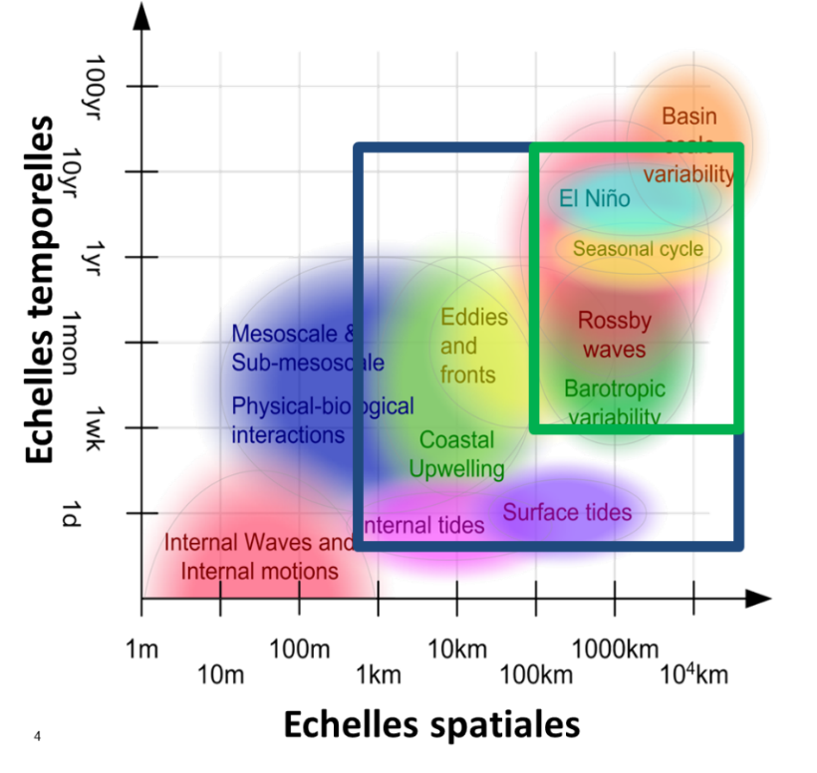
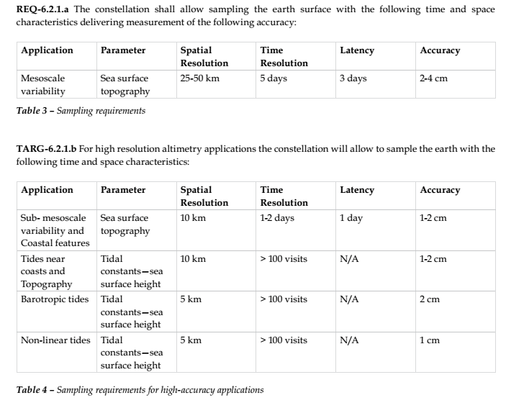
Current constellation URD
“Next 15 years of altimetry”, 2009: Constellation User Requirement Documents @ Assmanhausen OST-VC meeting
Reference mission + complementing missions
Nadir altimetry only (swath altimetry mentioned)
Structured the current constellation (reference mission Jason + SARAL/Sentinel-3/Hy-2A/Cryosat)
Standards of products
temporal scale
spatial scale

Slide 7
Update of constellation URD
Objective 2018–2020: prepare a new URD
Discussed in OST-VC meetings 2016 and 2017 (and 2019)
Early works through CNES phase 0 study (mix nadir/swath, global UR analysis)
Coordination CNES-ESA Swath Altimeter for Operational Oceanography (SAOO) URD
What should be in it?
Analysis of user needs: systematic + exploratory
Swath altimetry + nadir altimetry: combined
Recommendation for an “operational constellation” (targets: Copernicus Next Generation, Chinese and Japanese altimetry programmes)
Recommendation for additional science missions and techniques (e.g. GNSS-R) in complement
Multiple applications: mesoscale monitoring, polar oceans, long-term record for sea level rise
Links with other observables (e.g. SST, OC)

Slide 8
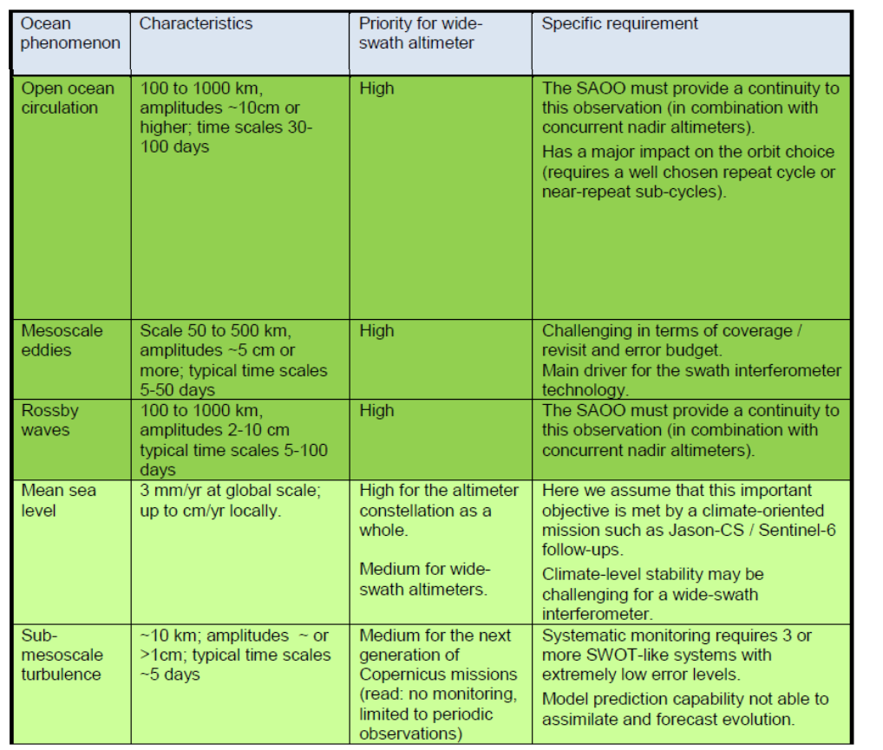
Example SAOO URD
50 km / 5 days as effective resolution
Precision/accuracy requirement aimed at meeting this resolution everywhere-every time with an 80% probability
Identify auxiliary information needed (tides, gravity field…)
Identify what is not considered in requirement (internal wave, sub-mesoscale)

Slide 9
OST-VC constellation updates (1)
Sentinel-3
Sentinel-3B started mission in tandem with Sentinel-3A
Unique opportunity to cross-calibrate altimetry, ocean colour and SST instruments on both platforms
Now interleaved with Sentinel-3A ground-track since end of 2018 for optimal space-time coverage
Both satellites provide excellent quality science data
CFOSAT
Launched 29 October 2018
Not directly for ocean topography, but winds and waves
Provides good quality science data since May; to be released to public next year

Slide 10
OST-VC constellation updates (2)
Jason-2
First moved to “geodetic orbit” (~400 day repeat) in 2017
Interleaved with previous ground track since 18 July 2018
Ground track “moved backwards” 90 days after long outage as to complete coverage
Decommissioning imminent (decision on 11 Sep)
Reprocessing
To secure and improve the climate quality sea level time series various reprocessing efforts are on-going
Sentinel-3: yearly
TOPEX/Poseidon: to be available soon
Jason-1/2/3: planned for next year

Slide 11
Questions?

