Slide 1
GFOI-SDCG
Osamu Ochiai & Stephen Ward: CEOS lead & alternate
CEOS 2019 SIT Technical Workshop
Session and Agenda Item 6.1
Fairbanks, Alaska, USA
11 – 12 September 2019

Slide 2
GFOI
The Global Forest Observations Initiative (GFOI) is an informal partnership to help coordinate international support to developing countries on forest monitoring and greenhouse gas (GHG) accounting for REDD+ and related activities.
One of GEO Flagships since 2011
Phase 2 has continued emphasis on Capacity Building aspects & country engagement to develop NFMS and MRV
GFOI-UNFCCC meeting in Bonn September 24-25 for discussing “Policy Mandate” associated with Paris Agreement (i.e. NDC, Global Stocktake)
GFOI Plenary will be at FAO in Rome, 9-13 March 2020, CEOS is one of Organizing members

Slide 3
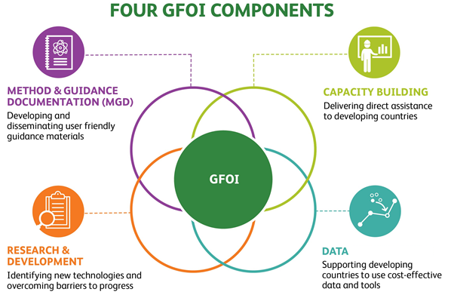
GFOI
GFOI Lead Team
Australia, CEOS, ESA, FAO, Germany, Norway, UK, US and the World Bank
GFOI Office (FAO)
4 Components
Capacity Building (FAO and SilvaCarbon)
MGD (Australia)
R&D (ESA)
Data (CEOS, FAO and the World Bank)
SilvaCarbon/USGS/USAid volunteered new Data Component Manager(s)
Chris Barber (space - USGS/EDC), Sara Geoking (insitu - USFS)

Slide 4
GFOI
Data Component – current activities
Registry of Tools
34 tools registered – CALM level 6 (INPE, EC/JRC and SEO (COVE, ODC))
CEOS agencies and partners welcome to submit their preferred systems
EO data acquisition and availability (SDCG)
Baseline space data somewhat taken for granted but need to assure GFOI advocates for free and open & CEOS data
SDCG still has plenty ideas of mutual benefit
Ground data review
To be Planned
Action panel integration
To be Planned

Slide 5
SDCG
Reduced agency attendance through personnel changes, budgets, natural evolution
Work Plan updated to reflect slimmer profile
Continued focus on the core business of assurance of data suitable for annual NFMS reporting
Healthy supply allows time to focus on additional value
data access, formats, ARD
support to LSI-VC on ARD pilots with thematic communities
working with FAO to link their SEPAL with Open Data Cube (Digital Earth Africa)
working through new USGS Co-chair (Chris Barber) to SilvaCarbon (eg ARD feedback)

Slide 6
SDCG WP

Slide 7
SDCG WP

Slide 8
Discussions in CEOS
Anchorage meeting revisited and reaffirmed conclusions of 2018 joint LSI/SDCG/GEOGLAM meeting in Ispra – SDCG AHT proposes to become thematic subgroup within LSI-VC
Biomass, will potentially become an increasingly important topic for CEOS to address from multiple points-of-view in the forthcoming years.
No formal home in CEOS structure. Within WGCV/LPV there is a CEOS Biomass Protocol team. There is an informal multi-mission group on Biomass mission validation (mainly NASA & ESA).
Worth discussing whether those agencies see value in more formal CEOS engagement. Biomass links to GHG Roadmap and Global Stocktakes a high-level and worthy goal.
Encourage CEOS agencies to consider how to form the best and comprehensive structure in CEOS and send specialists.
Meanwhile, seeking action for NASA and ESA to nominate a working contact to engage with forthcoming SIT Chair team (and SDCG) on their proposed Carbon and Biomass Thread
To be continue to discuss at Plenary and also Biomass validation workshop –likely 4-5 March 2020, Brisbane

Slide 9
Questions?

