Slide 1

COVID-19 NOAA Research Studies
Committee on Earth Observation Satellites
Mitch Goldberg, Shobha Kondragunta, Greg Frost (OAR) NESDIS, NOAA
CEOS SIT Technical Workshop 2020
Session and Agenda Item # 1.3
Virtual Meeting
8 September 2020

Slide 2

NOAA Response
Attributing observations (satellite & in-situ) to economic and human activity;
Carrying out additional in-situ atmospheric measurements to capture the state of the atmosphere during the economic slowdown and recovery;
Initiating modeling studies to understand how the atmosphere is changing and the role of human activity;
Updating emission inventories to improve air quality forecasting.
Collaboration with Copernicus Atmospheric Monitoring Service
While the focus of this talk is on the atmospheric impacts of the COVID-19 crisis, NOAA labs are investigating other impacts, such as impacts of the COVID-19 pandemic and beach closures on the coastal water quality
All our data will be accessible to a broad community of stakeholders, including public health community.
Participate in NASA-led weekly meetings to share results with colleagues

Slide 3

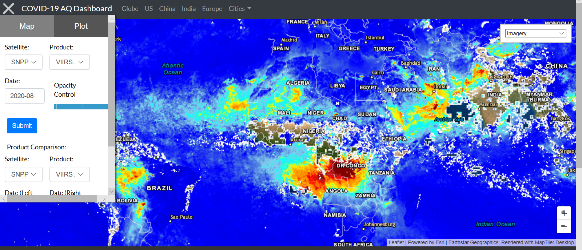
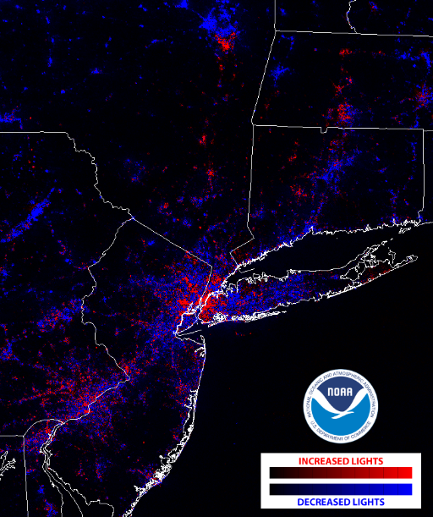
NOAA Dashboard to Track Economic Activity using
Satellite Aerosol and Trace Gas Products
Key Features
Monthly mean global maps of NOAA aerosol and trace gas products Ability to compare maps from different time periods Time series and histograms for any chosen month and year for major regions of the world and cities Key economic indicators Includes Insitu observations and correlations
NOAA will be reprocessing the entire SNPP and NOAA-20 record to produce
consistent aerosol and trace gas products.
Using SAR for to update emissions from changes in shipping
Using the VIIRS DNB to study correlations between change of night lights and economic activity
https://www.nesdis.noaa.gov/content/noaa’s-polar-orbiting-satellites-see-drop-us-air-pollution
https://www.nesdis.noaa.gov/content/suomi-npp-detects-changes-nighttime-lights-nyc-metro

Slide 4
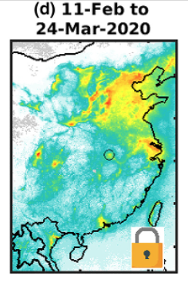
S5P vs SNPP vs NOAA20
TROPOMI SNPP OMPS NOAA20 OMPS
5.6 x 3.5 km2
50 x 50 km2
17 x 13 km2
Studying differences between TROPOMI and NOAA20 OMPS – because JPSS provides OMPS continuity in early afternoon orbit to 2040

Slide 5
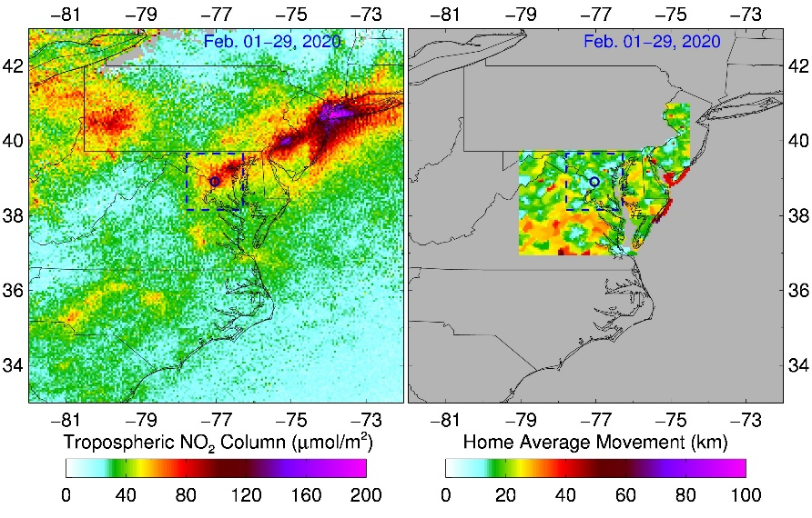
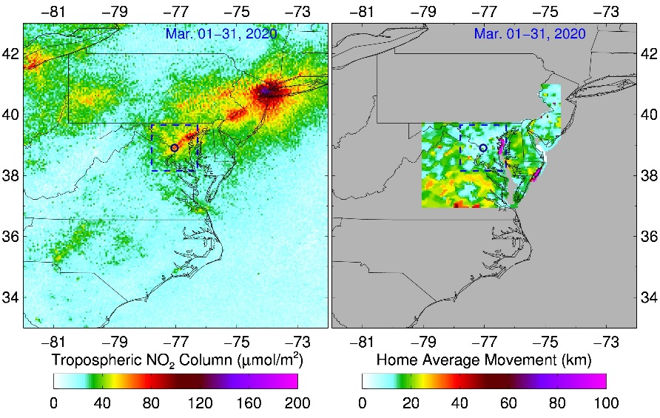
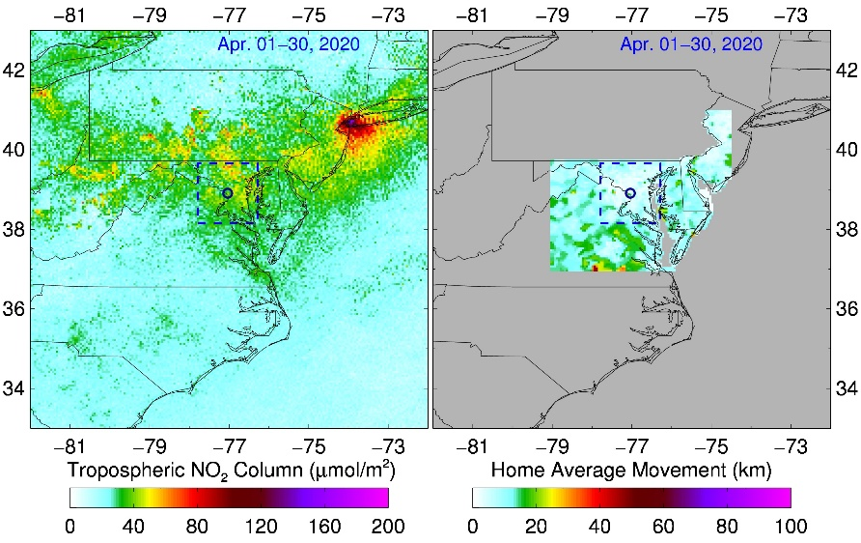
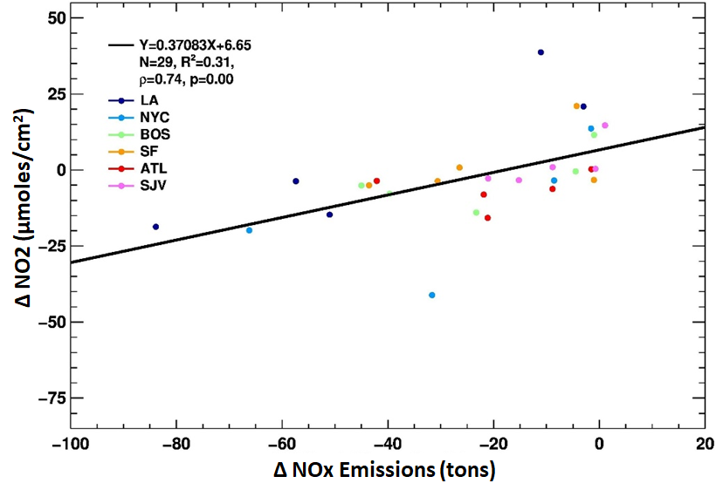
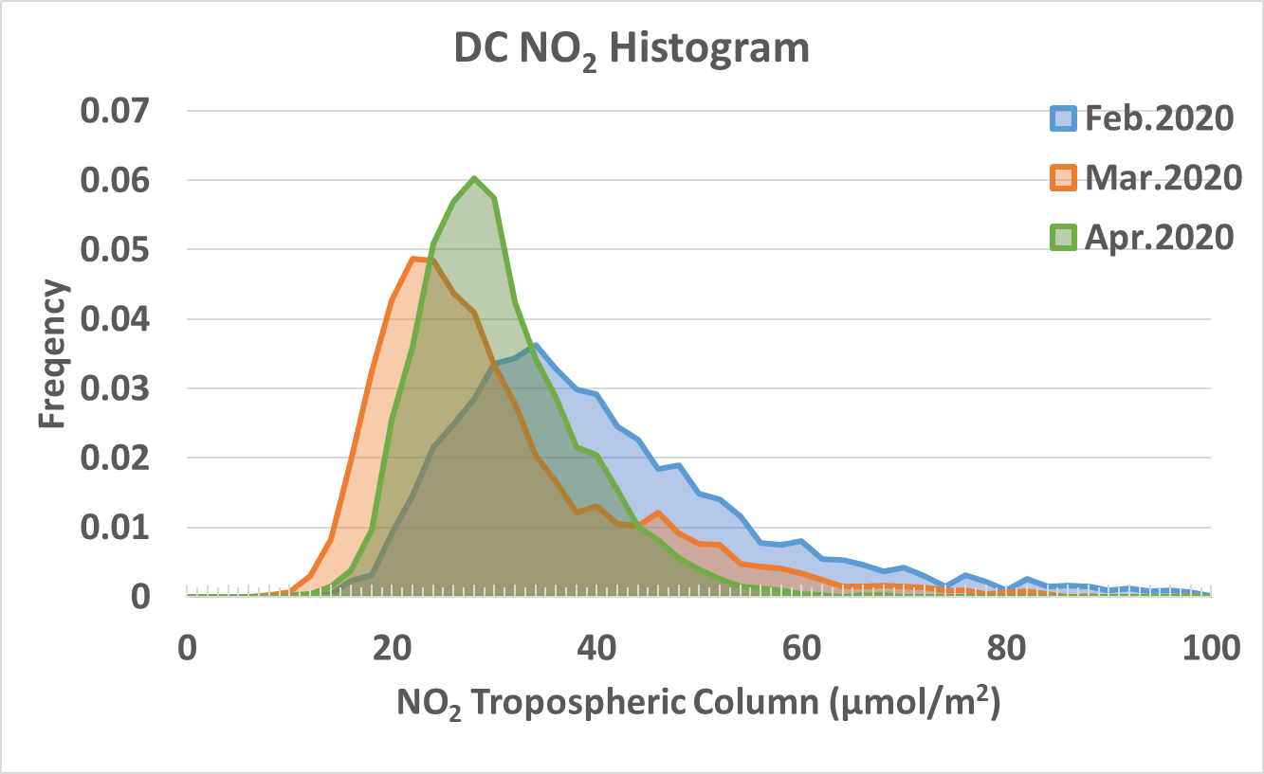
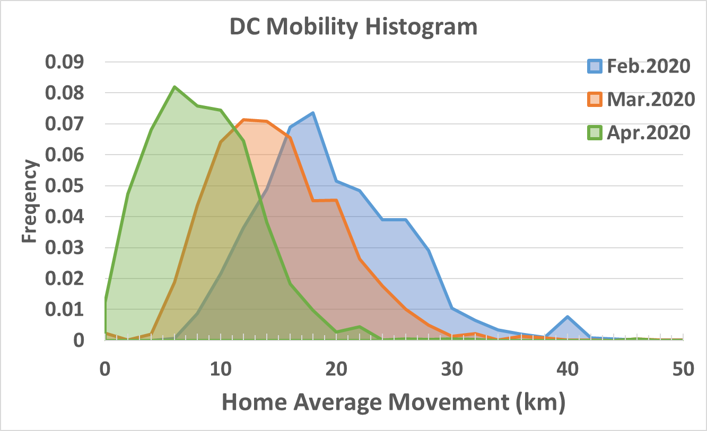
Mobility Changes and Reduction in NO2
February 2020
March 2020
April 2020
Studies can contribute to post pandemic mobility recommendations
Jan – May (2020 – 2019)
On-road emissions data from OAR (Brian McDonald)
S5P TROPOMI data from ESA
S5P TROPOMI NO2 data courtesy of ESA
Mobility data courtesy of Bluedot and Bandana Kar (Oakridge National Lab)

Slide 6
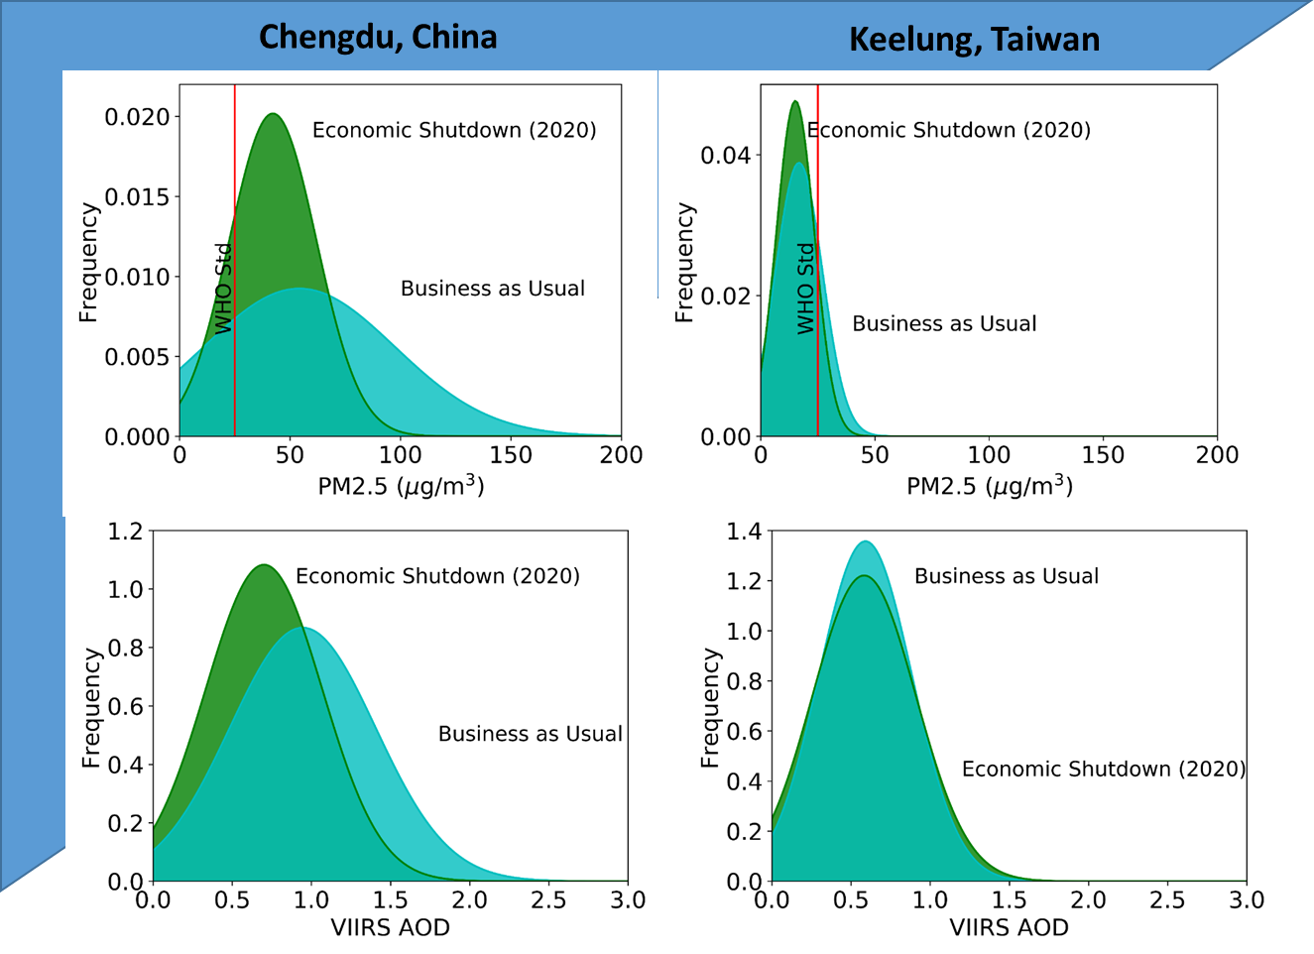
Two COVID-19 lockdown measures
and air quality impacts
Chengdu Keelung
Strict (100%) lockdown in Sichuan province leading to reduced emissions whereas Taiwan enforced strict screening of international travelers and went into isolation but no lockdown
Air quality (PM2.5 and AOD) in Chengdu showed improvement in March 2020 compared to Business as Usual. Keelung had no such air quality impacts. No difference between 2020 and BAU.
Ground
observations
Satellite
observations
Establishing a representative climatology is important

Slide 7
COVID-19 AGU Sessions
Atmospheric Satellite Measurements and COVID-19 Impacts.
  ESA, NASA, NOAA
Application of weather, water & climate products to track the spread and/or impacts of the COVID-19 pandemic
  NOAA organized
Science in the Time of COVID-19
  NASA organized

