Slide 1
GHG Observation Coordination
Session 2: Context & Intro
Yasjka Meijer GHG TT Lead (ESA)
Agenda Item 2
SIT Technical Workshop 2023
18th - 19th October 2023, ESA/ESRIN

Slide 2
Context
GHG Observations of crucial importance to Paris Agreement & Global Stocktake
CEOS efforts directed by the GHG Roadmap
CEOS actively engaging with International Methane Emissions Observatory (of UNEP)
CEOS actively engaging with WMO’s emerging with Global Greenhouse Gas Watch initiative
Increasing commercial & NGO activity on CH4 (and possibly CO₂) observations from space
Ever Increasing interest on GHG Observation across CEOS agencies and their governments
GHG Observation Coordination identified by incoming SIT Chair (JAXA), as a headline priority for 2024–2025

Slide 3
Agenda

Slide 4
Agenda

Slide 5
2.1 WMO Engagement Update
Natalia Donoho

Slide 6
2.2 IMEO Engagement Update
John Worden

Slide 7
2.3 Reporting Emissions
John Worden

Slide 8
2.4 GHG Missions Portal
Stephen Ward

Slide 9
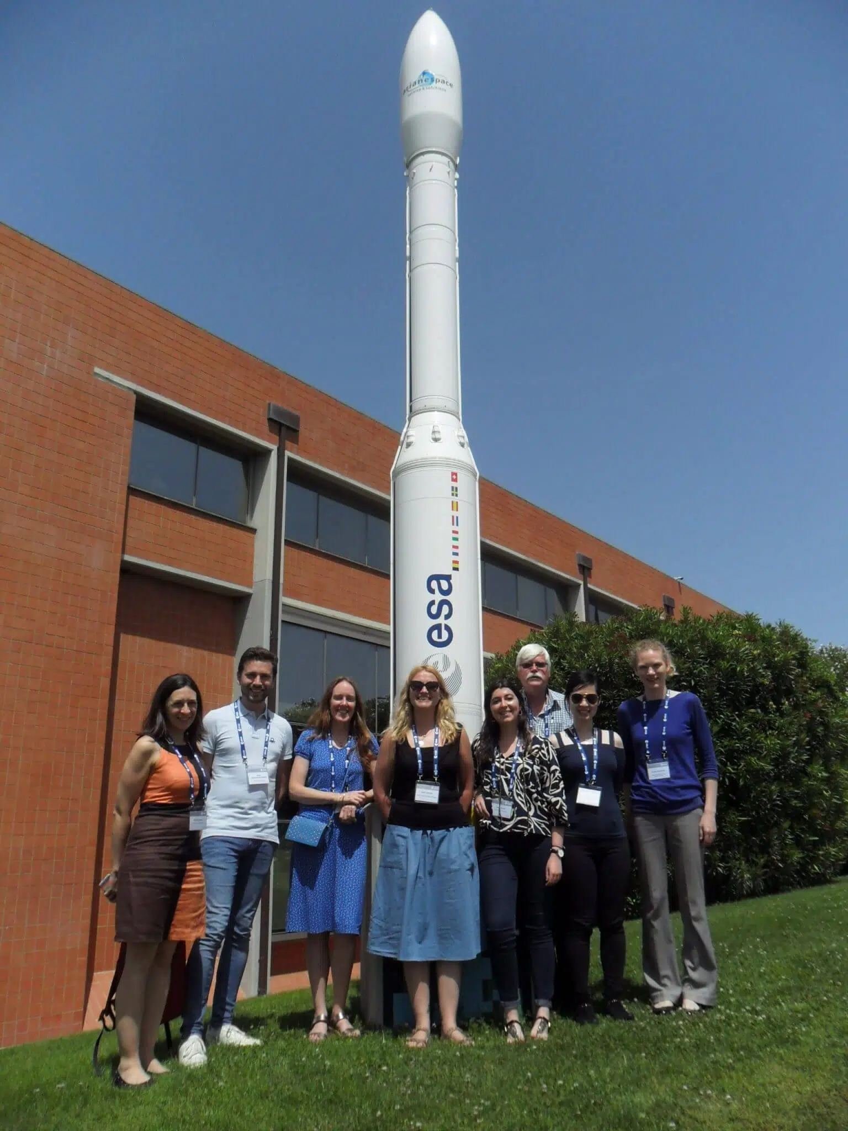
PHOTO & COFFEE BREAK
1st
2nd
Reconvene at 11:15 CEST

Slide 10
2.5 GHG Task Team
Yasjka Meijer

Slide 11
2.6 U.S. GHG Center
Argyro Kavvada

Slide 12
Challenges
User engagement:
UNFCCC (GST)
CO₂: policymakers at smaller spatial & temporal scales (covenant of mayors, finance)
CH₄: (policymakers) on non-O&G related emissions, e.g. landfills, wetlands
Mission delays or no follow-ups
False notion that New Space could do it all
Convey the message that measuring CO₂ & CH₄ do not directly result in emission estimates
Tackle the aquatic (mainly coastal & open ocean) aspect of the carbon cycle
Timely switch to missions capable to monitor the carbon cycle in a changing climate

Slide 13
Any Other Business?

