Slide 1
Global Greenhouse Gas Watch, Status Update
Lars Peter Riishojgaard and Natalia Donoho,
WMO Secretariat

Slide 2
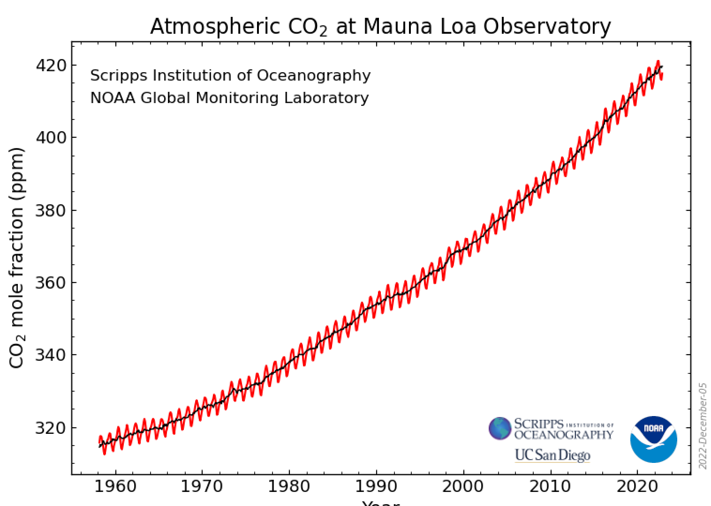
Problem Statement
The Paris Agreement aims to limit climate change by reducing net anthropogenic greenhouse gas (GHG) emissions;
Focus on accurate reporting of anthropogenic GHG emissions; however, GHG fluxes driven by natural processes are often much larger and are not explicitly taken into account;
Response of natural fluxes to anthropogenic emissions and climate change are not understood;
”Emissions” can be positive as well as negative (GHG removals), but
accounting for negative emissions (e.g. carbon offsetting via carbon credits) is problematic, poorly regulated and ineffectively monitored, leading to risk of overestimation of impact, double counting,…;
UNFCCC, Rio, 1992
Kyoto, 1997
The climate responds to the atmospheric GHG concentrations, not to claims about emissions or emission reductions;
Paris, 2015
Notes:
Globally coordinated: to ensure consistency between Parties, and ensuring global coverage by the information
Sustained: to ensure evaluation of the trends

Slide 3
To help address these issues, WMO and partners are developing a Global Greenhouse Gas Watch, building on the Global Atmosphere Watch and World Weather Watch
Key elements
Integrated global greenhouse gas observing system (surface- and space-based) operating under WMO Res. 1, with near-real time international exchange of all observations;
24/7 operational GHG modeling/assimilation (multiple systems), providing top-down flux estimates;
Routine internationally coordinated intercomparison and verification of model output;
Primary output
Time-continuous global fields of CO2, CH4 and N2O concentrations;
Consolidated, top-down, monthly estimates of GHG fluxes at global 100 x100 km resolution (1 x 1 km goal);
Users of GGMI output
Parties to the Paris Agreement (e.g input to GST and for support review of BTRs under ETF);
Regional and local users, e.g. via IG3IS;
Carbon markets, e.g verification of offsetting;
Science community working on GHG budgets;
IPCC, for emission pathways, future scenarios;
In order to provide authoritative data to UNFCCC Parties and other users, GGGW estimation will be conducted
Openly - with participation from all interested Parties;
Transparently – with free and unrestricted access to all input and output data as well as verification results;
Using documented (preferably published) methodologies and algorithms.

Slide 4
19th World Meteorological Congress, (May 22-June 2 2019)
Endorsed the concept for the WMO-coordinated Global Greenhouse Gas Monitoring Infrastructure, based on an Executive Summary developed by the Joint Study Group on Greenhouse Gas Monitoring;
Requested development of a detailed, costed implementation Plan
Requested the Secretary-General:
To allocate the necessary resources…
To further strengthen close collaboration and coordination with relevant United Nations agencies and other international partners …
…
193 countries now committed to developing internationally coordinated top-down estimation of GHG fluxes globally, with open access to all input and output data;
SBSTA-58 has requested briefing on this at SBSTA-59, to take place on Earth Information Day during COP-28 in Dubai, Nov 2023;
Goal is recognition of GGGW as a critical tool for implementation of Paris Agreement in SBSTA-59 Conclusions and potentially in COP28 Cover Decision.

Slide 5
Table of Contents, GGGW Implementation Plan
Other public sector stakeholders (including GEO…)
Scientific community
Private sector
Downstream data products definition and processing requirements;
Links to IG3IS and similar efforts;
Capacity development
Observing system installation and operation
Modelling establishment and operation
Data management
Uptake and use of data (creating policy relevance)
Cost estimates, funding sources
Flux estimation
Data exchange, internal to GGGW
Observing system, space-based components
Observing system, surface-based components
Data service, external users
Resource mobilization
WMO Members (EB contributions).
Philanthropy
Introduction, background.
Existing system components, gap analysis.
Observing system
Requirements definition
Observing system implementation activities (space-based)
Observing system implementation activities (surface-based)
Modelling system
Requirements definition
Modelling system implementation activities
Prior information (emissions…)
Data management
R&D needs
Upstream links to research; GAW, WCRP, WWRP;
User engagement and uptake of GGGW
WMO Members
UNFCCC Parties
Other UN agencies
Notes:
Globally coordinated: to ensure consistency between Parties, and ensuring global coverage by the information
Sustained: to ensure evaluation of the trends

Slide 6
Drafting of GGGW Implementation Plan
Drafting
Overall responsible body: Joint Study Group on Greenhouse Gas Monitoring (SG-GHG), in which both CEOS and CGMS are represented;
Additional expertise will be engaged as needed;
Remaining (overarching) sections will be developed in the next steps
Guiding principles:
Stay true to the Concept submitted by SG-GHG and endorsed by WMO Congress;
Do not reopen discussions about which greenhouse gases are included, what is the scope of the system attribution, what is a reasonable horizontal resolution, etc.
Focus on the upcoming four-year WMO Financial Period: 2024-2027;
This aligns well also with the 2nd Global Stocktake under the Paris Agreement, which will conclude in 2028, which means the system will need to be operational by 2027;
Longer-term high priority activities can be mentioned in the plan, even though they may not be implemented during the 2024-2027 period;
Notes:
Globally coordinated: to ensure consistency between Parties, and ensuring global coverage by the information
Sustained: to ensure evaluation of the trends

Slide 7
GGGW Modeling Workshop, Bonn, Sep 19-21, 2023
First steps toward designing an “operational” global system composed of national facilities, to ensure that Parties to the UNFCCC can obtain the GHG information they need to successfully implement their agreements;
Coordination and streamlining of:
Run-time procedures (schedules, data latency, output frequency);
Common access to observational and other input data;
File content, file format for output data;
Quality measures (what is the 500 hPa ACC for top-down GHG flux estimation?)
Routine intercomparison of model output;
Making output freely and openly available to users in common formats;
Guidance to observing system developers on observational data requirements;
…
Notes:
Globally coordinated: to ensure consistency between Parties, and ensuring global coverage by the information
Sustained: to ensure evaluation of the trends

Slide 8
GGGW Observation Workshop, Geneva, Oct 3-5 2023
Aim was to provide guidance on the design of a global observing network for GGGW and help set priorities for initial implementation activities;
Status of observations and gaps
Integrated observing system for GGGW
Standardization
Data systems and data utilization
Observing network implementation activities
Way forward (this session includes a plenary discussion of governance and finance).
Notes:
Globally coordinated: to ensure consistency between Parties, and ensuring global coverage by the information
Sustained: to ensure evaluation of the trends

Slide 9
Of particular relevance to the satellite community:
After much discussion about run-time schedules and data latency, both workshops more or less independently converged on a latency requirement of 72 hours;
Two main drivers:
Overall requirement for monthly fluxes soon after the end of the past month;
Secondary but important use of operational data assimilation as key quality control tool for both space-based and surface-based observing systems;
SG-GHG is seeking engagement from CEOS in helping to draft chapter on observations (Yasjka Meijer invited);
Access to space-based GHG data will be critical to the success of GGGW; could be discussed in the context of WMO Resolution 1, either at the Workshop on Core Data (December 2023) or at CM-15 (February 2024)

