Slide 1
Best Practices for Reporting Satellite Informed Emissions
J Worden (JPL)
Y Meijer (GHG TT) Agenda Item 2.4
SIT Technical Workshop 2023
18th - 19th October 2023, ESA/ESRIN

Slide 2
Context
Background: Concerns about how satellite informed emissions are reported were raised during the CEOS ACVC meeting May 2022 with the outcome being a proposed workshop on characterizing and reporting emissions estimates 🡪 which was subsequently held July 3rd at CNES HQ in Paris during the week of IWGGMS.
Focus of meeting: What do we need to report in order to make robust comparisons between satellite informed emissions estimates and use of these estimates for science, policy, and financial needs:
1) We need a common framework for reporting estimated emissions, their uncertainties (or covariances), and ancillary data indicating data sensitivity and potential biases.
2) We also need to review protocols for evaluating these emissions with independent data sets (e.g. aircraft data, point release). Formal error attribution, their evaluation with independent data, and corresponding product definition, will provide increased transparency (especially with New Space measurements!) and trust in the use of these data.
An analog for this effort is the harmonization, VVUQ, and data/science readiness levels developed by the satellite community for reporting Level 2 composition products.
Our use cases for this workshop include 1) top-down inversions that might inform inventories from the regional to the global scale (e.g. CEOS contribution to global stock-take) and 2) the facility scale emissions such as being reported by high-resolution plume-mapping instruments.

Slide 3
Use Case 1: Regional to global emissions from global mappers
What is the distribution and sector of each countries anthropogenic emission?
Do stated emissions reductions affect the global CO₂ or CH₄ growth rate? If emissions reductions do not match expected growth rate change then why and where?
How do natural processes as well as extreme events such as droughts, heat waves, and flooding affect atmospheric CO2, CH4, and their growth rates?

Slide 4
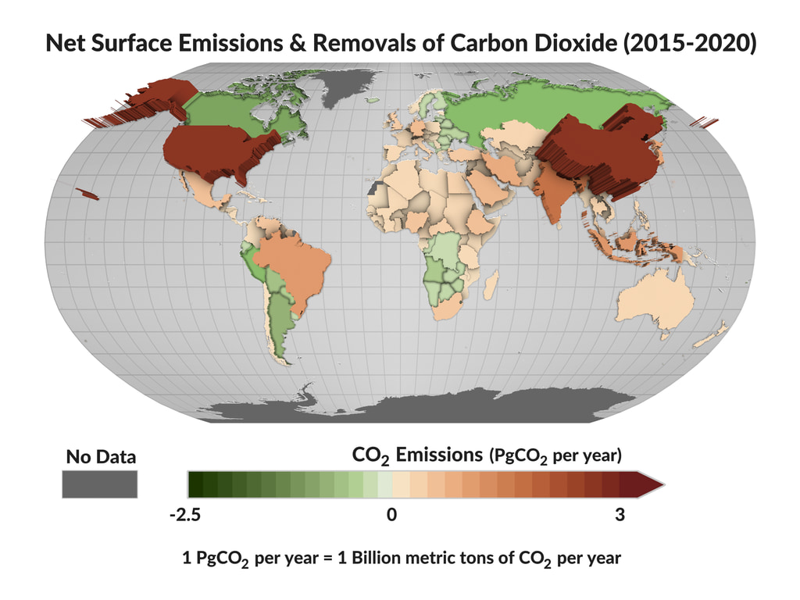
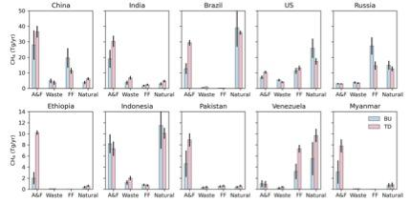
Use Case 1 example: CEOS Support of Global Stock Take (ceos.org/gst)
using data from Global Mappers (OCO-2 and GOSAT)
Emissions by sector for Methane (2019)
Worden et al. (ACP 2021)
Byrne et al. (ESSD 2022)

Slide 5
Use Case 1: What are primary uncertainties and how do they affect reporting of emissions
Null Space or smoothing error: Global emissions estimates are underdetermined as data from global mappers do not resolve emissions 🡪 adjacent emissions estimates are highly correlated
Transport (CO₂ and CH₄) and Chemistry (for CH₄)
Spectral albedo knowledge lead to biases in observations

Slide 6
Use Case 1: Other factors affecting reporting of emissions
Complex, computationally expensive problem means that different centers / groups are reporting emissions on different spatio-temporal grids 🡪 will affect end-user adoption
Different users will need different products describing emissions and uncertainty
Science user gets full range of error attribution + ancillary data describing goodness of fit and confidence (e.g. chi2, dofs, albedo)
Policy/finance might just get emissions plus uncertainty and confidence level

Slide 7
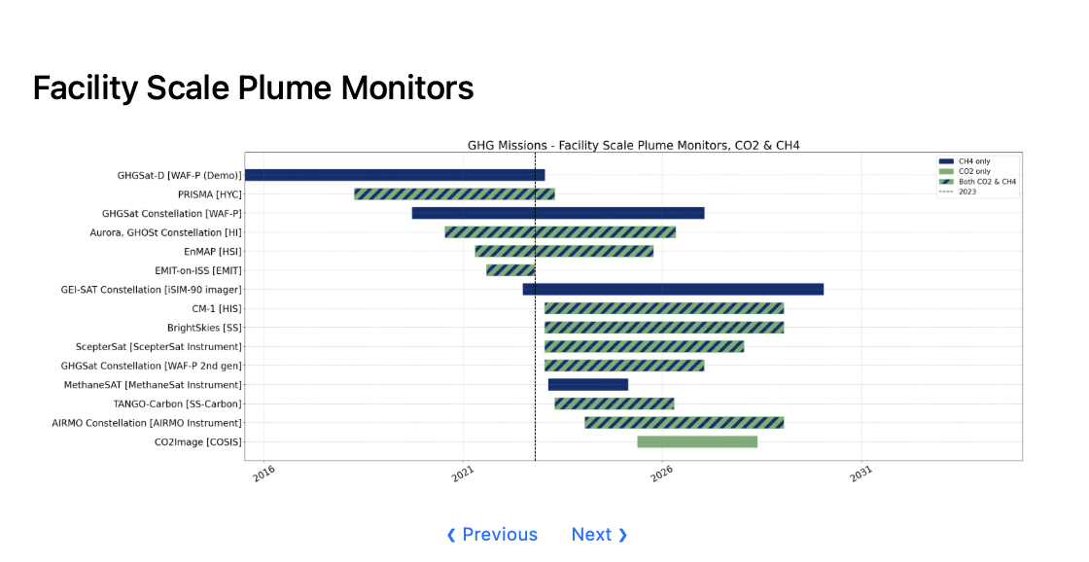
Use Case 2: Facility scale emissions from “plume mappers”
10 of these 15 missions are from New Space!
Intellectual Property concerns play a role in transparency of data provenance and processing
(more on this in subsequent slides)
Pre-2023 constellation has measured ~7 Tg/yr of methane relative to ~120 Tg/yr fossil and waste budget --> Unclear how additional measurements increase sampling of methane emissions
Operations: Where are the leaks and can we fix them?(increased methane production, reduces pollution)
Science: What is the role of high emitters (~>100 kg/hr for methane) on the CH₄ and CO₂ budgets ?
Policy: Prioritize which emissions to remediate for climate action
Finance: Evaluate a companies stated carbon footprint and its remediation approach (empirical data needed for carbon markets)

Slide 8
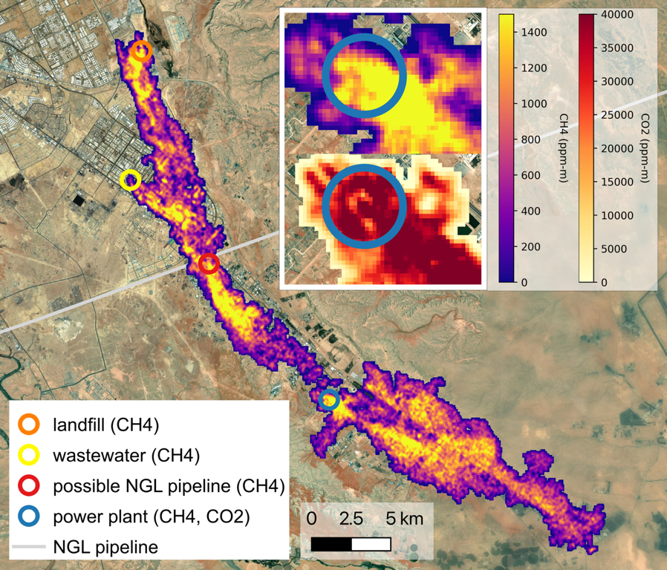
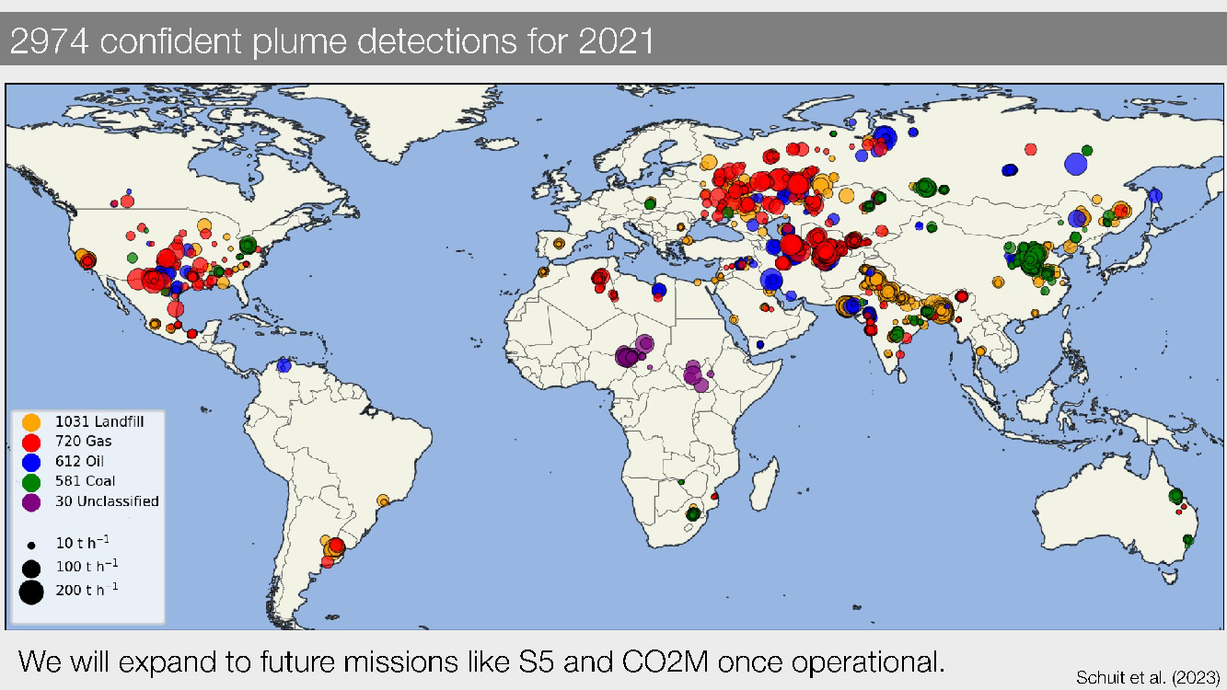
Use Case 2: Facility scale emissions from “plume mappers”
Use of plume-mappers with wide-field mappers such as TROPOMI (“tip and Q”)can prioritize where to observe and remediate emissions
EMIT can resolve CH₄ and CO₂ plumes from multiple sources in Riyadh
(Thorpe et al. Accepted)

Slide 9
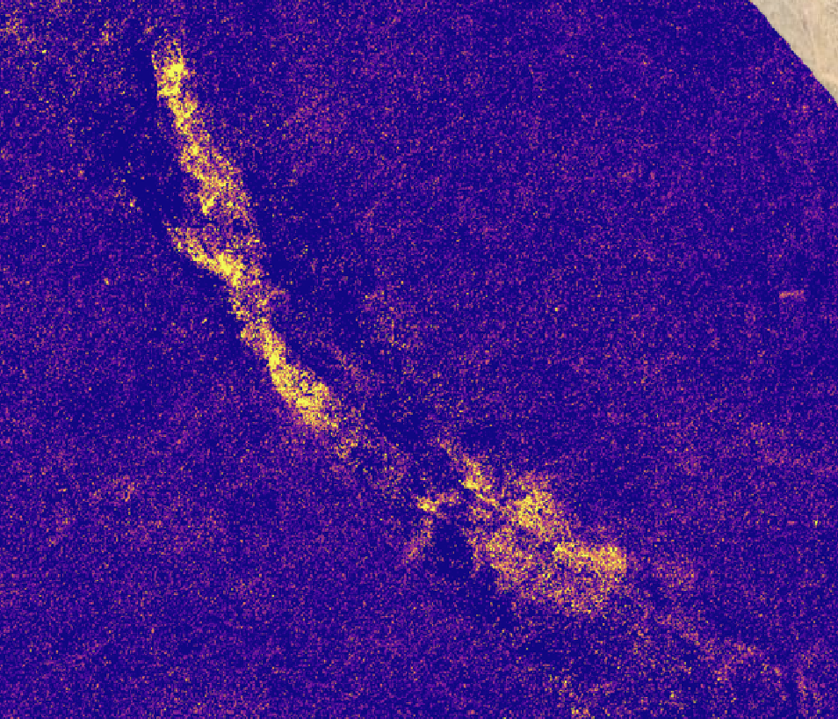
Use Case 2: What are primary uncertainties and how do they affect reporting of emissions
Transport only (chemistry too long lived)
Spectral albedo
”Null Space or smoothing error” this term now appears as a “detection limit”
Human in the middle needed to evaluate location of plume and support processing of plume filling algorithm
EMIT estimated CH₄ concentrations
EMIT estimated CH₄ concentrations after processing
Variations in surface albedo project into estimated methane 🡪 this affects how plume is “filled” prior to using algorithm to relate plume shape and concentration to emissions.
A human in the loop for each scene means limited processing of data 🡪 Could use ML codes to reduce this burden and increase data rate

Slide 10
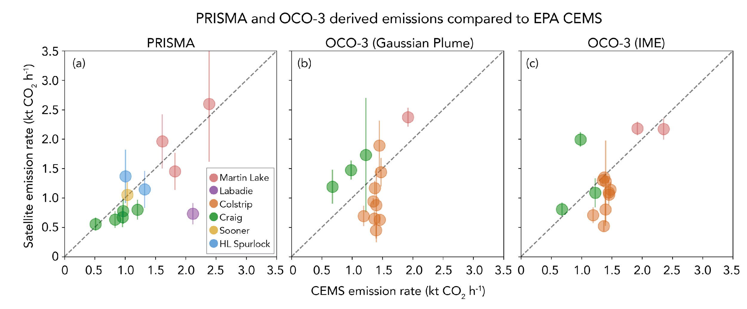
Use Case 2: Validation can be performed for CO2 emissions by comparing against power plants in “Annex 1 countries”
Example of how different instruments as well as knowledge error in wind fields affects reported emissions 🡪
Lots of scatter! But the mean is reasonably well estimated

Slide 11
Use Case 2: Validation of CH4 emissions can be performed using “controlled release” experiments
Figure courtesy of GHGSat

Slide 12
Use Case 2: Other factors affecting how plume mapping based emissions are reported from New Space
Intellectual property concerns mean that provenance of data in different levels of data products (L1 radiances, L2 concentration enhancements, and L4 emissions) are not necessarily traceable
Need to develop evaluation metrics for how well these products are reported and evaluated (in process with ESA / NASA evaluation team)
Public missions (e.g. EMIT, CO2Image) can be used as benchmarks for data products and transparency
May need to move away from “no false positive” for public missions and instead provide gradation of data quality flags

Slide 13
Summary
Emissions based on Public and New Space observations of CO₂ and CH₄ are increasingly being used for policy (e.g. CEOS contribution to stock take, air quality) and these empirical data are likely needed for a functioning carbon market
Are remediation efforts “bending the curve” of atmospheric CO₂ and CH₄ 🡪 global to local satellite based emissions estimates needed to assess the why and the where if actual and expected disagree.
Initiation of operational GHG emissions estimates (e.g. CAMS, USA GHG Center) and rapid expansion of satellites which report emissions at facility scales (especially New Space) means we need to think carefully about how these emissions are reported
These concerns were raised during May 2022 CEOS ACVC and led to meeting to assess how we report carbon emissions from satellite data (held July at CNES HQ during week of IWGGMS)
Meeting objectives supports incoming JAXA focus on GHG measurements
Meeting objectives supports CEOS New Space and Stock Take activities

Slide 14
Feedback Welcome!
Meeting recommendations
and possible future directions
(Use Case 1: regional to global emissions)
Support harmonization of satellite based emissions reporting from different groups / centers 🡪 Products should also include ancillary data that describe how the primary errors affect emissions AND ancillary data (e.g. covariances, mapping matrices, priors) needed to compare one set of emissions to another
Products should likely be staged for different users (e.g. science users requires emissions and all ancillary data, policy user may just need a number an its uncertainty / confidence level)
(Use Case 2: facility scale emissions)
(Given issues with intellectual property, person in the middle processing of data, and “no false positive” goal) CEOS should support transparency of New Space data, if they are to be used for science, policy, and financial markets by developing evaluation metrics for reported concentrations and emissions
Evaluation metrics can be baselined against (operational) products from public missions (e.g. EMIT, and upcoming CO2Image and TANGO). Note that ongoing work with IMEO and a joint ESA/NASA working groups are supporting these efforts.
Support development of machine learning codes to reduce “person in the middle” need for evaluating plume concentrations and increasing throughput of emissions reported by public missions.
Should CEOS support control release validation of these emissions? Or is current support from UNEP / IMEO sufficient?

