Slide 1
Greenhouse Gas (GHG) Task Team within joint CEOS/CGMS WG Climate
Y.Meijer, ESA
GHG Task Team Lead
Agenda Item 2.5
SIT Technical Workshop 2023
18th – 19th October 2023, ESA/ESRIN

Slide 2
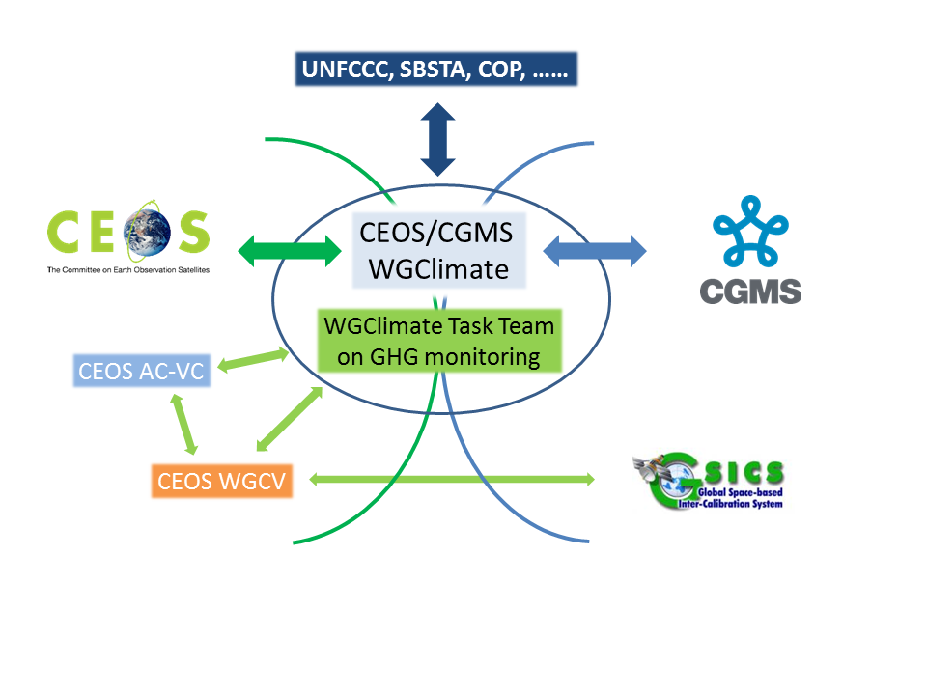
GHG Task Team Role
Responsible for maintaining and implementation of the GHG Roadmap
Interfaces with, stimulates and monitors GHG related activities across various (CGMS &) CEOS WGs: WG-Climate, WG-CalVal, AC-VC, WG-CapD, NewSpace Task Team, etc
Actively ensure representation of CEOS and CGMS bodies by identifying Points of Contact (PoCs) for tasks to be executed by these bodies

Slide 3
GHG Task organisation
Area leads (plus deputies) have been appointed using the thematic areas of Annex C (actions) in the GHG Roadmap:
Stakeholder Engagement - Mark (John, Wenying)
System Development Facilitation – Richard (John, Kevin)
Operational Preparation and Training – TT discuss
Sensor Development – John (AC-VC) (Yasjka)
L1 & L2 GHG Product Development – Ruediger & Dave
Flux Inv. Model Development – Kevin (Frederic)
Calibration & Validation – Hiroshi (Kuze)
Leads mailing list has been set-up ghg-tt-leads@googlegroups.com
Points of Contact of all WGs have been obtained
GHG TT mailing list has been set-up ghg-tt@googlegroups.com
Work has been supported by Symbios!

Slide 4
Meetings in 2023
General Meetings
02 FEB: GHG Task Team meeting #2, at WMO, Geneva
12 SEP: Leads discussion (telecon)
17 OCT : GHG Task Team meeting #3, at ESRIN
Contributions to various CEOS and CGMS (WG) meetings
Topical meetings
7-8 JUN (Joint CEOS/IMEO) International Coordination Workshop on Detection of Anthropogenic Methane Emissions from High-Resolution Satellites, Harvard Uni., USA
03 JUL Emission Uncertainties Workshop, Paris, France

Slide 5
Recent Achievements – 1/2
GHG Roadmap Update
Only soft update through Annex C of the GHG Roadmap
Action list has been updated through a thorough review per Area coordinated by Area Leads (add more milestones & specific (SMART) actions)
Split along various scales (point/area vs national/regional)
Split between CO₂ & CH₄
GCOS IP
Contributed to the Space Agency Response to “GCOS IP 2022”, specifically to activities: B3.1, F2.2, F5.2 & F5.4
Response quite well covered by current or planned GHG TT activities
Main activity gap is for observations in difficult areas and challenging circumstances, e.g. Polar regions (esp. winter)
Engagement with WG-CV on sustainability of GHG Cal/Val networks

Slide 6
Recent Achievements – 2/2
International Engagement
CMS Application Workshop
WMO Global GHG Watch (G3W)
IMEO (members participating in WGs)
CEOS GHG Missions Portal; centralized overview of GHG Missions in one Portal
New Space
As just outlined under agenda 2.3 by J. Worden, significant steps have been taken
IMEO seeks expertise to coordinate facility scale observations (in general) and then especially for the ‘tip-and-cue. This would be across various operators (commercial, NGOs, philanthropic, public and mixes thereof) → ROLE for CEOS?

Slide 7
CEOS Work Plan & Way forward
Status GHG Task Team actions in CEOS Work Plan
CARB-23-01: Lessons learnt from pilot CO₂ and CH₄ products (delivered for GST-1) → closed
CARB-23-02: Standards for uncertainty monitoring of flux estimates → closed*
CARB-23-03: GCOS IP response for GHG-related activities → closed
CARB-23-04: Update GHG Roadmap (focus on Action List) → (almost) closed
CARB-23-05: New Space and GHG product development and standards setting → closed*
* This will evolve further as normal work in GHG TT
Next steps of GHG Task Team:
Coordinate GHG TT activities with the AFOLU Roadmap Coordinate with New Space TT
Ensure continuity to earlier/existing missions
Engage with and ensure CEOS expertise is used in WMO’s G3W and UNEP’s IMEO

Slide 8
Following slides provide detailed info on:
CARB-23-01: Lessons learnt from pilot CO₂ and CH₄ products delivered for GST-1

Slide 9
Lessons learned from GST pilot CO₂ and CH₄ products Kindly provided by B. Byrne and J. Worden (NASA-JPL)
Key take-home message:
A number of challenges have been noted that need to be addressed for the GST product. However, it’s also important to note the substantial interest from both the public and policymakers in the product.
As noted at the WMO Workshop and the press release on these products, there is a clear need for this information with over 50 countries not reporting emissions in the last decade.
These lessons learned provide the context and motivation to advance and improve on these products.
→ Further details in backup slides

Slide 10
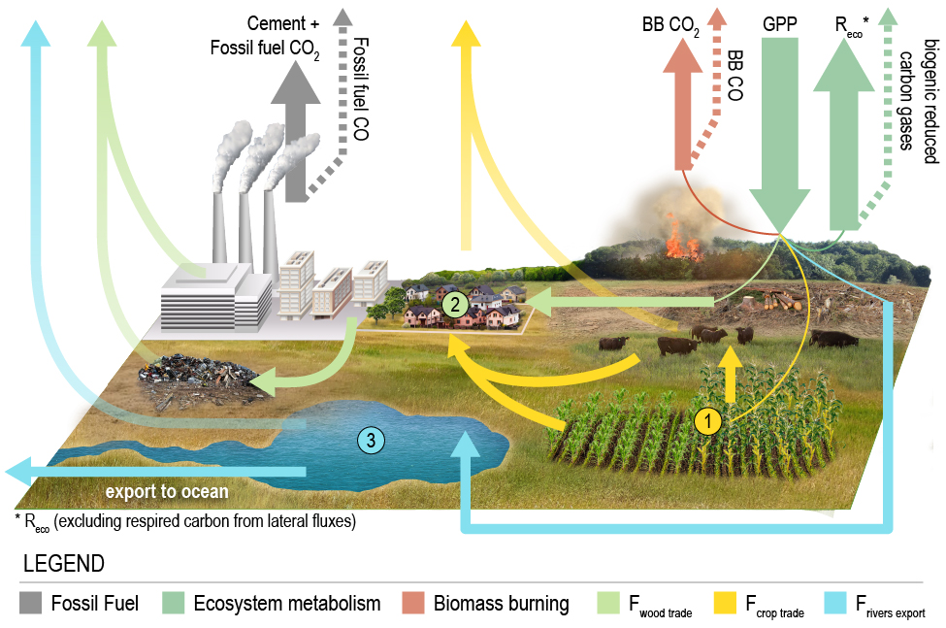
Review – CO₂ dataset Byrne et al. (2023): https://doi.org/10.5194/essd-15-963-2023
Based on ensemble of CO₂ inversions (11 inversion systems)
Luckily could take advantage of ongoing OCO-2 MIP activities.
Allowed estimate of uncertainty from ensemble spread
Net surface-atmosphere fluxes were corrected for fossil fuel emissions and lateral fluxes to estimate carbon stock changes (to be more comparable to bottom-up inventories).
Provided estimates of country and 1x1 gridded fluxes with uncertainties of: net surface- atmosphere flux (NCE), change in terrestrial carbon stocks (dC) and bottom-up fossil fuel and lateral flux estimates
Illustration of how lateral C fluxes impact carbon budget

Slide 11
Review – CH4 dataset Worden et al. (2022): https://doi.org/10.5194/acp-22-6811-2022
Example Sectoral CH₄ emissions
Analytic inversion using GEOS-Chem model
Allowed estimate of Bayesian uncertainty and information content from CH4 data (DOFs)
Net CH₄ emissions were decomposed into sectors:
Livestock, Rice, Waste, Fire, Oil, Coal, Gas, Seeps, and Wetland
Provided sectoral emissions estimates with uncertainty estimates for countries and on a 1x1 grid

Slide 12
Lessons learned: 1. Challenges in making apples-to-apples comparisons
Changes in atmospheric CO₂/CH₄ mole fractions are a result of net fluxes due to all sources and sinks. Inventories track emissions/removals due to specific processes.
Particularly challenging for CO₂, where isolating impact of land management is challenging:
Countries do not provide maps of managed lands.
There are also large uncertainties in lateral fluxes, particularly at sub-national scales.
Fossil fuel biases (which are assumed un-biased) will also impact land emission/removals estimates.
CH₄ benefits from comparatively distinct sectoral sources, which show distinctive enhancements in CH₄.
An Analytic solution also improves the comparison between estimates as prior information and correlations in the estimate (e.g., smoothing error) can be quantified and accounted for with the comparison

Slide 13
Lessons learned: 2. Uncertainty quantification
Accurate assessment of uncertainties is critical. Challenging to characterize all components:
Errors associated with atmospheric inversion model/configuration (transport, biased priors).
Can be estimated by using an ensemble of inversion models (was possible for CO₂ dataset but not CH₄)
Errors in GHG measurement – biases in particular.
CO₂ dataset attempted to identify biases through comparisons of posterior model CO₂ fields with independent atmospheric CO₂ measurements that were not assimilated (found OCO-2 ocean glint data had significant biases).
Regional biases are very challenging to identify due to sparse data for evaluating performance. For example, large regional flux differences in tropical in situ and OCO-2 inversions were indistinguishable when compared with independent data.
Bayesian posterior uncertainties.
This characterizes the impact of errors in the observations and prior constraints on posterior flux estimates.
Not characterized in many inversion techniques, only small subset of MIP models calculate. Of those that did, the estimates were hugely variable.
Posterior errors and degrees of freedom were calculated for CH₄ dataset

Slide 14
Lessons learned: 3. Limitations for small and mid-sized countries
Uncertainties are very large for mid-sized (e.g., Turkey-sized) and smaller countries. CH4 dataset suggests 57 countries are well constrained by the GOSAT data, with increased information expected when we can fully utilize TROPOMI data plus the plume mapping observations (i.e. an integrated multi-scale inversion approach) Several main limitations:
Data density from GOSAT / OCO-2 is still pretty sparse. Denser observational coverage would help capture smaller areas.
Transport models are too coarse (many run at 4 x 5 degrees, which is insufficient for many countries).
Biases in model transport and potential regional greenhouse gas retrievals limit the spatial scales that can be captured. We need to reduce both of there errors.

