Slide 1
SIT Technical Workshop 2023
Satellite-based global maps in support of the global stocktake
Joana Melo, EC JRC
Agenda Item 3.2 biomass harmonization update
SIT Technical Workshop 2023
18th - 19th October 2023, ESA/ESRIN

Slide 2
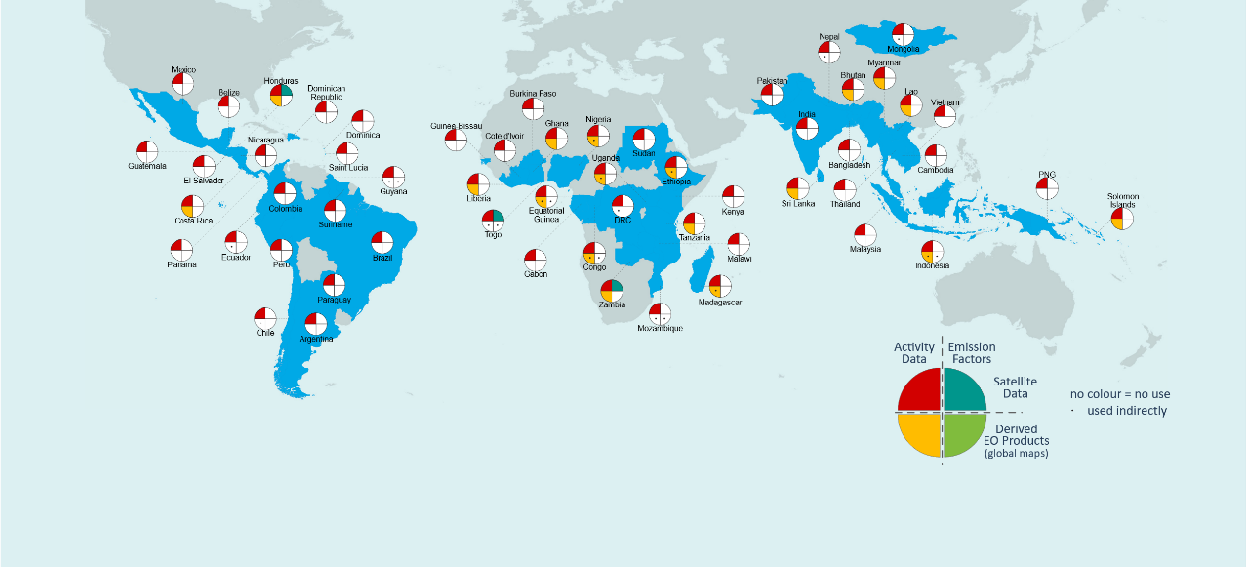
Satellite-based global maps in support of the GST Uptake in national GHG inventories – our baseline
Melo et al 2023 Environ. Res. Lett. 18 034021
Use of satellite-based global maps?
75 submissions to the UNFCCC
56 countries (a subset of the 153 developing countries included in the JRC database)
80% tropical forests
Global product | AD | EF | Indirectly
Global forest change (GFC) | 16 | - | 14
MODIS Fire (BA, AF) | 2 | - | 1
Saatchi et al (2011) | - | - | 3
Baccini et al (2012) | - | - | 2

Slide 3
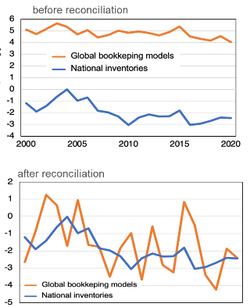
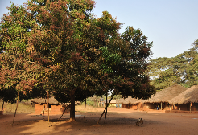
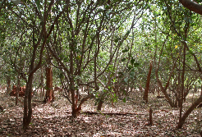
Satellite-based global maps in support of the GST Considerations for uptake and for global independent estimates
Contributing to the Global Stocktake with independent estimates requires
Adherence to IPCC guidance and national definitions
and explaining the differences to GHGI
$$∆C=\frac{C_{t_{2}}−C_{t_{1}}}{t_{2}−t_{1}}$$
$∆C={∆C}_{G}+{∆C}_{CONVERSION}−$ ${∆C}_{L}$
4.8 GtCO₂ yr⁻¹
$$Emission=A×EF$$
6.7 GtCO₂ yr⁻¹
−1.9 GtCO₂ yr⁻¹
Forest land converted to cropland
settlements
cropland
Grassi et al 2023 Earth Syst. Sci. Data, 15, 1093–1114

Slide 4
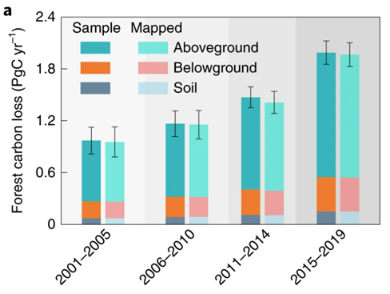
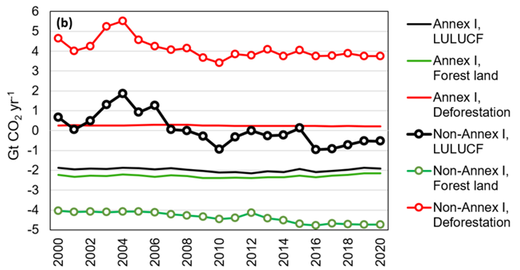
Satellite-based global maps in support of the GST Considerations for uptake and for global independent estimates - example
independent estimates using EO datasets
aggregation of national GHG inventories
Feng et al 2022 Nat Sustain 5, 444–451
Grassi et al 2023 Earth Syst. Sci. Data, 15, 1093–1114

Slide 5
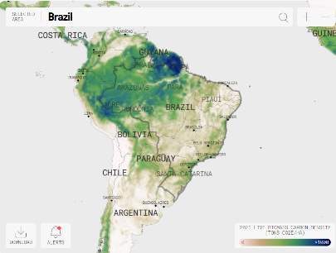
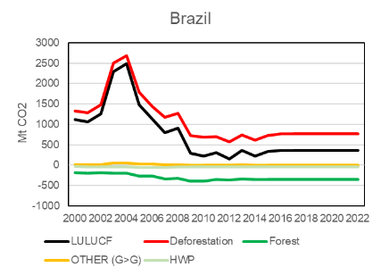
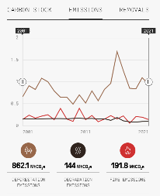
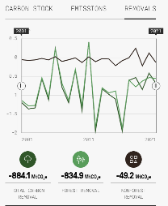
Satellite-based global maps in support of the GST Considerations for uptake and for global independent estimates - example
Brazil as a much larger source in the GHGI than in independent estimates
lower forest sink in the GHGI (-317 MtCO2) compared to -835 MtCO2 in ctrees) – unmanaged forest (?)
higher emissions from deforestation in the GHGI (1093 vs 862 MtCO2 in ctrees)
MRV capacity / submissions to the UNFCCC
NC4
BUR4 with REDD+ Annex
FREL 2014, 2017, 2018, 2023
Average 2001-2021
1,093 MtCO2
736 MtCO2
7 MtCO2
-317 MtCO2

Slide 6
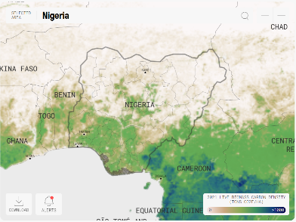
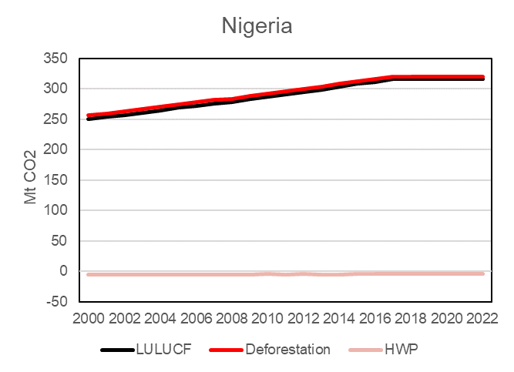
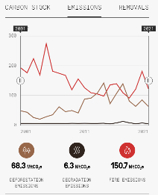
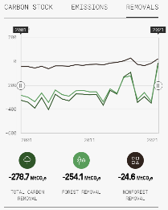
Satellite-based global maps in support of the GST Considerations for uptake and for global independent estimates - example
Nigeria as a large source in the GHGI and a sink in independent estimates
No forest sink reported in the GHGI vs -279 MtCO2 in ctrees
higher emissions from deforestation in the NGHGI (295 vs 68 MtCO2 in ctrees; FREL = 32.4 MtCO2)
MRV capacity / submissions to the UNFCCC
NC3
BUR2
FREL 2018, 2019
Average 2001-2021
295 MtCO2
290 MtCO2

Slide 7
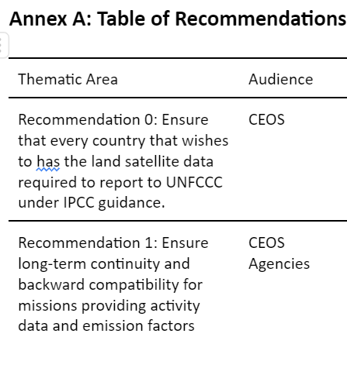
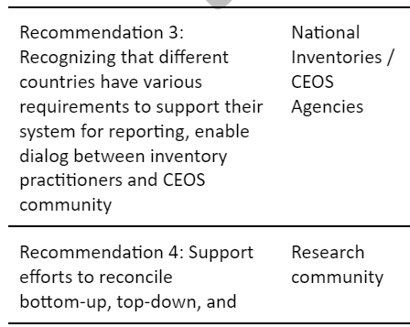
Satellite-based global maps in support of the GST moving forward with the implementation of the AFOLU roadmap

