Slide 1
Session 4: GEO-CEOS Relationship 4.2 GEO Work Programme
Wenbo Chu, GEO Secretariat
Agenda Item #4.2
SIT Technical Workshop 2023
18th - 19th October 2023, ESA/ESRIN

Slide 2
CEOS in GEO Work Programme
EO4DRM
EO4SDG
Notes:
GFOI: Leadership group

Slide 3
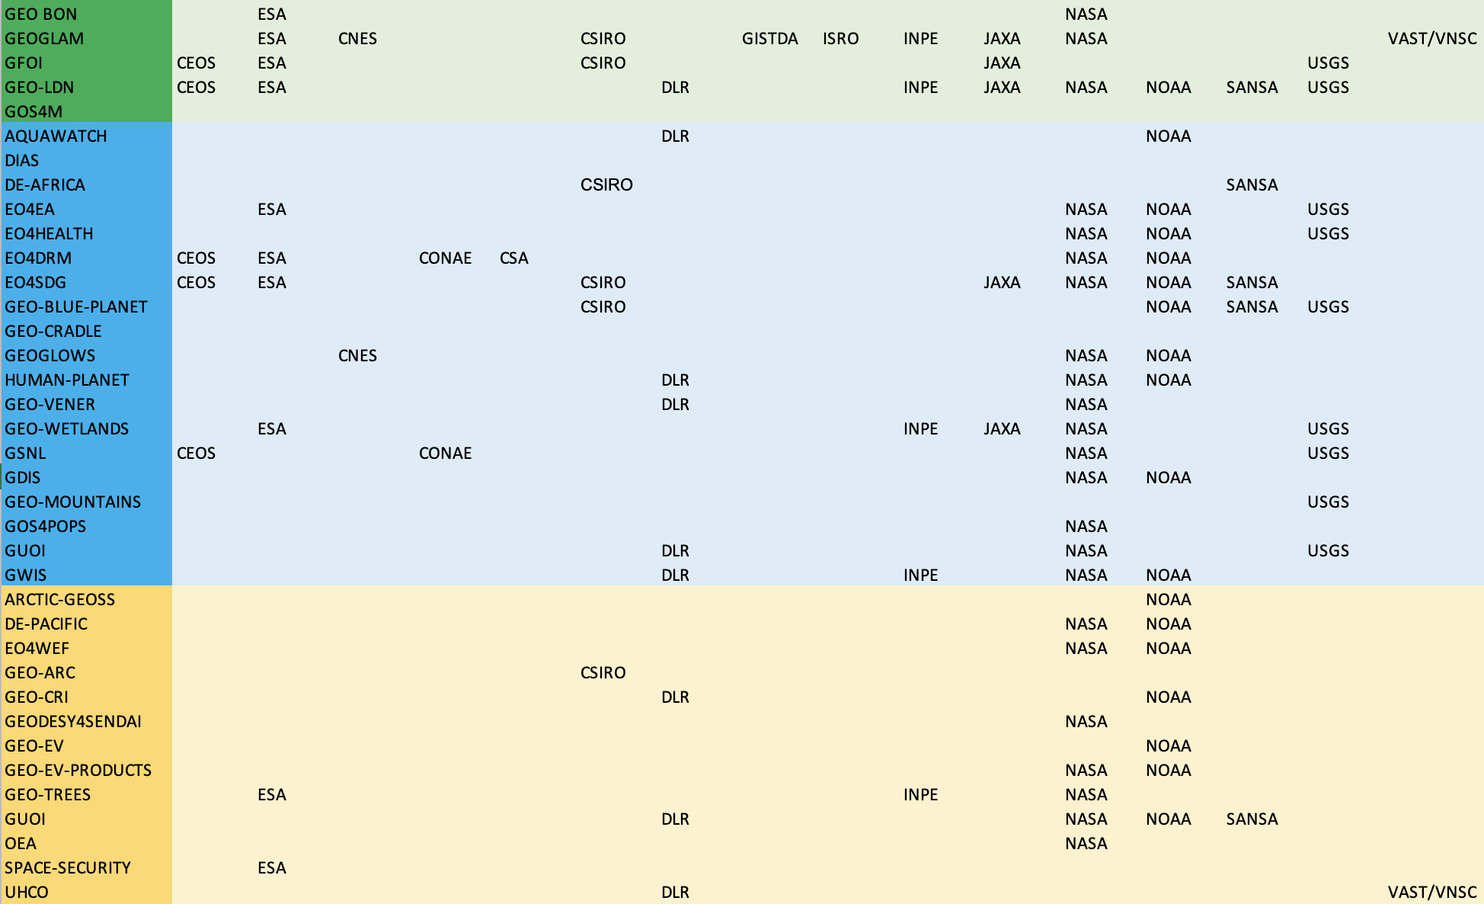
CEOS in WGs
CEOS Agencies in GEO Work Programme

Slide 4
CEOS Agencies in GEO WGs and TT
Capacity Development WG - Nancy Searby (NASA) - Co-chair - Allison Craddock (NASA) – Co-chair Climate WG - Mark Dowell (EC) - Co-chair - Virginia Burkett (USGS) - Co-chair - Wenying Su (NASA) - Osamu Ochiai (JAXA) - Frank Martin Seifert (ESA) Data WG Richard Moreno (CNES) – Co-chair | DRR WG - David Borges (NASA) - Bandela Ajay Kumar (INCOIS) - Helene De Boissezon (CNES) - Laura Frulla (CONAe) - Amy Parker (CSIRO) GIDTT - David Borges (NASA) - Mirko Albani (ESA) - Richard Moreno (CNES)
Notes:
Climate WG
Mark Dowell (JRC) - Co-chair of CC-WG
Virginia Burkett (USGS) - Co-chair of CC-WG
Wenying Su (NASA)
Patrick Taylor (NASA)
Osamu Ochiai (JAXA)
Joerg Schulz (EUMETSAT)
Frank Martin Seifert (ESA)
Susanne Mecklenburg (ESA)
Simon Pinnock (ESA)
Albrecth von Bargen (DLR)
Laurence Monnoyer-Smith (CNES)
Emma Fernandes (CSA)
Maria Libera Battagliere (ASI)
Armel Nzue Mba (AGEOS)
Others are not CEOS agencies while they participate in both GEO and CEOS-CGMS WGClimate:
Stefan Roesner (DWD)
Antonio Bombelli (GCOS)
Joanna Post (UNFCCC) – now replaced by Tracy Tollman
DRR WG
David Borges (NASA)
Bandela Ajay Kumar (INCOIS, not ISRO..I don’t know why he is a CEOS representative)
Helene De Boissezon (CNES) (last year’s CEOS WG Disaster chair),
Laura Frulla (CONAe) (this year’s CEOS WG Disaster chair),
Amy Parker (CSIRO)
Stefano Salvi and Marcelo Uriburu Quirno are also members to both CEOS and GEO Disaster Working Groups. This is because we have integrated each other’s activities:
GSNL and GWIS Initiatives are registered as CEOS WG Disaster activities
EO4DRM Initiative is an umbrella for a few CEOS WG disaster activities

Slide 5
CEOS in GEO Governance
Programme Board:
CEOS has been continuously sitting on the GEO Programme Board since 2016
Representatives from CEOS agencies: ESA, JAXA, NASA, NOAA
Executive Committee:
CEOS is an observer at the GEO ExCOM meetings

Slide 6
Observations
GEO greatly values the contribution of CEOS and its agencies and associates
GEO is a brand and network that we all share
Looking ahead, there are many new opportunities for GEO and CEOS to continue working together

Slide 7
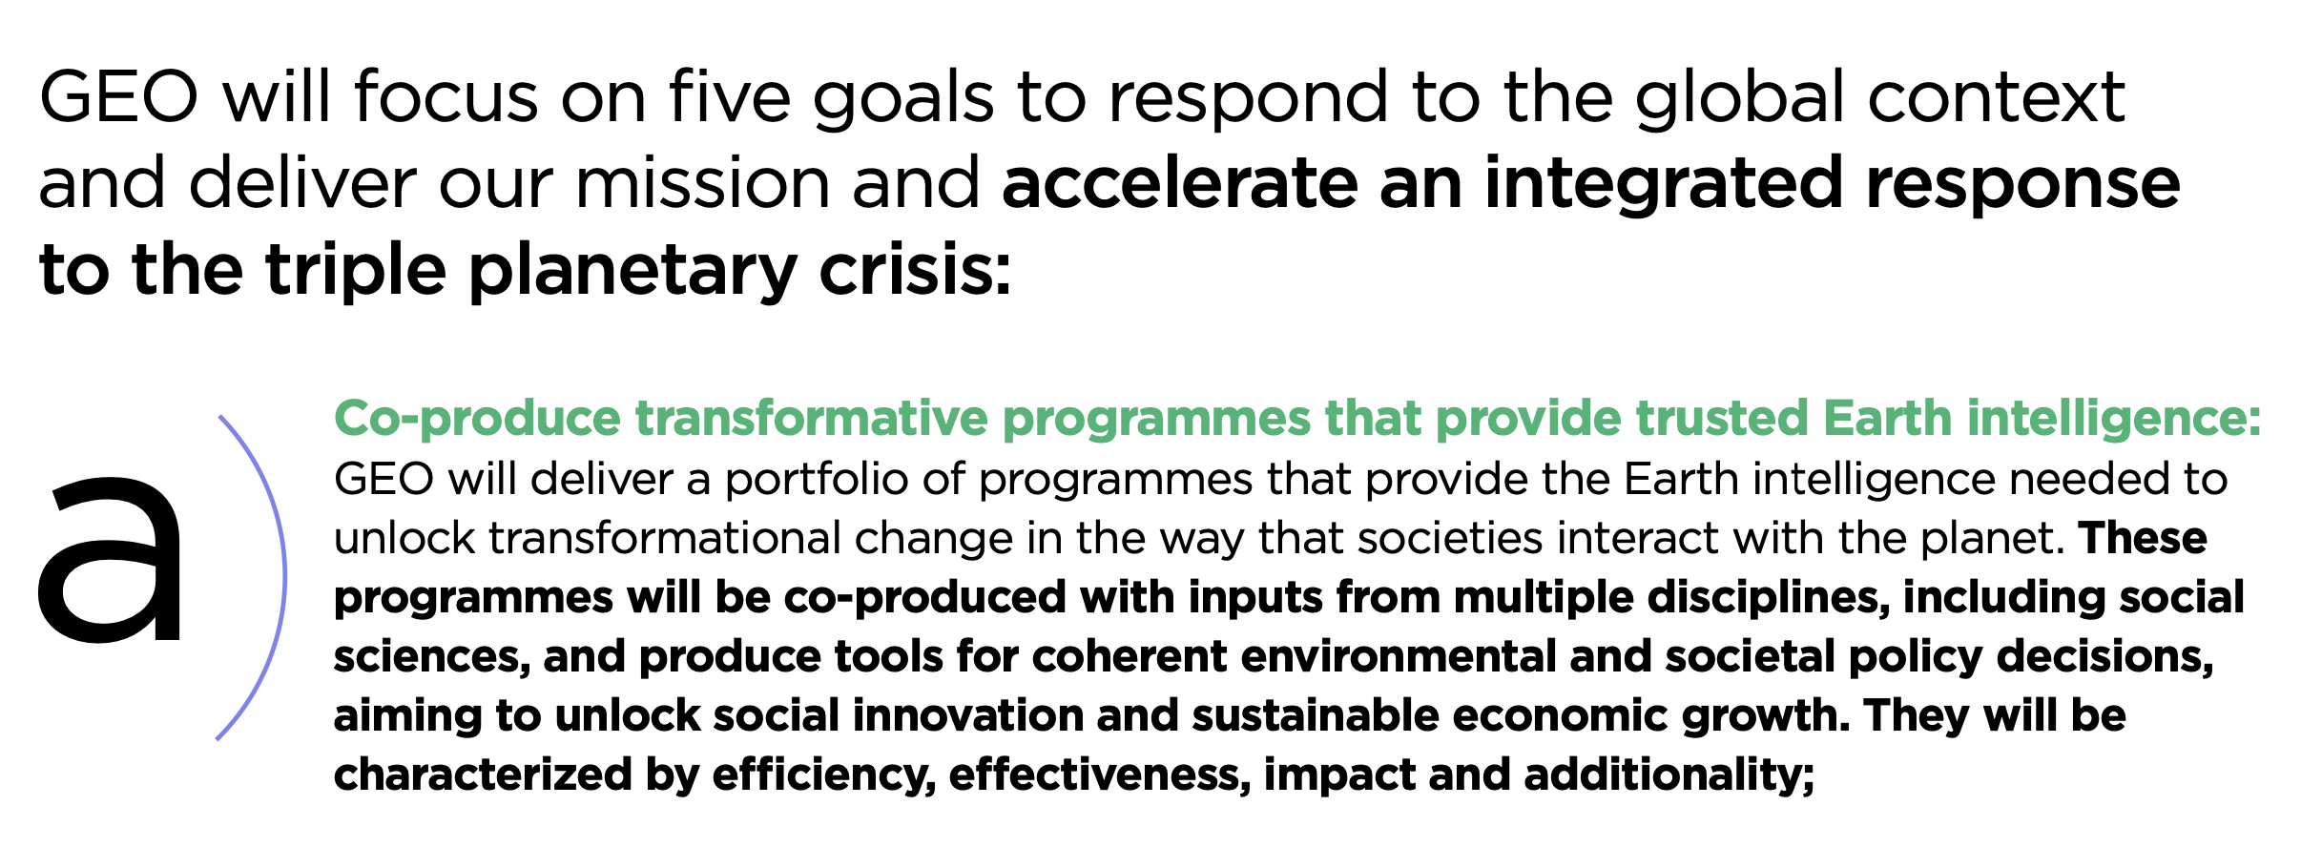
Engagement Opportunity
Shaping the Post-2025 GEO Work Programme

Slide 8
PB Task Force
The PB to steer the development process until the next “GEO Week” (April 2025) of designing the Post-2025 GEO Work Programme (part of the Post-2025 Implementation Plan) which
Aligns with the Post-2025 Strategy: focused on delivering transformative programmes that deliver value against major policy priorities and innovative operational services
Transitions from the current GWP 2023-25 through the “development of a prioritization framework for the GEO Work Programme”
Conceptualizes and documents the process and the principles to initiate and operate Post-2025 Incubators.

Slide 9
Anthony Milne (GRSS) - Lead Evangelos Gerasopoulos (Greece) - Lead Amos Kabo-Bah (Ghana) - Lead Xiang Zhou (China) Mark Dowell (EC) Thierry Ranchin (France) Laurent Durieux (France) Osamu Ochiai (Japan) | Hiroyuki Muraoka (Japan) Jesarela Lopez Aguilar (Mexico) Matthew Foote (UK) Justyna Nicinska (US) Karl Benedict (ESIP) Allison Craddock (IAG) Bapon Fakhruddin (ISC) Nils Hempelmann (OGC)

Slide 10
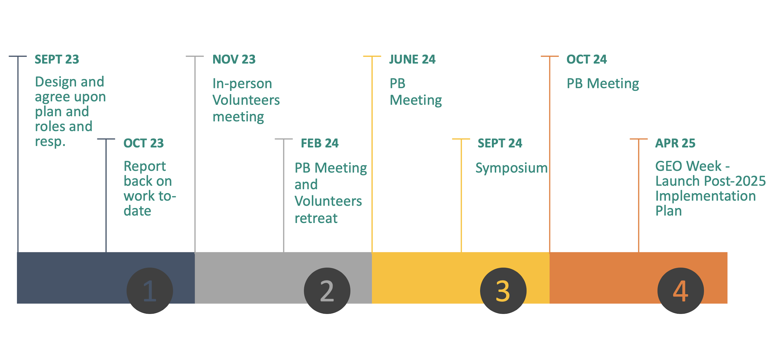
Timeline

Slide 11
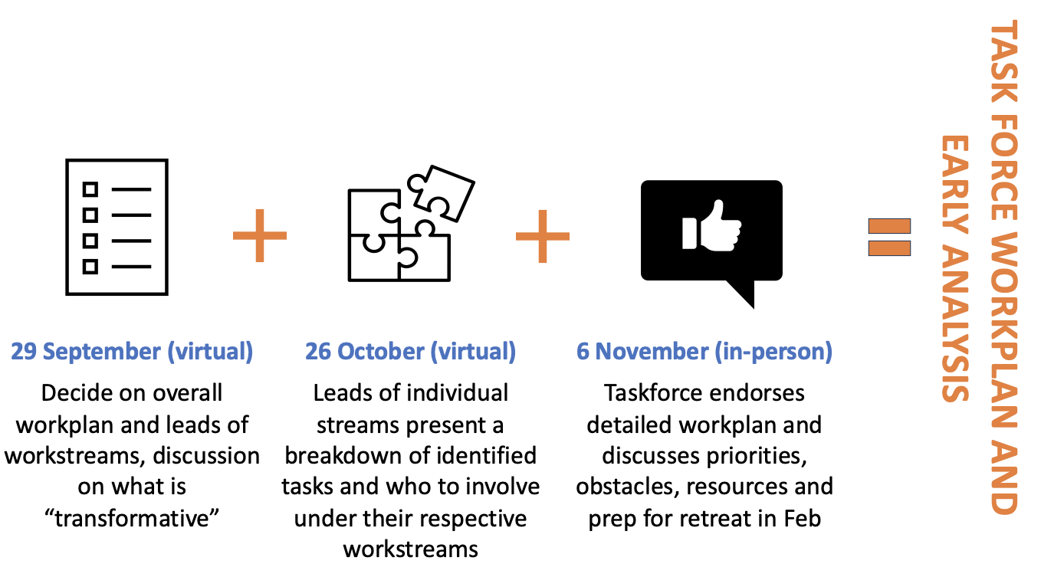
Near-term activities

Slide 12
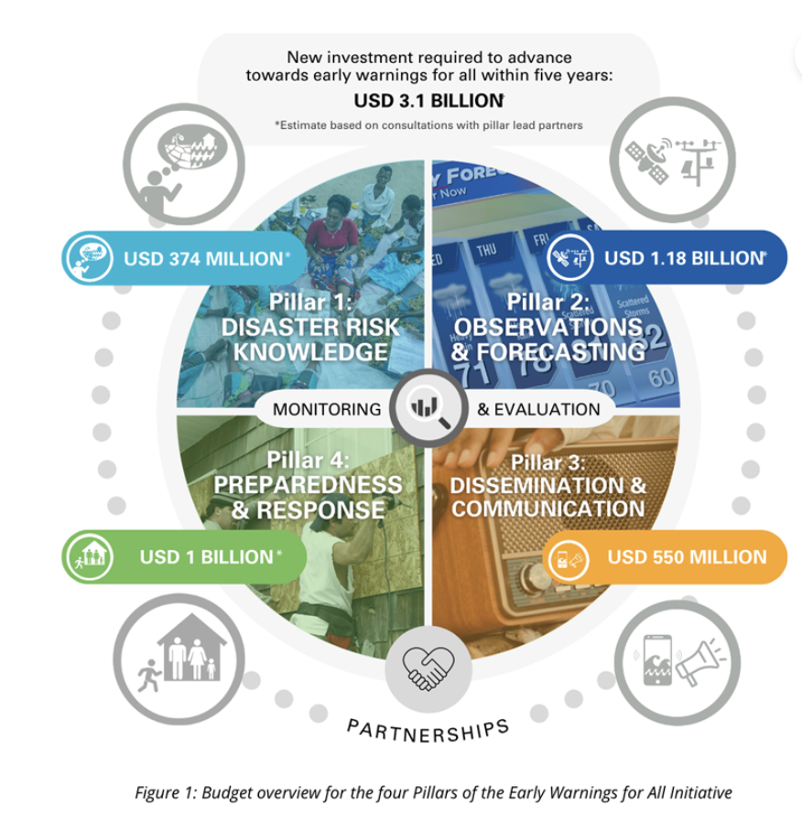
Engagement Opportunity – EW4ALL
(2023-2027)
a supporting implementing partner
of
Notes:
GEO is a supporing implementing partner of the EW4All, the UN Global Early Warning Initiative for the Implementation of Climate Adaptation
GEO has been supporting planning of implementation for Pillar 1 and 2
Having a chance to collaborate with the 4 leads (WMO, UNDRR, ITU and IFRC) as well as other implementing partners, such as REAP, FAO, WFP, UNICEF, UNEP, UNESCO and UNFCCC.

Slide 13
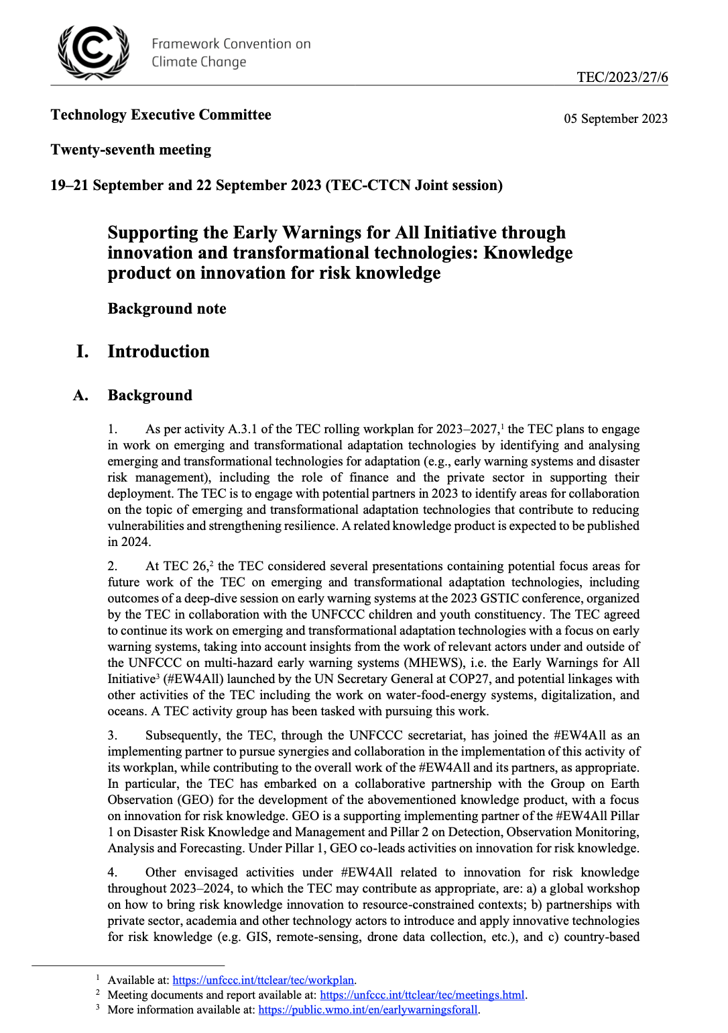
UNFCCC TEC-GEO collaboration:
A knowledge product on innovation for risk knowledge
Assessing gaps in available risk knowledge in developing countries, especially in SIDS and LDCs with regards to the early warning systems
Possible sources of info: GCF, AF, CREWS etc.
Aiming to provide guidance/insights on how gaps could be overcome through utilizing existing and emerging technologies, tools and innovation
Concept note was presented and agreed at TEC meeting (21 September)
Planning to leverage GEO WGs
Notes:
Within this outcome 7, GEO and UNFCCC Technology Executive Committee (TEC) is now planning on a new knowledge product to conduct gap assessment in available risk knowledge in developing countries, especially in SIDS and LDCs with regards to the early earning systems.
This work is positioned as an official work of TEC, and the proposal is presented at TEC meeting on 19-22 September for formal approval.
Rui intends to leveradge the experties of GEO DRR and Climate WGs to conduct this work.
CEOS members are most welcome. Please contact Rui if you are interested.

Slide 14
Engagement Opportunity – COP

Slide 15
Thank you
Wenbo Chu
wchu@geosec.org

