Slide 1
New Space Task Team
White Paper Overview and Recommendations
Antonio Ciccolella, ESA
Agenda Item 5.1
SIT Technical Workshop 2023
18th - 19th October 2023, ESA/ESRIN

Slide 2
Introduction
The public sector has historically played a role as an entrepreneurial force in space market: today, the private sector is more and more active in the space market
This has resulted in an increase in commercial opportunities produced from space:
The landscape of space activities has evolved thanks to the growth of industrial interests with the support of ever-increasing private capital flows
This evolution, started in the US, has begun transforming the way governments/public institutions operate in space and opened new avenues for economic growth & technology development
Actions at government level aim at achieving sustainable growth of the national space sector, through a combination of economic, industrial and legislative innovations

Slide 3
The NSTT in CEOS
The topic of “New Space” has been introduced in CEOS by the 2022-2023 CEOS Strategic Implementation Team (SIT) Chair
The CEOS New Space Task Team (NSTT) was established to explore opportunities in New Space that bring mutual benefit to all parties, including the identification of concrete initiatives, if any, that will drive the agenda forwards
The membership of the NSTT was open to representatives of all CEOS Agencies and to leads of the various CEOS Working Groups (WGs), Virtual Constellations (VCs) and Ad Hoc teams (AHTs)
The CEOS WGs, VCs and AHTs aimed to foster the partnership between CEOS Members and the New Space sector to provide more accurate and tailored information

Slide 4
Objectives and deliverable
Sharing experience between CEOS Space Agencies, through dedicated sessions at each CEOS meeting attended by CEOS Principals (SIT, SIT Technical Workshop, and CEOS Plenary)
Recommend actions within the CEOS framework that aim to enhance the outcomes of CEOS entities (WGs, VCs, AHTs) working with New Space companies
Assess areas and issues that are common among CEOS agencies and that may impact public EO programmes in future
Issue a White Paper summarising Findings & Recommendations, based on both the information collected during the experience sharing sessions and reporting of specific relevant activities undertaken by CEOS entities

Slide 5
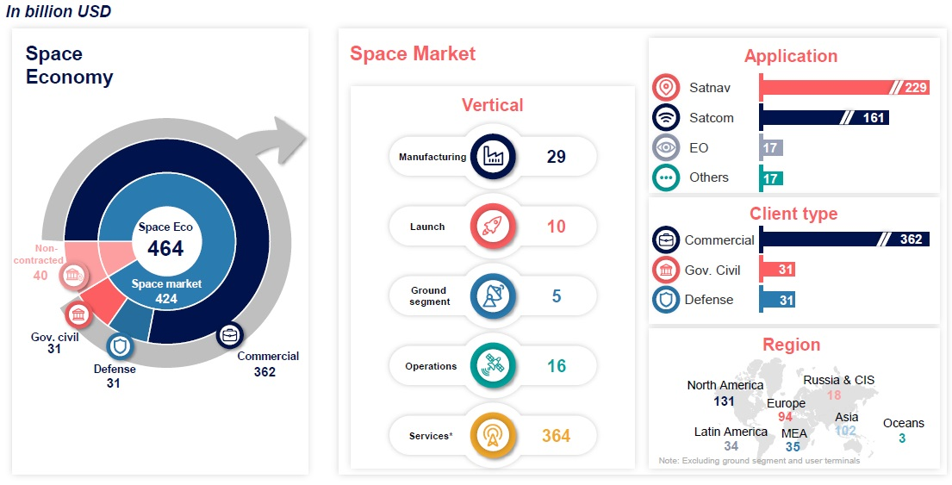
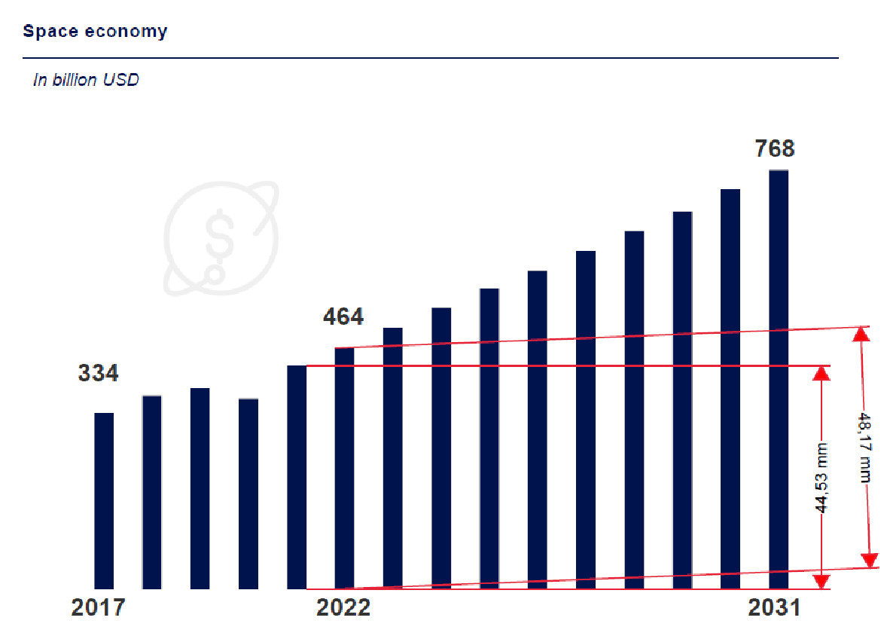
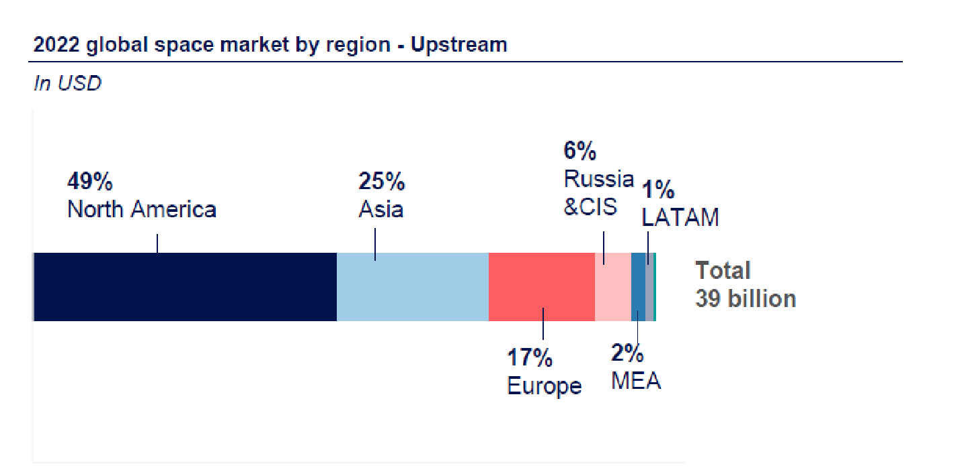
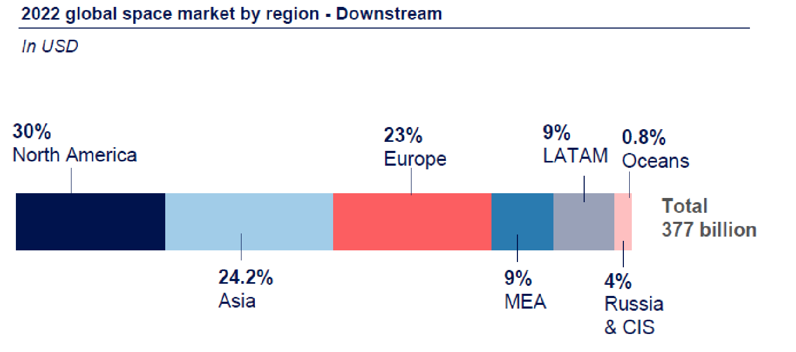
The Space Economy: Main Facts and Figures
Credit: Euroconsult Space Economy Report, 2022

Slide 6
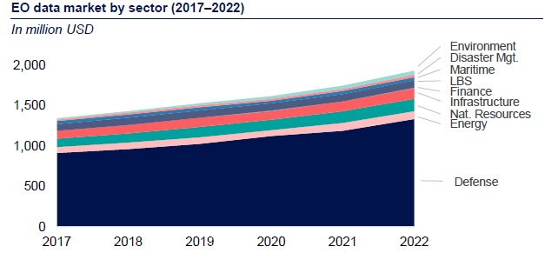
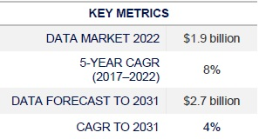
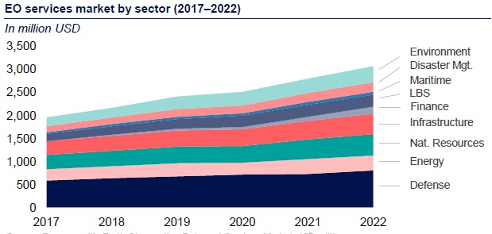
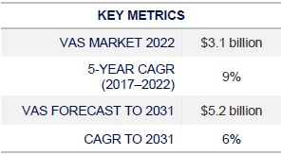
The Earth Observation Data and Services Market
Forecasted trend of EO data market is growing (4%) but less that in the past (8%)
Forecasted trend of EO service market is growing (6%) but less that in the past (9%)
Market is fragmented
Constellation operators don’t plan profitability soon. This could reduce attractiveness for investor
Security and Defence have a dominant share in data market, less pronounced in VAS
EO market is modest (4%) compared to NAV and SatCom mainly due to early stage of commercial services uptake and the absence of B2C market
SatNav is dominated by indirect space businesses, SatCom see a decreasing satellite TV compensated by connectivity needs
Credit: Euroconsult Space Economy Report, 2022

Slide 7
What is “New Space”?
An unequivocal definition of “New Space” is not available
In the EO context, its use tends to describe the emergence of an entrepreneurial space industry characterised, inter alia, by:
Financing from the private sector; widespread use of commercial-off-the-shelf (COTS) and miniaturised technologies; rapid prototyping and development; innovative business models and procurement approaches; observations via macro-constellation; use of ML and AI for data processing
Efficient cost management; sharing development funds and operational risks between public and private sectors through Public Private Partnerships (PPP).
Ownership of the assets usually belongs to industry unlike the traditional space approach, where it belonged to the public sector.
In the traditional approach the public sector decided “what” and “how” defining the detailed requirements, in the new paradigm the public indicates only the “what” with high level needs, leaving industry to define the “how” and the detailed outcomes.
EO “New Space” businesses have demonstrated growth and stability only when explicit public support has been granted to them

Slide 8
Potential role of the public/governmental sector for emerging EO industry
Regulation
Legitimacy
Partner
User/Customer
Investor
Fostering, via proper regulations, national products/services to support market growth, enhancing commercial market access
Commercially tailored regulations and procurement rules minimizing bureaucratic burden and uncertainty
Ensuring reciprocity with foreign markets
Defining policy and Space Law of the commercial sector
Regulating the implications of national security and sovereignty for the emerging industry (e.g. VHR)
Developing, establishing or enforcing standards
Fostering applications of EO and synergies to generate an internal ecosystem with governmental-commercial links
Conferring market credibility to EO Industry through technical and business support and qualification
Supporting the trajectory of novel EO industrial activities (e.g. for strategic purposes or for filling a gap)
Co-funding EO industry through large PPP to establish investment trajectories for commercial businesses
Supplying competences (i.e. technical, industrial and business) to advance concept design towards commercial stage
Coordinating complementary technology, market, and partners for a common effort in the EO industry facilitating new entrants
Creating human capital by supporting academia and industry in specialized business tailored education to a EO commercial novel labour market
Support the development of technical capacity
Defining an economic framework to aggregate the demand and procuring them, capitalising on national and international assets
Being the Anchor customer for an unproven product to reduce market risks
Procuring products and services from both space and non-space, which better suit public needs and policies
Co-funding EO industry through Anchor Tenancy set up or large PPP for priority and strategic applications (e.g. fostering end-to-end Value-Added Services)
Providing funding availability to industry complementary to market and private investors
Providing dedicated financial structures to facilitate access risk capital or debt financing

Slide 9
Experience of CEOS Members
Although the experience of “New Space” in EO is heterogeneous and depends on national policies, strategies and capabilities, all the participating Agencies, directly or indirectly, support private investments in the space sector (e.g. for SME)
Many dedicated programmes are flourishing at national and international level
Motivations range from stimulating space economy and the competitiveness of national industry to the provision of novel products and services complementing the traditional “big” satellite missions
PPP and anchor tenancy are the most common arrangements methods
The use of commercial data are also being explored for scientific and operational applications, thus creating synergies between industry, academia and government

Slide 10
Observation Gaps and Opportunities for New Space
Thematic Areas Observation Gaps - Opportunities
Agricolture Forests and Other Land Use | Documenting smaller scale AFOLU variables and land management, augmenting rather than replacing the observations of long-term programmes, increasing the revisit time.
SDG | Very High spatial and temporal resolution, with short latency tasking over specific location
Precipitation | 1) Timely precipitation products in near-real time for operational weather and hydrological services, ensuring consistency over time scales from few hours to decades. 2) Expanding the measurement network of GHG, provided that transparency on algorithms and datasets are guaranteed (IPR).
Climate | 1) Low-cost, affordable and sustainable frequent sampling and redundancy are potentially transformative for climate work, but dataset homogeneity shall be guaranteed, and the potential value depends upon the data use. 2) IPR and data costs may hinder the benefits of "New Space" implying commonality of contractual language
Disaster | 1) Urgent tasking, acquisition and short latency from the data request, high revisit and high resolution for the different stages of disaster 2) Great interest for emergency response in spite of the intrinsically limited image quality 3) Identify provisions to access free and open data policy while preserving the commercial interests of industry
Agriculture | 1) New Space data are already used e.g. in precision agriculture and crop classification, requiring consistent radiometric calibration 2) 10 m resolution TIR (+ VNIR) and 10-30 m radiometers with reliable and long- term access to archives 3) Hyperspectral data potentially add value to agricultural application 4) CEOS Agencies cooperate with industry and provide to develop user cases in exchange of data. Unclear the sustainability of this process.
Capacity Development | Albeit not traditionally engaged with the private sector in their activities, WDCapD advocate free and open use of data archives held by the private sector. Historical archives are of interest, which have negligible commercial value.
Land Surface Imaging | 1) Defined acquisition requirements for Essential Agriculture Variables: moderate resolution and tasking time can be contributed by Commercial/New Space 2) Fill the gaps in LST for Climate data record 3) Analysis Ready Data is of great interest in this sector, with trends in Machine learning and Artificial Intelligence
Ocean Surface Wind Vector | 1)For studies on mesoscale the target is 10 km with a frequency of, ideally, 6 h so addressing the need of scatterometer constellation 2) Ocean Current Retrivial, would, in future require Doppler scatterometers 3) Ocean Wind information would also require accurate information for wind speed greater than 30 m/s
Sea Surface Temperature | New Space could push the boundaries for higher spatial IR and temporal resolution for observations dynamic in sub-mesoscale coastal ocean region (0.1-10 km) [Niche application]

Slide 11
Opportunities of New Space to support Science
GNSS - Radio Occultation
GNSS - Reflectometry
Hyperspectral Imaging Spectroscopy
Synthetic Aperture Radar
Thermal Infrared Remote Sensing
VHR Commercial Optical Imagery (< 2 m)
Hyperspectral Imaging

Slide 12
Activities Supporting New Space in CEOS
Current Activities Supporting New Space in CEOS
Calibration and Validation References | 1) CEOS WGCV provides reference for Cal/Val and allow comparison of results that New Space can use to anchor its own satellites’ observations to assess fitness of purpose for these new data sources so reducing time to market and the return of investments 2) Achieve a good understanding of observation characteristics for interoperability and increase opportunity for global applications (agriculture, water use, climate applications etc). Harmonisation in Cal/Val is fundamental for augmenting the trust in accuracy and characterisation 3) Establishing reference for geometry and image quality Cal/Val via Reference Ground Control Point Database
Intercomparison of CEOS and New Space Data Base | CEOS WGCV has ongoing activities aimed at establishing intercomparison algorithms or approaches to Cal/Val, with obvious benefits for New Space
SI-Traceable Satellite SITSat Coordination | WGCV is coordinating SI-Traceable Satellite missions for the traceability of the measurement standards and measuring instruments to the International System of Units (SI) considering unbroken chain of calibrations or comparisons linking them to relevant primary standards of the SI units of measurements. A dedicated WG has been proposed for mission coordination, new technologies and spectral domain in view of integrated system approach.
Cal/Val Maturity Matrix | NASA launched the CSDA Project and ESA the EDAP to assess the quality of data from new vendors and constituted a common framework to verify claimed mission performances (ESA-NASA EO Mission Quality Assessment Framework). This is an interactive process between assessors and vendors. New Space gains knowledge of their data quality and have a feedback for improvements, increasing synergies between New Space and CEOS missions
CEOS Analysis Ready Data (CEOS-ARD) | CEOS-ARD and LSI-VC have engaged with a few new Space Providers and continues establishing dialogue for the sector, developing connections in the frame of VH-RODA, JACIE and LPS meetings. Having datasets processed to a minimum set of requirement and organised in a form allowing immediate analysis is of great benefit for New Space.
CEOS Interoperability Framework | The 2022 CEOS Plenary recorded a decision for a CEOS Interoperability Framework to be developed as a multi-Working Group and multi-Virtual Constellation activity, to provide guidance for the development of interoperable service and data. This may include and be beneficial for “New Space”
Open Data Cube | The Open Data Cube (ODC), created and facilitated by CEOS, is an open-source software architecture that can be equally used to manage CEOS datasets and New Space datasets. To date, there have not been any efforts to integrate and test CEOS data with New Space data in an ODC framework, but it can offer obvious advantages to CEOS and NS firms
CEOS Engagement with Standard Organisations | If CEOS considers the definition of standards to be one of its roles in supporting the New Space sector, additional coordination is necessary. In fact, New space has been active in the Spatio-Temporal Access Catalogue specification (i.e. a common language to describe geospatial information, so it can more easily be worked with, indexed, and discovered). CEOS needs to be reactive on this.

Slide 13
Conclusions 1/2
Institutional long-term programmes are the reference for New Space industry
New Space should be seen as augmenting long-term institutional programmes, albeit with reduced quality, rather than replacing them. Data quality is an essential factor for scientific and operational endeavours and needs harmonised assessment methods
Many New Space EO companies have started to re-structure their businesses with governments and public customers in mind, with data policies regulated by End-User License Agreement
B2G is prevalent in EO, B2B is increasing in certain areas (e.g. insurance). B2C is not existent
New Space applications are on the rise for some EO disciplines such as carbon monitoring, climate risk reporting etc.
New Space firms are still evolving and face the challenge to enlarge the user base beyond the public/government one to ensure an affordable and sustainable business case
The business continuity of New Space firm cannot be given for granted a priori
In general, today it is premature to assess the maturity of the commercial space market for EO and the definition of its priorities, which are still with public/governmental entities

Slide 14
Conclusions 2/2
Nonetheless, the overall volume of investments is such that public and private cooperation it is expected to continue, generating a natural selection of the commercial firms
In line with CEOS objectives, CEOS should have a supporting role to play within this nascent industrial community, e.g. (not exhaustive) :
Developing common methodologies and practices for data harmonisation, Cal/Val and expert advisory role for matters relevant to the development of system and services that supply EO data
Addressing methods to assess the data quality of constellations
Providing intercomparison opportunities for current CEOS and New Space Datasets
It is important to consider the IPR and the free and open availability of long-term archives, to ensure transparency and a smooth process for the scientific use of data

Slide 15
Recommendations
1 | CEOS Members and Associates should strive to continue to share information on relevant events and activities related to New Space, including commercial data evaluation results when possible, and for CEOS Agencies investigate ways to work together on cooperation agreements with New Space actors.
2 | CEOS Members and Associates should support the development of a Radiometric Cal/Val matchup Database and a Ground Control Point (GCP) Database, to ensure long-term confidence in the accuracy and quality of EO data and products produced by either public or private missions. Reporting on uses of those databases should be encouraged. CEOS Members and Associates are also encouraged to continue to support the development, maintenance and operation of Cal/Val sites and networks, which are essential to all EO sectors.
3 | To ensure users can benefit from increased complementarity and interoperability of CEOS Agency and New Space datasets, the CEOS-ARD initiative should identify and implement mechanisms to deepen engagement with the New Space sector, consistent with the CEOS Governing Documents. NOTE: Examples include: establishing a mechanism to consult the New Space sector during the development and review of CEOS-ARD Product Family Specifications (PFS); encouraging commercial sector participation in the ISO-AGC ARD Standards Working Group; encouraging and assisting New Space entities to undertake self-assessments of their datasets against CEOS-ARD PFSs.
4 | CEOS Members and Associates should continue unified engagement with New Space actors on key topics such as ARD, Cal/Val and data quality via CEOS representation at key meetings including VH-RODA, JACIE, IGARSS, LPS and ARD2x.
5 | A revision of CEOS-ARD Industry Engagement Strategy should include consideration of aspects of specific relevance to the New Space sector and the CEOS-ARD Oversight Group should the considers the merits of organising a dedicated New Space workshop.
6 | CEOS Members and Associates should support the ongoing development and maturation of the CEOS Interoperability Roadmap by making available additional technical and personnel resources to the CEOS Working Groups and Virtual Constellations that will be asked to specify needed interoperability criteria. These activities and contributions will ensure that legacy and new public and private datasets can be used more interoperably to generate advanced decision-support products and new research applications.
7 | The CEOS Systems Engineering Office should demonstrate the integration of New Space data into the Open Data Cube (ODC) framework and evaluate its interoperability with common CEOS datasets.
8 | Future CEOS SIT Chairs are encouraged to routinely provide the opportunity for CEOS Members and Associates to report on developments in the standards domain, be they from public or private sources, at future SIT Technical Workshops.

