Slide 1
SIT Technical Workshop 2023
Precipitation Virtual Constellation
Chris Kidd, NASA/GSFC
Takuji Kubota, JAXA
Agenda Item 8.3
SIT Technical Workshop 2023
18th - 19th October 2023, ESA/ESRIN

Slide 2
Precipitation Virtual Constellation (P-VC)
Background: The CEOS Precipitation Virtual Constellation was established in 2007 with the participation of seven CEOS members as one of the four prototype CEOS Constellations.
Purpose: Its primary role is to establish an international framework to guide, facilitate, and coordinate the continued advancement of multi-satellite global precipitation measurement. Its original purposes included:
1. Facilitating implementation of the Global Precipitation Measurement (GPM) mission and encouraging more nations to contribute to the GPM constellation – GPM is approaching 10 years of operation.
2. Sustaining and enhancing an accurate and timely global precipitation data record including a Fundamental Climate Data Record fit for the purpose specified by GCOS for the monitoring of Precipitation as an Essential Climate Variable (ECV).
P-VC membership: co-leads NASA/JAXA, core members ESA, ISRO, (EUMETSAT), CGMS/IPWG.
P-VC science meetings: Aim to provide 2 meetings per year, one at the NASA Precipitation Measurement Mission workshop and one at the IPWG workshop (or virtual).

Slide 3
P-VC activities
Level 2 precipitation products from new missions:
NOAA-21 (ATMS) products available (NOAA, MiRs RR; NASA GPROF), snowfall rates (NOAA SFR).
TROPICS (01/03/05/06) products available (NOAA MiRs RR; NASA/SSEC PRPS).
Updated Level 3 precipitation products:
IMERG V07 (NASA) now available (NASA PPS/GES-DISC)
CMORPH2 (NOAA) global rainfall and snowfall, transitioned to real-time production.
Geo Enterprise Rain Rate (NOAA - SCaMPR) – transition to operation in the Cloud, Nov. 2023
GSMaP (JAXA) new JAXA/ISRO merged rainfall product over India using India Met Dept. gridded data
H SAF (EUMETSAT) transition to global estimates and integration of new sensors (e.g. EPS-SG); rapid update blending technique for 4-5km resolution every 15 minutes.
H SAF Snowfall products (SLALOM) for global (Polar regions) exploiting all available MW sounders.
CM SAF (EUMETSAT) extension of PRPS scheme for development of climate data records.

Slide 4
P-VC updates
Recent precipitation-relevant meetings:
23 January 2023: Air Sea and Atmospheric Profile (ASAP), ISS TEMPEST/COWVR
1-2 March 2023: Workshop on Precipitation Estimation from LEO satellites (virtual)
11-13 April 2023: CYGNSS-TROPICS applications workshop, Miami, FL.
5-9 June 2023: International Precipitation Conference-14, Norman OK.
11-15 September 2023: EUMETSAT conference, Malmo, Sweden.
18-22 September 2023: NASA/JAXA Precipitation Measurement Missions workshop, Minneapolis, MN.
(P-VC side meeting)
6-10 November 2023: JAXA Preicpitation Science Team meeting, Tokyo, Japan.
Future meetings:
13-16 February 2024: Remote Sensing of the Water Cycle: Sensors to Science to Society, Honolulu, HI
15-18 July 2023: IPWG-11, Tokyo Institute of Technology, Tokyo, Japan.

Slide 5
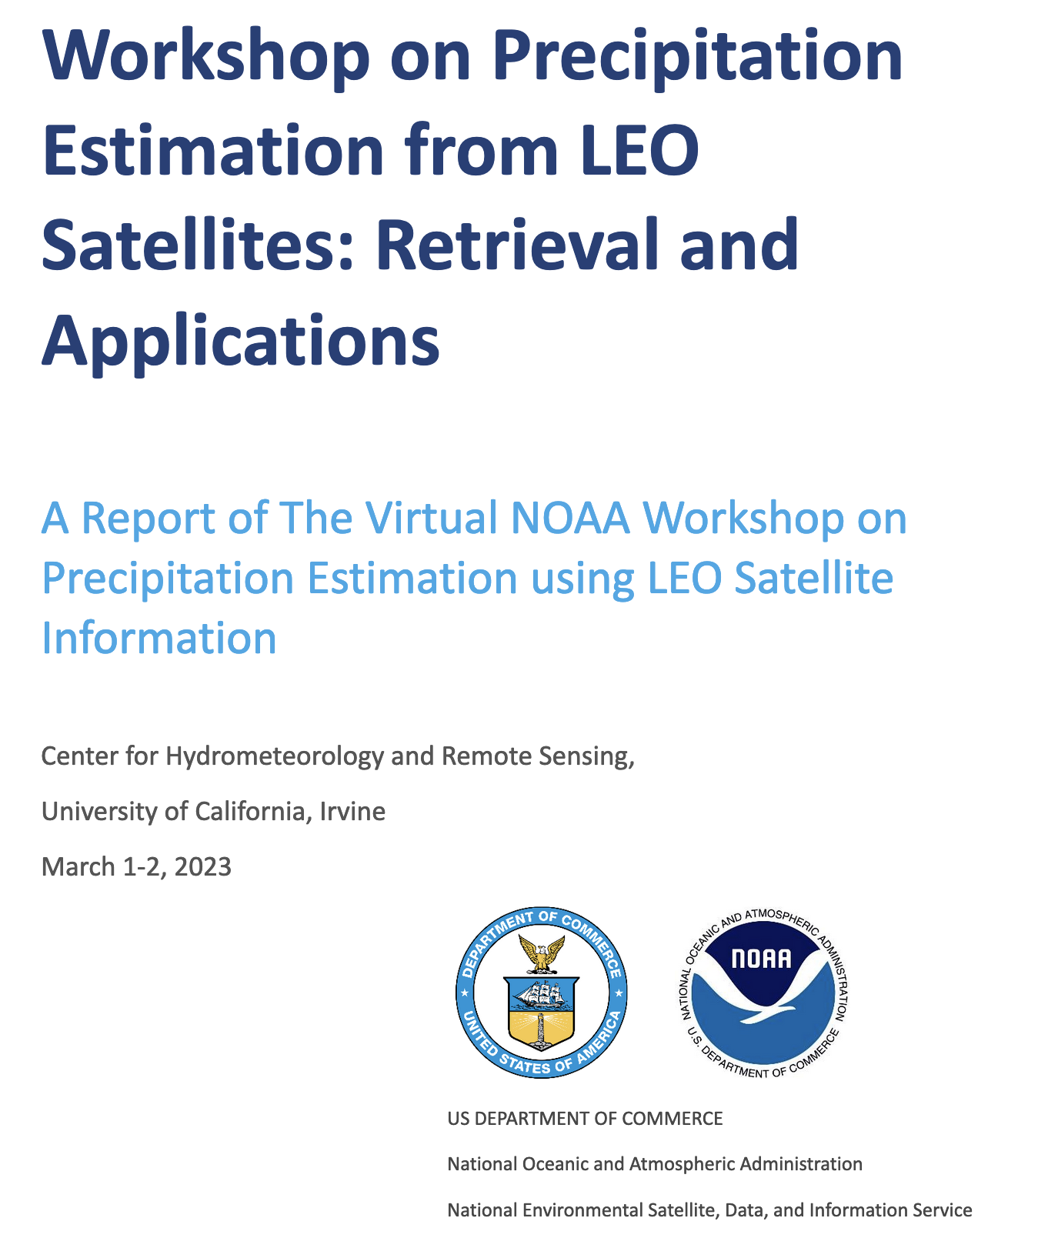
NOAA Workshop on Precipitation Estimation
The Joint Polar Satellite System (JPSS) at NOAA's National Environmental Satellite, Data, and Information Service (NESDIS) tasked the Center for Hydrometeorology and Remote Sensing (CHRS) at the University of California, Irvine, to bring together remote sensing precipitation experts to conduct a review of the existing and future requirements of LEO meteorological satellites, with the aim to identify the current and emerging needs in this field for enhanced satellite-based precipitation monitoring and analysis. Report of the virtual workshop, 1-2 March 2023, has been published:
Conclusions:
no single observation method can provide global precipitation estimates
sensor diversity require accurate inter-sensor calibration
frequent and low-latency observations are required
scientific advances are needed to optimize information content (AI/ML)
Recommendations:
continuity and expansion of precipitation-capable sensors to achieve hourly to sub-hourly refresh rates
prioritise efficient acquisition of sensor data to provide low-latency data
sustain a joint precipitation radar/radiometer capability for inter-calibration
provide an assessment of uncertainty for precipitation measurements
define requirements for establishing robust climate data records

Slide 6
IPWG activities
The IPWG-11 workshop will be hosted by JAXA, 15-18 July 2024 at the Tokyo Institute of Technology, Tokyo, Japan, with a GPM 10th anniversary symposium held in Tokyo, Japan, on 19 July 2024.
The International Precipitation Working Group (IPWG) was established as a permanent Working Group of the Coordination Group for Meteorological Satellites (CGMS) and is co-sponsored by CGMS and the World Meteorological Organization (WMO).
Working Groups (each tasked with generating White Papers):
Baseline Surface Precipitation Network. Outline and implement a Quantitative Precipitation Estimation (QPE) product for use in satellite data validation.
Satellite Precipitation: Assess the needs of global product producers and from the research community.
Machine Learning: Produce a standard training and independent test data set test ML algorithm capabilities.
CubeSat/SmallSat: Study relative channel combinations/spatial resolutions to help define future requirements.
Focus Groups:
Orographic Precipitation, Snowfall, Particle Scattering, Data Assimilation, and Land Surface

Slide 7
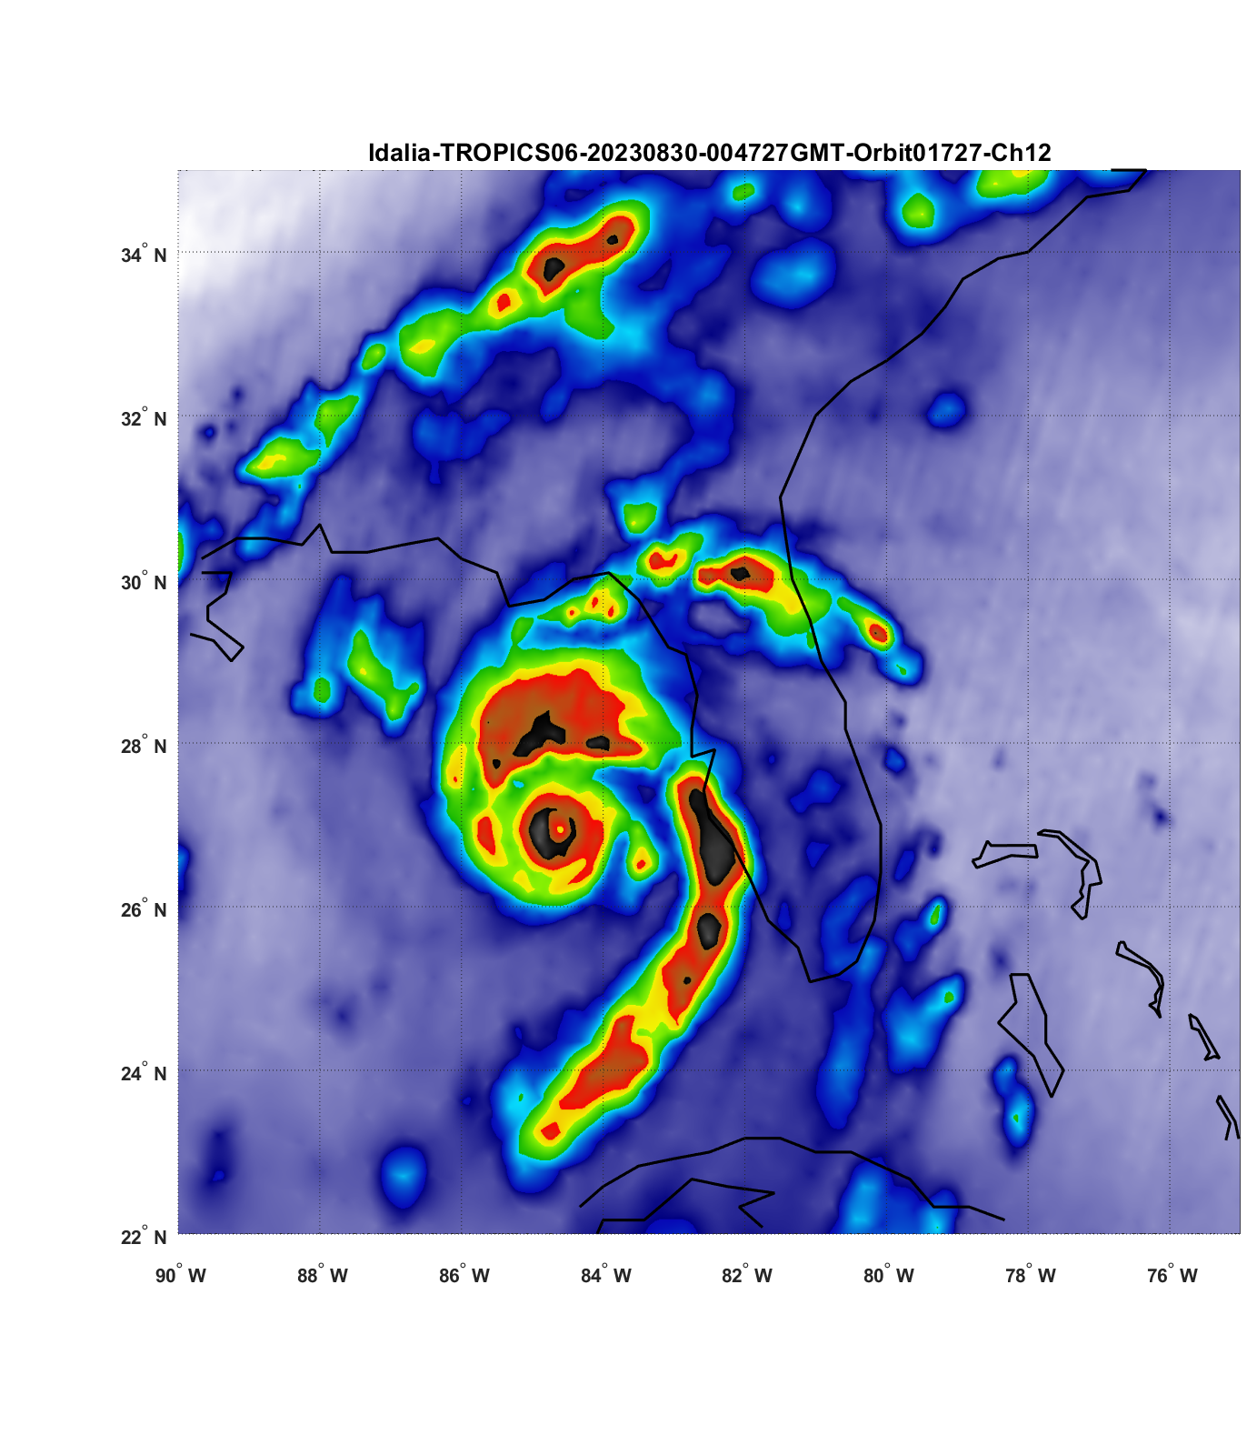
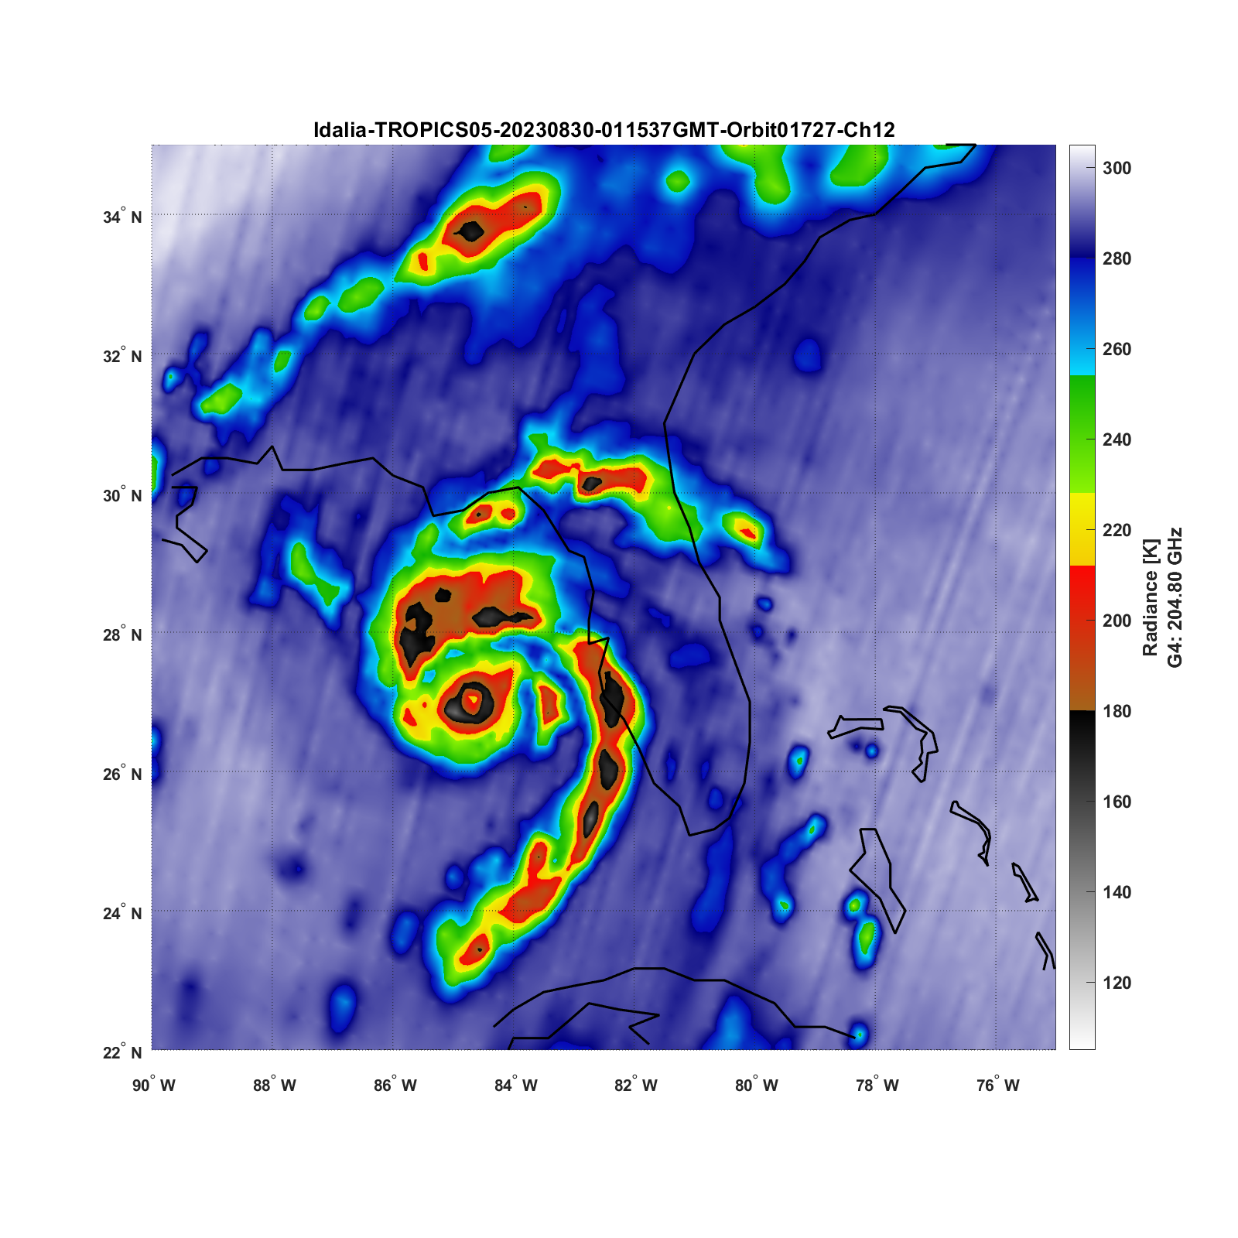
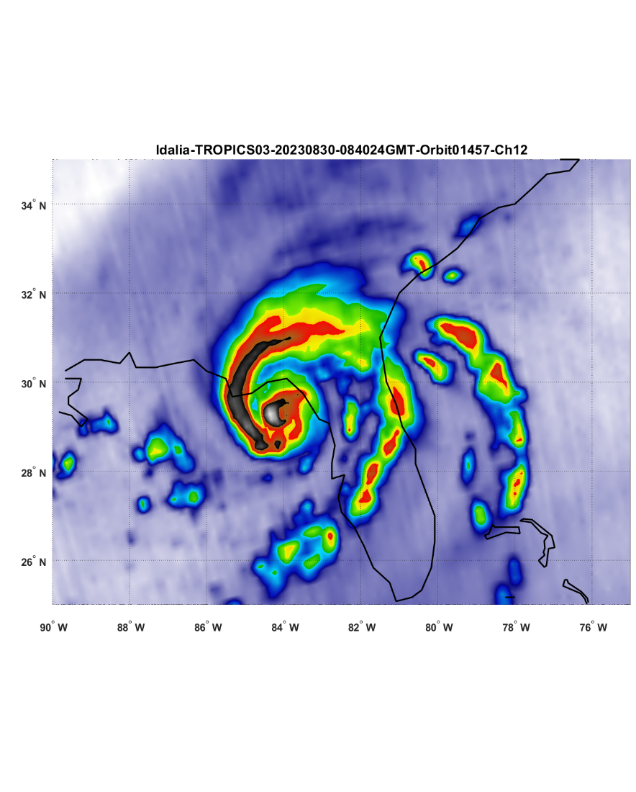
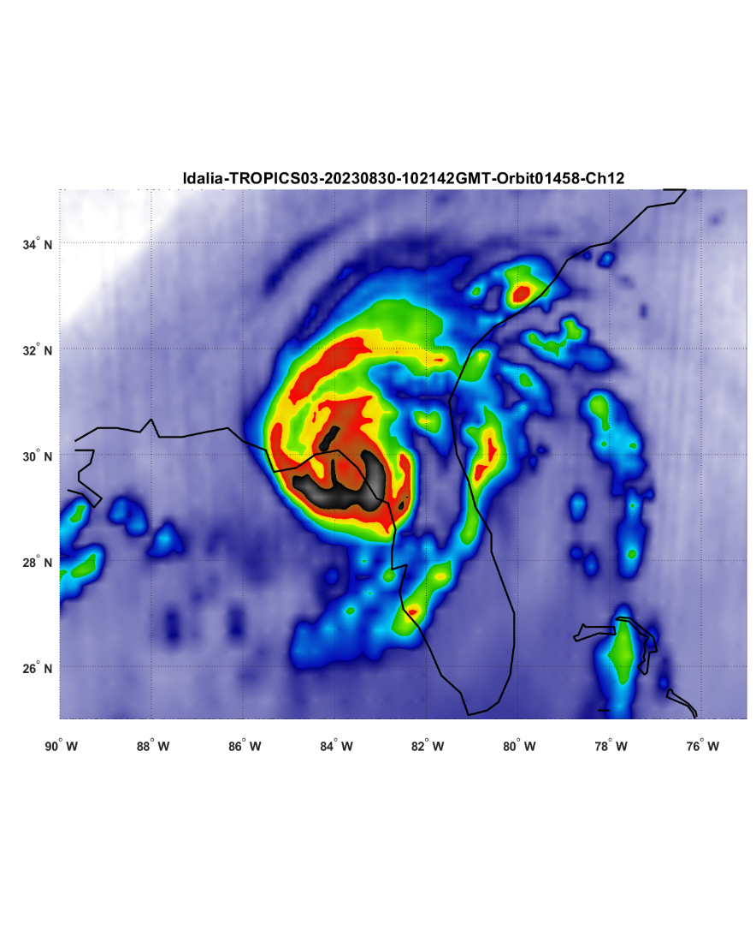
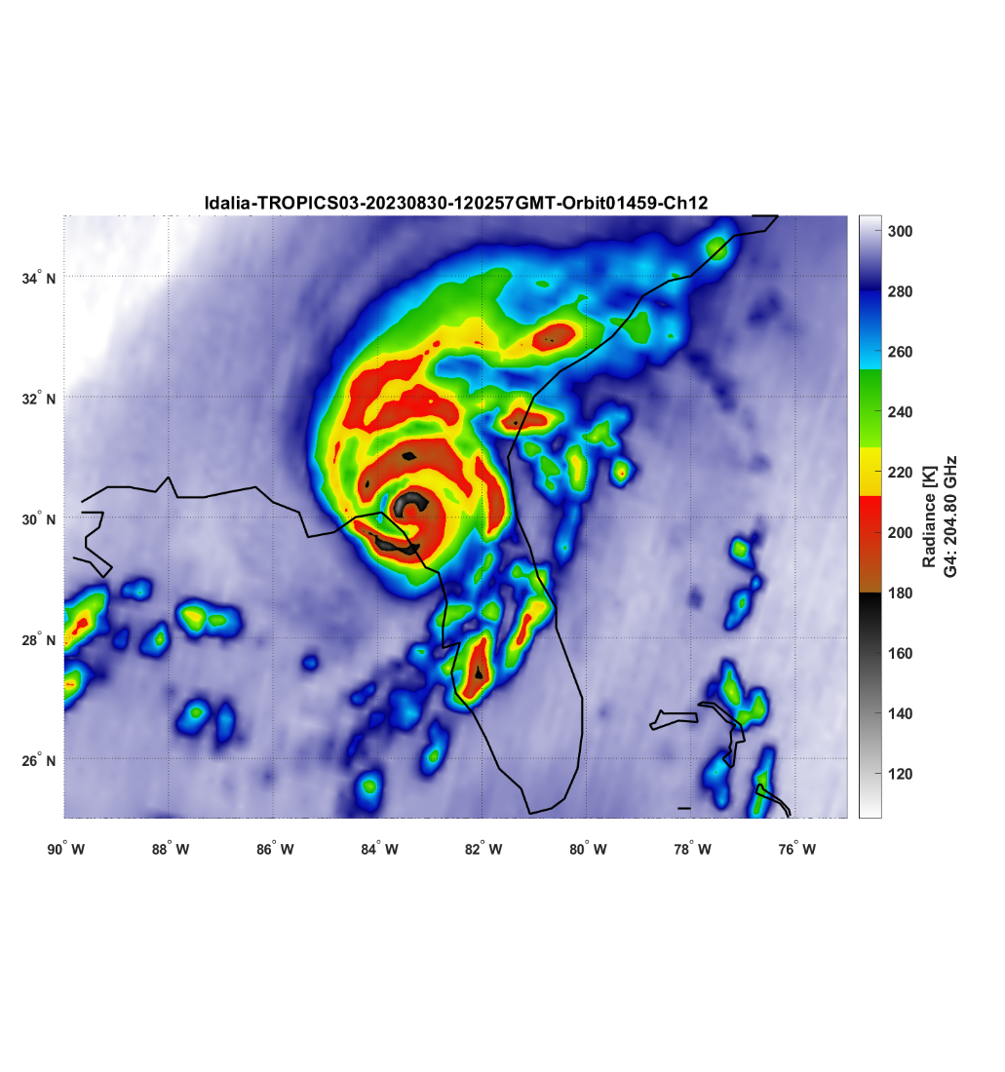
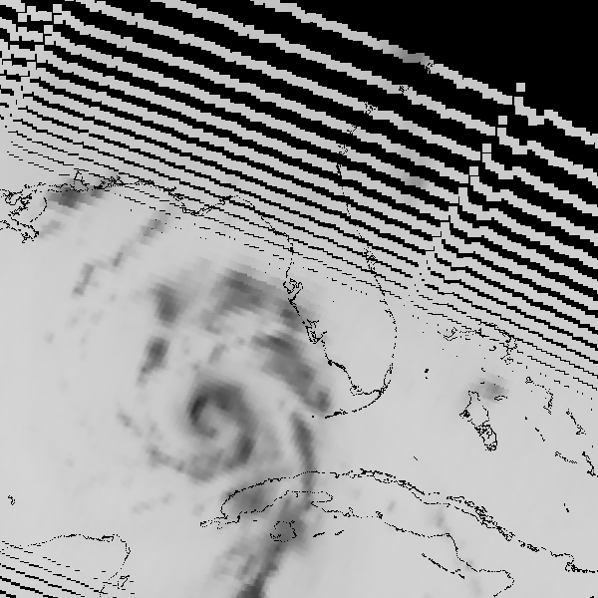
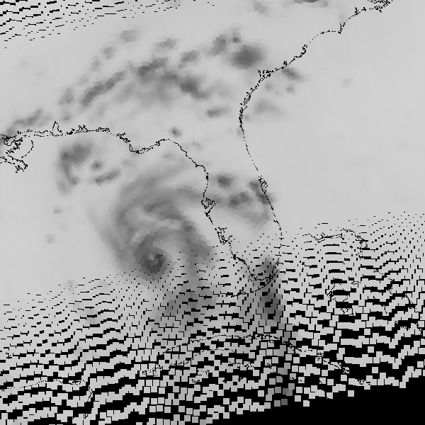
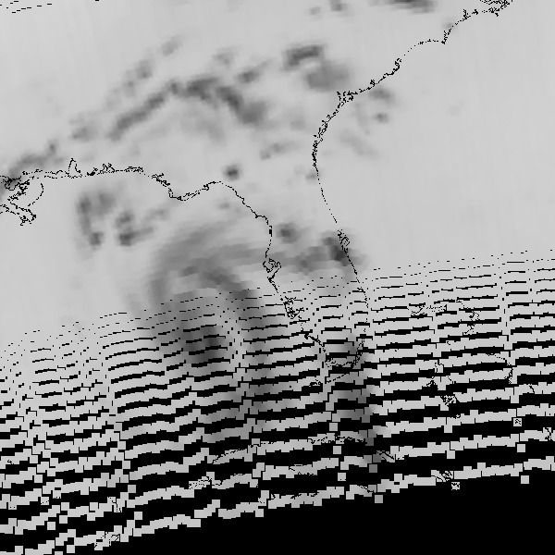
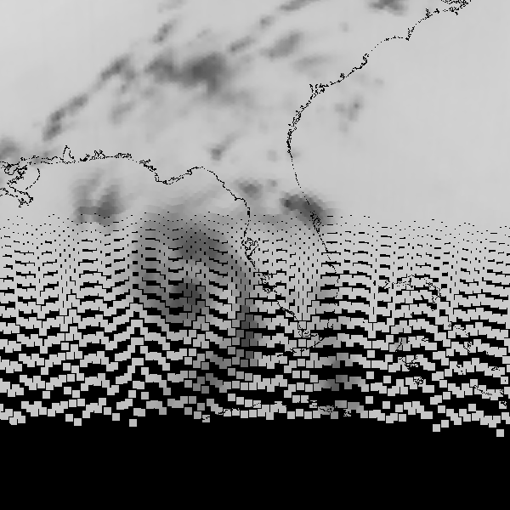
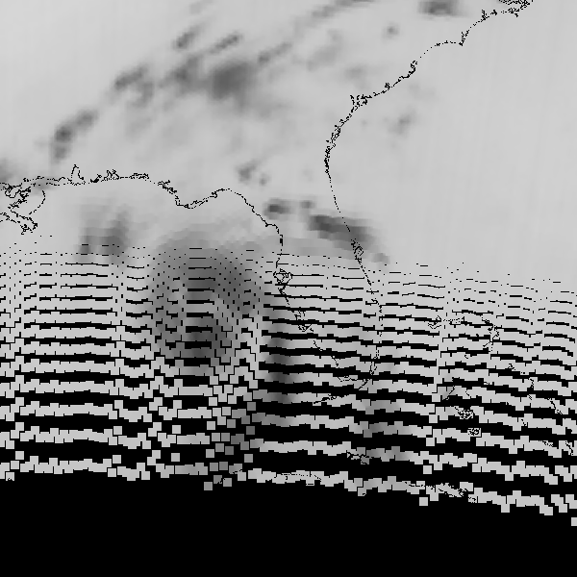
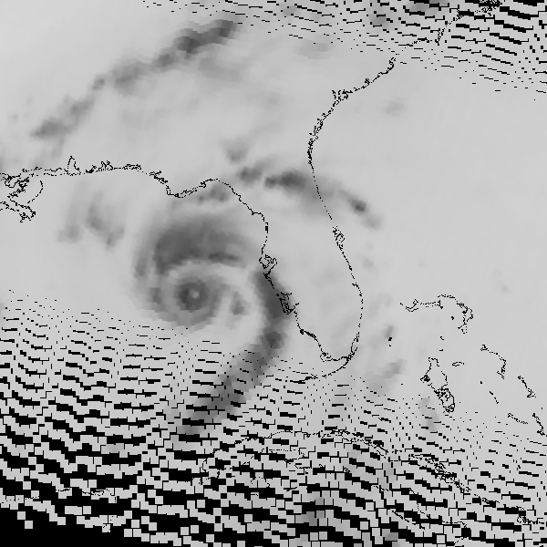
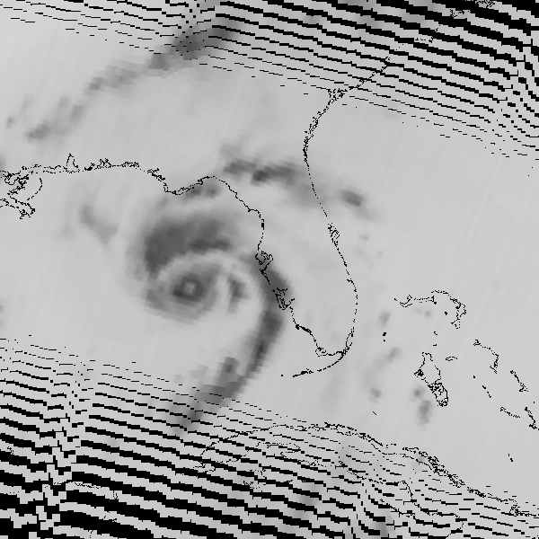
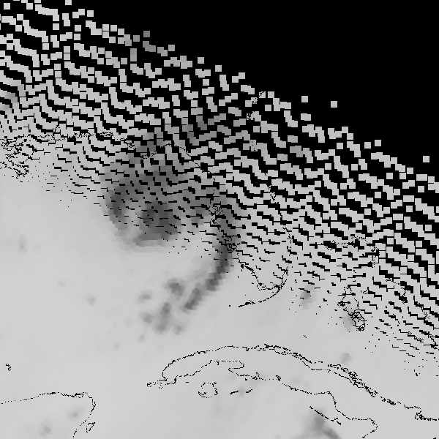
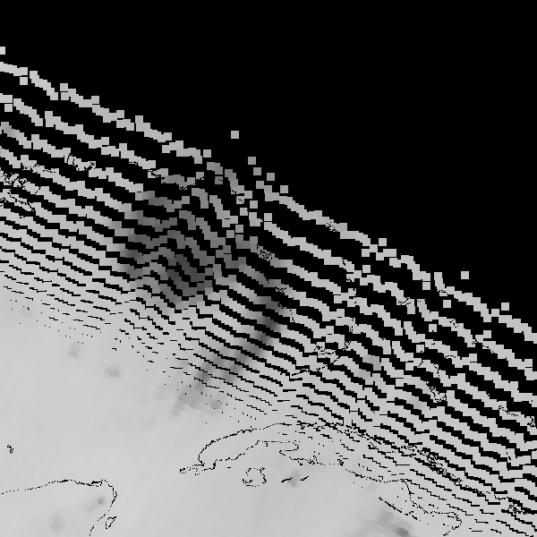
Recent satellites launches
10 Nov. 2022: NOAA-21 (ex JPSS-2), ATMS, 22-channel cross-track radiometer, 23.8-183 GHz, 16-75 km resolution, 2200 km swath.
16 Apr. 2023 CMA/NRSCC: FY-3G (formerly FY-3RM-1), conically scanning 26-channel radiometer 10.65-191.31 GHz, 800 km swath; Ku/Ka precipitation radar, 300km swath.
08 and 26 May 2023: NASA/MIT TROPICS-03/07 and TROPICS-05/06, cross track 12-channel radiometer, 91.655-204.8 GHz, 17-50 km resolution, 220 km swath.
TROPICS 205 GHz imagery of Hurricane Idalia, 29/30 August 2023
T03 13:59
T06 21:47
T05 22:14
T06 23:23
T05 23:50
T06 00:58
T05 01:25
T06 02:33
T05 03:00
27 mins
67 mins
27 mins
68 mins
27 mins
68 mins
27 mins

Slide 8
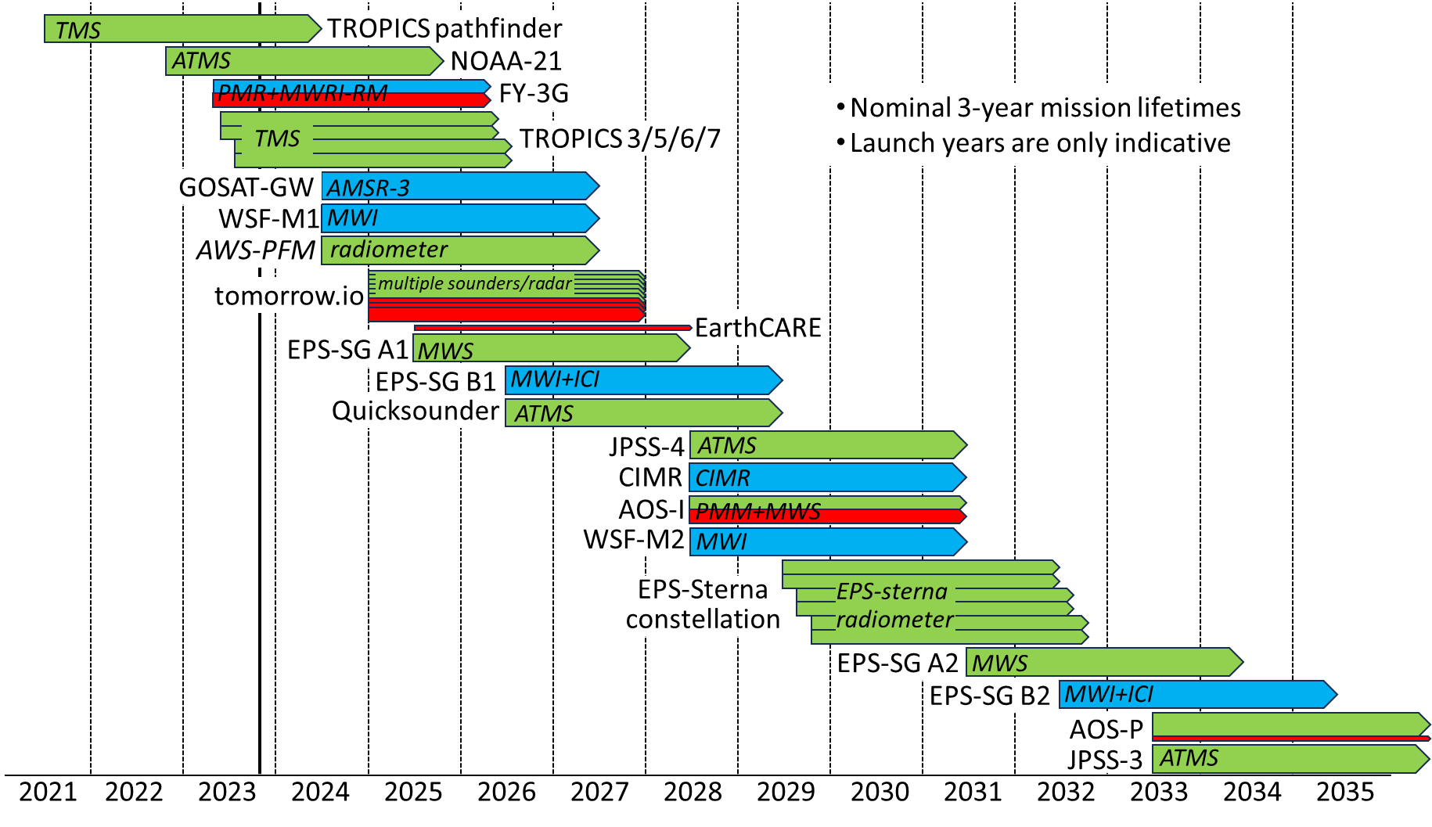
Future mission updates
Precipitation retrievals rely primarily upon observations passive microwave sensors.
Future observations will include an increasingly diverse range of sources, including commercial.
Limited ‘premier league’ (wide frequency range e.g. 10-183 GHz) sensors.
NASA, on behalf of NOAA’s Near-Earth Orbit Network (NEON), awarded 4 contracts for Phase-A studies for NOAA’s Sounder for Microwave-Based Applications (SMBA)
PMW sounder
key near-term missions
PMW imager
cloud/precip radar
2030+

Slide 9
GPM Constellation
Current GPM constellation includes:
NASA/JAXA: GPM core observatory (GMI & DPR)
JAXA: GCOM-W1 (AMSR2)
NOAA (4): NPP, NOAA-20, NOAA-21 (ATMS) and NOAA-19 (MHS)
EUMETSAT (2): METOP-B and METOP-C (MHS)
US DoD (3): DMSP-F16/F17/F18 (SSMIS)
Under evaluation: TROPICS-01,-03,-05,-06,-07 (TMS) and ISS STP-H8 (TEMPEST-H8 and COWVR)
State of health:
GPM Core Observatory is very good. (reduced redundancy of Guidance, Navigation and Control due to loss of 1 reaction wheel, leaving 4 out of the 5 – an extra reaction wheel was included).
SSMIS: F16 V91 high NEΔT warning; F17 V37 high NEΔT no data; F18 H150 set to missing
MHS: NOAA-19 183±1 high NEΔT warning
TROPICS: -01 GPS issue, -05 bad channel 2 (114 GHz), -07 slip ring communication issue.

Slide 10
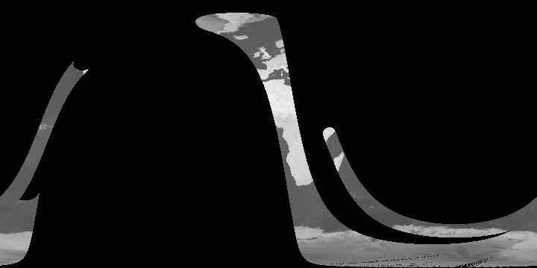
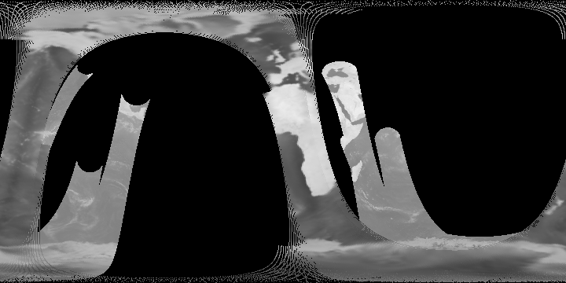
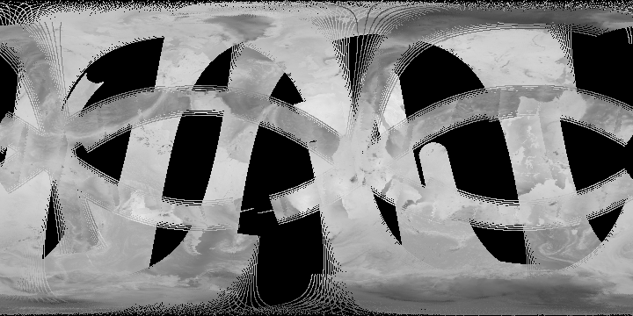
Current Global Coverage by PMW frequency
10.65 GHz
18.7-19.35 GHz
1 hour (12-13Z) 05-Jul-2023
Lower frequency (liquid=rain) channels poor sampling
higher frequency (frozen=ice)
channels better sampling
22.235-23.8 GHz
31.4-37 GHz
85.5-91.655 GHz
150-165.5 GHz
183 GHz
204.8 GHz

Slide 11
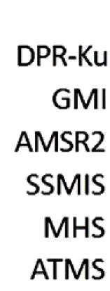
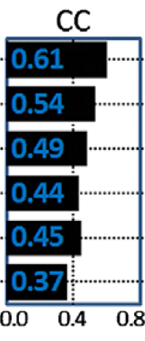
Precipitation Continuity
Band | L | C | X | Ku/K | K | Ka | Ka/V | V | W |  | G | mm | mm | mm
GHz | 1.4 | 6 | 10 | c.18 | 23 | 31 | 37 | 50-60 | 89 | 118 | c.157 | 183 | 200+ | 325+
Microwave
Bands
Passive Microwave
Missions
Precipitation – Liquid Frozen
WV Temp T/O₂ WV
US DoD
SSMIS
0.61
WSF-M
JPSS
ATMS
0.54
GPM-constellation
NOAA/EUMETSAT
MHS
0.49
GCOM-W
AMSR2
…+AMSR3
0.44
0.45
GPM-Core
GMI
0.37
TROPICS
TMS
ISS STP-H8
COWVR
TEMPEST
small/cubesat sensors are sounders – poorer precipitation retrievals
EUMETSAT EPS A/B
MWI
MWS
ICI
future
EUMETSAT EPS
AWS
NOAA
QuickSounder
tomorrow.io
TMS
E.Kim 15-Oct-2018
C Kidd 08-Sep-2023
CIMR
CIMR

Slide 12
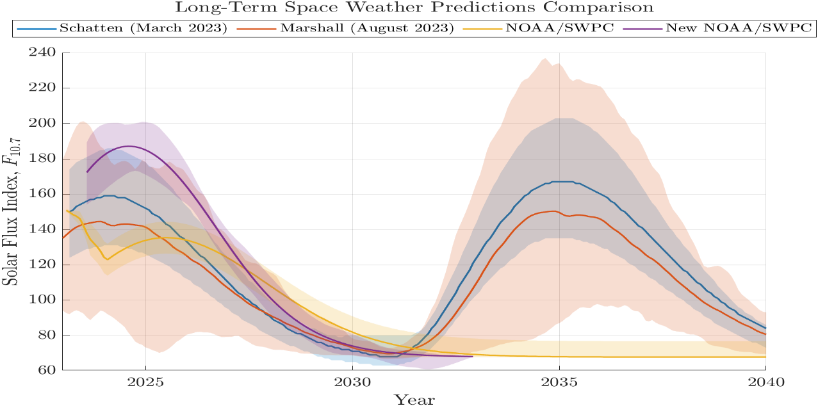
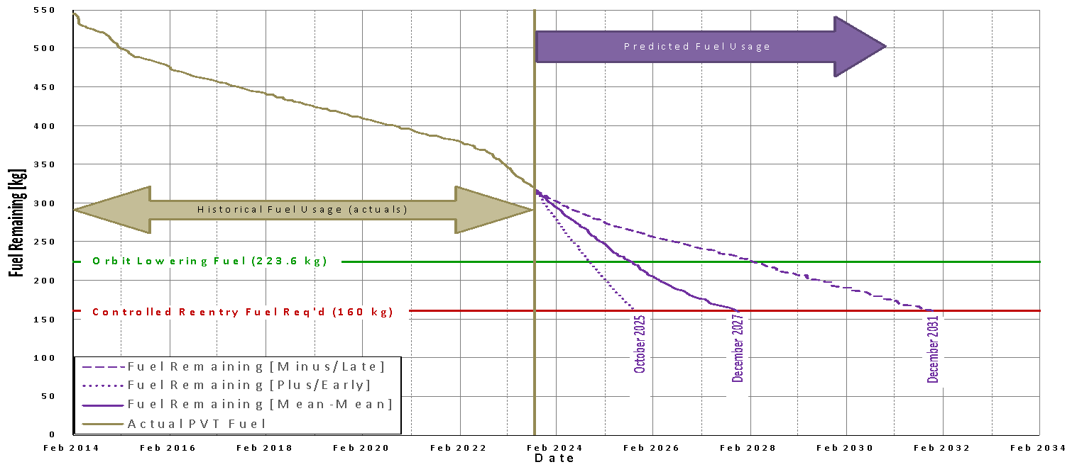
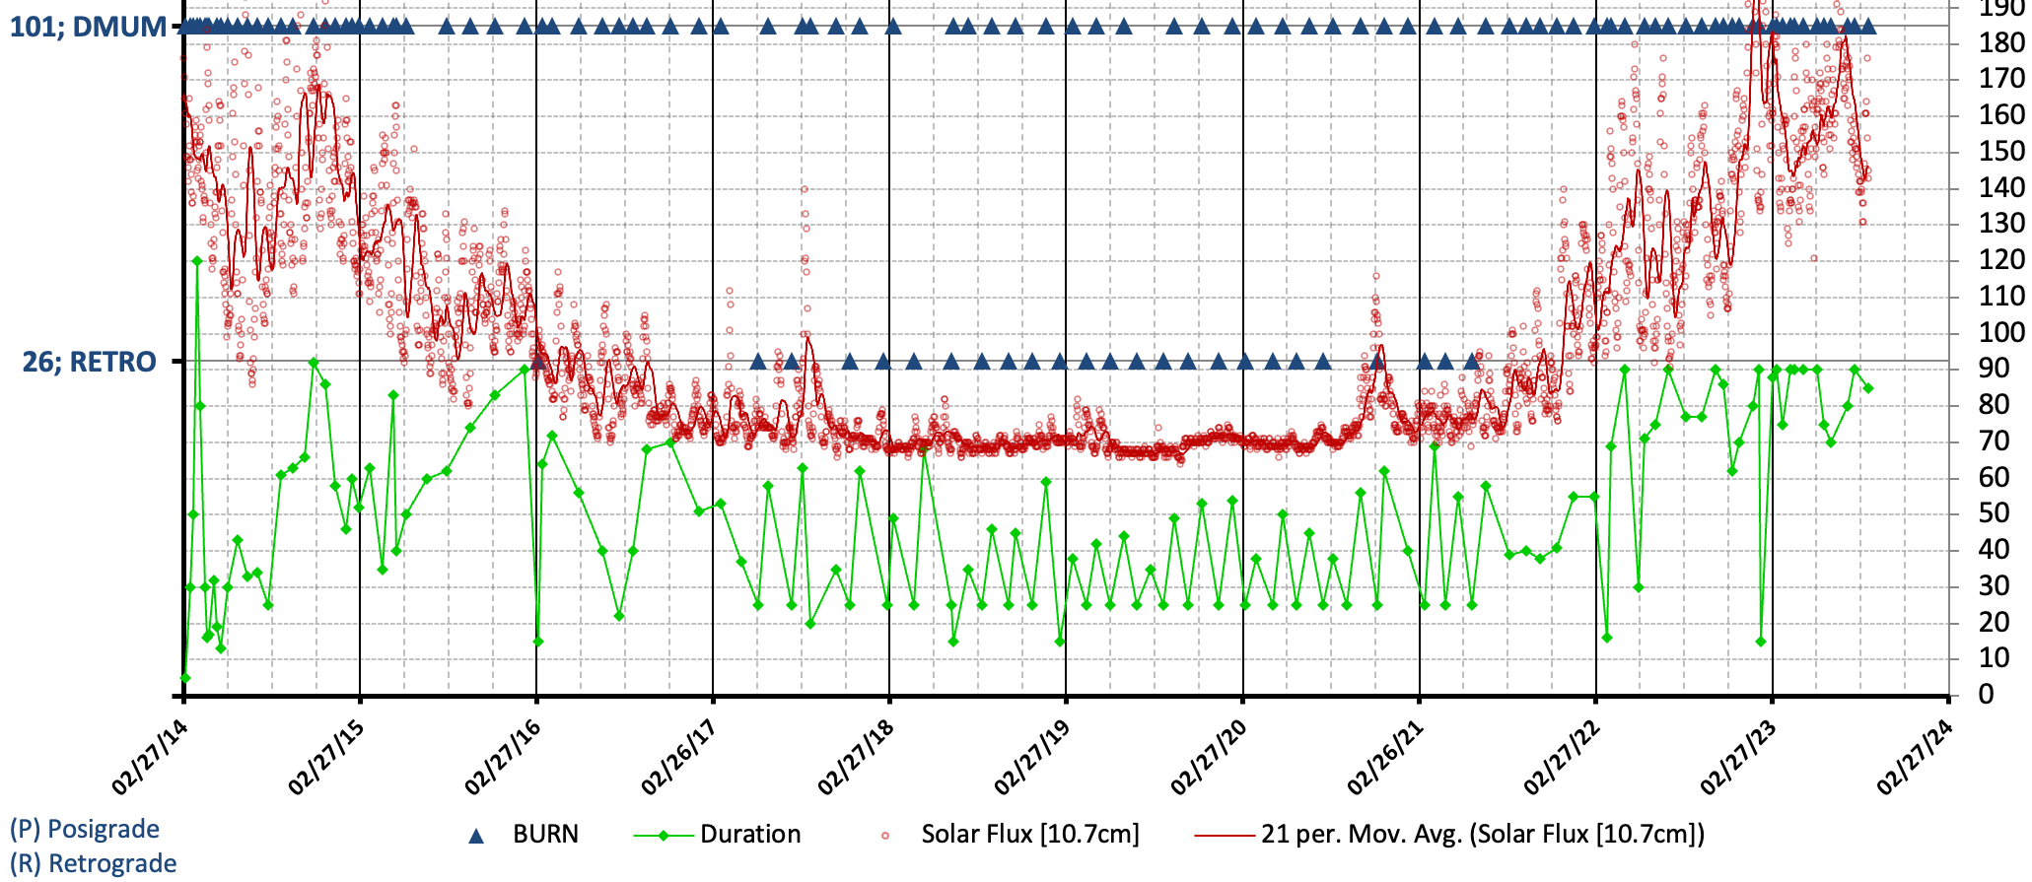
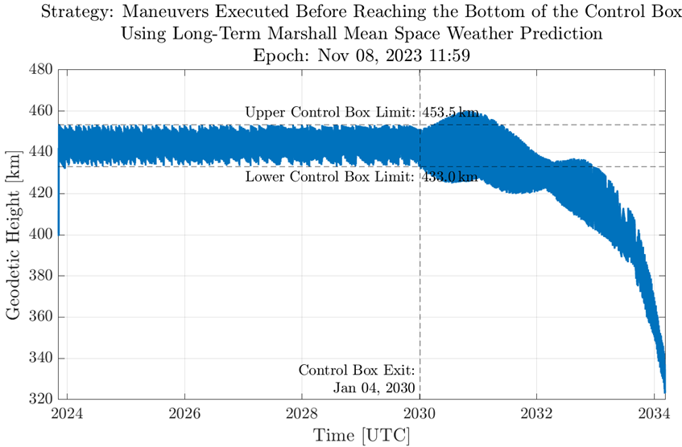
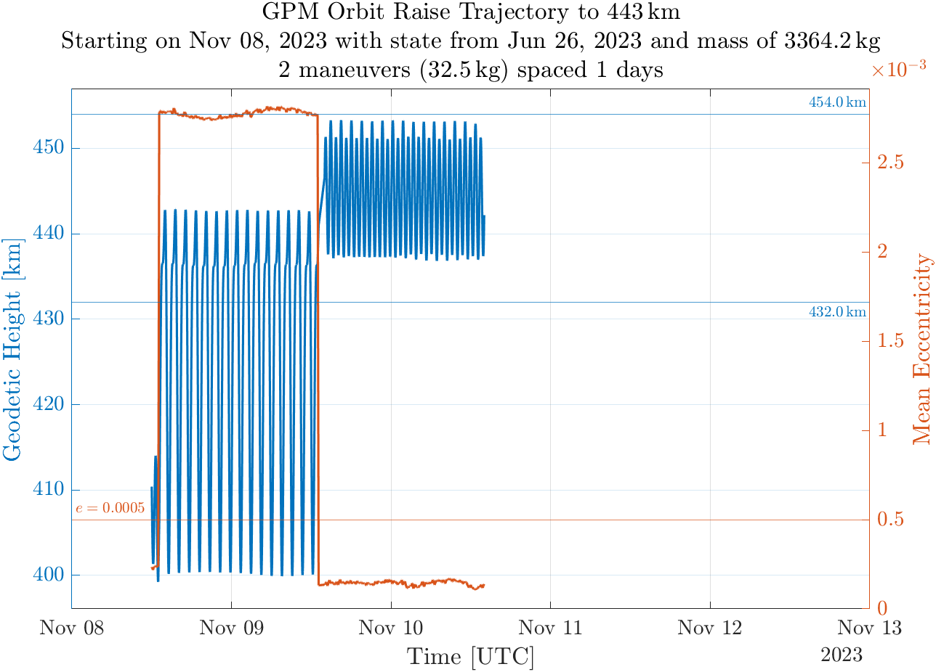
GPM orbital boost
GPM orbit
An active solar cycle has resulted in a greater fuel burn, potentially reducing the lifetime of the GPM-CO
Predicted Fuel Usage
burn events
Solar activity
Pre-boost forecast
Historical Fuel Usage
Orbit lowering fuel
Tony Scaffardi
Tony Scaffardi
Controlled reentry fuel req’d
Tony Scaffardi
Oct 2025
Dec 2027
Dec 2031
2014 2015 2016 2017 2018 2019 2020 2021 2022 2023 2024
2014 2016 2018 2020 2022 2024 2026 2028 2032 2034
Planned boost of GPM-CO to 432-454 km orbit ~8 November 2023.
This boost will recover several years of mission lifespan
DPR impact: no data during boost, post-boost poorer sensitivity, spatial resolution, and wider swath.
GMI impact: changes in spatial resolution, swath and EIA.
Precipitation product changes – dealt within the retrieval software (post-boost cal/val will be undertaken).
NASA & JAXA are undertaking the necessary preparations for the boost – NASA PPS will continue processing though End-of-Life +1yr
2nd-boost establishes higher orbit
Initial-boost increases eccentricity

Slide 13
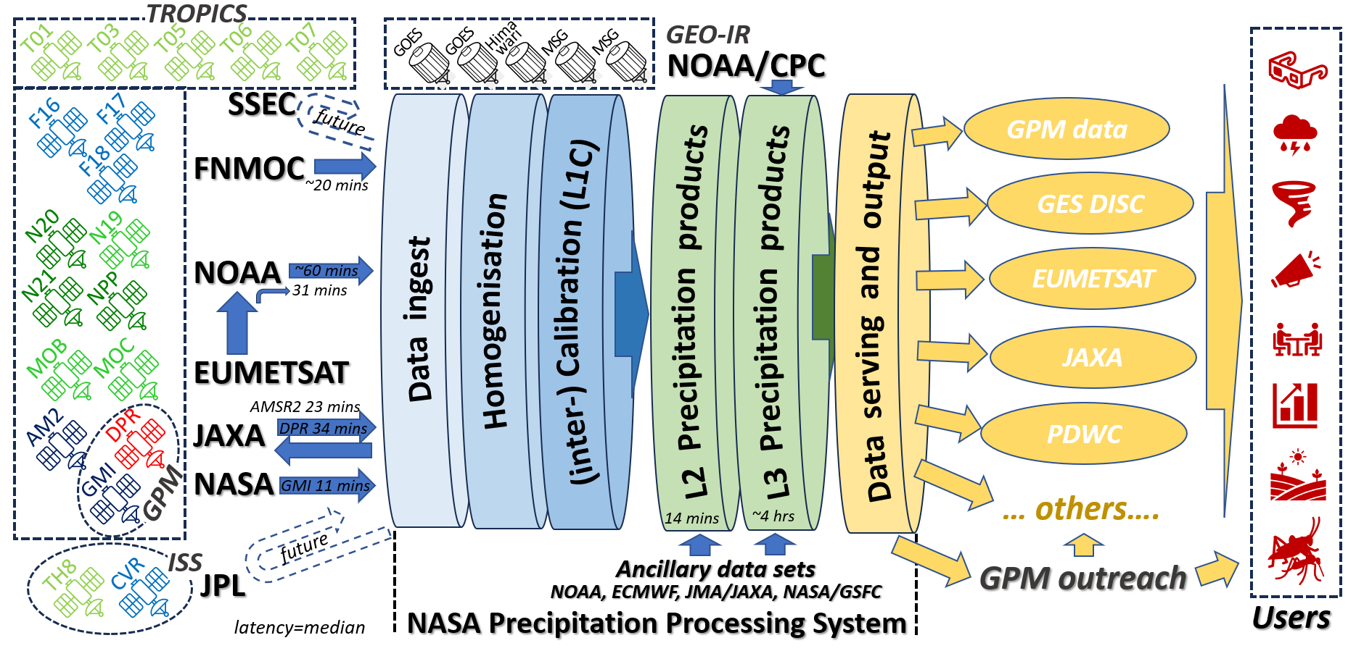
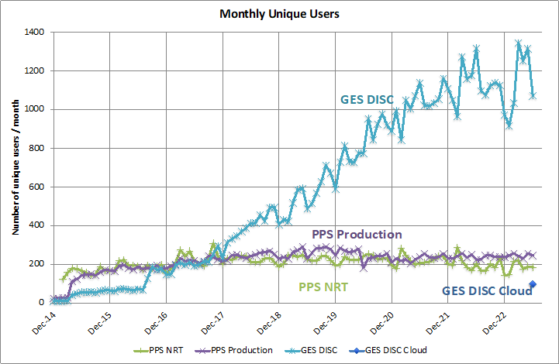
NASA Precipitation Processing System
GPM constellation

Slide 14
Summary
GPM constellation
GPM-CO will undergo an orbit boost 8 November 2023 – this should allow a potential overlap with the JAXA PMM (2029+).
GPM international partners – operational and legacy missions, continue to provide data. Data from new satellites/sensors being evaluated. Missions in near future: AMSR-3 & EPS-SG A/B
P-VC
Terms of references urgently needs updating
ARD product family specifications need formalising
Interoperability framework – reviewed at last PVC meeting
Opportunities:
Increase in number of sensors and observations
Scientific development – leading to improved understanding of the observations
Evolution of new ‘tools’ i.e. AI/ML, for maximising retrieval capabilities
Challenges:
Continuity of observations and products: short-duration sensors (cal/val spin-up times), different frequency bands, resolutions, sampling, etc.
long-term need for reference mission for inter-calibration
Radio frequency interference – increasing pressure on shared/protected bands

