Slide 1
Systems Engineering Office Report
David Borges
CEOS SEO, NASA
Agenda Item 8.4
SIT TW 2023, ESA/ESRIN
19 October 2023

Slide 2
SDG Coordination Group
Continuity & Future Work
David Borges, SEO, NASA
Marc Paganini, SIT Chair Team, ESA
Flora Kerblat, CSIRO

Slide 3
SDG Coordination Group: Members
Name | Organization
Marc Paganini | ESA
Marie-Claire Greening | ESA / CEOS CEO
David Borges | NASA / CEOS SEO
Brian Killough | NASA / CEOS SEO
Flora Kerblat | CSIRO
Neil Sims | CSIRO
Alex Held | CSIRO
Paul DiGiacomo | NOAA
Martyn Clark | GEOSEC
Julie Chamberlain | NASA / EO4SDG
Libby Rose | CEOS Communications Team / Symbios
Lead Agencies: ESA, NASA, CSIRO, NOAA
SME Content support: CNES, SANSA, JAXA, DLR, etc.
Technical contributions rely on experts across CEOS and external bodies (GEO communities, UN Agencies, etc.) including many other CEOS Agencies
Slide ‹#›

Slide 4
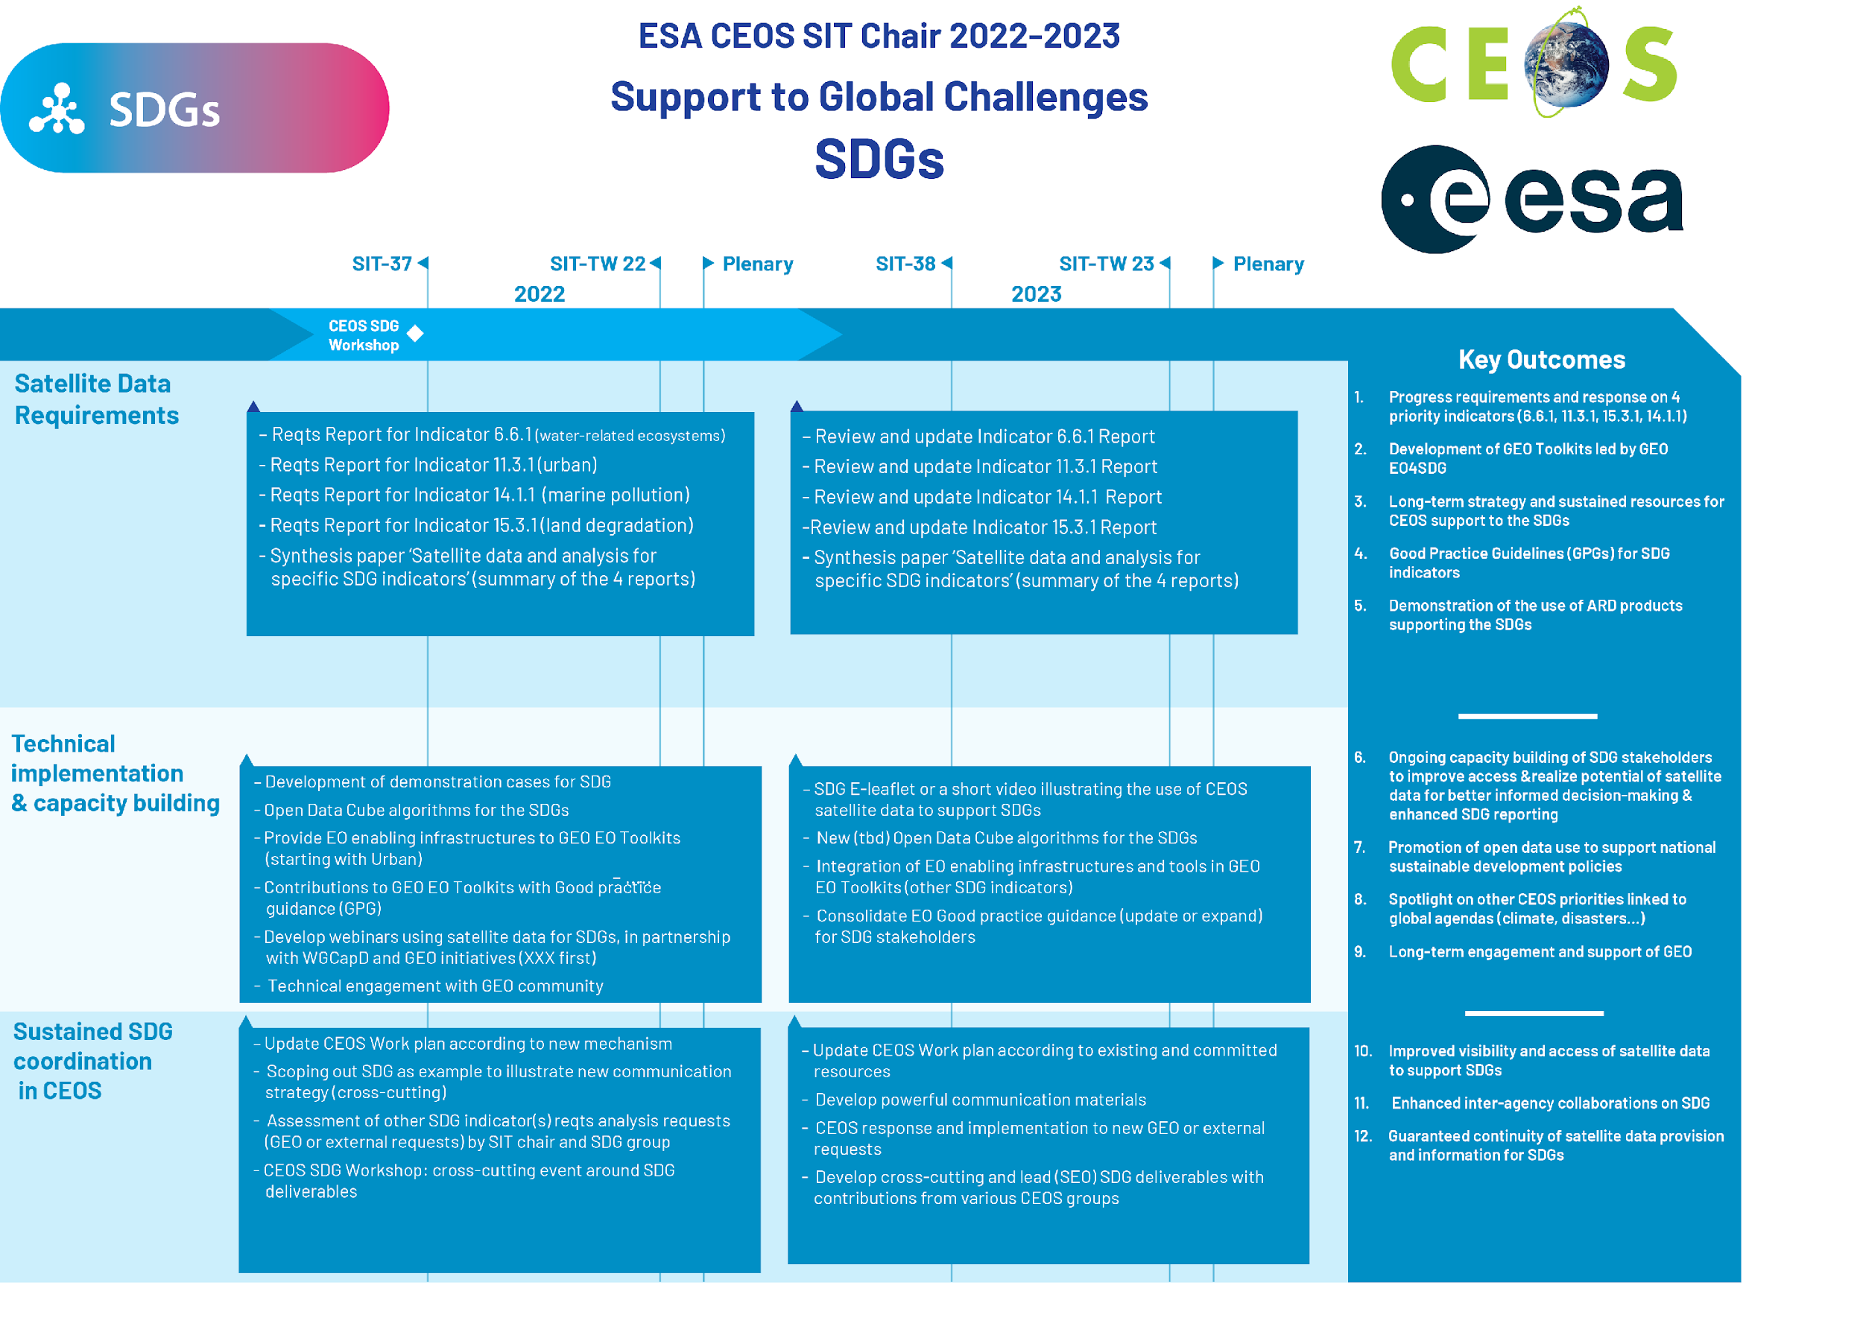
ESA CEOS SIT Chair 2022-2023
ESA CEOS SIT chair priorities on SDGs
for the 2022-2023 time frame
3 main lines of SDG priorities
Analysis of the relevance of satellite data for SDG indicators, starting with SDG 6.6.1 (water), 11.3.1 (urban), 14.1.1 (marine pollution) and 15.3.1 (on land degradation)
EO demonstrators and Capacity Building (in partnership with GEO activities and CEOS WGCapD)
Sustainable CEOS coordination and involvement on SDGs

Slide 5
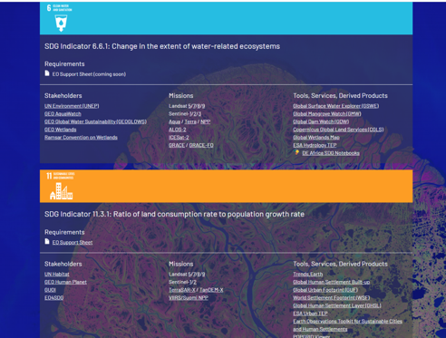
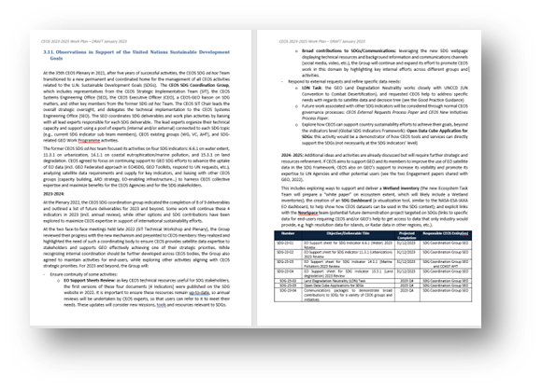
Progress since SIT-38
Since its creation at Plenary 2021, the SDG Coordination Group has:
Monthly meetings (last one 26 September): Notes
Expected completion of most 2023 Deliverables
Evaluating GEO / CEOS coordination
Coordinated CEOS capability with WGCapD to support UN Space Training event in Brindisi, Italy
2023 GEO SDG Award Winner!
ceos.org/sdg
Slide ‹#›

Slide 6
2023 GEO SDG Award
Winner
Recognizing the productivity, innovation, novelty and exemplary efforts in the use of Earth observations to support sustainable development.
CEOS SDG Coordination Group

Slide 7
2023 SDG Deliverables
Number | Objective/Deliverable Title | Projected Completion | Responsible CEOS Entities
SDG-23-01 | EO Support sheet for SDG Indicator 6.6.1 (Water) 2023 Review | 2023 Q4 | ESA
SDG-23-02 | EO Support sheet for SDG Indicator 11.3.1 (Urbanization) 2023 Review | 2023 Q4 | EO4SDG, GEO SEC
SDG-23-03 | EO Support sheet for SDG Indicator 14.1.1 (Marine Pollution) 2023 Review | 2024 | COAST AHT
SDG-23-04 | EO Support sheet for SDG Indicator 15.3.1 (Land degradation) 2023 Review | 2024 | CSIRO
SDG-23-05 | Land Degradation Neutrality (LDN) Task | 2023 Q4 | SEO, CSIRO
SDG-23-06 | Open Data Cube Applications for SDGs | 2023 Q4 | SEO
SDG-23-07 | Communications packages to demonstrate broad contributions to SDGs for a variety of CEOS groups and initiatives | 2023 Q4 | SEO / Communications Team
Responsible
Marc Paganini
Julie Chamberlain, Martyn Clark
Paul DiGiacomo
Neil Sims
Brian Killough, Neil Sims
Brian Killough
Libby Rose, Flora Kerblat

Slide 8
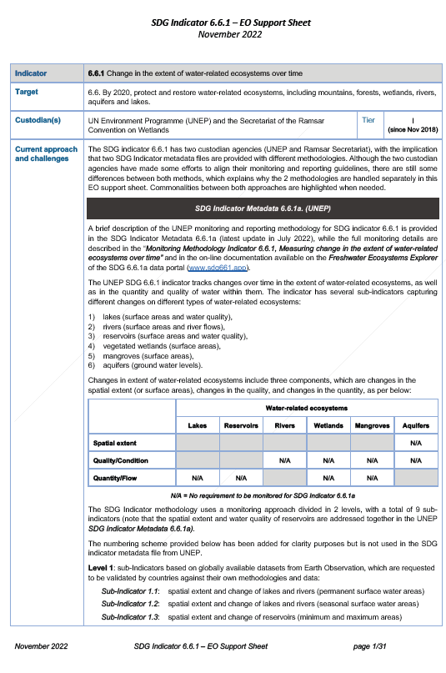
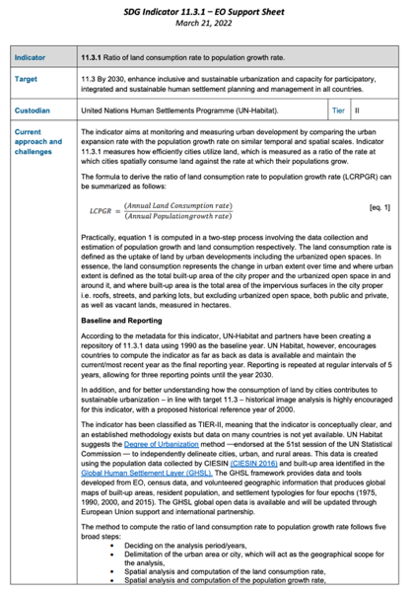
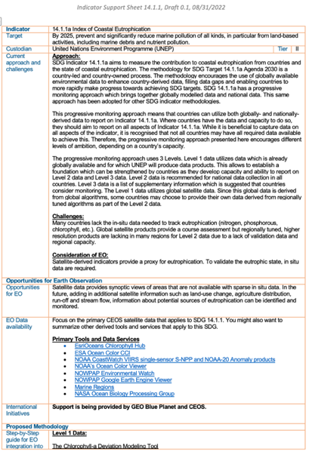
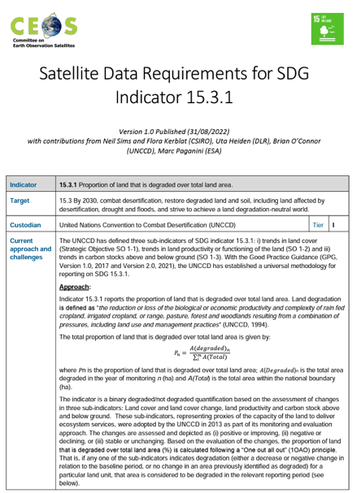
EO Support Sheets
ceos.org/sdg
SDG-23-01
Water
SDG-23-02 Urbanization
SDG-23-03
Coastal Eutrophication
SDG-23-04
Land Degradation
The Earth Observation (EO) Support sheets are a valuable resource for the user community and Custodian Agencies: CEOS plans to keep them updates by undertaking an annual review to ensure that details including current approaches and challenges, data requirements, access and tools, and publication references remain up-to-date and useful.

Slide 9
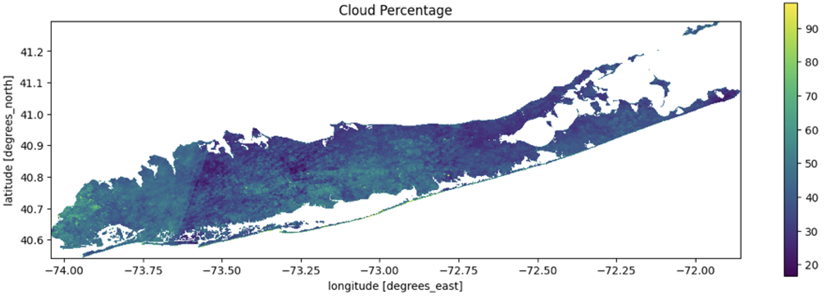
Land Degradation Neutrality (LDN)
SDG-23-05
Summary – After several discussion with the LDN team (June and July) we settled on the following plan: Complete a monthly cloud cover analysis (Sentinel-2 and Landsat) for the year 2019 over 31 SIDS (small island) countries. Also review data availability for Sentinel-1 and high-resolution datasets (e.g., Maxar, PlanetScope) to supplement sparse data regions.
Status –The SEO team (Brian Killough and AMA) has completed some preliminary analyses using a new Jupyter notebook that calculates mean monthly cloud cover over any island region. The intended product is a pixel-level summary in the form of a “heat map” to display mean cloud cover for the year. The preliminary models need to be scaled to operate over the 31 SIDS countries. Additional work is needed to assess data availability for S1 and commercial datasets.
Completion is expected in late 2023 or early 2024

Slide 10
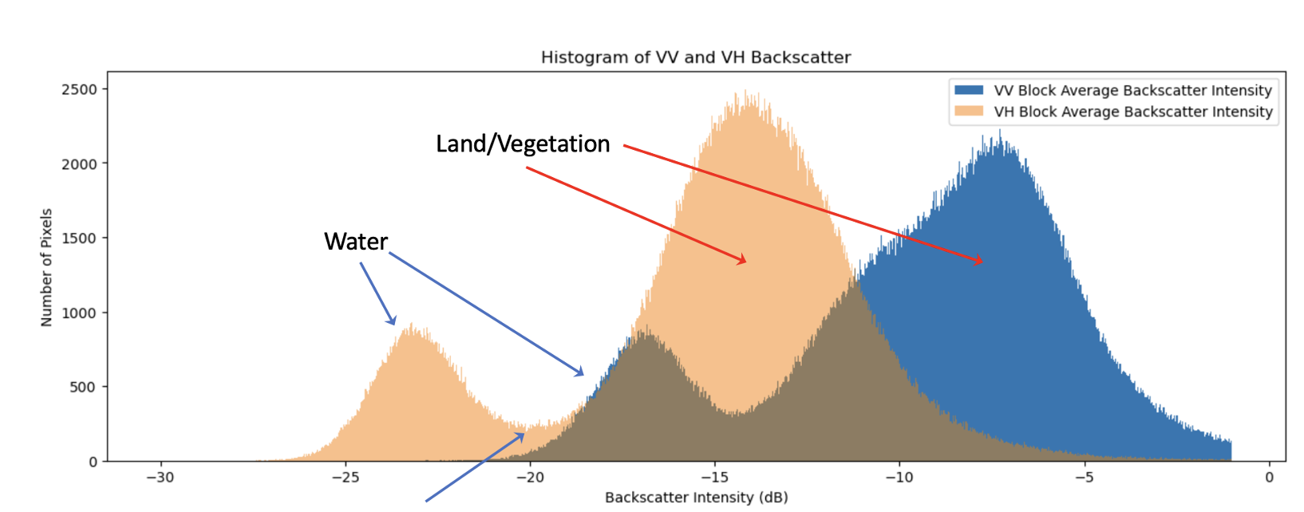
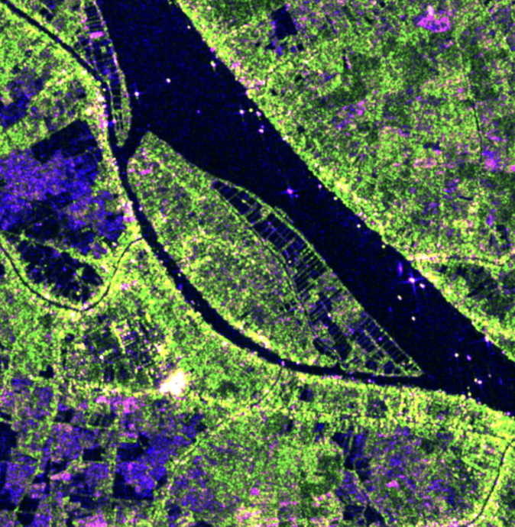
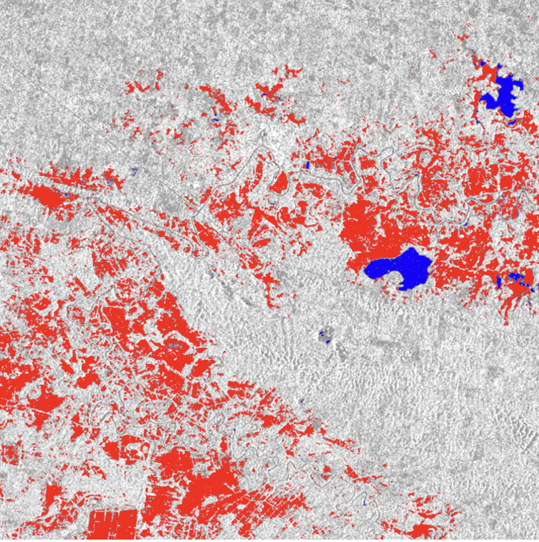
Open Data Cube Application
SDG-23-06
Sentinel-1 (radar) flooding application in support of SDG 6.6.1 (water extent).
Uses a Jupyter notebook solution on the Microsoft Planetary Computer (MPC) with Open Data Cube (ODC) utilities.
Improved functionality over Google Earth Engine version. Easy to duplicate by any public user.
See the GitHub link below which includes the Python notebook, documentation, and ODC utilities.
The final notebook is an ideal application for UN-SDG or WGCapD training and capacity building.
COMPLETED: October 3, 2023
https://github.com/ceos-seo/data_cube_notebooks/tree/master/notebooks/UN_SDG

Slide 11
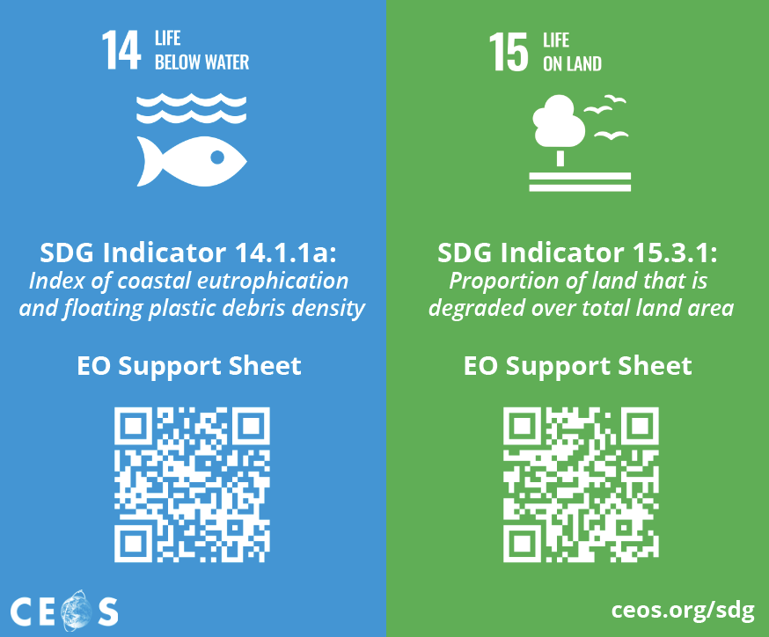
SDG Communications
SDG-23-07
In 2023:
Developed content to support the promotion of the Support Sheets
Will be distributed at GEO Week 2023, and at future events

Slide 12
2024 Outlook
SDG Coordination Group planned activities / deliverables:
SIT Chair transition [ESA -> JAXA]
EO SDG Indicator Support Sheets (4) Annual Revisions / Impact
UNCCD Land Degradation Neutrality (LDN) Good Practice Guidance (GPG)
SDG capacity building support with WGCapD
Communications material / outreach
Biodiversity activity (possibly with Ecosystem Extent Task Team)
UN-GGIM IAEG-SDGs WG Geospatial Information (WGGI)
Rescuing the SDGs proposed paper
Joint deliverables with ongoing WG/VC/etc activities
Identification of additional SDG Targets and/or Indicators
Slide ‹#›

Slide 13
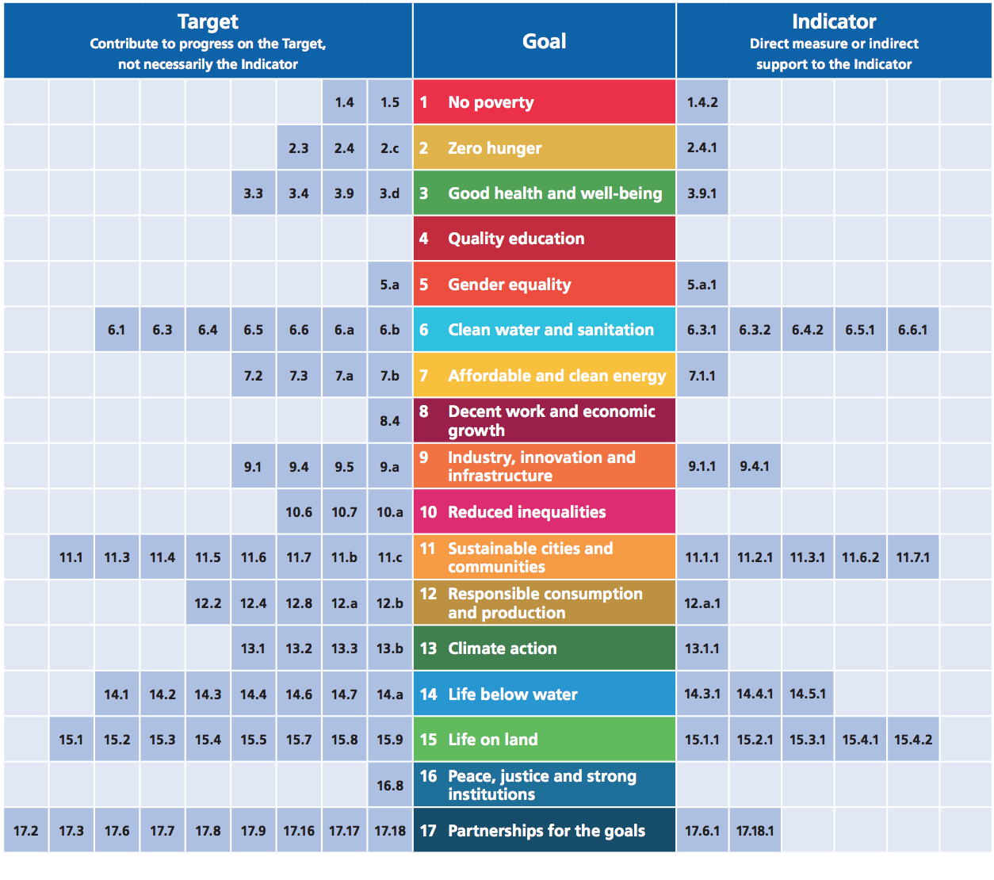
Earth Observations and Geospatial Information for SDG Monitoring
Alignment of Earth Obs. to the SDG Goals, Targets, and Indicators
SDGs with most opportunities:
Notes:
Earth observations can contribute to progress on many more Targets than Indicators
11.4: Strengthen efforts to protect and safeguard the world’s cultural and natural heritage
11.4.1: Total expenditure per capita spent on the preservation, protection & conservation of all cultural and natural heritage
13.3: Improve education, awareness-raising and human and institutional capacity on climate change mitigation, adaptation, impact reduction and early warning
13.3.1: Number of countries that have integrated mitigation, adaptation, impact reduction and early warning into primary, secondary and tertiary curricula

Slide 14
CEOS Communications Strategy
David Borges, SEO, NASA
Libby Rose, CEOS Comms Team
CEOS Community

Slide 15
Action SIT-38-07
SEO to bring an updated CEOS Communications Strategy to CEOS Plenary 2023 for consideration
Draft available here - comments and suggestions welcome
Document outline:
1. Executive Summary
2. Introduction & Objectives
2.1. CEOS Mission
2.2. Communications Objectives
3. Situation Analysis
4. Stakeholders
4.1. Internal CEOS
4.2. External CEOS
5. Campaigns
5.1. 40th Anniversary of CEOS
5.2. EO for Biodiversity
5.3. Greenhouse Gas Observations from Space
6. Content Types & Processes
6.1. CEOS Blog
6.2. CEOS Newsletter
6.3. CEOS Quarterly Revisit
6.4. Social Media
6.5. Video
7. Measuring Impact
7.1. Goals for Publication
7.2. Measuring Success
7.3. Reporting
8. Implementation & Execution
8.1. Core Comms Team
8.2. CEOS Community Liaisons
8.3. CEOS Agency Communications Staff
8.4. Contacts & Connections
9. Conclusion

Slide 16
Stakeholders
Internal CEOS Communications
External CEOS Communications
CEOS Principals
Working Teams
Ensure cross-cutting work is shared broadly
Decision Makers
Including local/regional, governments UN Agencies
EO Experts
Academics, technicians and commercial EO industry
Candidate CEOS Members/Associates
Organisations who meet the criteria to join CEOS
EO Allies
E.g. biodiversity experts, urban planners

Slide 17
Campaigns
40th Anniversary of CEOS Jan - Dec 2024
Reflect on past 40 years, and look to the future
EO for Biodiversity Plenary 2023 - Plenary 2024
Support CSA Chair Priority
Promote EETT White Paper & EO for Ecosystems
Greenhouse Gas Observations from Space 2024-25
Support JAXA SIT Chair Priority
Promote related deliverables and activities

Slide 18
Implementation & Execution
Core SEO Comms Team
Responsible for publishing all content – Libby Rose
CEOS Community Liaisons
Volunteers from across CEOS Community, including CEOS Executive Officer
So far: Katy Matthews (NOAA), Chris Barnes (USGS), Flora Kerblat (CSIRO), Marie-Claire Greening (ESA, CEO)
More nominations welcome
CEOS Agency Communications Staff
To help cross-promote relevant content
CEOS Entities
It is expected that CEOS Working Groups, Virtual Constellations, and other teams contribute one piece of communications each year

Slide 19
Measuring Impact
Goals for publication:
2 blog articles each month (total of 24 annually)
Annual series of articles focusing on one Chair or SIT Chair priority
1-2 videos published each year, focusing on topics of interest to Chair, SIT Chair or otherwise.
Publication of Quarterly Revist, 4 times per year.
Monitor analytics:
Views per blog post
Social media followers
Average engagements on social media posts
Submit 1-2 page report to SEO annually prior to SIT meetings, reporting on the progress towards the above goals
SEO can submit the report to SIT for information if desired

Slide 20
SEO Activities

Slide 21
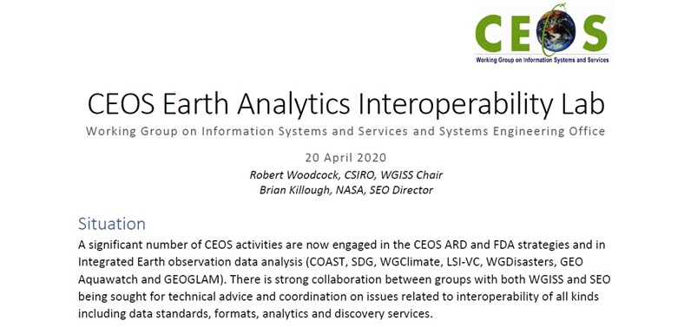
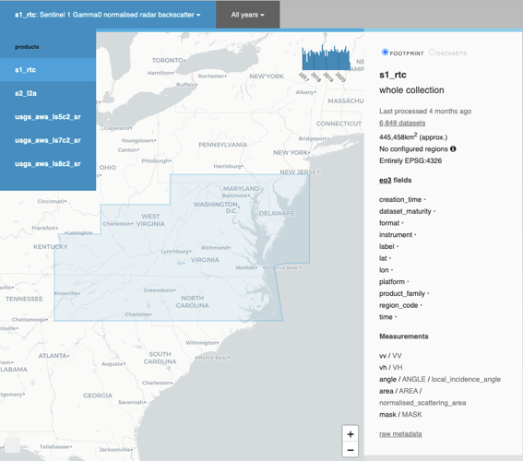
Earth Analytics Interoperability Lab (EAIL)
Initiated in April 2020 as a CEOS WGISS / SEO initiative, EAIL was a data and analytics platform that used AWS Cloud and Open Data Cube. Its advantages included Jupyter Hub, Dask scaling, customized ARD pipelines and GPU processing.

Slide 22
CEOS Analytics Lab
Built using the Open Data Cube software and CSIRO’s Earth Analytics, Science and Innovation platform
Scalable Production Workflows
Dashboards
Web Applications
Web Mapping Services
Exploratory Data Analysis
Powered by Open Data Cube and the Python data science ecosystem
Slide ‹#›

Slide 24
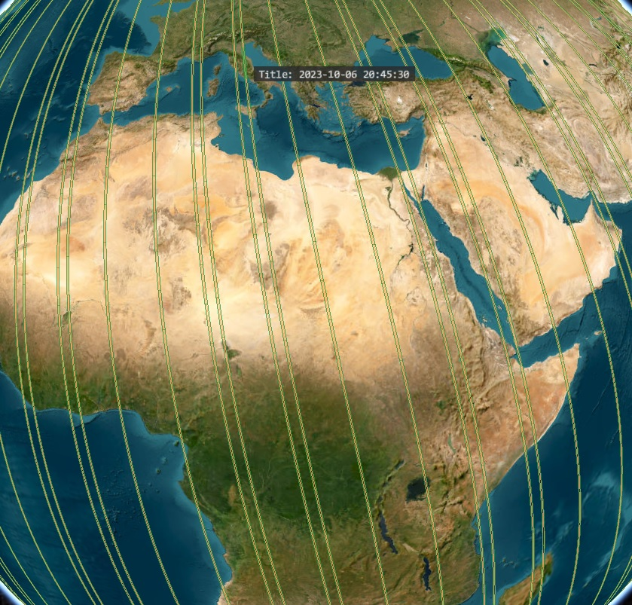
SEO Activities
GEO Infrastructure Development Task Team (GIDTT)
Space-based data, Data Cubes, Cloud providers
ODC Community Engagement
Digital Earth Africa
Digital Earth Pacific
COVE
New commercial missions
STAC data access

Slide 25
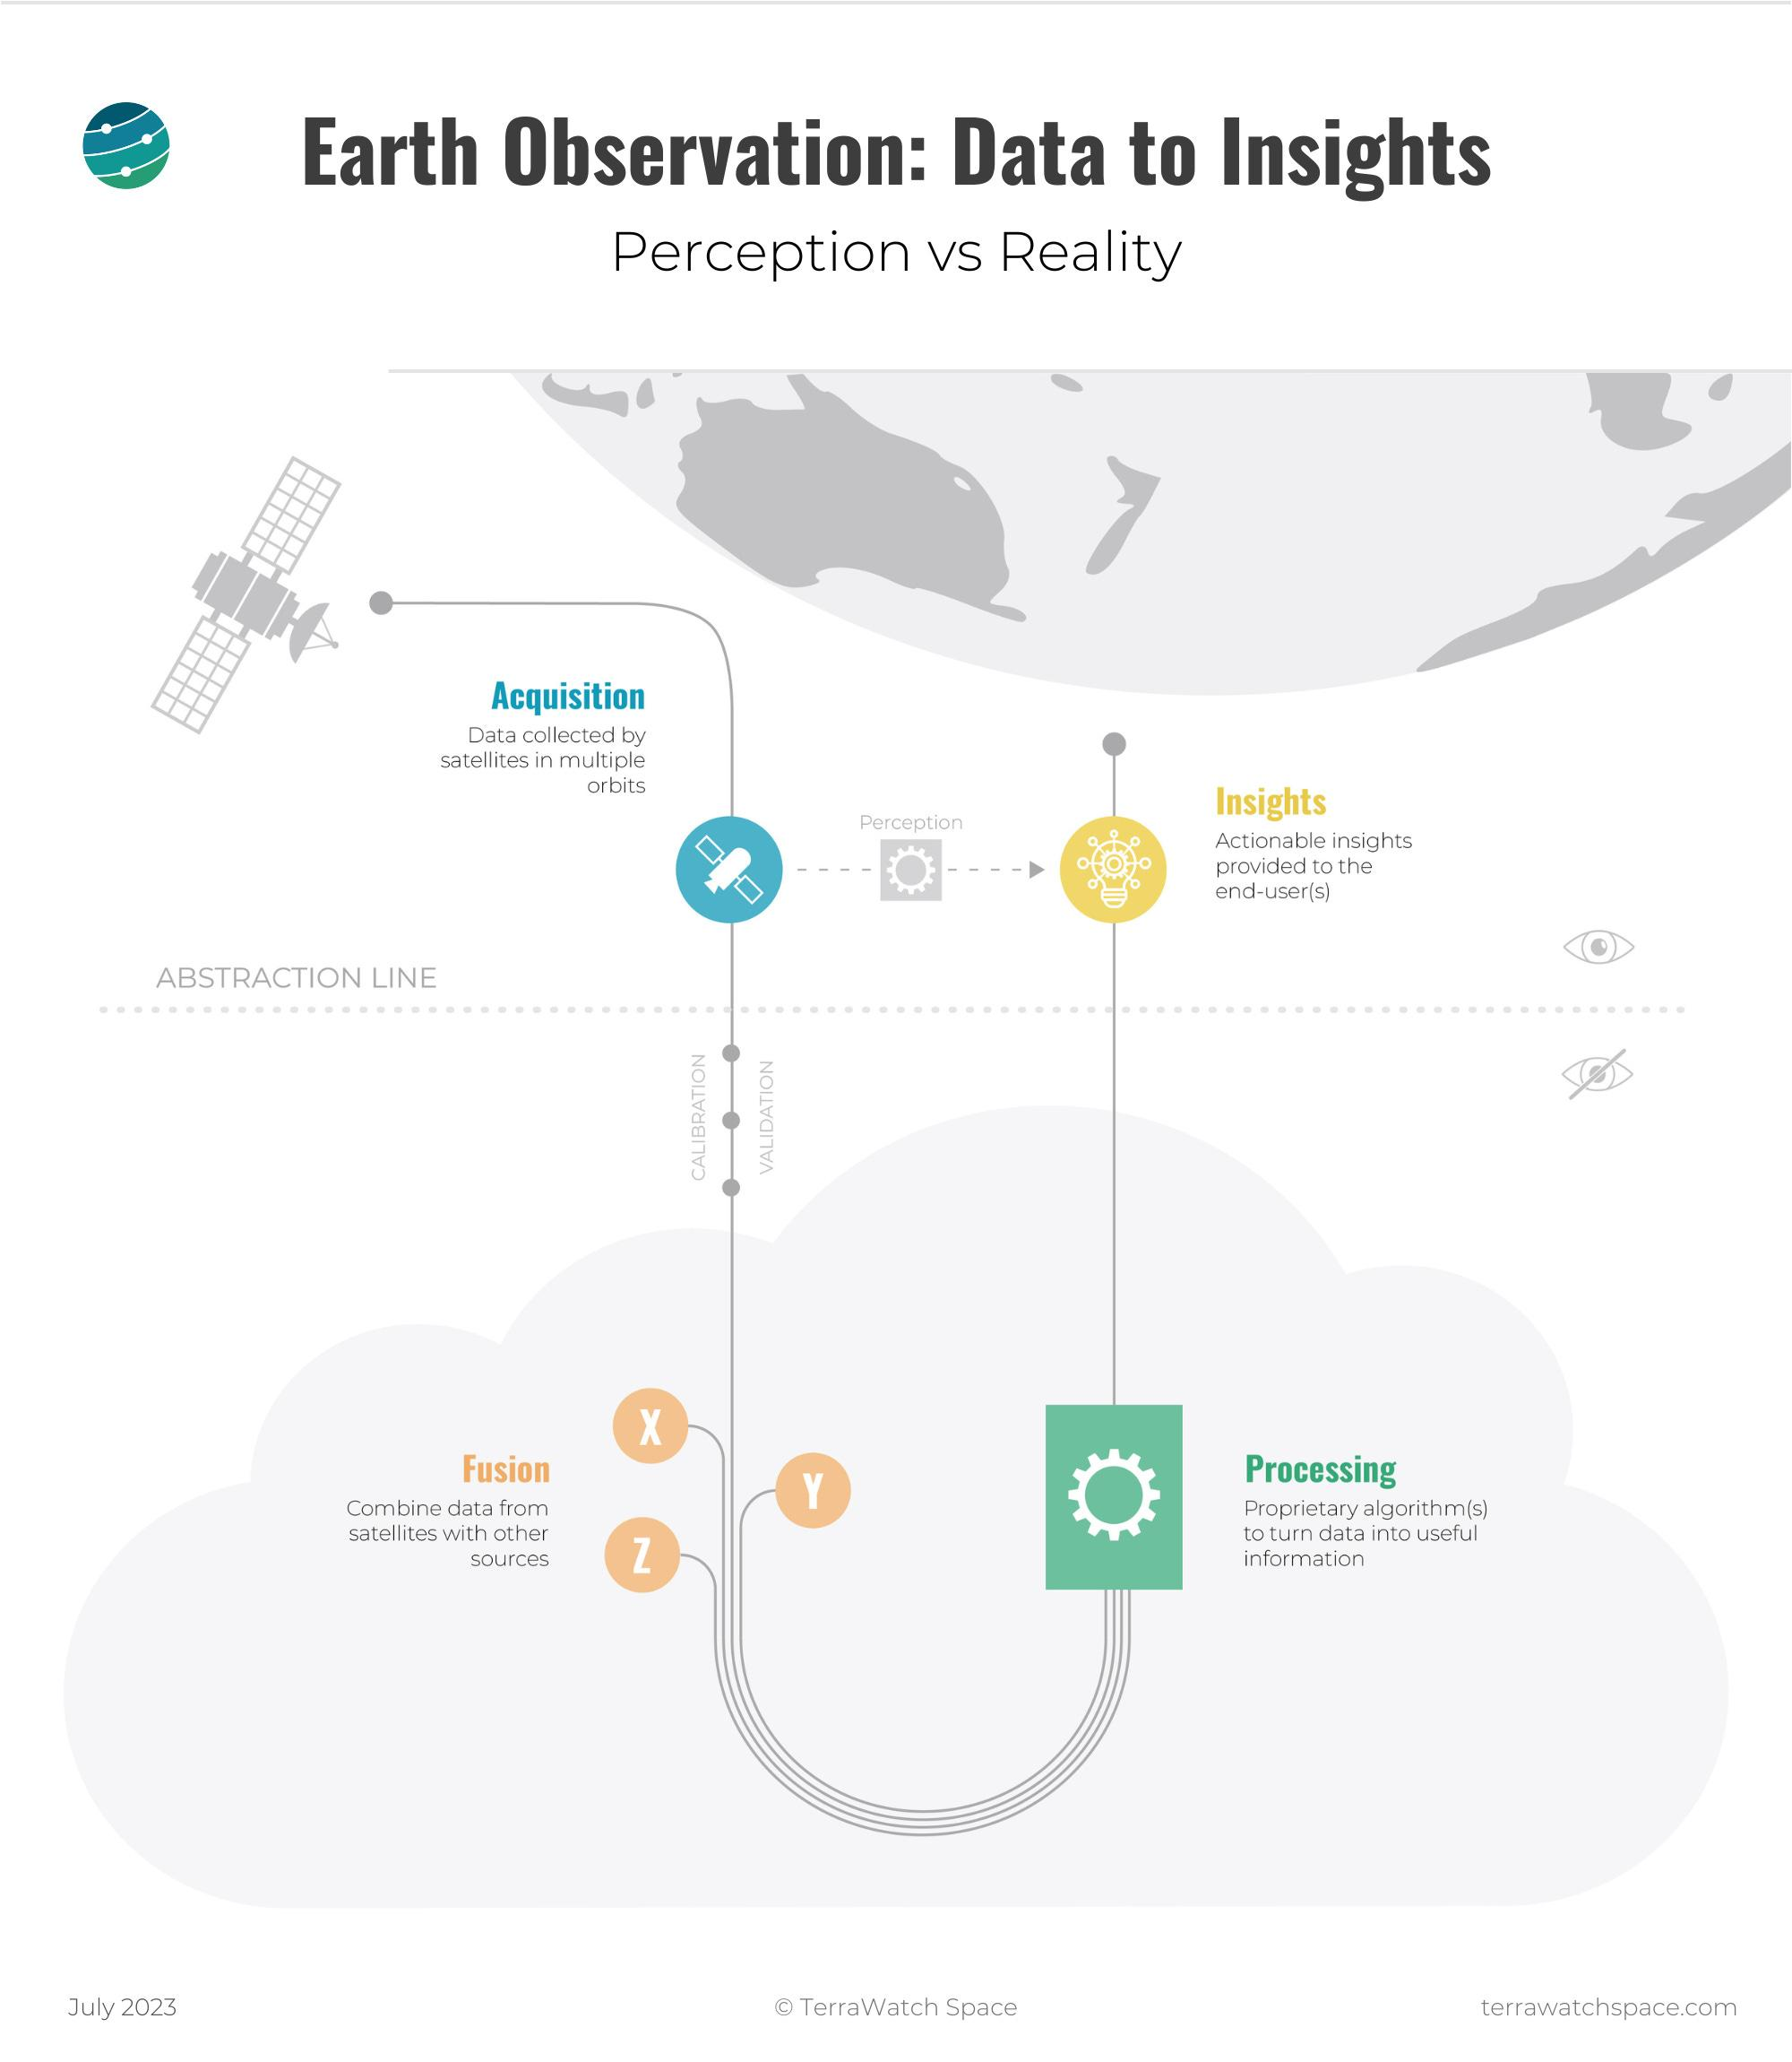
SEO Activities
CEOS ARD
Standards / Community Engagement
Nighttime Lights Occlusion Analysis
AI/ML
Generative Pre-trained Transformer (GPT)
WGISS Tech Exploration White Paper
New Space Task Team
Commercial data ODC integration
Interoperability with CEOS datasets

Slide 26
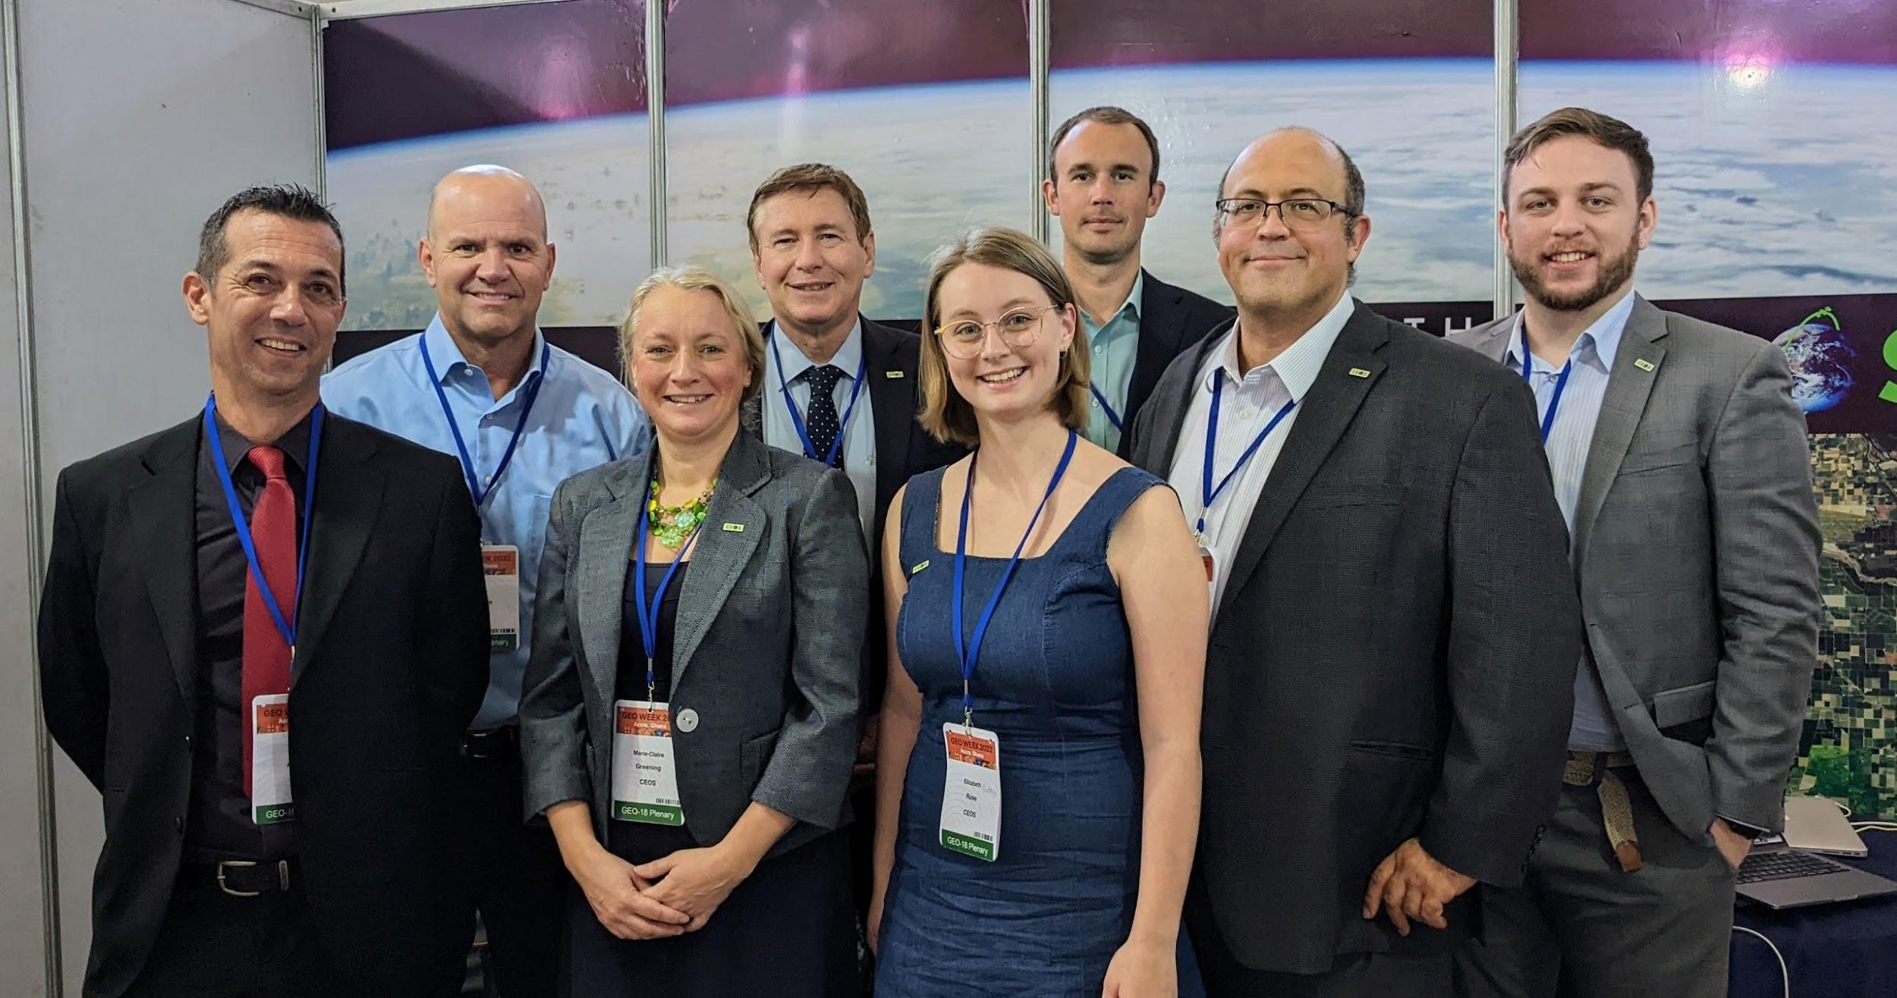
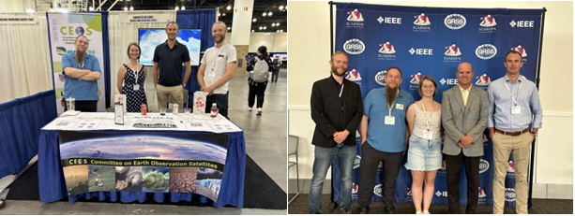
Communications Team
Newsletter
Quarterly Revisit
CEOS Booths
IGARSS 2023
GEO Ministerial Week 2023

