Slide 1
Carbon Roadmaps
& Policy Impact
Session Context & Intro
Susanne Mecklenburg, ESA
Agenda Item 3
SIT Technical Workshop 2023
18th - 19th October 2023, ESA/ESRIN

Slide 2
Context
Climate issues are a significant part of the CEOS coordination agenda
The past year has highlighted the insecure nature of the observation community relationship with the UNFCCC
COP-28 preparations have been particularly problematic
Studies have demonstrated that space agency global datasets are not having intended impact
CEOS land carbon (AFOLU) Roadmap is in development and aquatic roadmap in definition
New edition of the EO Handbook has been developed to showcase the capabilities of satellite EO in support of the Global Stocktake

Slide 3
Session Objectives
Update the community on the Roadmap status
AFOLU (heading for endorsement at Plenary)
Aquatic carbon (in definition stage by OCR-VC)
Hear the latest from the biomass harmonisation team and consider lessons to take forward on our approach to new datasets generally
Includes update on country engagement case study
Take stock of our preparation for COP-28 and brainstorm potential new approaches for observation sector engagement with the policy processes
Preview the EO Handbook and discuss promotion opportunities at COP-28

Slide 4
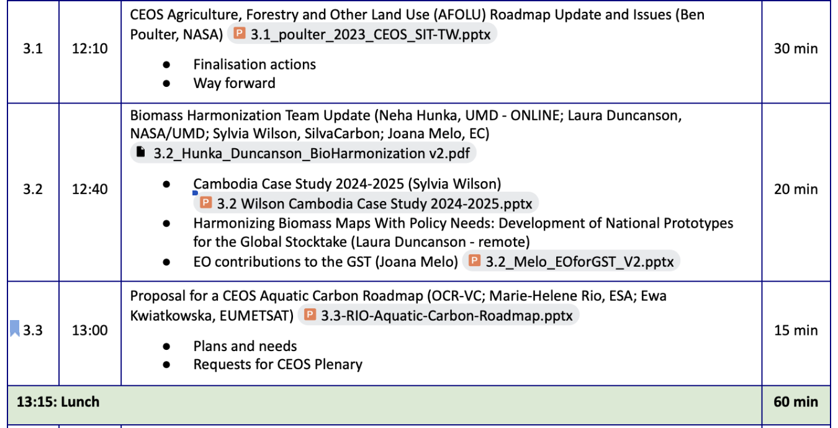
Agenda

Slide 5
Agenda

Slide 6
3.4 Discussion
UNFCCC Research and Systematic Observation (RSO) interface
Insecure relationship with UNFCCC SEC highlighted through staff changes (esp Jo Post)
COP-28 preparations have been particularly problematic
GEO is taking a new tack with UNFCCC citing ‘too much noise’ in RSO - looking more at adaptation and other sectors
Jo Post now at GOOS but willing to support CEOS strategising
Studies (Melo et al) indicate limited uptake of our datasets for UNFCCC reporting
JAXA incoming SIT Chair has indicated the topic will be a priority for their term
Past and recent discussions have raised several new paradigms for improvement
UNFCCC Global Goal on Observations
New groupings - Covenant of City Mayors (reporting, data needs)
IPCC TFI GPG Update - a 5 year EO optimisation campaign, starting now

