Slide 1
SIT Technical Workshop 2024
2024-2026 CEOS Work Plan
Lefteris Mamais,
CEOS Executive Office Team
Agenda Item 1.3
SIT Technical Workshop 2024
Sydney, Australia
18th September 2024

Slide 2
2024-2026 CEOS Work Plan
Level of representation and activity of each CEOS entity (Ref: Action SIT-39-01): Initial findings and reflections
CEOS Executive Office Team operations: Brief overview of work and responsibilities

Slide 3
Action SIT-39-01 – Scope and rationale
Scope
“CEOS Executive Officer team to undertake an assessment of the level of activity of all CEOS constituent groups. Consideration should be given to their representation in the CEOS Work Plan and activity more generally, as well as their interactions with other CEOS entities. The CEO will report findings to the 2024 SIT Technical Workshop and facilitate a discussion.”
.
Rationale
“CEOS should reflect on all existing elements of the CEOS structure and consider whether they are essential elements if they are not appropriately reflected in the CEOS Work Plan with clear deliverables or tasks.”

Slide 4
Action SIT-39-01 - Methodology
The CEO team, in alignment with the CEOS and SIT Chairs, has developed a robust approach to tackle this action
Meetings held
Desk Research to complete as much of the assessment as possible
Member participation
Consultations with CEOS reps for insights and validation
How dynamic?
Representation of CEOS in int’l fora
Level of Activity
Presentation at SIT TW for feedback
How much output?
Deliverables
How much synergy?
Collaboration with other CEOS entities
Solicitation of feedback from all CEOS entity leads
Development of Grid with Indicators
Final findings at CEOS Plenary
Supporting mission of CEOS members
Impact
How impactful for CEOS members?
Contributing to CEOS communications
Presentation at SIT TW to reflect on whether this should be tackled and how
How impactful for broader community?
Citations of work
Contribution to SDGs
…

Slide 5
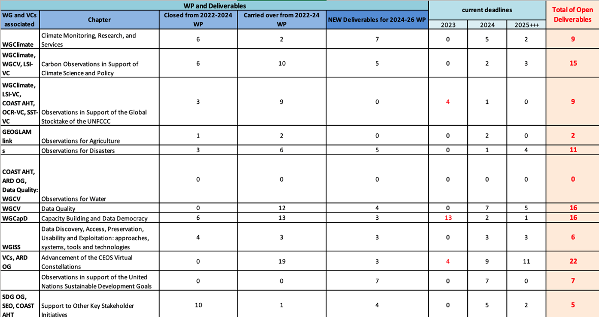
Action SIT-39-01 – Level of activity – initial findings
Analysis of deliverables
Activity of several WGs strongly reflected on the many active deliverables they have | From the VCs LSI-VC is the most active in terms of deliverables
CEOS ARD is very active amongst “other activities”
Important nuances not necessarily reflected in number of deliverables | often its simply the date that changes | several groups do not use the tracking tool
Analysis of meetings
CEOS entities have regular meetings (these have been mapped), yet level of active participation of members in these meetings remains to be assessed
Analysis of synergy
Full mapping has been performed confirming significant synergies within CEOS (WGISS, ARD and LSI-VC stand out) and outside (e.g. WMO, GEO)

Slide 6
Action SIT-39-01 – Impact – initial reflections
Impact within CEOS: Value for CEOS Members
The CEOS community is instrumental in providing input for future space missions, which directly benefits participating agencies. Information Sharing: enhanced access to mission-related information.
Exchange of Best Practices: facilitation of sharing good practice across agencies.
Expert Mobilization: bringing together specific experts to address critical issues.
Impact outside CEOS
Initial attempt to measure citations highlights need for more systematic approach
Tracing impact from CEOS all the way to users can be pursued (e.g. see work on calibration approaches for certain products that then inform the GEOGLAM community)
Mapping against SDGs already performed
Key question: Shall this be pursued in a more systematic way?

Slide 7
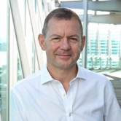
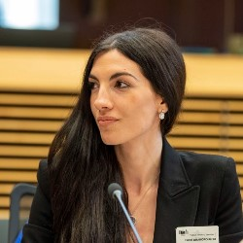
The CEOS Executive Office Team
 | STEVEN | LEFTERIS | IRENA
CEOS Work Plan & Deliverables | ✔ | ✔ | ✔
Stakeholder Coordination & Reporting | ✔
Leadership Support | ✔
Liaison with CEOS Groups | ✔ | ✔ | ✔
Representation & Participation | ✔ | ✔ | ✔
Administration & Communication | ✔ |  | ✔
Miscellaneous Tasks (additional activities) | ✔ | ✔ | ✔
Steven Ramage
CEOS Executive Officer (CEO)
Founder & CEO, Réseau Consulting
Lefteris Mamais
Strategic support to CEO team
Co-Founder & Director, Evenflow
Irena Drakopoulou
Operational support to CEO team
Programme Manager, Evenflow

Slide 8
Thanks for your attention 2024-2026 CEOS Work Plan
Lefteris Mamais,
CEOS Executive Officer Team
Agenda Item 1.3
SIT Technical Workshop 2024
Sydney, Australia
18th - 19th September 2024

