Slide 1
SIT Technical Workshop 2024
Requests on Improved Coastal Coverage in Future TIR Sensors from SST-VC & COAST-VC
Misako KACHI, JAXA
with SST-VC & COAST-VC Agenda Item #8.3
SIT Technical Workshop 2024
Sydney, Australia
18th - 19th September 2024

Slide 2
Interests on Coastal SST
One of priority areas discussed within the SST-VC and the Group for High Resolution Sea Surface Temperature (GHRSST) Science Team in recent years is coastal SST.
GHRSST was established 25 years ago to promote state-of-the-art SST dataset (https://www.ghrsst.org/).
Several GHRSST science team members also participated to CEOS SST-VC and COAST-VC.
Many satellite agencies already provide their SST datasets in GHRSST Data Specification (GDS) format (NetCDF), and the datasets are operationally used in various meteorological agencies to produce boundary SST for NWP.

Slide 3
Coastal SST Observation
In response to establishment of COAST-VC in April, SST-VC and COAST-VC in collaboration with GHRSST had a special workshop on 14 June during the GHRSST25 in Montreal.
Many talks regarding coastal SST observations from space and their applications are presented and we also had a panel discussion on gap areas in coastal observing systems.
One of issues raised at the workshop is coastal coverage for existing and future ultra high resolution TIR instruments.

Slide 4
Ultra High Resolution SST
A novel ultra high resolution IR measurements less than 100 m will open a new era of SST observations, such as ECOSTRESS (2018), TRISHNA (2026), LSTM (2028), SBG (2028).
Traditional TIR sensors have 750-1100 m spatial reolution, such as VIIRS, MODIS, SLSTR, AVHRR, METimage, etc.
SGLI on GCOM-C has IR observation with 250 m for coastal areas and bridges traditional TIR and novel ultra high resolution IR obs.
ECOSTRESS shows large improvements in resolving coastal sub-mesoscale eddies and filaments, tidal signature, etc. It is also critical for air-sea coupling in coastal regions.

Slide 5
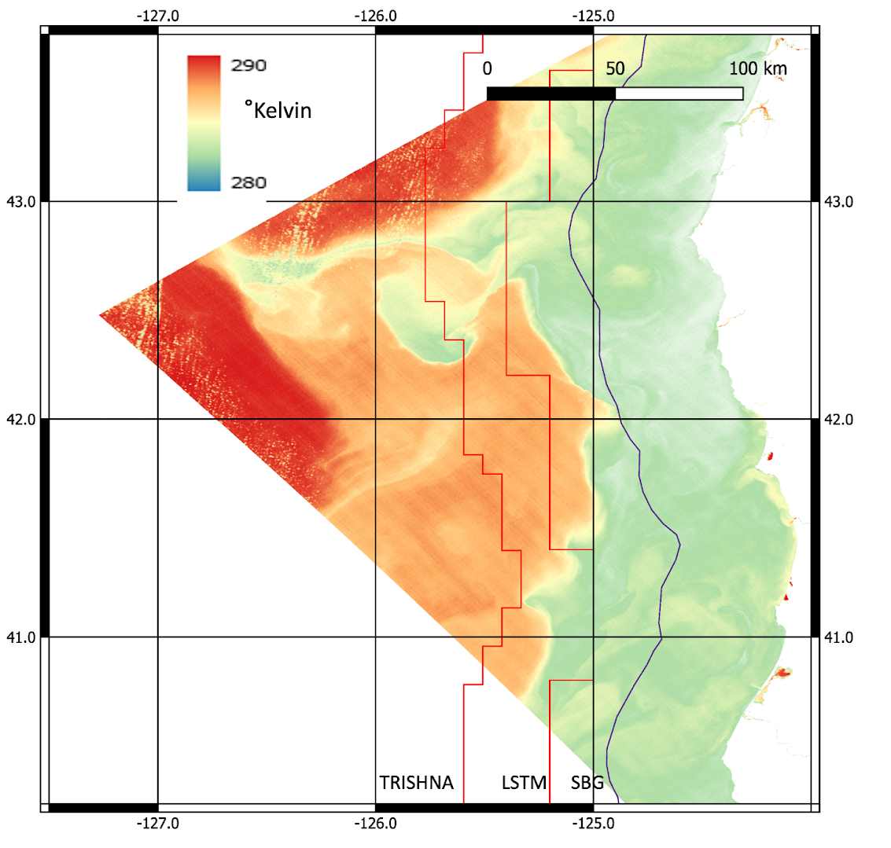
Requests in coastal coverage
The spatial resolution of observation is a key factor but also the size of the area is extremely important so that synoptic ocean observations can be made.
However, ocean observation boundary of existing ultra high resolution TIR missions are quite limited and would miss the important ocean information.
TRISHNA and LSTM coverage of min. 100 km would be minimum requirement for coastal SST
Coast line→
SBG→
LSTM→
TRISHNA→
SST image from ECOSTRESS on 2021-09-01 with the proposed ocean observation boundaries from TRISHNA (orange line), LSTM (red line), and NASA’s SBG-TIR (purple line) overlaid. SBG would miss the thermal fronts, eddies and filaments observable from the other sensors.

Slide 6
Request to CEOS Members
We strongly encourage the CEOS members who plan future ultra high resolution TIR missions to provide the opportunity to obtain coastal SST in GHRSST format with enough coverage up to minimum 100 km from the coast, like LSTM and TRISHNA.
We recommend, especially, the SBG-TIR mission planners and project team improve the coastal coverage to make it more scientifically useful for the coastal ocean applications.

