Slide 1
UKSA 2025 CEOS Chair Theme
Harshbir Sangha,
Patrick Gibson,
Shaneigh Turner
UKSA
Agenda Item 9.9
SIT Technical Workshop 2024
Sydney, 18th - 19th September 2024

Slide 2
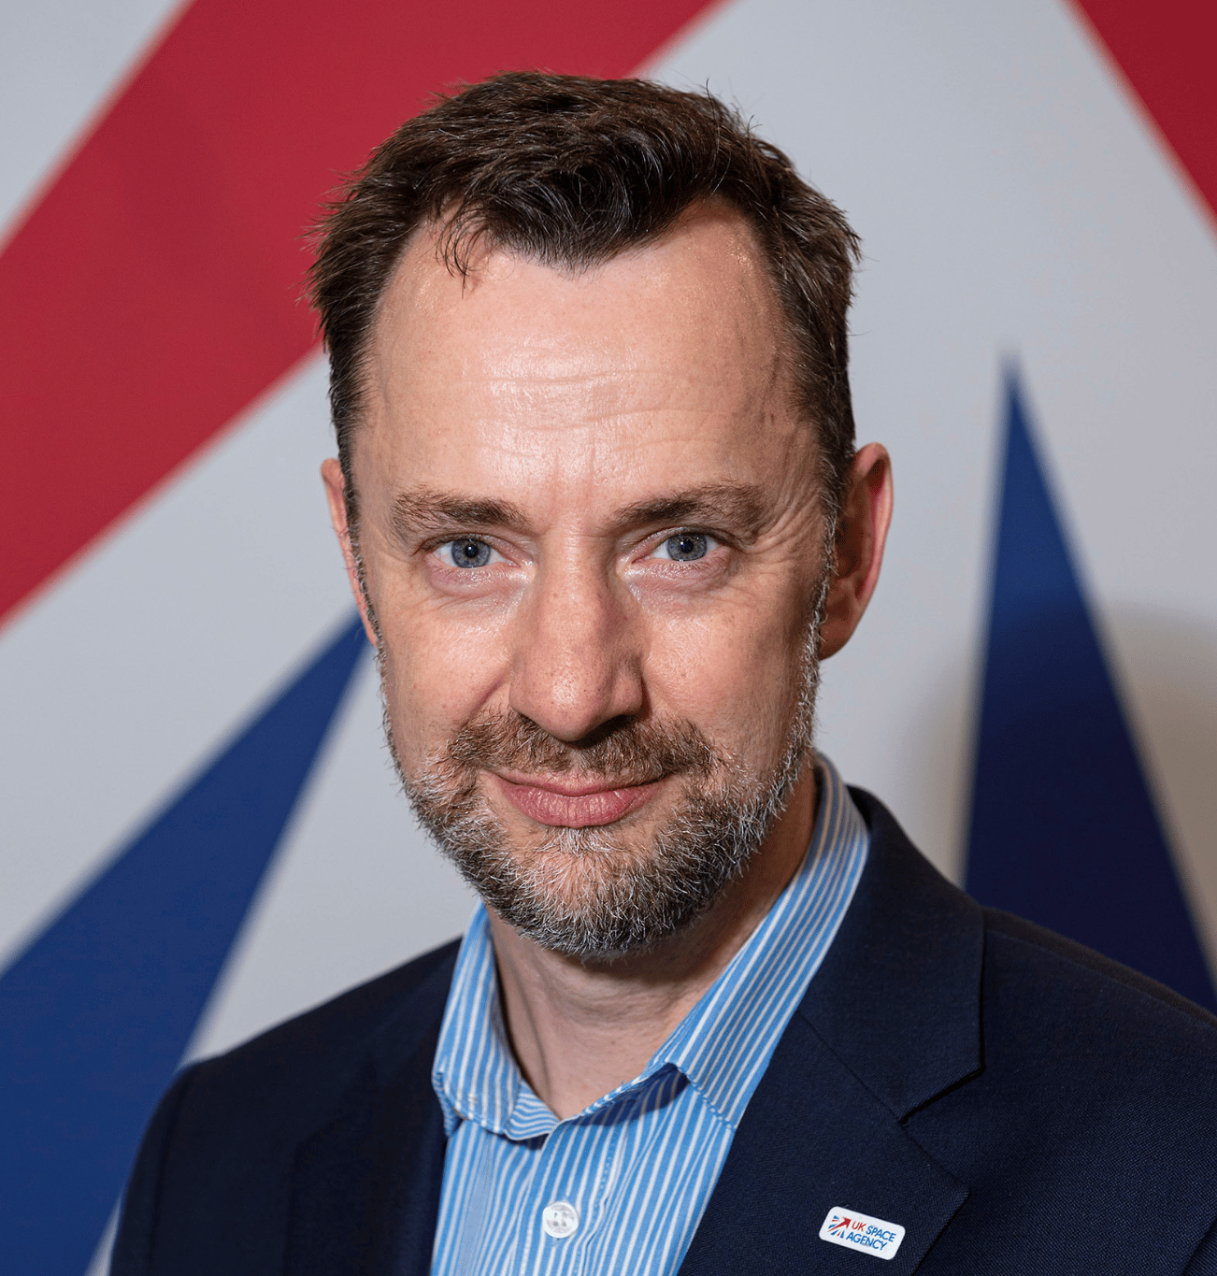
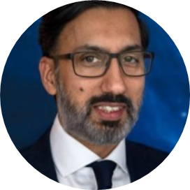
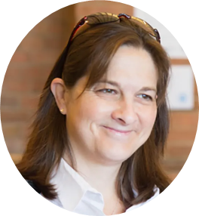
UKSA CEOS Chair Team
Dr. Paul Bate
UKSA CEO and Incoming CEOS Chair
Harshbir Sangha
Director of EO, LEO and SSR
Beth Greenaway
Head of Earth observation and climate
Shaneigh Turner
EO Climate lead
Niall Bradshaw
EO Senior lead for CEOS and Copernicus
Patrick GIbson
EO Senior lead for climate

Slide 3
Overview
‘Unlocking Earth Observation for Society’
Explore strategies to bridge the gap between satellite EO data and services
Learn from the experiences of CEOS Agencies and identify what we might do better together as an international community to maximise the uptake of EO data for societal impact.
Four focus areas:
Unlocking EO for Public Service
Unlocking EO for the UNFCCC Global Stocktakes
Unlocking EO for the Global Methane Pledge
CEOS In Schools and Youth Summit
Also support JAXA SIT Chair priorities

Slide 4
1: Unlocking EO for Public Service
Aim: Identify strategies to better bridge the gap between EO data and services for the public sector.
Promote discussions on CEOS Agency national strategies
Side meeting at SIT TW 2025 – share agency activities and discuss the potential of CEOS
Short paper presenting findings on initiatives from across the CEOS community will be presented for CEOS Principal awareness at CEOS Plenary 2025.

Slide 5
2: Unlocking EO for the UNFCCC Global Stocktakes
Aim: Support and encourage sustained discussion and action on GST Lessons Learned recommendations through 2025
EO can play a far greater role as we look ahead to GST-2
JAXA SIT Chair and WGClimate working to address challenges
GST Lessons Learned; Updated CEOS GST Strategy
Potentially organise side meetings at:
WGClimate-22 (February 11-13, 2025; Harwell, UK)
ESA Living Planet Symposium (June 23-27, 2025; Vienna, Austria)
Generally support JAXA SIT Chair efforts in this direction

Slide 6
3: Unlocking EO for the Global Methane Pledge
Aim: CEOS GHG TT methane standards adopted through an update of the Global Methane Pledge at UNFCCC COP30 (Brazil, Nov 2025)
CEOS GHG TT preparing best practices for facility scale space-based methane measurements.
UK National Physical Laboratory (NPL) is co-leading the effort alongside NASA JPL.
We hope to build on this overcoming year and join-up with our policy colleagues to push for these standards to be adopted as an official method for measuring facility-scale methane emissions in the framework of Global Methane Pledge.
158 countries + European Union now participating.

Slide 7
4: CEOS In Schools and Youth Summit
Aim: Pilot a CEOS mechanism to inspire global youth collaboration in EO.
Targeted at students in all CEOS countries (approx 14-16yo)
Demonstrate how satellite EO can be used for the benefit of society
Climate, environment, disasters
Highlight the power of international collaboration
Two international workshops on applications for:
Built environments
Natural environments (biodiversity – supporting 2024 CEOS Chair priority).
Conclude with hybrid CEOS Youth Summit, ahead of the 2025 CEOS Plenary.
Seek to maintain an informal working group of participating CEOS members to explore how this strand of activity might be improved and continued by future CEOS Chairs.

Slide 8
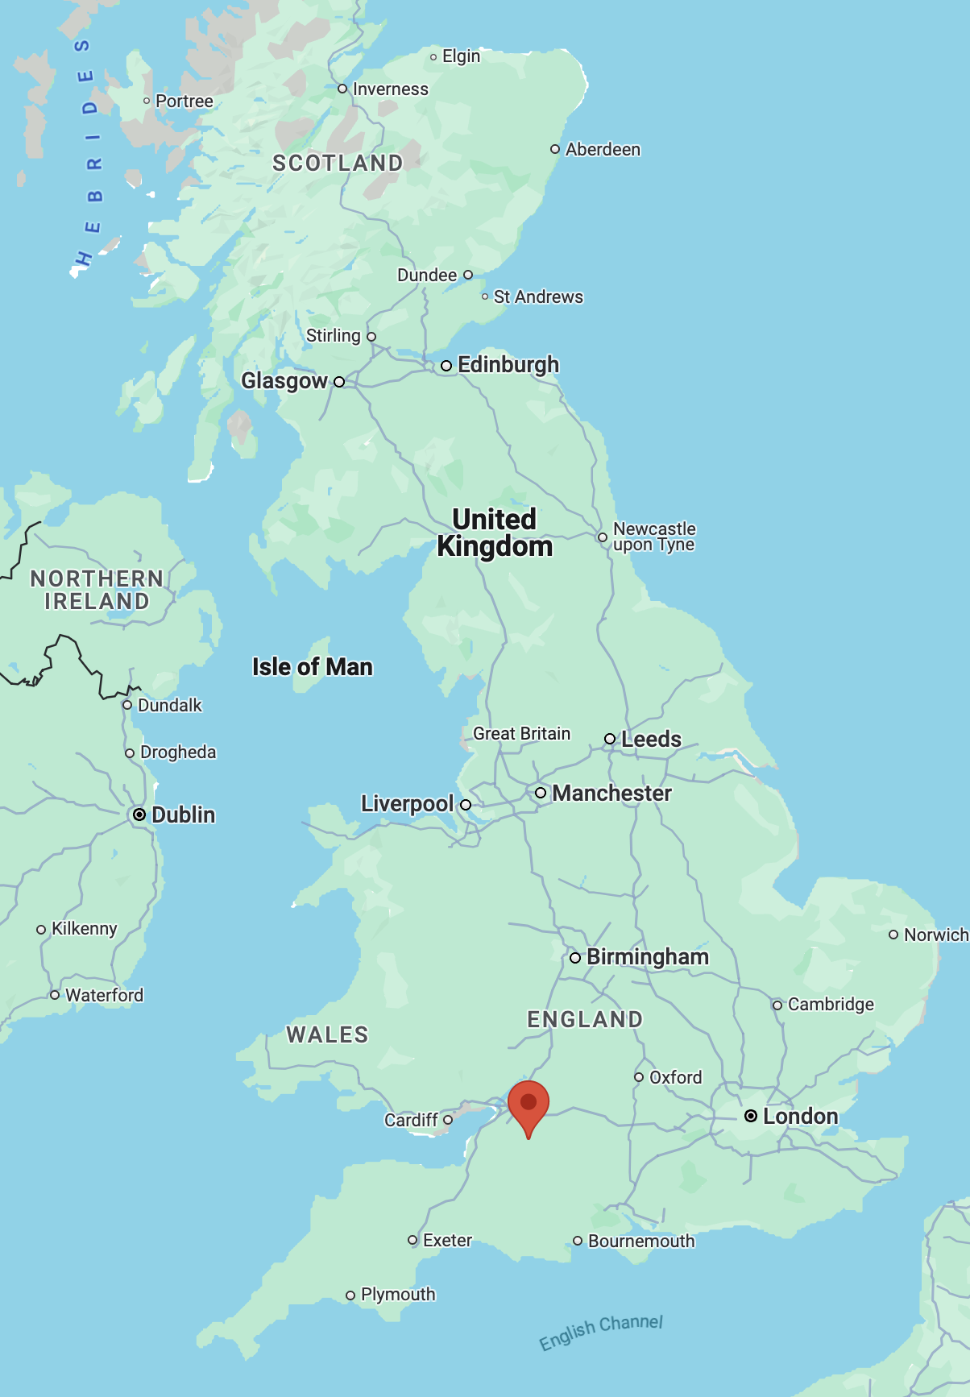
39th CEOS Plenary and 1st Youth Summit
November 4th - 6th, 2025
Bath, UK
Please save the date!
Source

