Slide 1
SIT Technical Workshop 2025
Welcome
Hironori Maejima,
JAXA SIT Chair
Phil Evans,
EUMETSAT Director General
Agenda Item 1.1
SIT TW 2025
Darmstadt, Germany
9-11 September, 2025

Slide 2
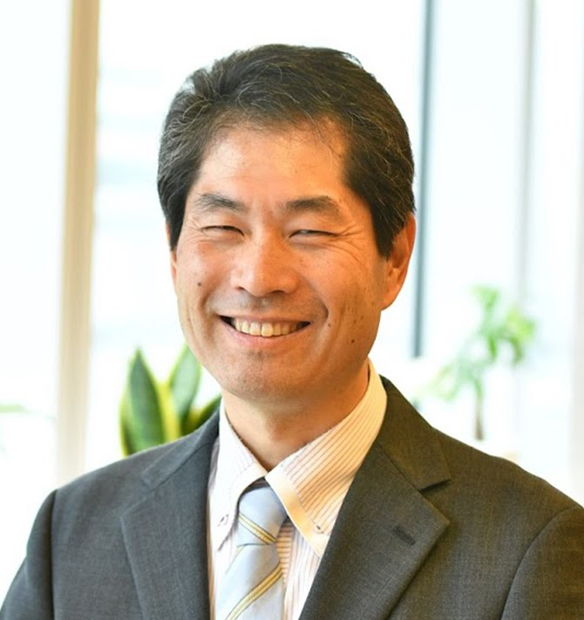
Welcoming Remarks
Hironori Maejima
CEOS SIT Chair 2024-2025
Senior Chief Officer of Earth
Observation Missions
JAXA
Agenda Item 1.1
SIT TW 2025
Darmstadt, Germany
9-11 September, 2025

Slide 3
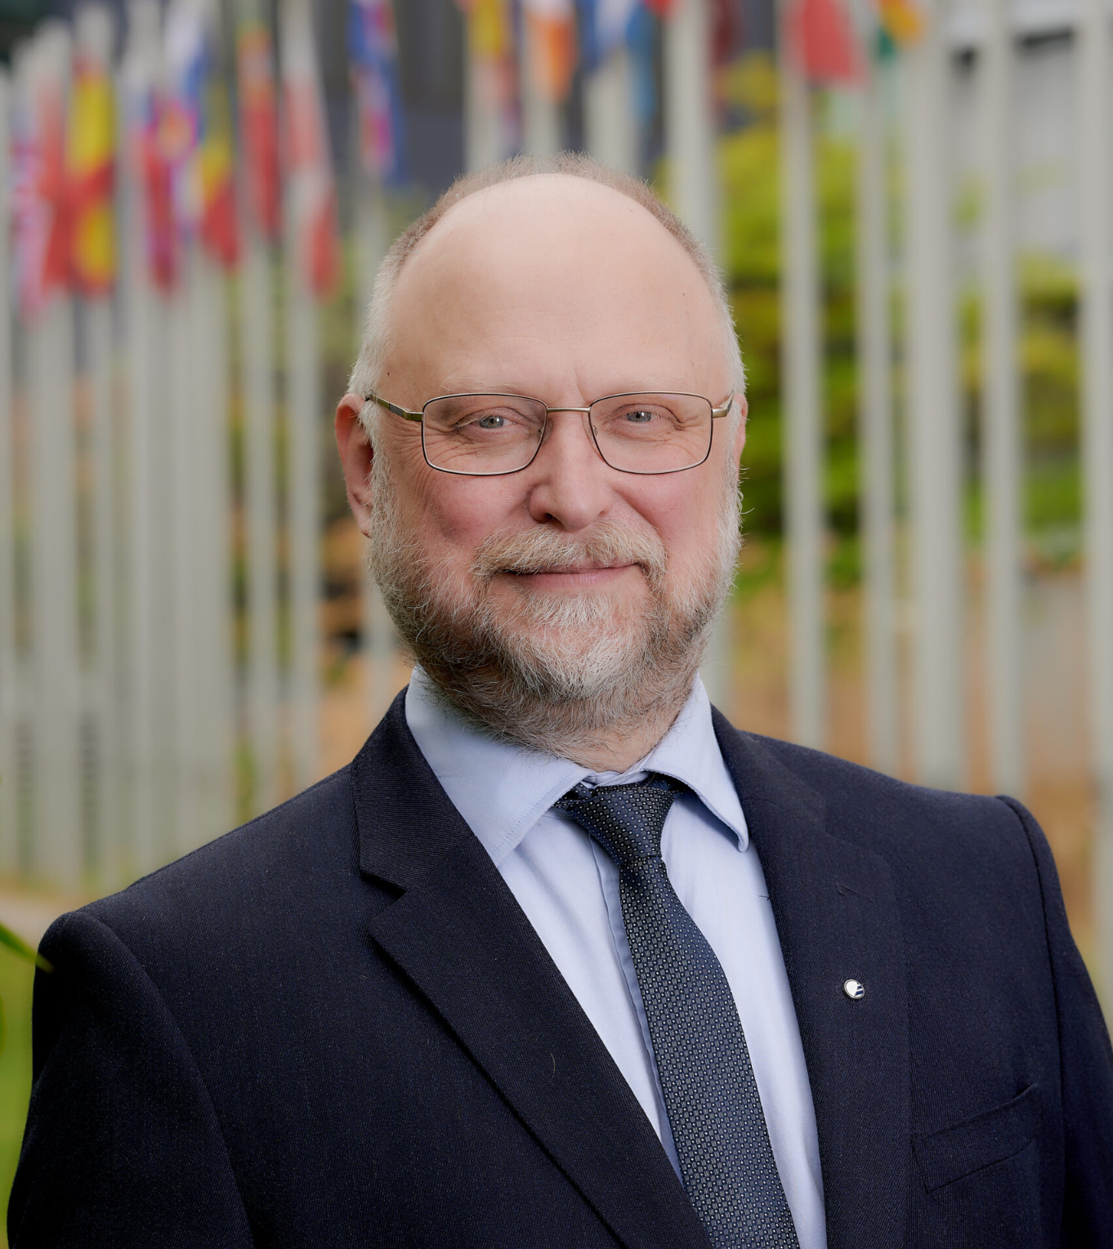
Welcoming Remarks
Phil Evans
Director-General of EUMETSAT
CEOS Principal
Agenda Item 1.1
SIT TW 2025
Darmstadt, Germany
9-11 September, 2025

Slide 4
JAXA SIT Chair Priorities
JAXA SIT Chair Priorities
EO Data Impact – addressing obstacles and opportunities for CEOS agency data, particularly AFOLU/Biomass map datasets, to have maximum impact in the key climate actions such as the Global Stocktake of the Paris Agreement
GHG observations from space – addressing coordination for data continuity challenges ahead and developing good practices so that operators of all kinds may contribute to societal needs
Supporting existing & emerging CEOS business
Escalating, elevating and expediting the CEOS WP activities underway and planned in which CEOS agencies are investing

Slide 5
SIT Chair Term Activities
In 2024:
GHG Roadmap Update
AFOLU Roadmap Actions Review
Coordination with IMEO
IPCC coordination
COAST-VC established
In 2025:
GST1 Lessons Learned delivered by WGClimate [SIT-40]
GST Strategy 2025 [item 3.3]
IMEO-CEOS Joint Database of Controlled Release Experiments [item 5.3]
Methane Common Practices [item 5.2]
GFOI engagement [item 2.3]
IPCC coordination [item 3.4]
VC Coordination [Session 7]

Slide 6
Review of Agenda
Today:
Agriculture Forestry & Other Land Use
EO Data Impact
Interoperability and Data Quality
Atmospheric Observations
Other Thematic Topics (pt 1)
Tomorrow:
Virtual Constellations: State of the Global Observing System
Other Thematic Topics (pt 2)
Systems Engineering Office
CEOS Chair & SIT Chair Themes (current and future)
Biodiversity
Dinner at Vollrads Castle

Slide 7
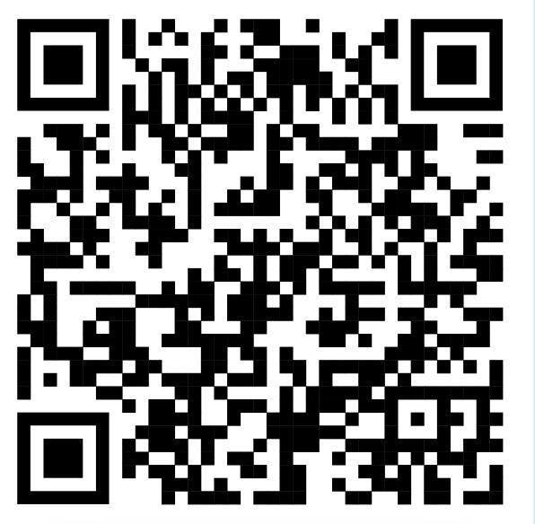
Agenda item 10.3
Thank you to Christine Bognar
Christine will dial in
Please complete a message to her Kudoboard today!
https://www.kudoboard.com/boards/eSbdTYoC
Or scan:

