Slide 1
CEOS Plenary Update
CEOS Chair Team
Agenda Item 10.2
SIT TW 2025
Darmstadt, Germany
9-11 September, 2025

Slide 2
Objectives of the 2025 CEOS Plenary include:
Discuss the Biodiversity Study Team’s Proposal for Sustainable Support for Biodiversity in CEOS and decide the appropriate way forward.
Consider applications for membership in CEOS
Endorsement: CEOS Global Stocktake Strategy Issue 2
Provide an opportunity for CEOS Principals to hear updates from CEOS Working Groups (WGs).
Discuss implementation of the Common Practices for Quantifying Methane Emissions from Plumes Detected by Remote Sensing.
Discuss strategies for capacity building and country engagement in support of CEOS AFOLU Roadmap implementation.
Provide an opportunity for CEOS Principals to hear updates from CEOS Virtual Constellations (VCs). The SIT Chair will provide a synthesis report on topics that are for information-only. Additional VC agenda items related to discussion or decision/endorsement were welcomed by request.
Review results of the community consultation / survey on the future of CEOS-ARD presented in the form of a concept note for an ambitious next-generation CEOS-ARD Strategy, and initiate development to meet community expectations.
Discuss CEOS organisational level response to EW4All
Highlight and acknowledge the substantial efforts that contribute to the routine functioning of CEOS as well as ongoing services provided by CEOS to the international Earth observation community
Discuss the 2026-2027 SIT Chair priorities.
Consider endorsement of the 2027 CEOS Chair nomination Norway (one-year term).
Welcome the consortium of CSIRO, Geoscience Australia (GA), and the Australian Bureau of Meteorology (BOM) as 2026 CEOS Chair (one-year term) and discuss the proposed themes for the coming year.

Slide 3
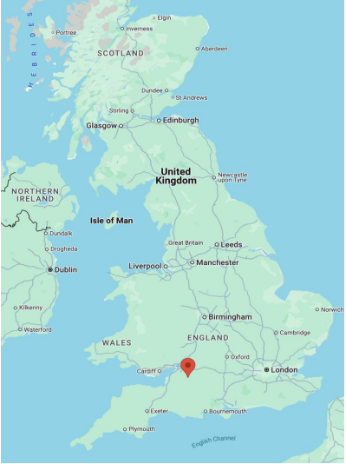
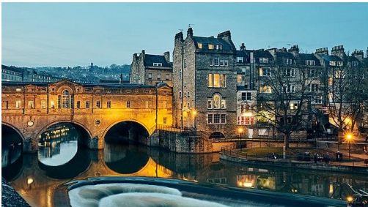
UK CEOS Plenary
Tuesday 4th – Thursday 6th November 2025
Bath, UK (1.5-hour train ride from London)
London Heathrow, Bristol Airport
Register by 19th September please! https://ceosdotorg.wufoo.com/forms/z1ypczsz045j4hd/

Slide 4
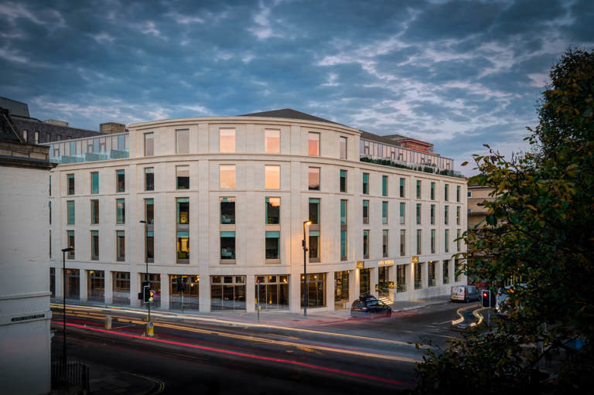
Venue & Accommodation
Apex City of Bath Hotel, Bath, UK. Accommodation is available at the venue with additional options nearby
Welcome afternoon tea on Tuesday (5pm)
Evening hosted dinner reception on Wednesday evening at the Roman Baths
For visa support or a personalised invitation please contact:
UKSA-CEOS-Chair-2025@googlegroups.com

Slide 5

See you there!

