Slide 1
AFOLU Roadmap Status and Outlook
Takeo Tadono (JAXA)
Neha Hunka & Clement Albergel (ESA)
Agenda Item 2.2
SIT TW 2025
Darmstadt, Germany
9-11 September, 2025

Slide 2
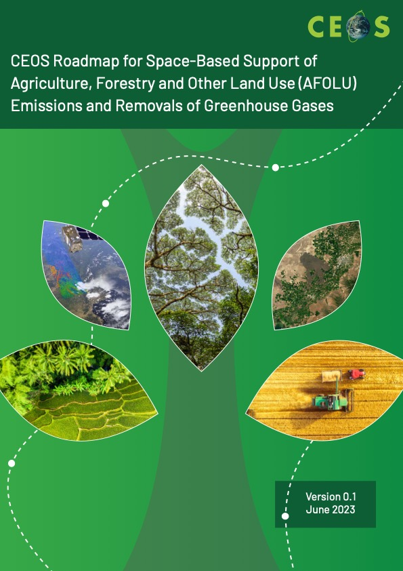
Purpose
Update for community on status
Way forward on key actions
Seeking engagement from relevant agencies
Ensuring continuity and progress

Slide 3
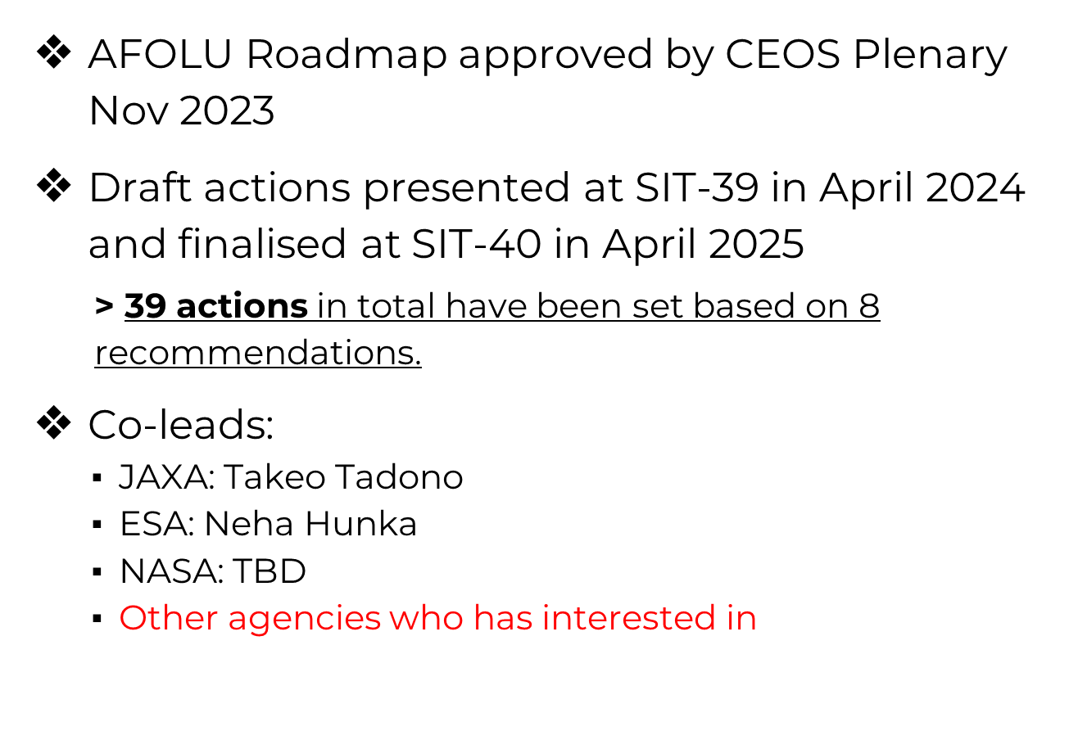
AFOLU Roadmap - Status

Slide 4
AFOLU Roadmap - Direction
A framework for long-term coordination of agency programmes in support of the needs of society for Agriculture, Forestry and Other Land Use (AFOLU)-related information, with a particular focus on the needs and ambition cycle of the Global Stocktake of the 2015 Paris Climate Agreement.
A guiding vision for long-term space agency coordination around AFOLU.
An effective means for communicating the intentions of CEOS
Address basic observation continuity and necessary agency coordination to achieve goals of sustained land-imaging of land-use and land cover change and biomass estimates

Slide 5
Recommendations
Recommendations from AFOLU Roadmap (reported by Ben Poulter at SIT-40 in Fukuoka, Japan in April 2025):
Universal access to satellite data needed for national reporting
Continuity and backward compatibility for missions providing activity data and emission factors
Improve data use in UNFCCC reporting and IPCC Guidelines
Enable dialogue between inventory practitioners and CEOS community
Reconcile bottom-up, top-down, and inventory estimates of GHG emissions and removals
Systematically target activities to support IPCC Land Cover classes
Work with New Space to provide comprehensive coverage for national GHG inventories
Consistency of AFOLU and GHG Roadmaps for integrated national GHG inventory system, GHG+.

Slide 6
Three Classes of Actions
Actions across all Recommendations broadly fall into three categories:
Those pertaining to presently available data to support AFOLU procedures as in the 2006 IPCC Guidelines for National GHG Inventories vol.4, and their 2019 Refinement.
Actions to develop new or improved products that would allow more accurate and/or easier implementation of the Guidelines
Actions to facilitate greater interaction with the GHG Roadmap and hence improve characterisation of land management emissions through MVS based on satellite-based atmospheric inversions.
Notes:
- focus at this stage on two action classes above for technical reasons on MVS integration)

Slide 7
Governance
LSI-VC is the formal home for AFOLU in CEOS, within the Forests and Biomass team
LSI-VC is also home to our thematic work in ag (GEOGLAM) and forests (GFOI)
LSI-VC Leads recognise the need to ensure suitable ownership and tracking of these threads and arranging agenda time on their meetings and calls for at least virtual representation and reporting
Notes:
- focus at this stage on two action classes above for technical reasons on MVS integration)

Slide 8
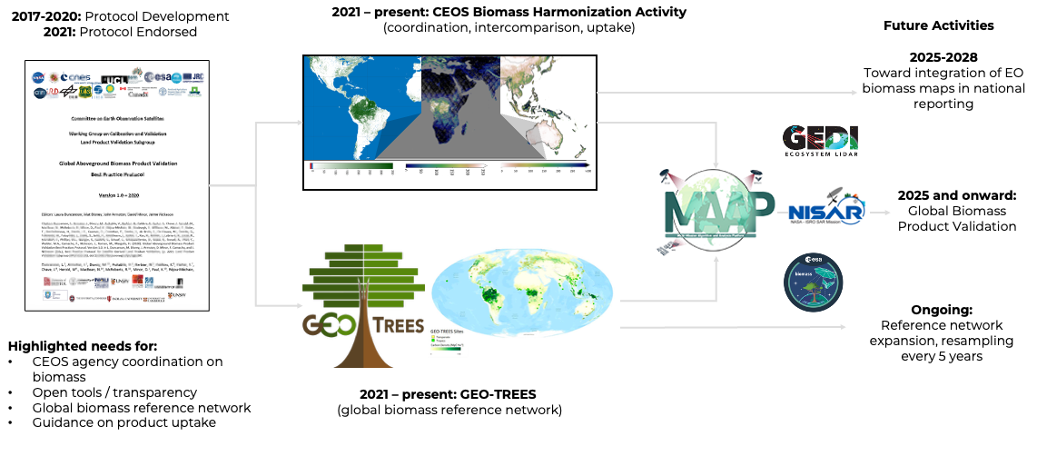



Action 0.3: Support biomass harmonization efforts
Notes:
The biomass harmonization activity is transitioning to a new phase (Phase 2) in recognition of the recent launches of the ESA BIOMASS and NISAR missions, and advances in reference data availability from GEOTREES. Phase 2 will rekindle communication between NASA, ISRO, ESA, and JAXA mission teams focused on intercomparison of new datasets from these new missions, as well as independent validation using available biomass reference maps from GEOTREES. Both ESA and NASA are supporting the development of a biomass validation tool via the MAAP platform to link new mission datasets to GEOTREES.

Slide 9
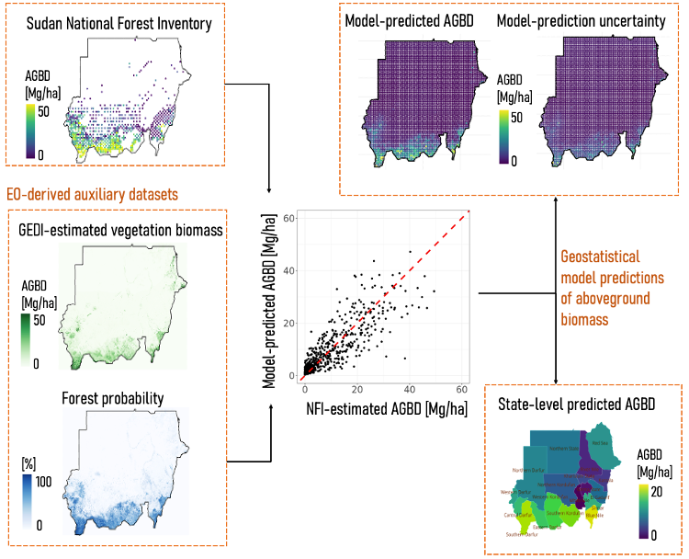


Action 0.3: Support biomass harmonization efforts
Uptake of AGB map products: Republic of Sudan
The first uptake of a NASA GEDI-based biomass product for national reporting to the GST.
Submitted by Sudan, positively reviewed by the IPCC, and final approval is expected in late 2025.
This pathfinding uptake of satellite AGBD products will enable other countries to follow.
Product development and analysis was conducted on the NASA MAAP cloud computing environment (https://scimaap.net/)

Slide 10
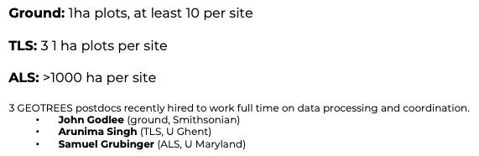
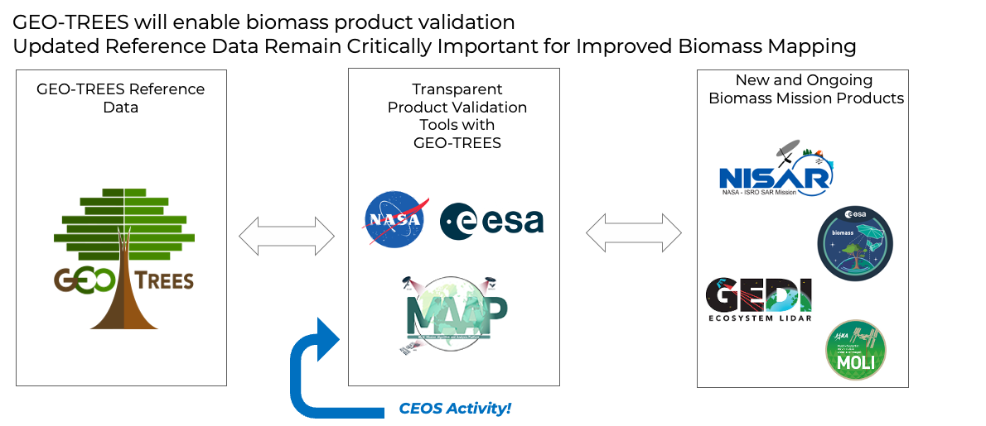
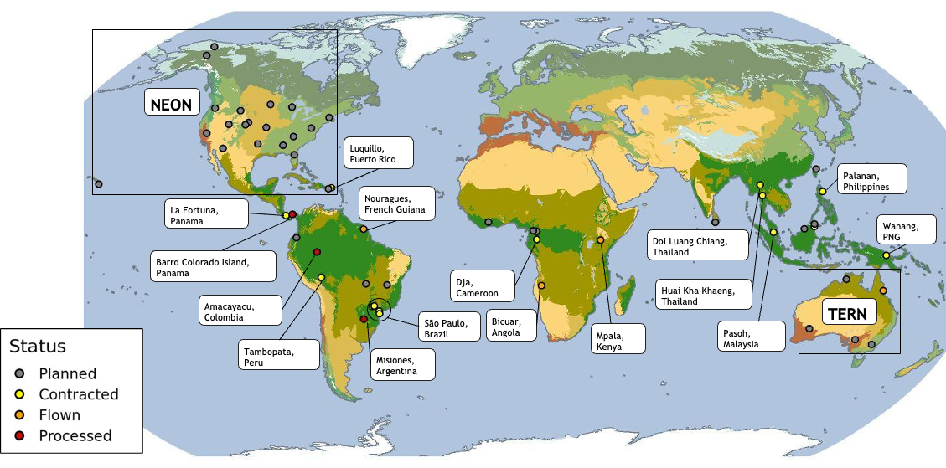
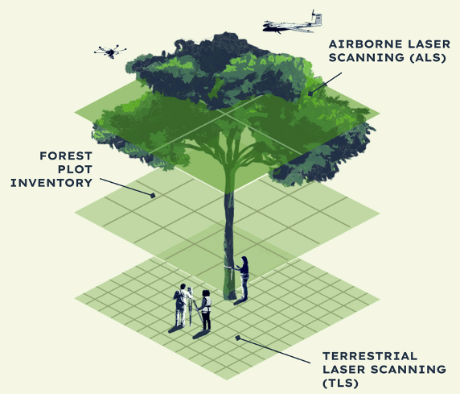
Action 2.5: Support GEO-TREES efforts
GEOTREES ALS Sites (Status August 2025)
Notes:
‘partner networks are being engaged to join, for example TERN in Australia is already a GEOTREES partner, and there are plans to collaborate with NEON in the US to expand beyond the tropics.’
ISRO being a key partner
We have right now 42 sites in the doing. Data should be available starting end of this year and throughout 2026.
Other points of interest for SIT:
Data from the first sites should become available in the next weeks. There is still some technical issues pending (agreeing on formats, versioning numbers etc) but nothing critical.
Complementing observation
All sites are covered with high priority by Tandem-X
All sites are covered by EnMAP though with low priority and cloud cover is an issue (usually we have ~10 acquisitions per site of which 80% are cloud covered). I agreed with them to select ~20 sites for which we will get higher priority to improve the coverage.
CSA RCM, and ALOS cover all sites but I have no visibility about the status.
Engagement of Agencies is still weak. So far ISRO, ESA, CNES and CSIRO (I assume they co-fund TERN activities) are the only ones providing funding for ground data collection. DLR, JAXA, CSA providing EO capacities. Maybe the expansion to the North can be a hook for other Agencies.
I believe we have a unique multi source EO data set. Agencies could support GT by supporting the analysis of this data. CEOS could coordinate these efforts?

Slide 11
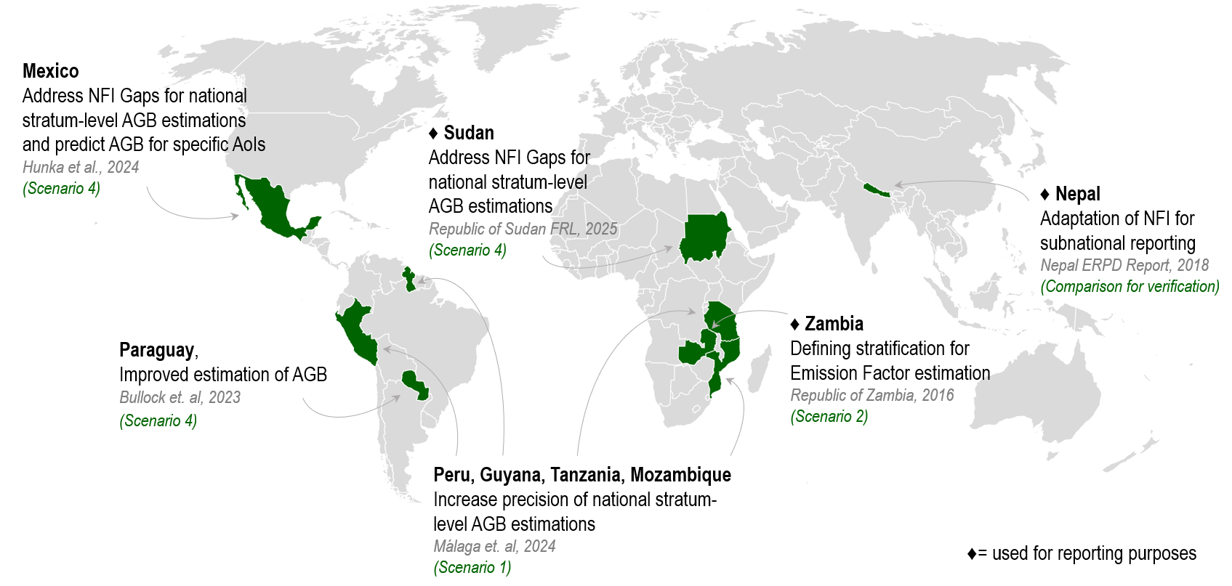
Action 2.6/2.8/3.1: GFOI R&D efforts on informed uptake of space-based biomass products
GFOI Plenary 2025
21–23 October 2025 in Bali, Indonesia, and online
Theme: ”Forests and the marvel of monitoring”
Information: https://www.fao.org/gfoi/plenaries/plenary-2025
Review of Biomass Rapid Response Module (to be launched at GFOI Plenary)
Possible applications of EO-based biomass data (in combination with existing ground data), and their current level of maturity
Key operational and research examples for the use of space-based forest biomass-related data as auxiliary information for reporting purposes
Notes:
Facilitates international efforts to bring EO data and research towards operational uptake by countries in the tropics
Identifying gaps and needs to advance research and data provision
Foster a scientific community knowledgeable of country uptake needs
Contribute to the GFOI process, organization of expert meetings, support in capacity building workshops, assessment of maturity of methods and datasets…
Involvement in international forums (UNFCCC, GCOS/TOPC, GEO-TREES, CEOS cal/val efforts, UN-SDGs…)
Advocate for the use of remote sensing coupled with in-situ observations
Global gathering for countries, donors, development partners and practitioners in the forest monitoring sector

Slide 12
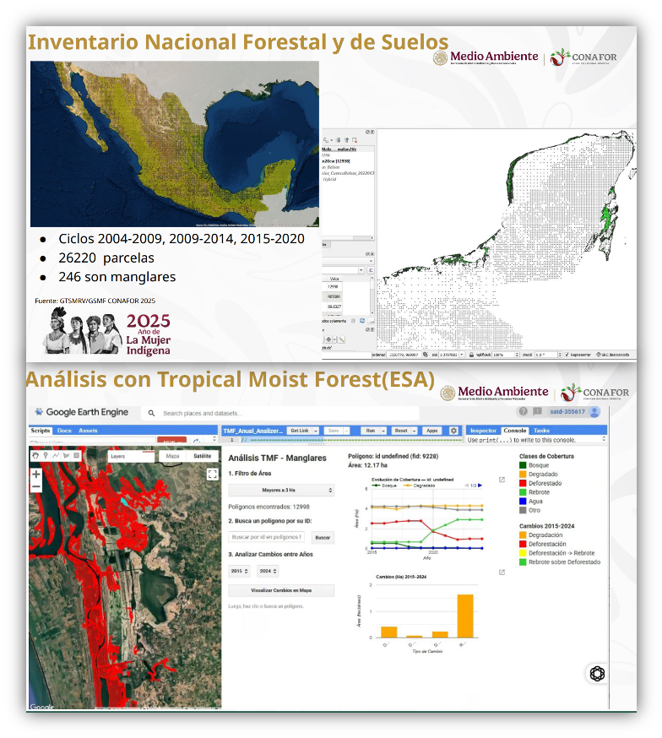
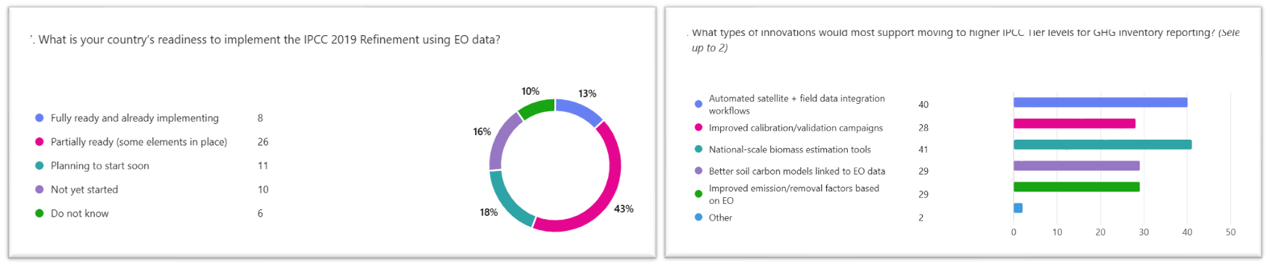
Action 2.8: Scaling from global to national inventory needs
GFOI R&D Broad Assessment of satellite data needs and integration into reporting systems
Survey deployed to 34 countries, and currently collecting results
Analysis and presentation at the GFOI summit in Bali
Results to inform R&D and Capacity Building efforts
Success stories using EO for AFOLU - Central American case study (Guatemala, Mexico, Belize) – ongoing and will be publish December 2025
EO supporting emission reductions and reporting CO₂ in mangroves ecosystems
Analysis with multiple datasets, including Tropical Moist Forest (ESA)
Two more case studies (Africa, and Asia) for 2026

Slide 13
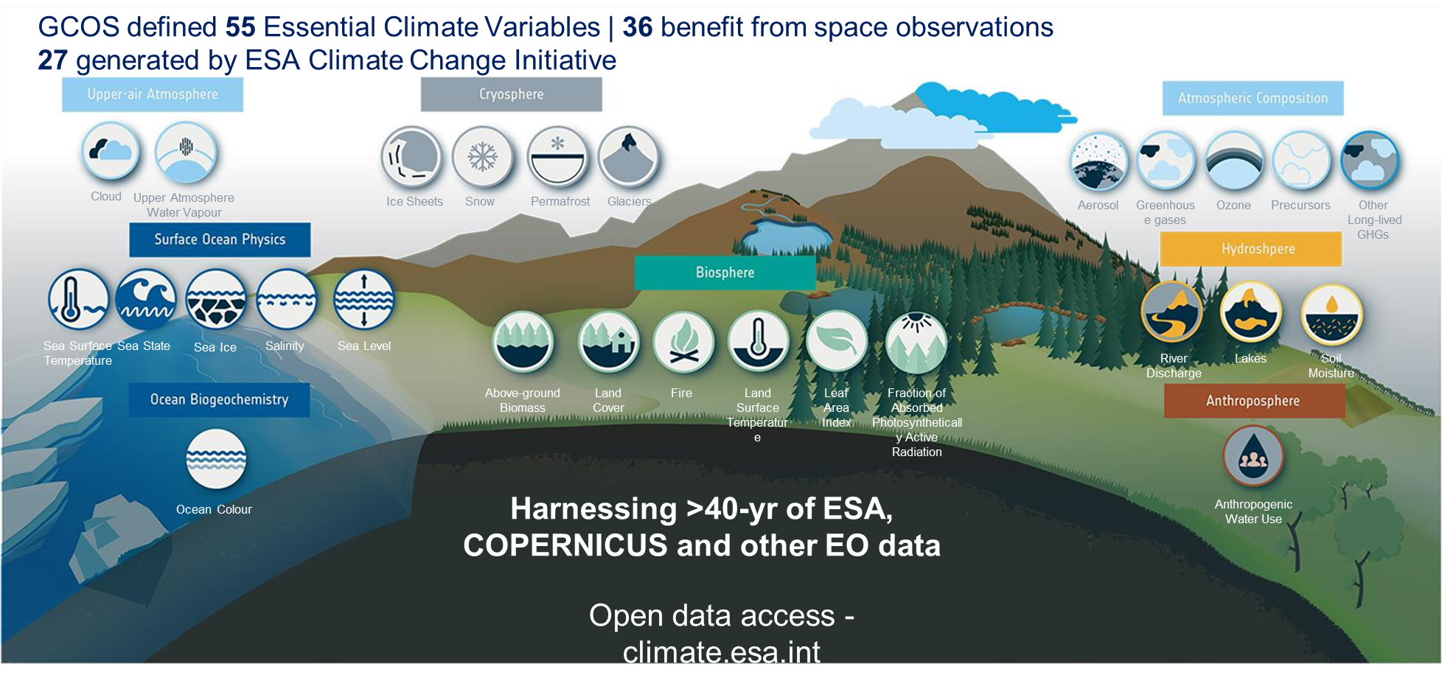
Action 2.9: Supporting GCOS for NRT and low latency variables
Notes:
4 new ECV projects:
Land evaporation
Ocean Surface Heat Flux, Phytoplankton biomass and diversity, Sea Ice Age and Drift

Slide 14
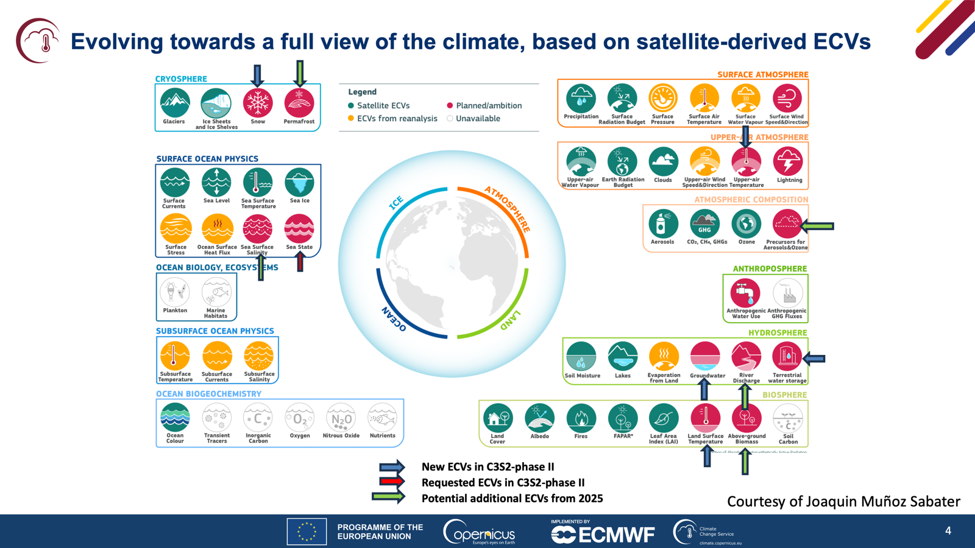
Action 2.9: Supporting GCOS for NRT and low latency variables

Slide 15
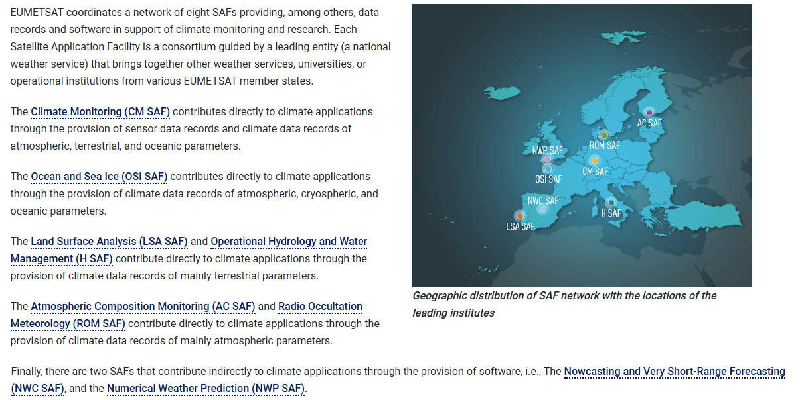
Action 2.9: Supporting GCOS for NRT and low latency variables
Working with SAFs | EUMETSAT

Slide 16
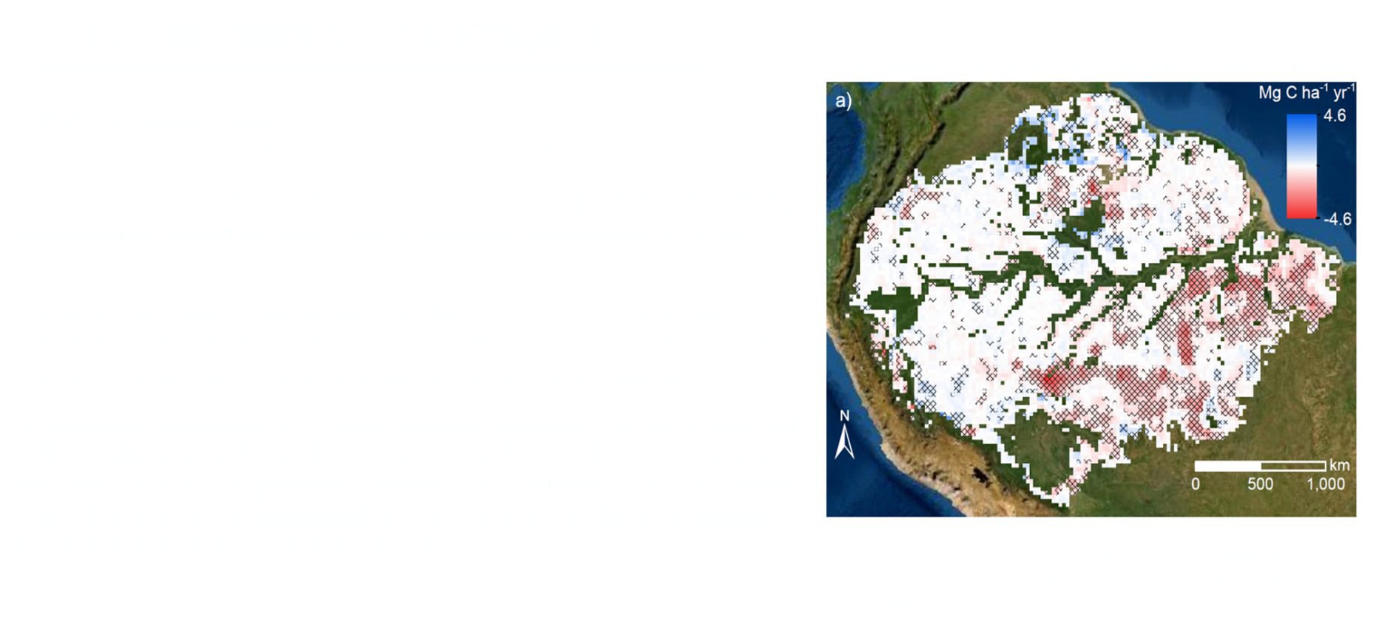
Action 3.2/6.1: ESA-INPE Campaign

Slide 17
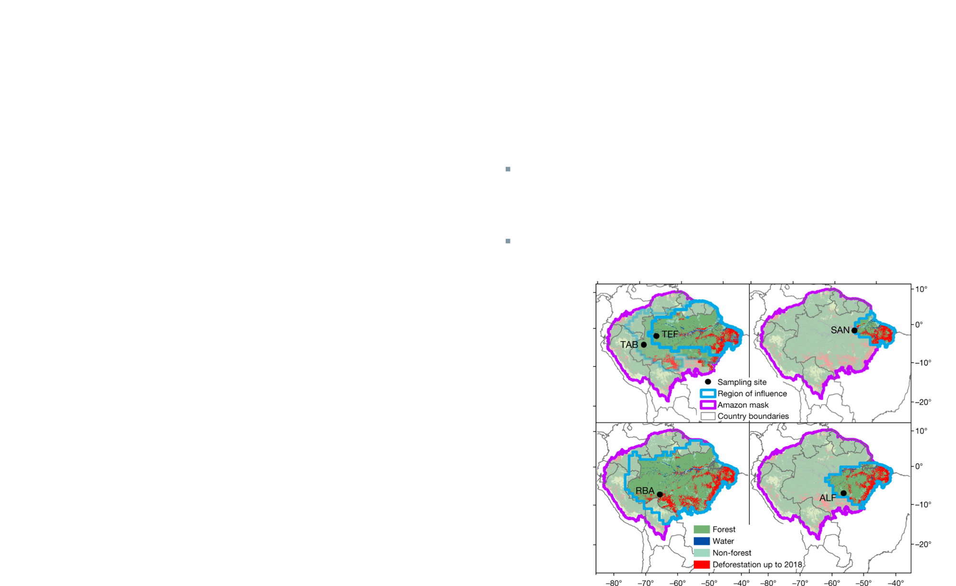
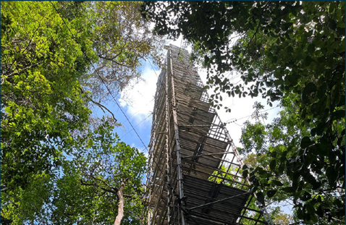
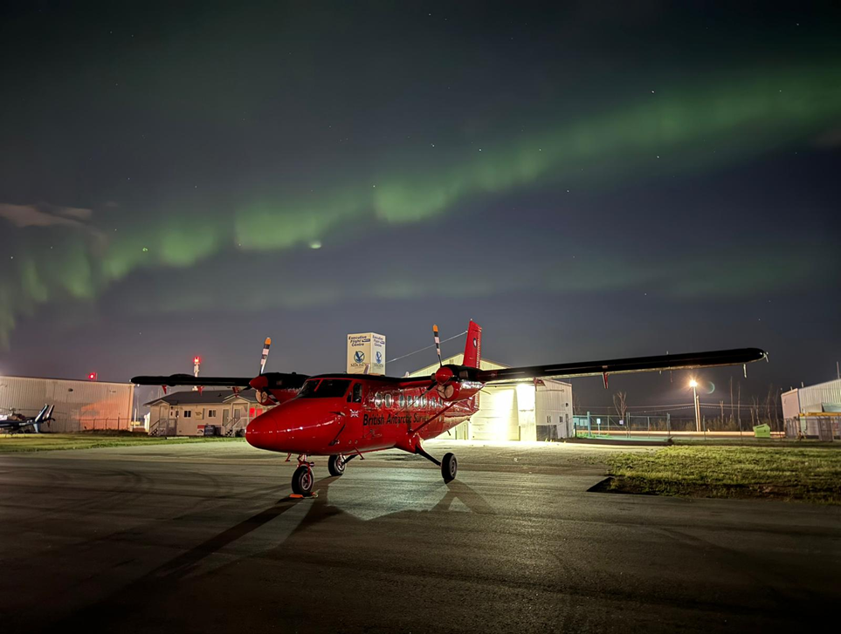
Action 3.2/6.1: ESA-INPE Campaign

Slide 18
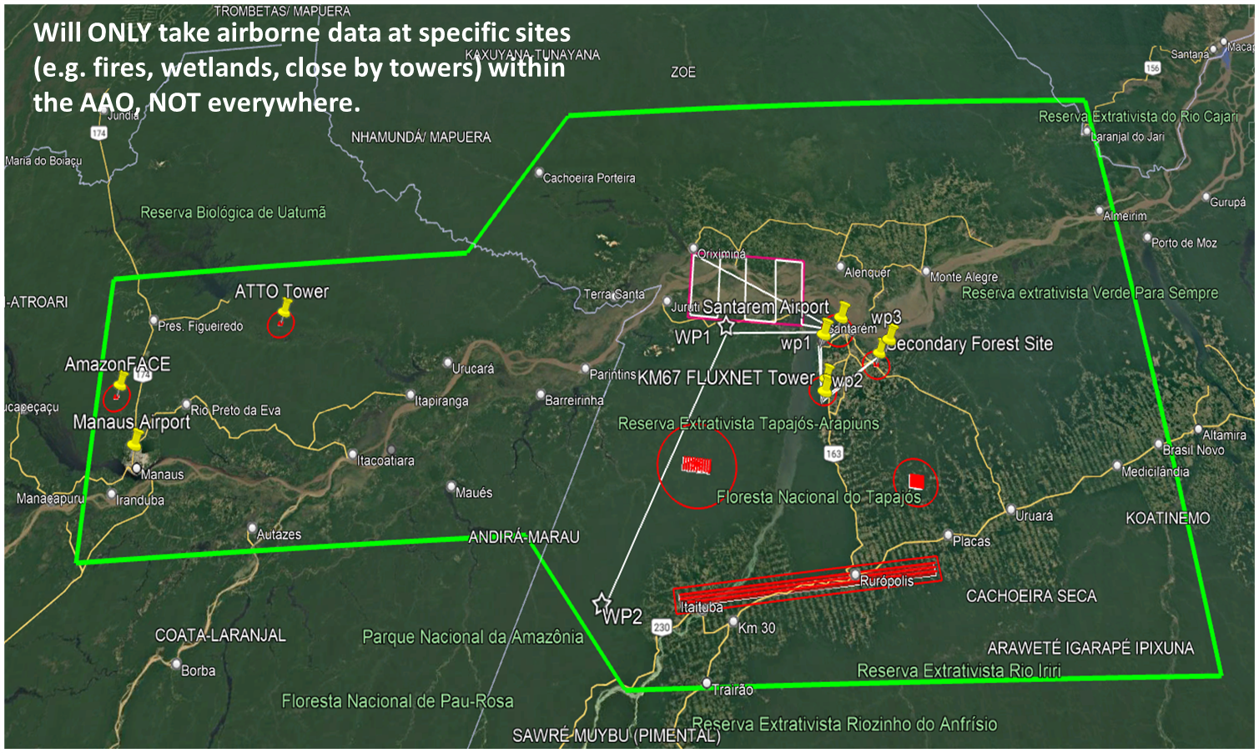
Action 3.2/6.1: ESA-INPE Campaign

Slide 19
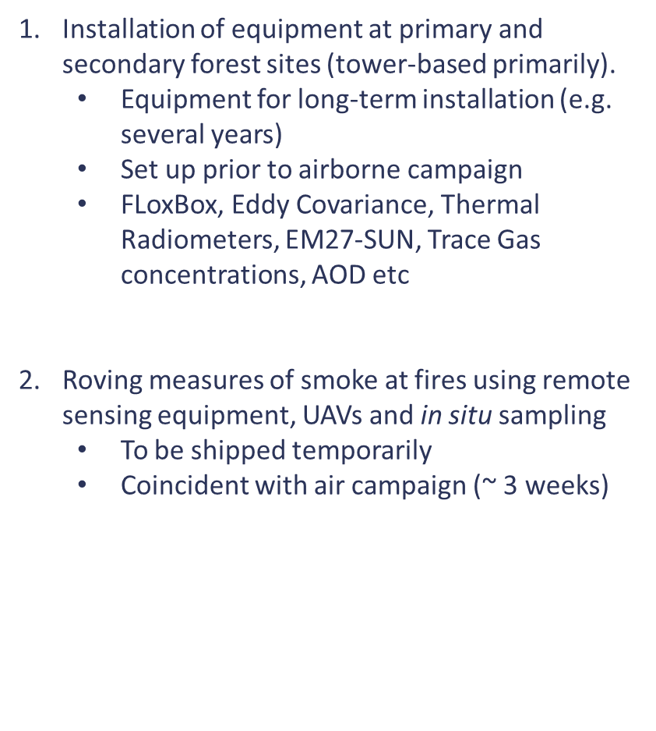
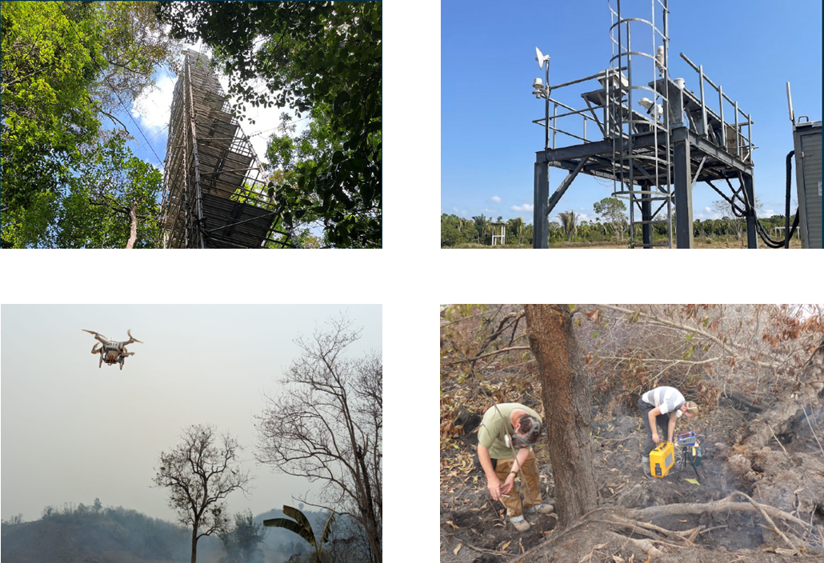
Action 3.2/6.1: ESA-INPE Campaign
Notes:
The airborne component is the UKRI BAS Twin Otter aircraft
the shippment of a large part - two tonnes and more - of the equipment has arrived in Santarem and is now at UFOPA.
(aircraft instruments, ground equipment).
First science flight at the moment is expected (fingers crossed) around 27th Sept.

Slide 20
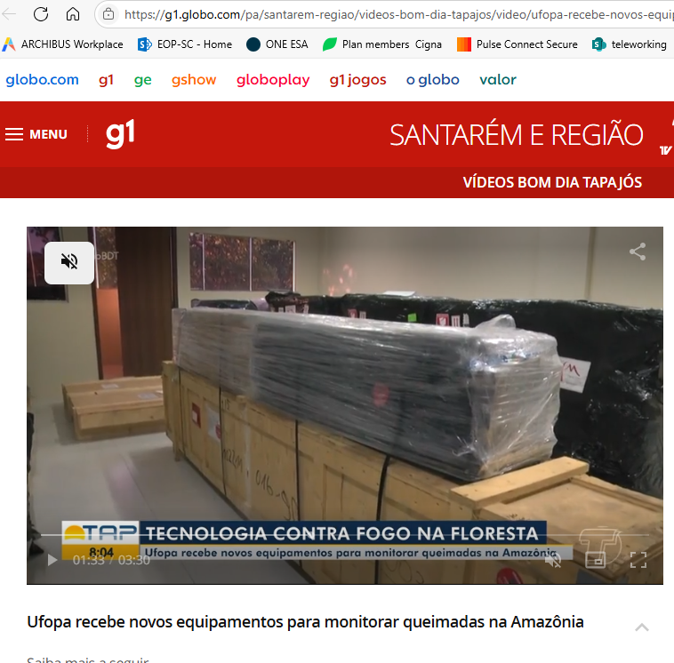
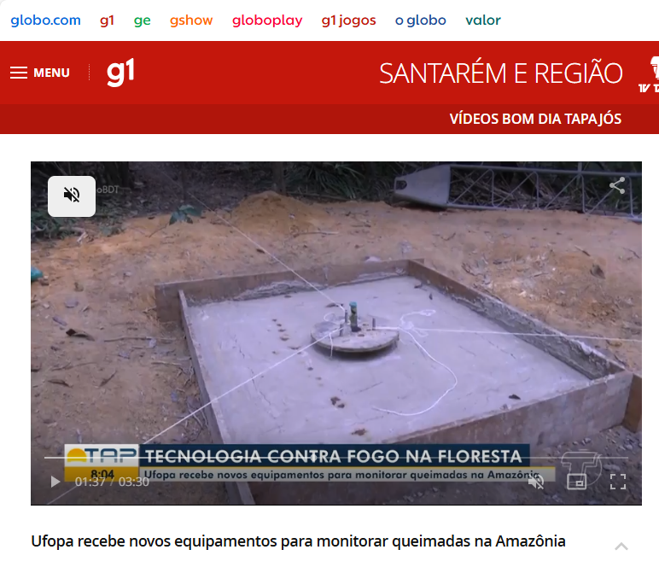
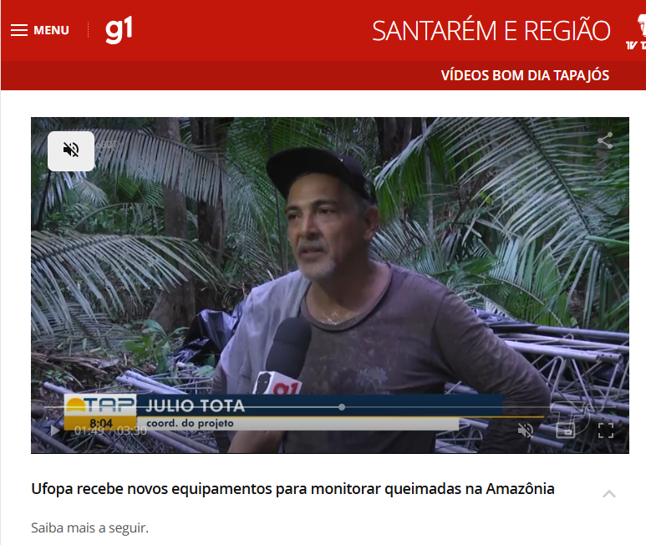
Action 3.2/6.1: ESA-INPE Campaign
Ufopa recebe novos equipamentos para monitorar queimadas na Amazônia | Vídeos Bom Dia Tapajós | G1

Slide 21
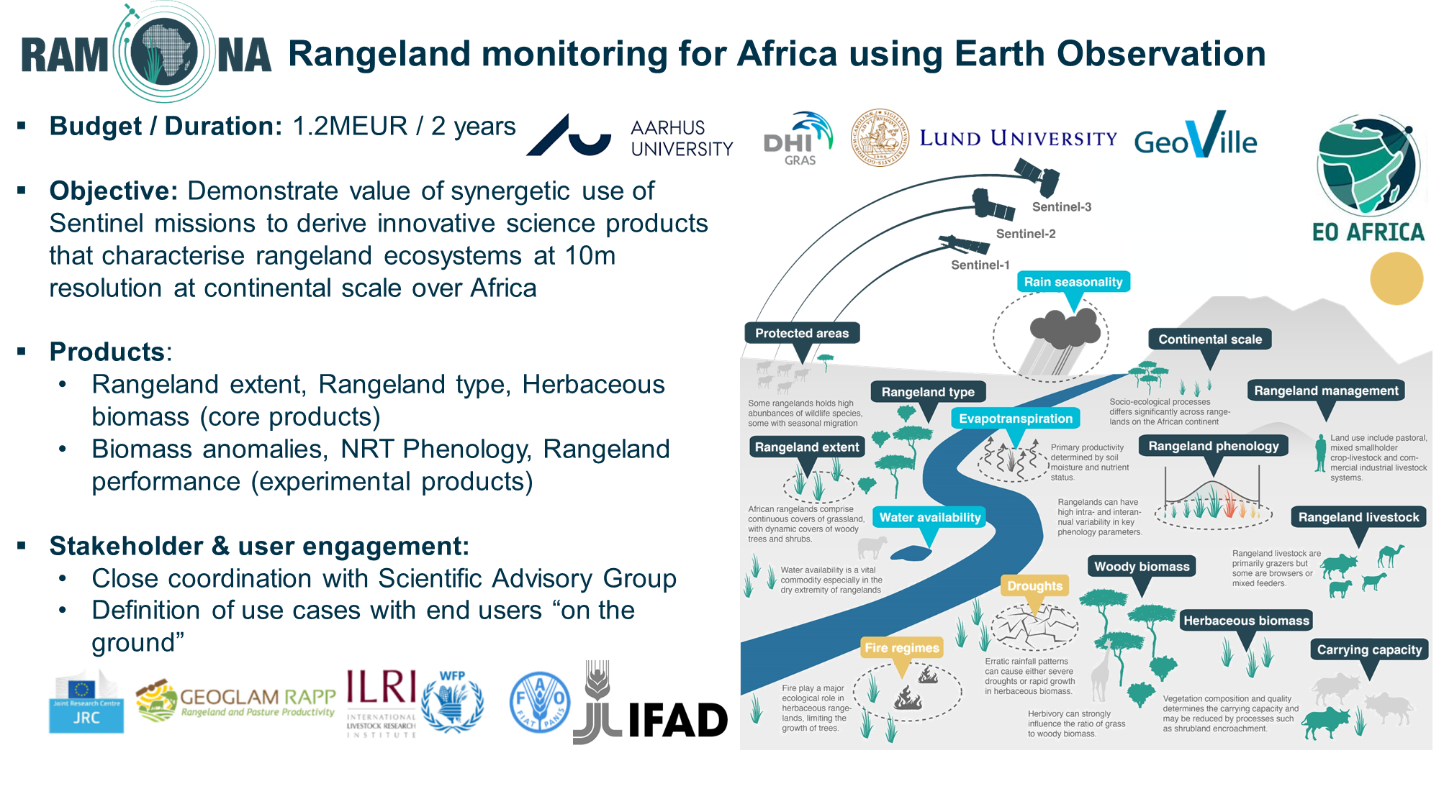
Action 5.6: Improve grassland and rangeland mapping

Slide 22
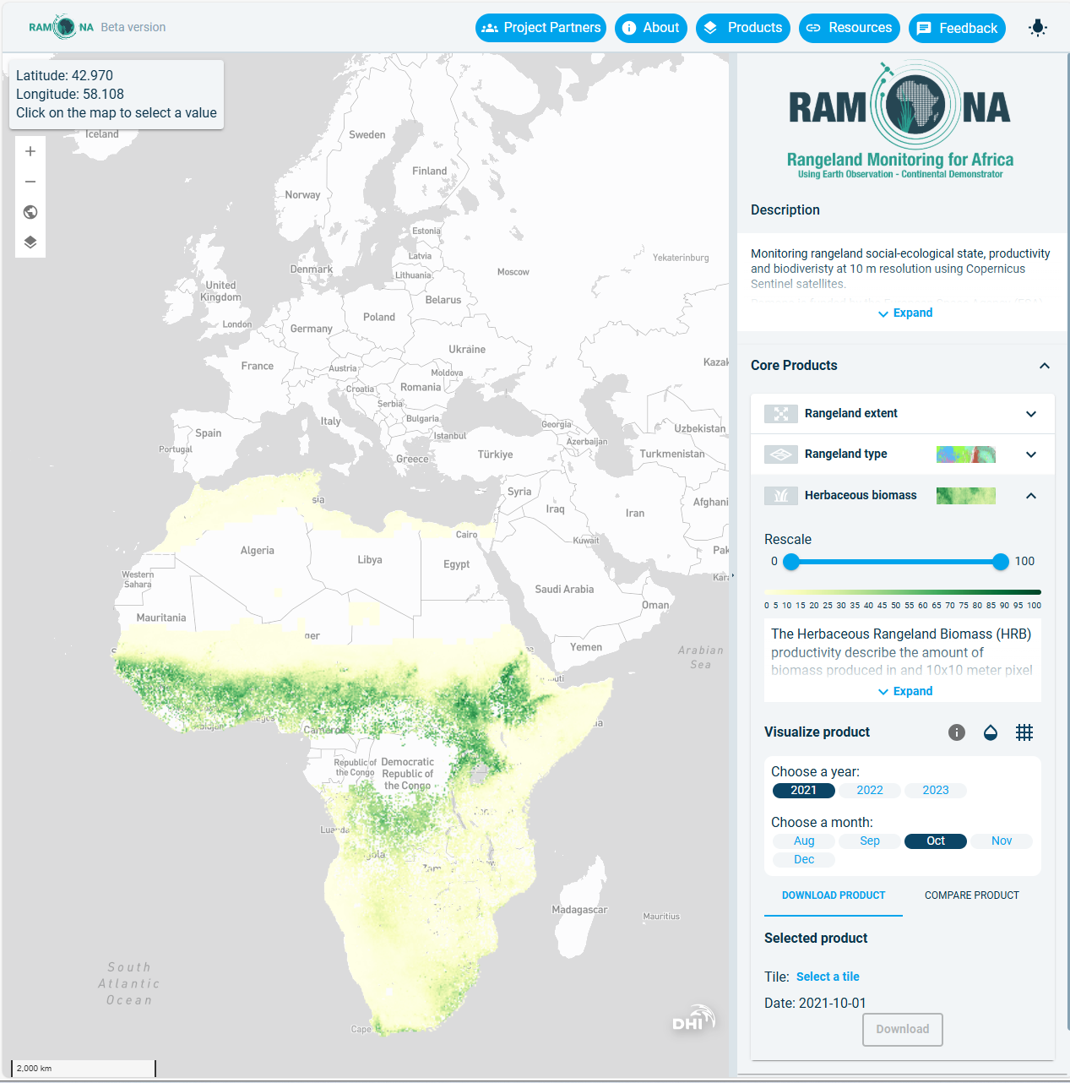

Action 5.6: Improve grassland and rangeland mapping
ESA plans to operationalise the RAMONA production system to enable on-demand generation of rangeland products in the near future
Currently validation and quality control is ongoing:
•Ground data collection at selected sites in 2022 (Senegal, Sudan, Kenya, South Africa);
•Limited flux tower in-situ measurements;
•Intercomparison with other products
•Eyes on the ground from partners
The RAMONA project would greatly appreciate additional (qualitative/quantitative) investigations into product quality by local/regional experts – national/regional scale product mosaic can be made available

Slide 23
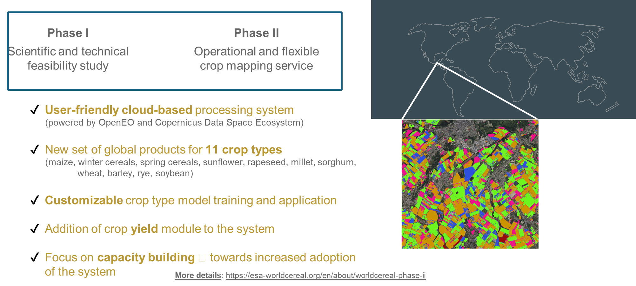

Action 5.7 & 5.8: WorldCereal products
Notes:
Currently under discussion the new year to be processed 2024 vs. 2025 with all the crops present
The cloud based system is basically ready and it will be deployed in the NoR asap (people can call the functions and run the system independently, pay only for the processing)
The local/hpc based system (mirroring the cloud based system) is almost done, and it will be ready to be deployed anywhere by anyone who has the computing capabilities
Both 2 and 3 systems will be capable to run global, regional, national etc levels.

Slide 24
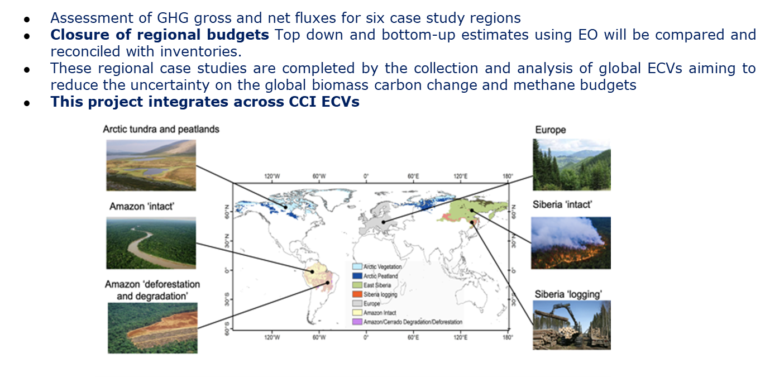
Action 7.1: REgional Carbon Cycle Assessment & Processes study (ESA & RECCAP 2)
Notes:
Northern hemisphere forests have shifted from carbon sinks to carbon emitters
Europe’s forests losing their carbon sink power
Human influence on Amazon’s aboveground carbon dynamics intensified over the last decade | Nature Communications

Slide 25

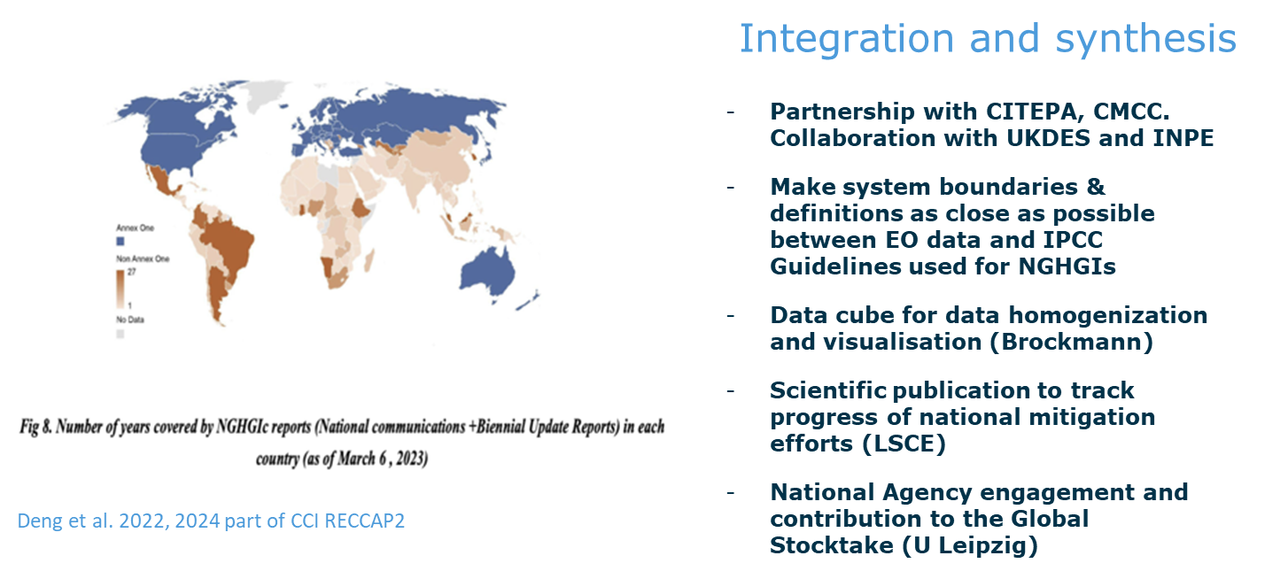
Action 7.1: REgional Carbon Cycle Assessment & Processes study (ESA & RECCAP 2)
Notes:
Northern hemisphere forests have shifted from carbon sinks to carbon emitters
Europe’s forests losing their carbon sink power
Human influence on Amazon’s aboveground carbon dynamics intensified over the last decade | Nature Communications

Slide 26
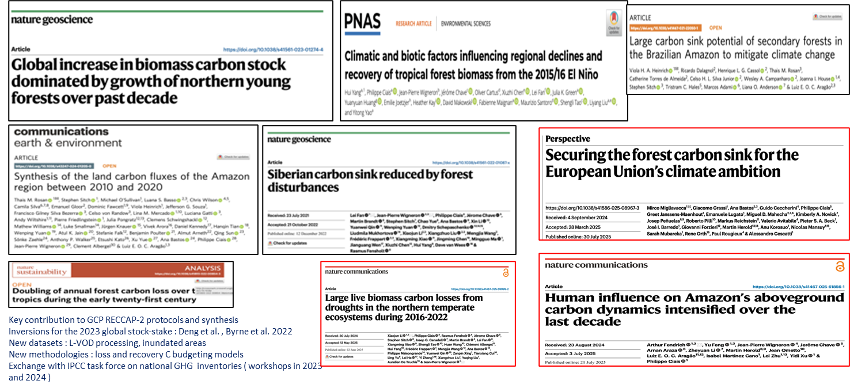
Action 7.1: REgional Carbon Cycle Assessment & Processes study (ESA & RECCAP 2)
Notes:
Northern hemisphere forests have shifted from carbon sinks to carbon emitters
Europe’s forests losing their carbon sink power
Human influence on Amazon’s aboveground carbon dynamics intensified over the last decade | Nature Communications

Slide 27
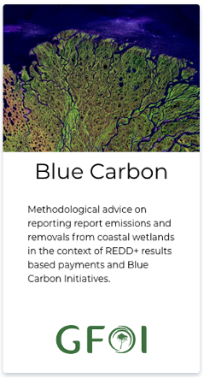
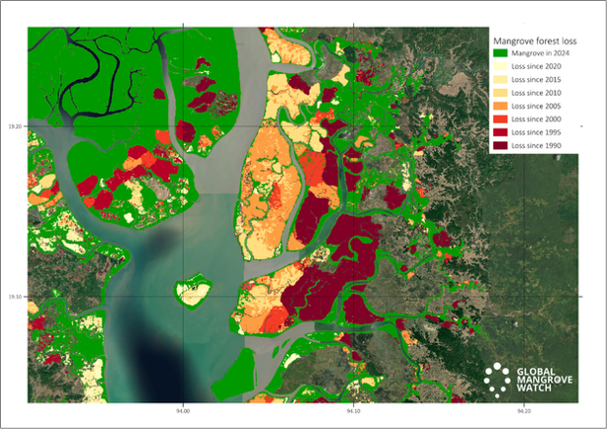


Action 5.3/ 5.4/ 5.5: Wetlands
❖ Action 5.3: Consider best practice for including Blue Carbon Ecosystems (BCEs) in national inventories.
MGD: Blue Carbon Guidance
❖ Action 5.4: (a) Explore the development of new CEOS initiatives on wetlands mapping and monitoring.
LSI-VC EO & Wetlands theme
GEO-Wetlands in GEO Work Programme. Led by Ramsar, Wetlands Int’l, ESA and JAXA
5.4 (b) Ensure that new CEOS missions consider wetlands amongst their mission goals.
Wetlands science objectives in ALOS-4 and NISAR missions
❖ Action 5.5: Establish closer collaboration with the Ramsar Convention and Ramsar Science and Technology Review Panel (STRP)
JAXA & ESA long-term STRP Observer Organisations
Earth Observation Side Event and GEO-Wetlands exhibition organised at Ramsar COP15
EO in the Ramsar STRP Work Plan for the next triennium 2025-2028.
Blue Carbon Guidance for national reporting
https://www.reddcompass.org/mgd
Activity Data. Global Mangrove Watch map showing mangrove extent 2024 [green] annual losses [yellow/orange/red] and annual gains [blue] for 1990-2024
Notes:
Northern hemisphere forests have shifted from carbon sinks to carbon emitters
Europe’s forests losing their carbon sink power
Human influence on Amazon’s aboveground carbon dynamics intensified over the last decade | Nature Communications

Slide 28
Action 5.1/5.2/5.3: FAO Land Cover Classification System (LCCS) to IPCC AFOLU
5a: Review and demonstrate approaches for providing globally consistent mapping of land covers relevant to the IPCC, including adoption of more detailed but relevant taxonomies (e.g., the FAO LCCS).
Action 5.1: Provide demonstration studies (nationally/regionally but also globally) that illustrate and demonstrate capacity to generate IPCC classes through amalgamation of mapped FAO LCCS classes, given the latter can be mapped directly from Earth observation data or reconstructed from existing land cover products.
5b: Review how AFOLU/LULUCF definitions align with local, country and region-specific land cover and land use categories and assess consistency of these across scales and how they translate to the defined AFOLU/LULUCF classes.
Action 5.2: Consider how local, country or regional maps of land cover can be deconstructed and reconstructed to generate land cover maps that align with global taxonomies (primarily the FAO LCCS), with this requiring no new classifications but use of existing products.
5c: Consider best practice for including Blue Carbon Ecosystems (BCEs) in inventories (including mangroves, saltmarshes and seagrass)
Action 5.3: Review and consolidate current approaches to characterising, mapping and monitoring BCE (e.g., those used in Global Mangrove Watch) and establish approaches that are consistent globally (and ideally across scales) and facilitate detection and description of change and links between terrestrial and aquatic environments.
Notes:
Northern hemisphere forests have shifted from carbon sinks to carbon emitters
Europe’s forests losing their carbon sink power
Human influence on Amazon’s aboveground carbon dynamics intensified over the last decade | Nature Communications

Slide 29
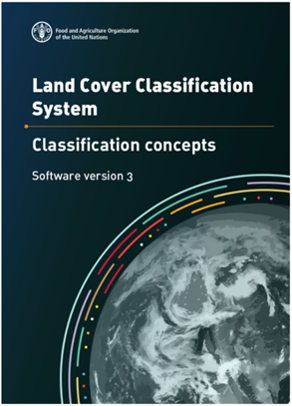
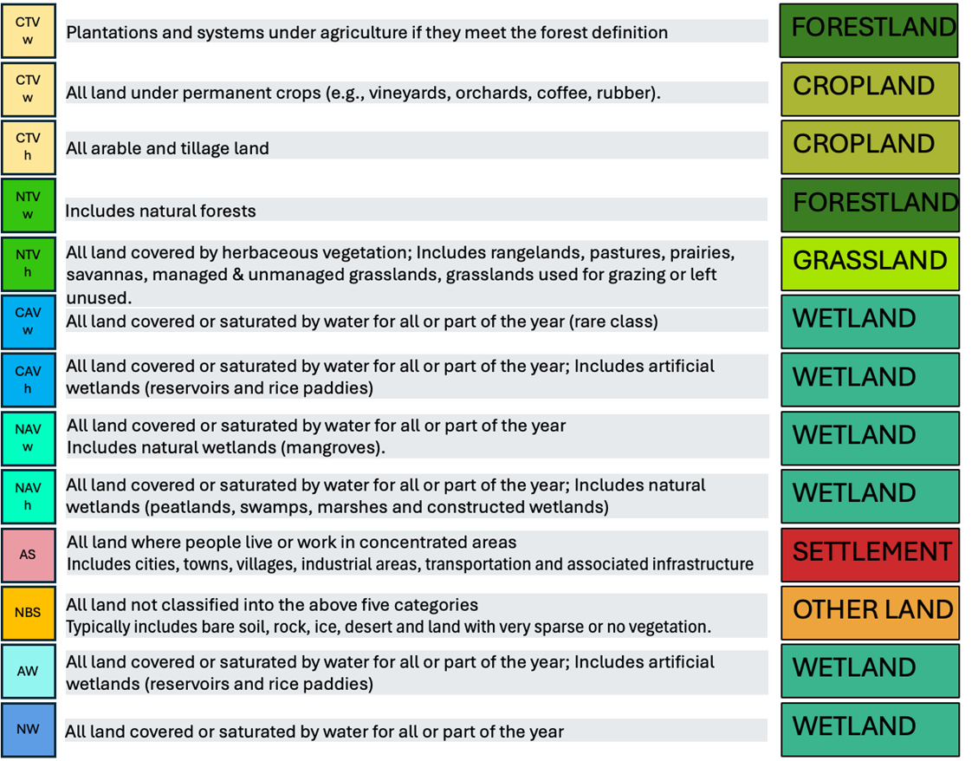
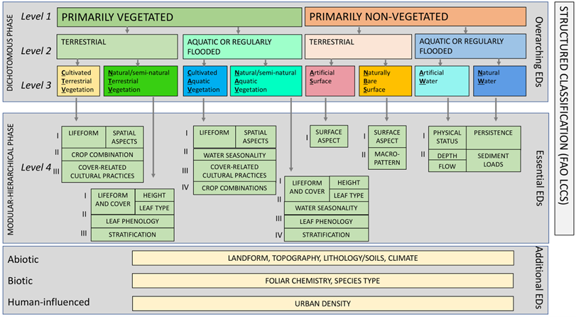
Action 5.1/5.2/5.3: FAO Land Cover Classification System (LCCS) to IPCC AFOLU
8 broad (Level 3) land coverategories are described in the Dichotomous Phase.
Lifeform (woody trees/shrubs or herbaceous (grasses/forbs) is described in the Modular Hierarchical Phase.
These broadly translate to the six IPCC AFOLU categories.
Some change information is required to capture land use transitions.
(Lucas et al., 2022)
Notes:
Northern hemisphere forests have shifted from carbon sinks to carbon emitters
Europe’s forests losing their carbon sink power
Human influence on Amazon’s aboveground carbon dynamics intensified over the last decade | Nature Communications

Slide 30
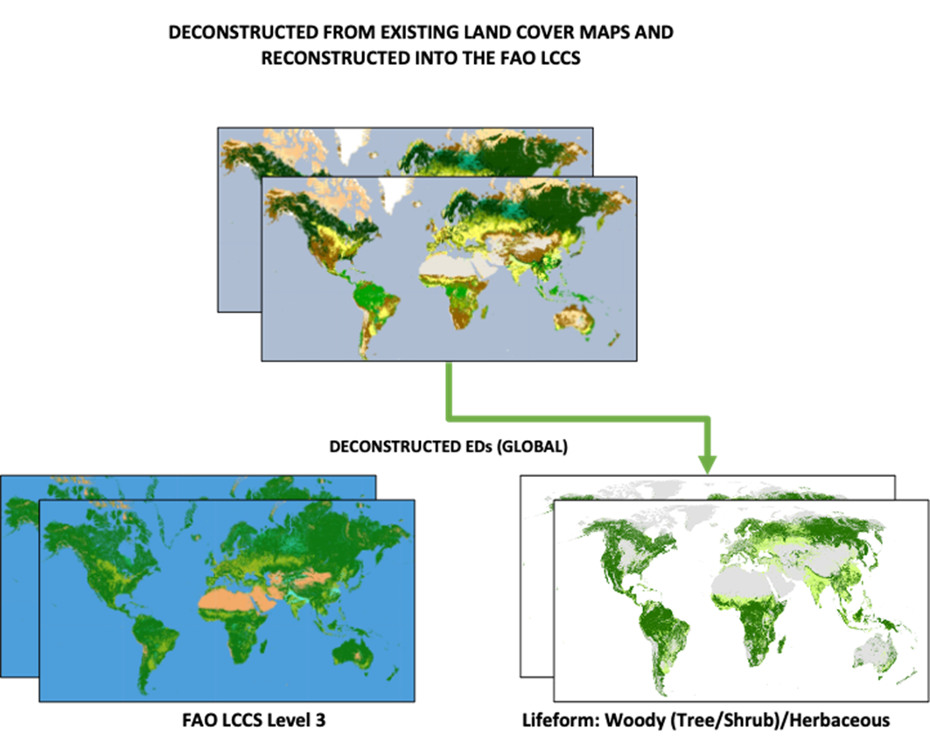
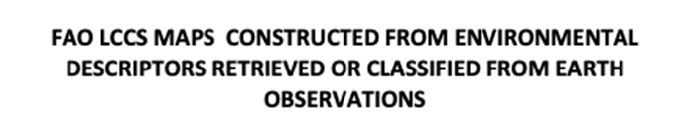

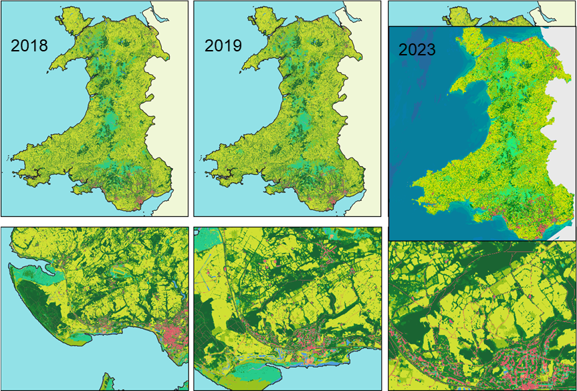

Action 5.1/5.2/5.3: FAO Land Cover Classification System (LCCS) to IPCC AFOLU
Maps according to the FAO LCCS (now including water) can be reconstructed from existing maps
or constructed directly from Environmental Descriptors.
(Lucas et al., 2022)
Notes:
Northern hemisphere forests have shifted from carbon sinks to carbon emitters
Europe’s forests losing their carbon sink power
Human influence on Amazon’s aboveground carbon dynamics intensified over the last decade | Nature Communications

Slide 31
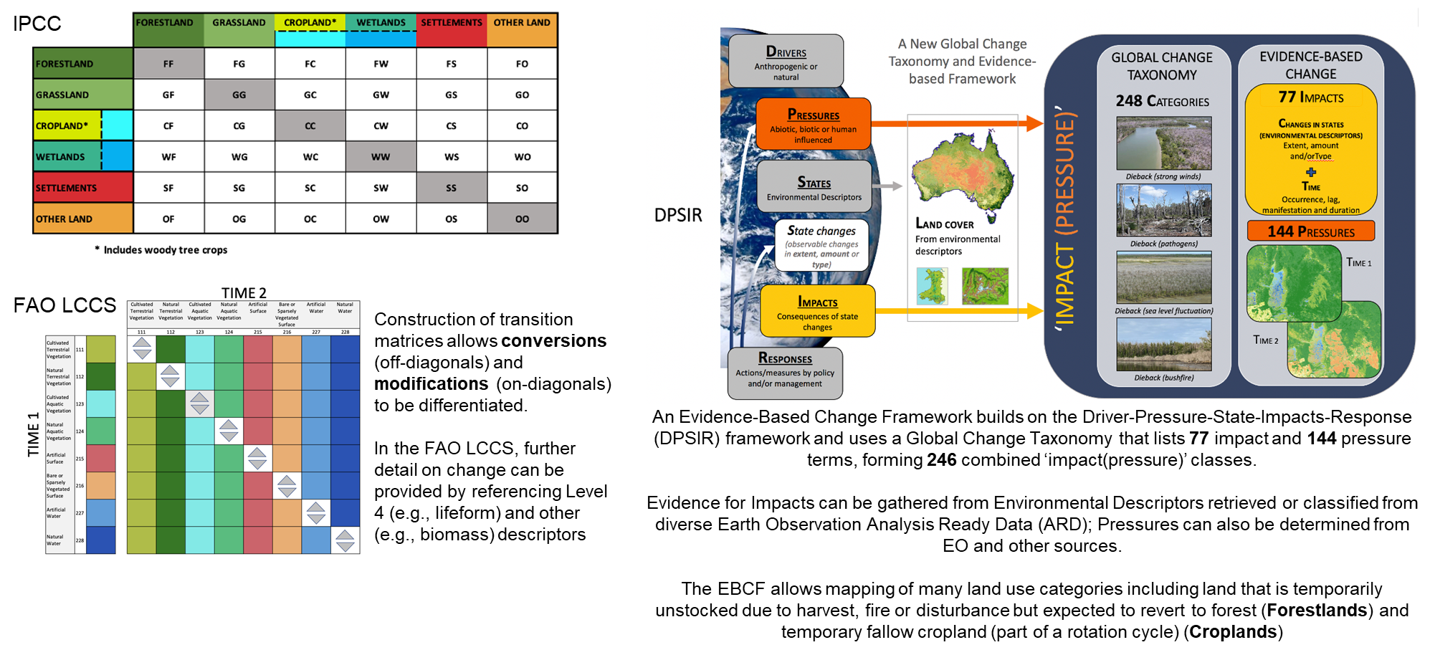
Action 5.1/5.2/5.3: IPCC AFOLU Global Change
(Lucas et al., 2022)
Notes:
Northern hemisphere forests have shifted from carbon sinks to carbon emitters
Europe’s forests losing their carbon sink power
Human influence on Amazon’s aboveground carbon dynamics intensified over the last decade | Nature Communications

Slide 32
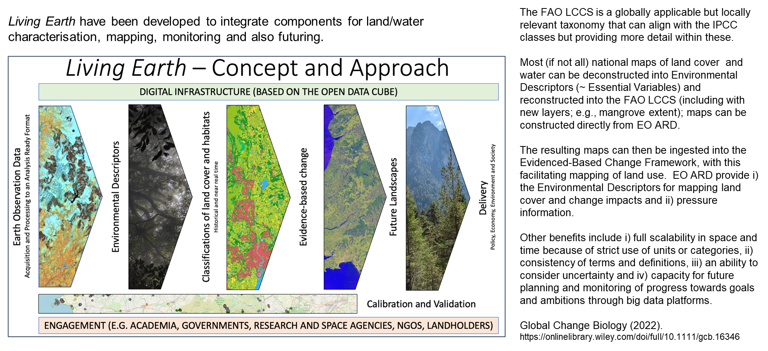
Action 5.1/5.2/5.3: IPCC AFOLU Integration
(Lucas et al., 2022)
Notes:
Northern hemisphere forests have shifted from carbon sinks to carbon emitters
Europe’s forests losing their carbon sink power
Human influence on Amazon’s aboveground carbon dynamics intensified over the last decade | Nature Communications

