Slide 1
CEOS & GFOI
Neha Hunka (ESA)
Agenda Item 2.3
SIT TW 2025
Darmstadt, Germany
9-11 September, 2025

Slide 2
GFOI R&D Component
Facilitates international efforts to bring EO data and research towards operational uptake by countries in the tropics
Identifying gaps and needs to advance research and data provision
Foster a scientific community knowledgeable of country uptake needs
Contribute to the GFOI process, organization of expert meetings, support in capacity building workshops, assessment of maturity of methods and datasets…
Involvement in international forums (UNFCCC, GCOS/TOPC, GEO-TREES, CEOS cal/val efforts, UN-SDGs…)
Advocate for the use of remote sensing coupled with in-situ observations
Led by team at GFZ Helmholtz Centre for Geosciences (Potsdam, DE)
R&D Component Funded by ESA (2023-2025) -> Now extended through to 2028
Coordinates and supports research in collaboration with country teams in the tropics.
https://gfoi-rd.gfz-potsdam.de/

Slide 3
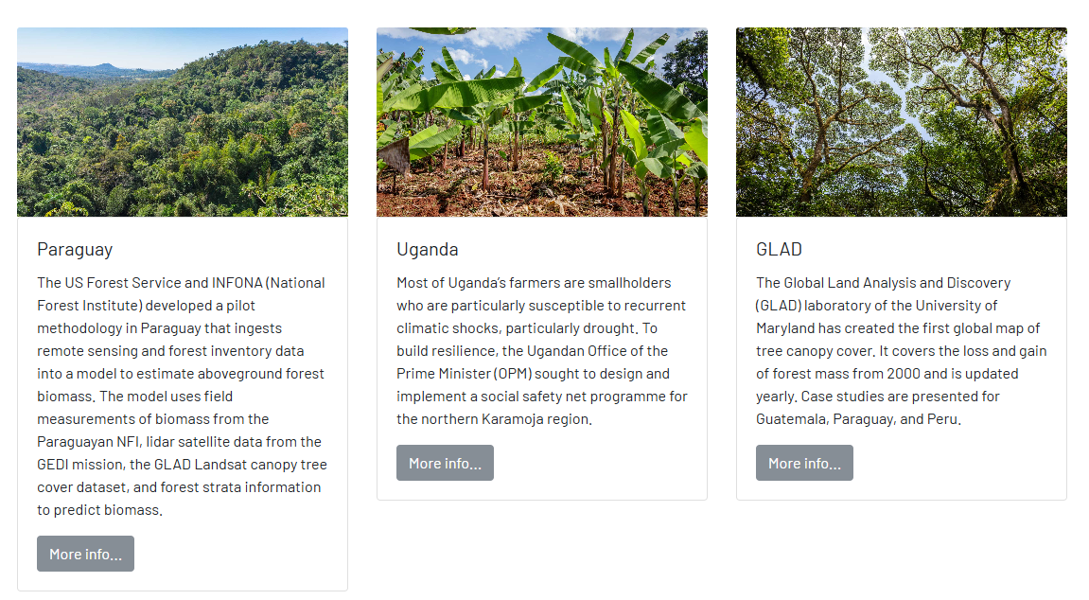
GFOI R&D Country engagement activities
Engagement with country teams on R&D Priority Topics, including the integration of new EO datasets into their national monitoring systems
Establish and maintain a structured dialogue between national forest monitoring institutions, environmental ministries, and global EO data providers to assess current use and data needs, via regular meetings, guided interviews and dedicated surveys.
Continuation of CEOS AFOLU success stories
Development of 3 success stories by mid 2026
First success story in prep.: Guatemala (next slide)
demonstrating effective integration of EO data
into national monitoring systems, including
challenges, solutions, and impacts.
GST Portal - User Stories

Slide 4
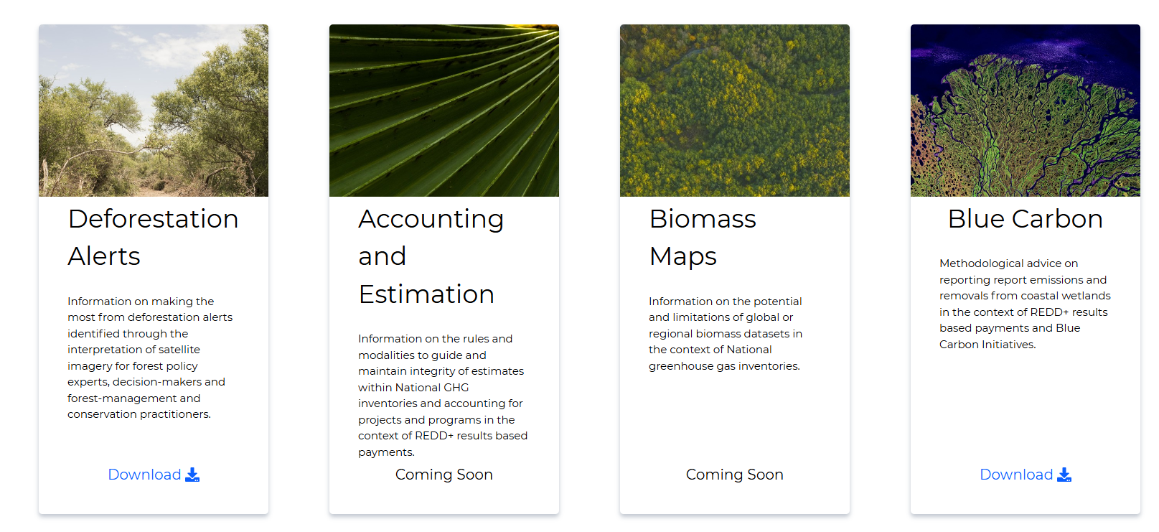
Recent GFOI MGD Modules
https://www.reddcompass.org/mgd

Slide 5
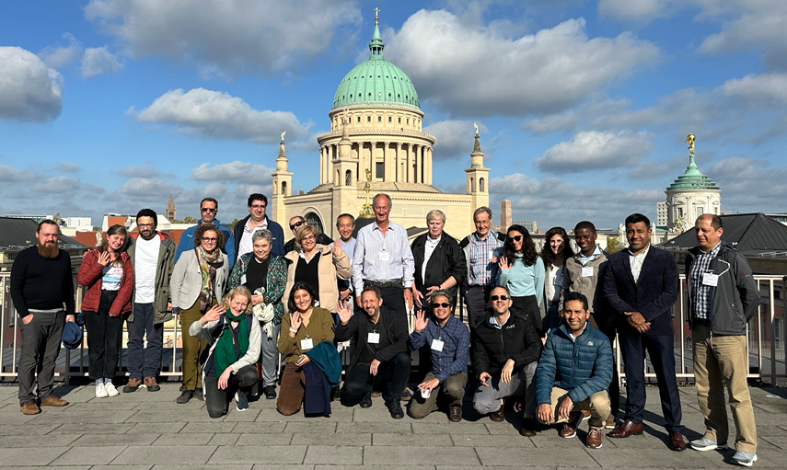
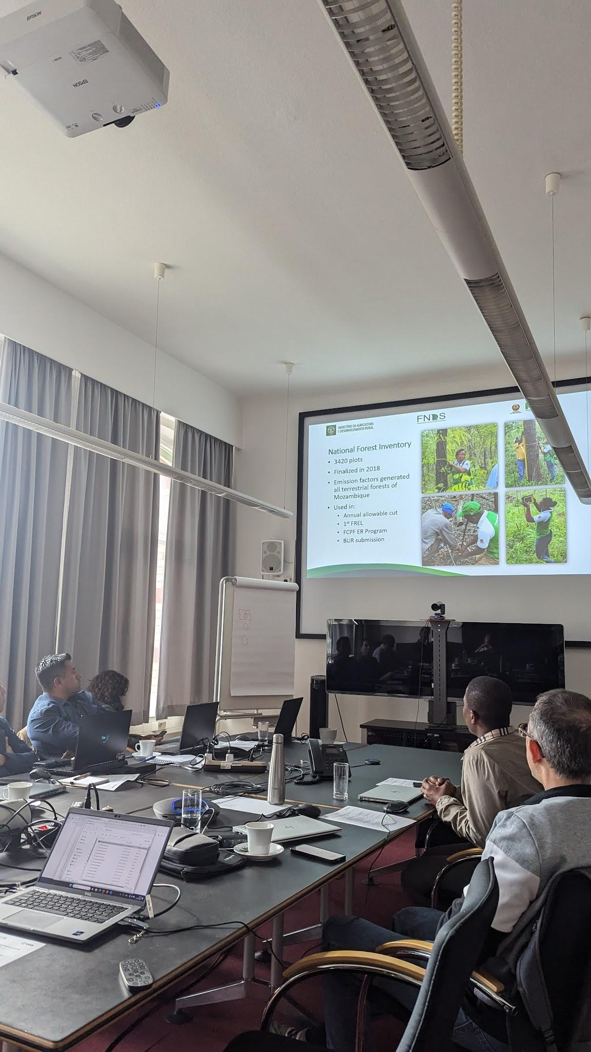
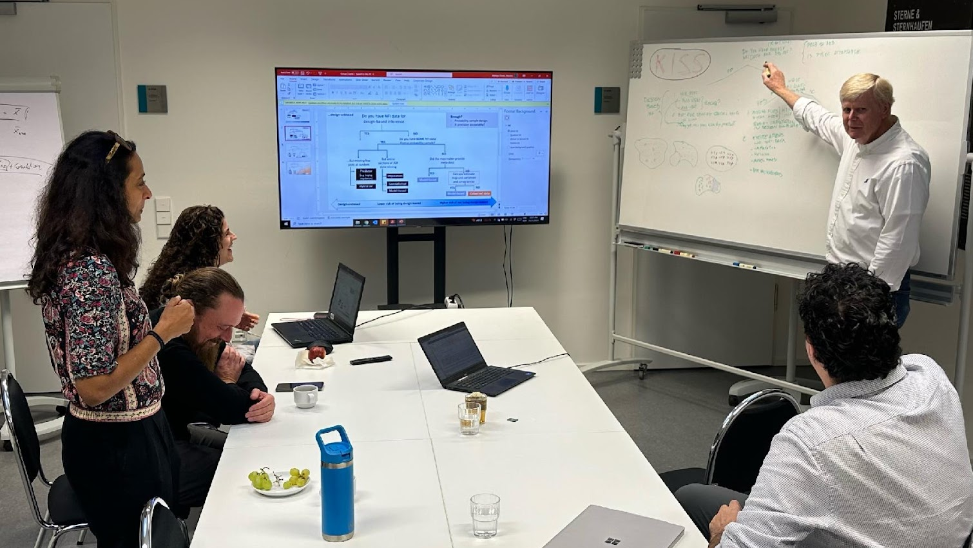
GFOI R&D/MGD Biomass workshop and guidance
GFOI R&D/MGD Workshop: Informed use of biomass maps in MRV procedures
Held on October 2024 in Potsdam, Germany
Workshop objectives
Provide an updated perspective on country needs and developments related to improving forest biomass estimations
Develop a draft of supporting guidance on the informed use of biomass maps for MRV procedures
Plan next steps for finalizing guidance and continuing R&D and capacity-building efforts
Ongoing writing of Biomass Rapid Response Module (to be launched at GFOI Plenary)
Contains:
Possible applications of EO-based biomass data (in combination with existing ground data), and their current level of maturity
Good-practice considerations for their use in NGHGIs and REDD+ activities
Methodological framework for selecting the best approach for the integration of NFI data with EO-based biomass data for improving emission factors
Country examples describing existing needs and methodological approaches employed

Slide 6
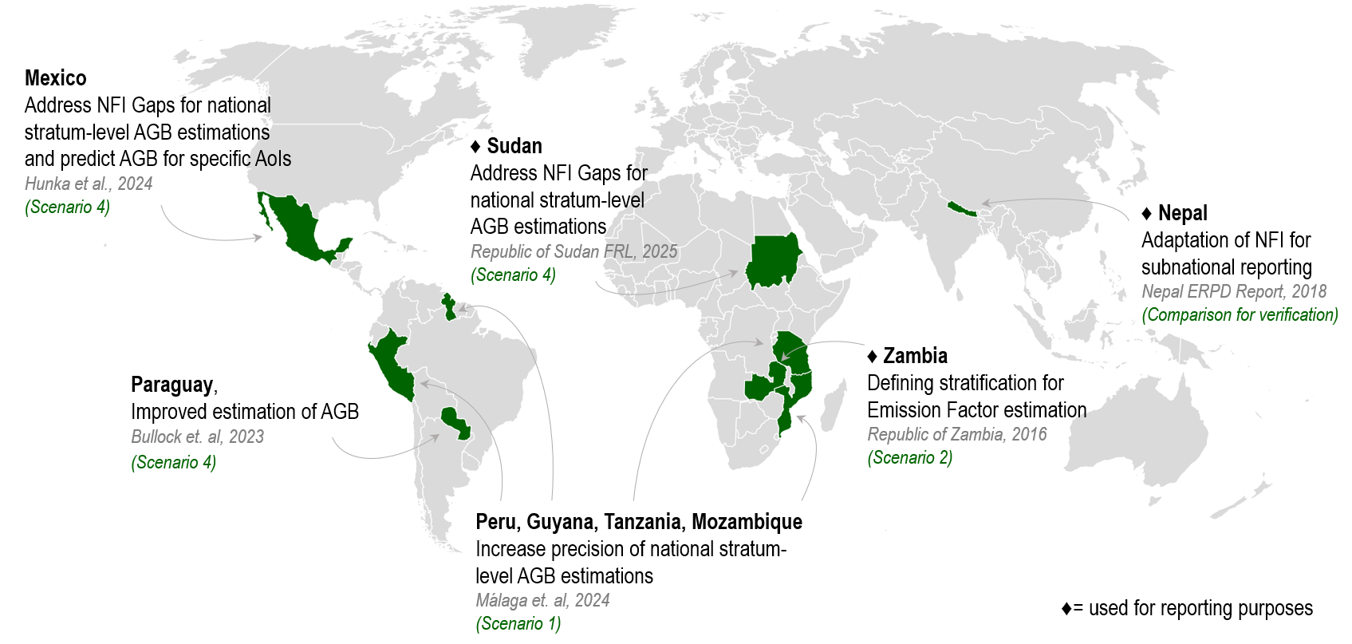
GFOI R&D/MGD Biomass workshop and guidance
Biomass Rapid Response Module: Country Case Examples and Methodological Approaches
Key operational and research examples for the use of space-based forest biomass-related data as auxiliary information for reporting purposes

Slide 7
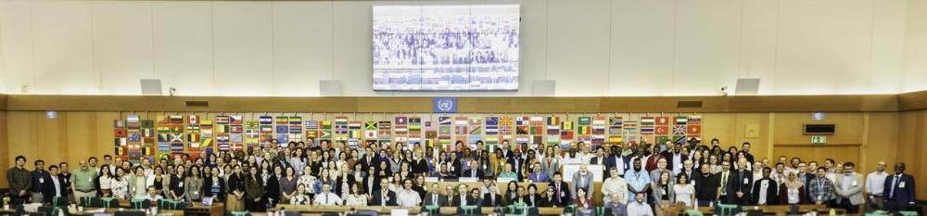
2025 GFOI Plenary
Theme: ”Forests and the marvel of monitoring”
21–23 October 2025 in Bali, Indonesia, and online
Global gathering for countries, donors, development partners and practitioners in the forest monitoring sector
Information: https://www.fao.org/gfoi/plenaries/plenary-2025
2023 GFOI Plenary, FAO HQ, Rome

Slide 8
Potential points of interest for CEOS
Continuation of CEOS AFOLU Success stories – aim is to communicate the impact of Agency EO data provision in national reporting activities
Elaboration of guidance material, and summarizing key case studies -> Key outputs contributing to AFOLU roadmap
Expert workshops - Participation of CEOS agencies would benefit two-way communication regarding needs and data provision realities
Enhance data quality, transparency and documentation of available datasets
Communicating the level of maturity of approaches and biomass datasets
Developing and comparing approaches tailored to country needs
Notes:
Continued discussions with country teams and data providers, related to:
Enhance data quality, transparency and documentation of available datasets
Communicating the level of maturity of approaches and biomass datasets
Developing and comparing approaches tailored to country needs

