Slide 1
Country Engagement
EO for National Reporting
(REDD+, IPCC, UNFCCC...)
Stephen Ward (SIT Chair Team) Agenda Item 2.4
SIT TW 2025
Darmstadt, Germany
9-11 September, 2025

Slide 2
Purpose
A recurring theme from many threads of the JAXA SIT Chair Term:
Climate policy impact calls
UNFCCC Lessons Learned Review (WGClimate)
GST Strategy Update
GFOI engagement
Uptick in intentions coincides with a collapse in capacity
SilvaCarbon cancelled
TW25 last mtg of JAXA term and we seek to:
Take stock of the various ambitions
Ensure maximum awareness of contributing efforts in agencies and groups
And maximum connectedness and leverage

Slide 3
Country engagement threads
GST Lessons Learned Review
Recommendation 2.1.1: Build Stronger Relationships with COP Delegates and Leverage CEOS and CGMS Member Countries at Key UNFCCC Events
Recommendation 2.1.2: Identify Champions for Space-based data among COP Delegates
Recommendation 2.2: Enhance Country Engagement Through Targeted Support, Capacity Building, Strategic Partnerships, and Co-Development of GHG Flux Products
For developed countries: foster strong partnerships through "twinning" exercises - representatives from space agencies paired with counterparts from national inventory agencies
For developing countries: emphasis on building capacity and providing technical support through a dedicated initiative

Slide 4
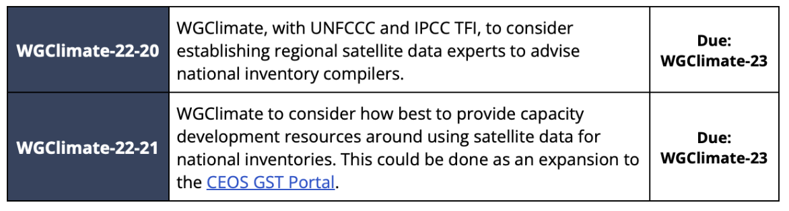
Country engagement threads
WGClimate
Pilot session at WGClimate-22 (Feb, UK) with national inventory reps from France, Germany, UK, Norway, Denmark
Tiger team working on COP/EID preparations

Slide 5
Country engagement threads
GST Strategy Update
Identifies requirements and opportunities for country engagement across the Mitigation, Adaptation, and Means of implementation focus areas of the Paris Agreement
Reinforces need for co-developed products and capacity building to foster their use
IPCC engagement
Working with countries to use EO data in place of default values for reporting
Recall also WGCapD
add….

Slide 6
Country engagement threads
GFOI
CEOS engaged as a founding member of the Global Forest Observations Initiative since 2011
Includes a mature network of national practitioners with strong interest and motivation in the uptake of CEOS agency datasets
Also set back by SilvaCarbon cancellation and looking to adapt
At the moment FAO is trying to pick up the gaps left by SilvaCarbon (more TBD at the Plenary) - get input from Sylvia here.
Mention the country-led planning process - GFOI expanded to sustain the technical capacity.

Slide 7

Reminder of SilvaCarbon
Global Reach: Supported forest monitoring capacity-building in over 25 countries across Africa, Asia, Latin America, and the Caribbean, focusing on regions engaged in REDD+ initiatives.
Provided training and tools for national forest inventories, remote sensing, and MRV systems (Measurement, Reporting, and Verification) to improve greenhouse gas accounting from the land sector.
Promoted open data and collaborative methods.
Helped countries develop Tier 2/3 GHG inventories, adopt open-source tools (e.g., Collect Earth, SEPAL), and improve transparency in forest carbon reporting under the Paris Agreement.

Slide 8
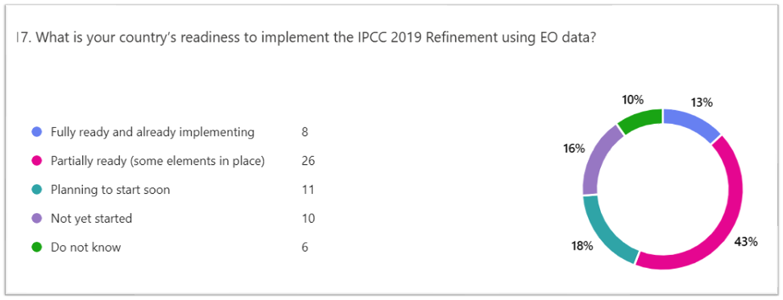
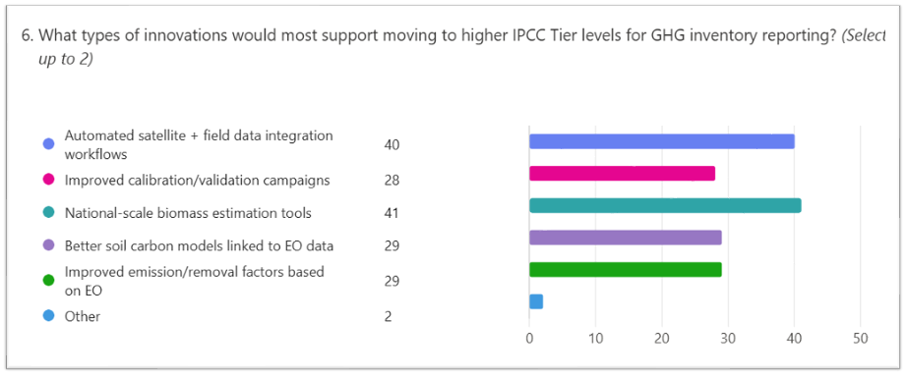
GFOI R&D Assessment
GFOI R&D Broad Assessment of satellite data needs and integration into reporting systems
Survey deployed to 34 countries, and currently collecting results
Analysis and presentation at the GFOI summit in Bali
Results to inform R&D and Capacity Building efforts

Slide 9
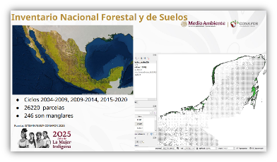
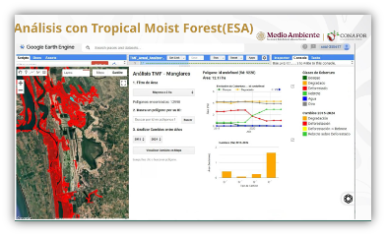
GFOI Success stories EO for AFOLU
❖ Success stories using EO for AFOLU
❖ Central American case study (Guatemala, Mexico, Belize) – ongoing and will be publish December 2025
❖ EO supporting emission reductions and reporting CO₂ in mangroves ecosystems
❖ Analysis with multiple datasets, including Tropical Moist Forest (ESA)
❖ Two more case studies (Africa, and Asia) for 2026

Slide 10
Discussion
Possible topics
Opportunities for linkages between our various engagement activities
Agency plans that can be leveraged
others...?
Notes:
- focus at this stage on two action classes above for technical reasons on MVS integration)

