Slide 1
WGClimate Report
Wenying Su, NASA
Vincent-Henri Peuch, ECMWF
Agenda Item 3.1
SIT TW 2025
Darmstadt, Germany
9-11 September, 2025

Slide 2
CEOS-CGMS Statement to SBSTA 63
Annual statement prepared by the WGClimate, will be delivered by the CEOS Chair during the SBSTA opening session at COP-30.
The 2025 statement emphasizes knowledge gained from sustained Earth observation in the following key thematic areas:
Earth’s energy imbalance
Land cover change and ecosystem dynamics
Ice loss and glacier retreat
Sea level rise monitoring and projection
Atmospheric composition measurement
Early warning and disaster response
Notes:
Open for comments until Oct. 3, 2025

Slide 3
Update WGClimate Term of Reference
WGClimate ToR was drafted in 2018, some initiatives referenced therein are no long active and new developments need to be reflected
The new ToR addresses evolving priorities, activities, and governance
Overarching goal of WGClimate: Optimize the benefit of Earth observations for climate research, projection, mitigation, and adaptation.
New ToR defines following aspects of the WGClimate
Organization
Objectives
Stakeholders

Slide 4
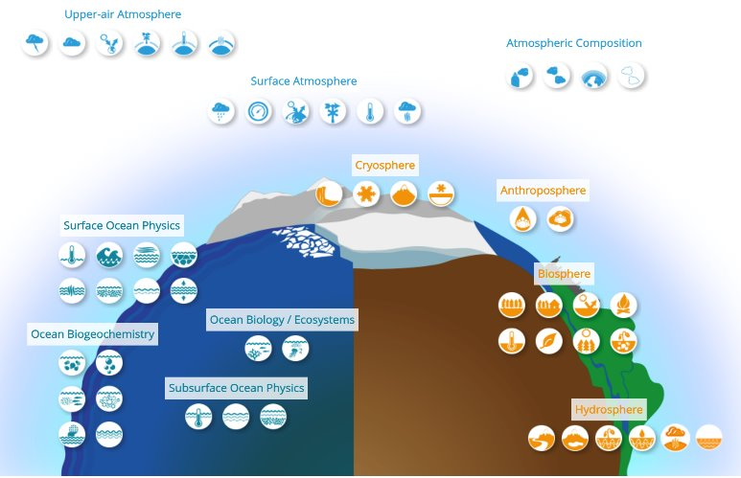
GCOS Essential Climate Variable Rationalization: motivation
Are all the 55 Essential Climate Variables still essential? Are we missing anything? ​
Is the current grouping the best possible one? Is it balanced? Is it consistent across domains and across the earth cycles?​
Is there enough transparency and coherence in the process that leads to including a new ECV in the list?

Slide 5
GCOS Essential Climate Variable Rationalization: high-level outcome
Removal of anthropogenic ECVs (GHG emissions and water use)
Introduction of four cross-panel ECVs: CH₄ and short-lived GHG, CO₂ and long-lived GHG, albedo, and turbulent heat fluxes.
All 19 modified ECVs are the result of reorganizing existing ECVs.
This reorganization has also streamlined the ECV list, reducing it from 55 to 42.
Original Number of ECVs(Total = 55)​
AOPC =16​ | OOPC = 19​ | TOPC = 20​
Proposed Number of ECVs (Total = 42)​
AOPC =11​ | OOPC = 13​ | TOPC = 14​ | CP = 4​
ECV products (Total = 176)​
AOPC = 75​ | OOPC = 44​ | TOPC = 57​
ECV quantities (Total = 177)​
AOPC = 70​ ​ | OOPC = 43​ | TOPC = 45​ | CP = 19 ​

Slide 6
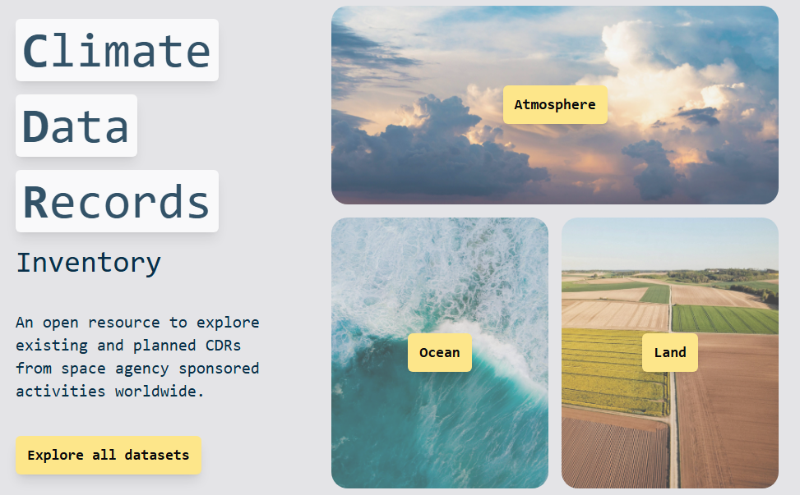
Evolution of ECV to CDR Inventory
New technical baseline to enhance discoverability and uptake of CDR Inventory
Added functionalities to make it easier to navigate the Inventory
Streamlined information for easier filtering and analysing the data
Simplified process to populate the database and verify the contents
Continuous publication, individual time tags used for record updates
Accommodation of non-GCOS climate-relevant variables
Discussion on further cooperation/synergies with WMO OSCAR/Space, MIM, and WGISS
Appreciate EUM and EC continued support for this activity.

Slide 7
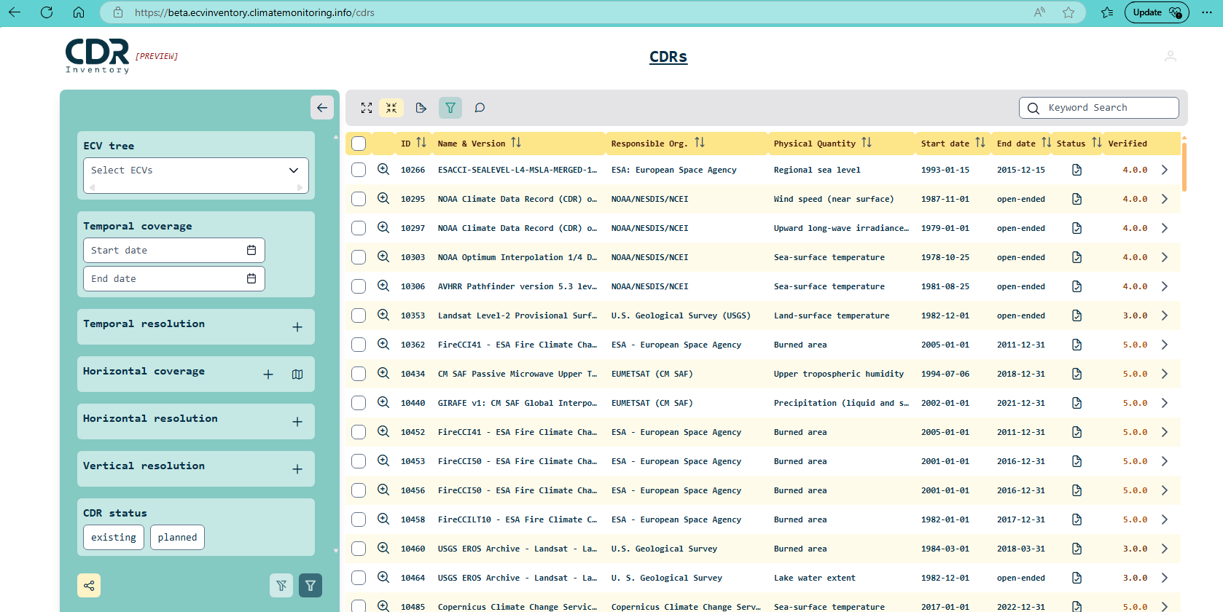
Added functionality to CDR Inventory
Filter functionalities

Slide 8
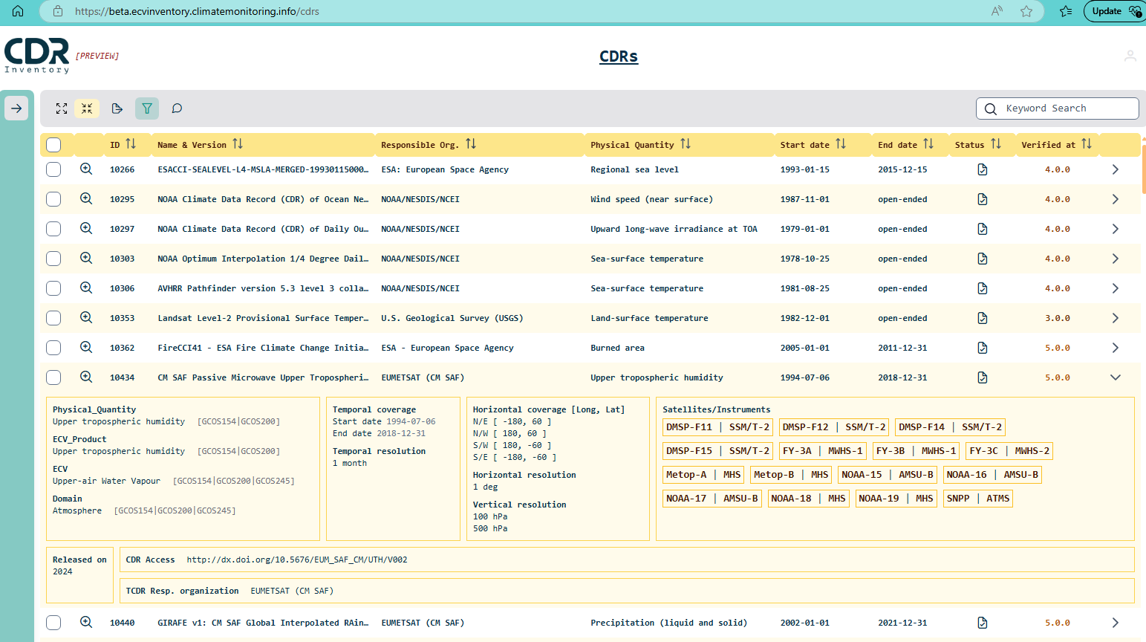
Added functionality to CDR Inventory
Comment
Label
Detailed view ( > new page)
Expanded view
Active links to WMO OSCAR / Space
Direct link to CDR

Slide 9
Why Expand the CDR Inventory
Improve discoverability and usability of the Climate Data Record
Develop a typology supporting research and application
Use this typology as the interface of the CDR inventory to improve its discoverability and usability
Currently used effectively for internal gap analyses and prioritization
Under-utilized by the wider external community
Goal: Make the inventory more discoverable and user-friendly
Align with adaptation, mitigation, and policy-support needs

Slide 10
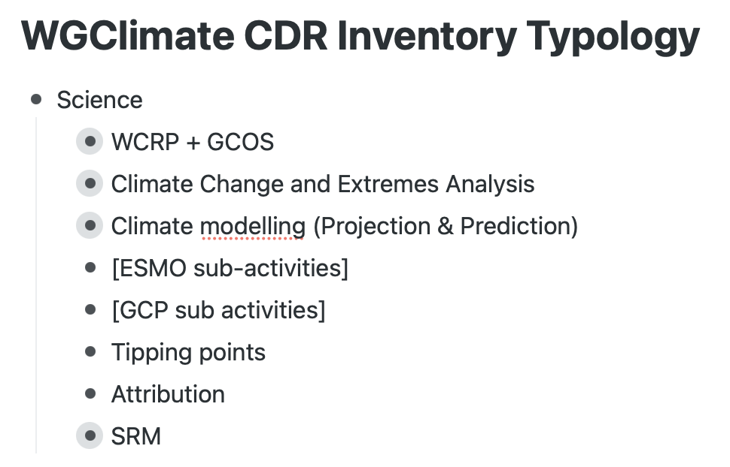
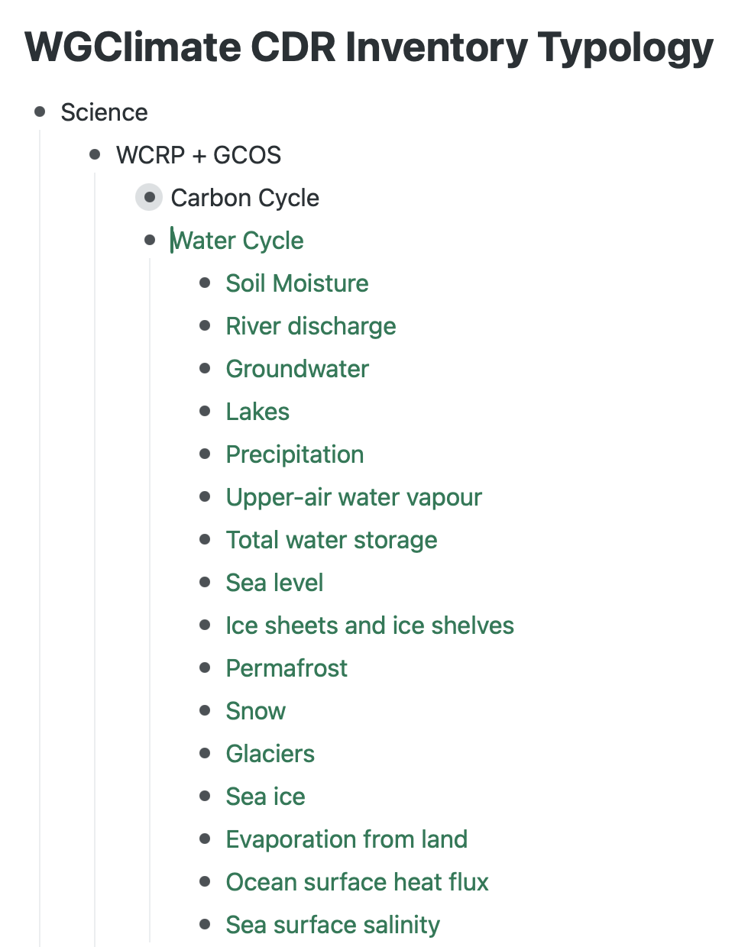
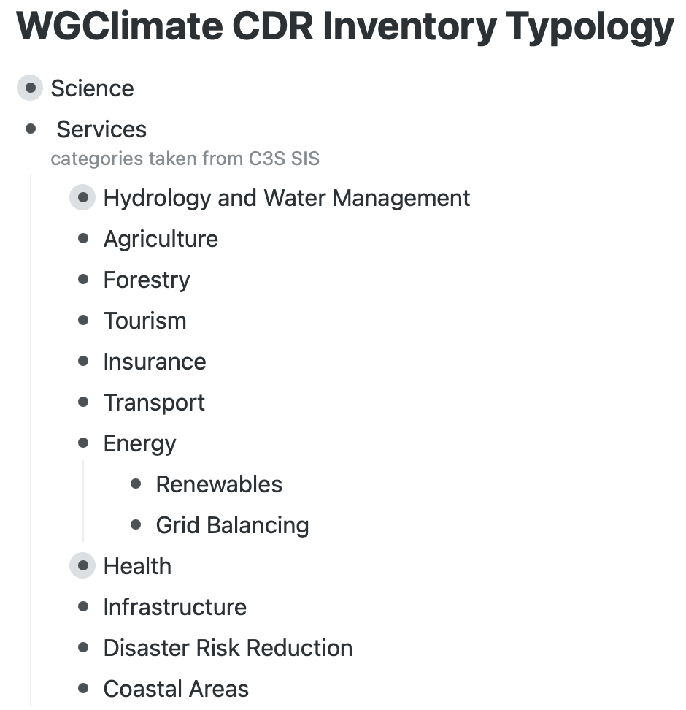
Proposed Typology Structure
Categories aligned with Science, Services, and Policy Support
Based on existing where possible e.g. UNFCCC/NAP subdivisions for adaptation
Application tags: space/time resolution, product level, AI-readiness
Keep initial typology small & manageable, avoid excessive complexity
Notes:
SIS: sectoral information system

Slide 11
WGClimate activities
Documents endorsed by CEOS and CGMS:
Space Agencies’ Response to the 2022 GCOS Implementation Plan
Lessons Learned and Recommendations from Space Agencies’ Support for the First Global Stocktake
Gap analysis Report and Coordinated Action Plan 2024
Drafted the CEOS-CGMS Statement for SBSTA 63.
Updated WGClimate Term of Reference.
WGClimate – UNFCCC Tiger Team was established and held engagement workshop with UNFCCC in April 2025 resulted in some concrete actions and contributed themes for the Earth Information Day.
WGClimate members contributed to the Global Stocktake Strategy v2.

