Slide 1
SIT Technical Workshop 2025
Update on TT-UNFCCC COP30 preparations
V.-H. Peuch, ECMWF
Agenda Item #3.2
SIT TW 2025
Darmstadt, Germany
9-11 September, 2025

Slide 2

Mandate and team
(Open) membership, status 09/2025
Clément Albergel (ESA)
Maggie Arnold (upcoming CEOS chair, GA)
Albrecht von Bargen (DLR)
Antonio Bombelli (WMO/GCOS)
David Crisp (SIT chair)
Adrien Deschamps (CNES)
Mark Dowell (EC)
Patrick Gibson (CEOS chair, UKSA)
Beth Greenaway (CEOS chair, UKSA)
Mariko Harada (SIT chair, JAXA)
Alex Held (upcoming CEOS chair, CSIRO)
Susanne Mecklenburg (ESA)
Yasjka Meijer (ESA)
Osamu Ochiai (SIT chair, JAXA)
Steven Ramage (CEOS exec)
John Remedios (CEOS chair, NCEO)
Frank Martin Seifert (ESA)
Joerg Schultz (EUMETSAT)
Vincent-Henri Peuch (ECMWF)
Matthew Steventon (CEOS exec, Symbios)
Libby Rose(Symbios)
Harvey Jones (Symbios)
WGClimate 22-24 (Feb. 2025): create Tiger Team for Engagement with UNFCCC with specific tasks to
Ensure consistent preparation for Earth Information Day
Enhancing coordination at key UNFCCC events throughout the year
(Develop a comprehensive multi-year engagement strategy aligned with the phases of the GST process, including proactive preparation for party submissions)
Define key objectives for each COP and EID, ensuring that CEOS and CGMS efforts are strategic and aligned with broader climate goals.
Survey agencies to understand their level of participation at each COP (individuals and/or pavilions)
NB: WGClimate-22-14/15 (GST Strategy developed by SIT chair, 3.3)

Slide 3
Overview of activities
Principle of twin telcos to allow participation at a „reasonable“ time of the day for all members across the globe. 5 meetings: 4 TT sessions (17 March, 15 April, 27 May, 17 July) and an online workshop with UNFCCC (30 April).
Main discussions/activities:
Refine ToR/mandate (clarify it is time limited) & interaction with GST strategy update process
Organise workshop to reboot/enhance collaboration with UNFCCC & follow-up actions
Limited effort on SB-62; in-person meeting of some members in the margins of the sessions
Input to Earth Info Day at COP30 (submitted 28/08)

Slide 4

Workshop with UNFCCC
30 April 2025
Main objective: engage with key UNFCCC lead persons and stimulate wider engagement on different streams of activities
Agenda:
Introduction UNFCCC
Introduction WG-Climate
Interests from different UNFCCC “workstreams”
Open discussion and next steps
11 participants from UNFCCC and 16 from WG-Climate/CEOS; minutes (from WG-Climate and UNFCCC) available.

Slide 5
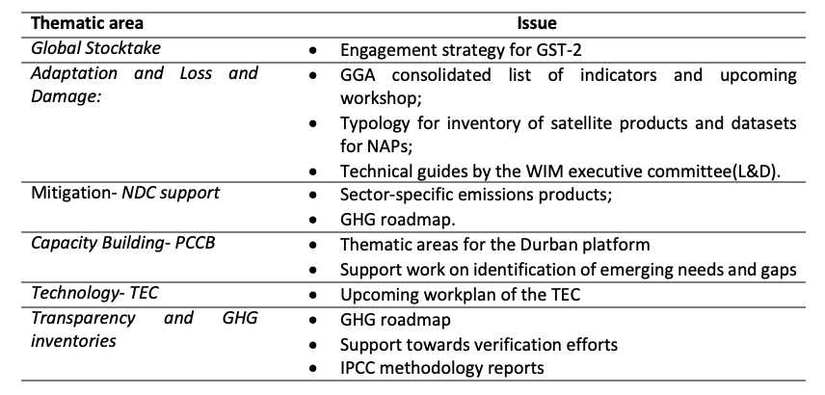
Streams of engagement
WGClimate PoCs
Global Stocktake: S. Mecklenburg and O. Ochiai
Adaptation and Loss and Damage: M. Dowell and S. Connors
Mitigation (NDC support): Y. Meijer and V.-H. Peuch
Capacity Building (PCCB): A. von Bargen and S. Ramage
Technology (TEC): J. Remedios and V.-H. Peuch
Transparency and GHG Inventories: O. Ochiai (or someone from JAXA), S. Mecklenburg and Y. Meijer
(Climate finance): ESA interested to connect with UNFCCC on this
+ COP/EID and SBSTA
Notes:
Yasjka: to ensure a streamlined message across CEOS towards UNFCCC/COP.

Slide 6

EID COP30 Belém
Principle: make our proposal fit with EID typical structure of all the past years
Introduction / setting the scene (1)
State of the Climate and the Global Climate Observing System (2)
World cafés / breakout sessions / thematic plenaries (3)
Support having a poster session with posters available during the full week or even two weeks.
Submitted 28/08 by ECMWF on behalf of CEOS-CGMS WG-Climate
Parties’ submissions (8): Saudi Arabia, Philippines, Norway, UK, Small Island States, Brazil, Japan, EU
Also: WMO + NGOs submissions (4)
Search “earth information”: https://www4.unfccc.int/sites/submissionsstaging/Pages/Home.aspx

Slide 7
EID COP30: intro
Propose a high-level speaker
Reaffirm key messages on the role and further potential of satellite EO
Capabilities are continually enhanced through launch of new satellites and development of technologies to extract increasingly robust and accurate information, often through co-design with the users including in-situ observations and dedicated campaigns.
Examples of recent launches : Biomass, GOSAT-GW, Microcarb, several instruments onboard MTG-S1 and MetOp-SG1.
Upcoming in the next few years: WildFireSat, CO2M x3.

Slide 8
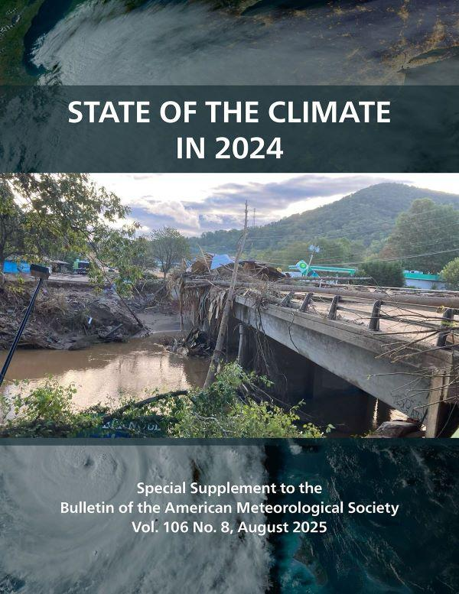

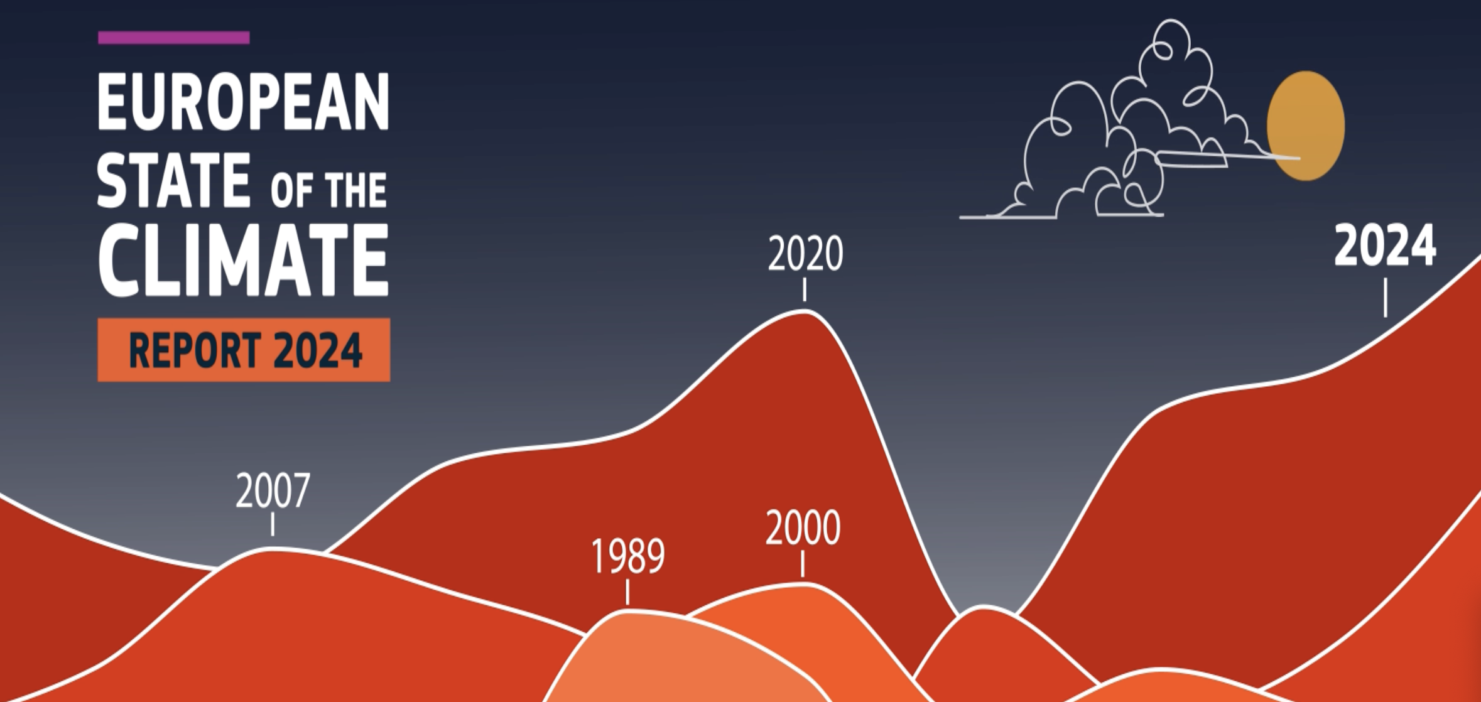
EID COP30: state of the climate
Propose speakers
Link to very high media visibility of BAMS State of the Climate and of Copernicus/ECMWF/WMO State of the Climate, with examples on Earth System components where satellite EO make decisive input
Possible example of 2025 wildfires, where EO helps before (fire danger forecasts), during (fires location & activity, air quality) and after (burnt areas, C emissions, impacts…)

Slide 9
EID COP30: thematic session(s)
Propose duos of speakers (1 provider and 1 user) to talk on concrete thematic EO-based data use cases. While the list of indicators of Global Goals on Adaptation is pending, these cases will also illustrate the capabilities to quantify certain candidate quantities that will likely be targeted.
EO and tipping points (abrupt changes or transitions in lake systems, marine ice sheets, rainforest dieback, dryland vegetation, permafrost thawing, the Southern Ocean Overturning Circulation as well as in-land and marine ecosystems) -ESA
GHG emissions derived from GOSAT supporting Mongolia and India -JAXA
Copernicus/CAMS methane hotspot explorer -EC/ECMWF
advances in reach and trust of satellite-derived methane data for supporting policy design and monitoring -UKSA

Slide 10
EID COP30 Belém
Liaison with UNFCCC about the process and timeline for elaborating the actual agenda of the EID, ideally well ahead of the COP; target date is Monday 10 November, with a possible back-up on 11 November
Accreditations recently provided by UNFCCC (lower than usual numbers, not a surprise)
Major concern: availability and price of accommodation; several organisations in a wait-and-see situation
Heard of some debate at national level about moving the COP to Rio de Janeiro

Slide 11
To be continued…

