Slide 1
CEOS Global Stocktake Strategy Issue 2
Dave Crisp
JAXA SIT Chair Team
Agenda Item 3.3
SIT TW 2025
Darmstadt, Germany
9-11 September, 2025

Slide 2
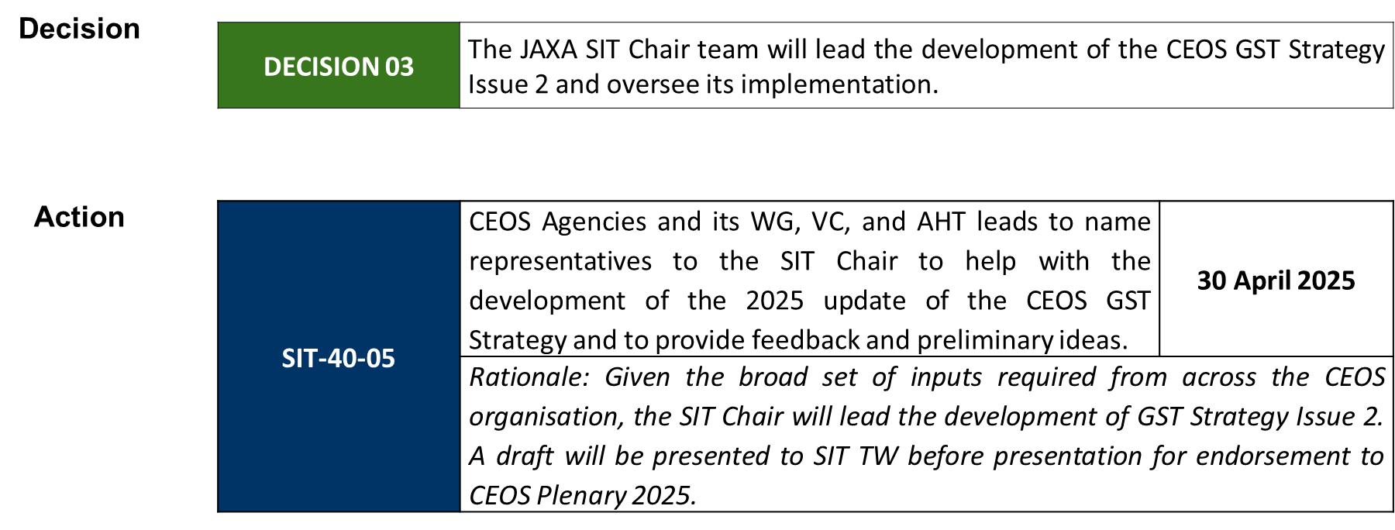
Our Charge

Slide 3
Motivation for an Update
The 2021 version of the GST Strategy document
Reviews the goals of the Paris Agreement and its Global Stocktakes (GST)
Focused on identifying opportunities and drafting requirements rather than developing specific interfaces or delivering specific products or services
Updates are needed to:
Incorporate the GST Lessons Learned, which were endorsed at SIT-40
Accommodate a changing landscape (UNFCCC, IPCC, G3W, IMEO, …)
Expand focus from Mitigation to Adaptation and Means of Implementation
Define interfaces between CEOS and critical stakeholders in the policy (CoP Delegates, UNFCCC), national inventory compiler and international scientific communities (e.g., IPCC, GCP); and
Define specific products, tools and services that are to be co-developed through cooperative activities with these communities.

Slide 4
Writing Team
David Crisp (SIT Chair Team) Coordinator/Editor
Clement Albergel (ESA) AFOLU Team, RECCAP and GCP interface
Christoph Aubrecht (ESA) Means of Implementation
Albrecht von Bargen (DLR) WGClimate Interface
Gianpaolo Balsamo (formerly WMO) WMO G3W interface
Sarah Connors (ESA) Adaptation
Mark Dowell (EC) Adaptation, Stakeholder Engagement
Christine McMahon-Bognar (formerly NASA) Incoming SIT Chair Team
Susanne Mecklenburg (ESA) Climate finance, loss & damage
Yasjka Meijer (ESA) GHG-TT, Mitigation
Joana Melo (EC) IPCC Interface, AFOLU Team
Vincent-Henri Peuch (ECMWF) UNFCCC Engagement
John Remedios (NCEO, Leicester) Technology Transfer
Libby Rose (SIT Chair Team) Outreach, Capacity building
Jorg Schulz (EUMETSAT) WGClimate Interface, Loss and Damage

Slide 5
Contents
Executive Summary
Introduction
Background
Paris Agreement, its Global Stocktakes and CEOS Lessons Learned
CEOS Support for Mitigation
Top-down GHG Budgets, Bottom-up GHG Inventories
CEOS Support for Adaptation
Reducing threats and vulnerabilities and increasing adaptive capacity
CEOS Support for Means of Implementation
Risk identification, risk management, investment tracking and reporting
Coordinating GST Support across CEOS
Working Groups, Virtual Constellations, Ad Hoc Teams
Conclusions and Way Forward
Annexes

Slide 6
Executive Summary
Systematic, space-based observations of the Earth provide the scientific foundation for tracking climate change on regional to global scales.
CEOS and its member agencies are now using these data to address the needs of a broad range of stakeholders in the science, policy, and regulatory communities.
This document expands and sharpens the CEOS strategy for exploiting this information to support the Paris Agreement (PA) and its Global Stocktakes (GSTs).
More generally, the actions recommended here could improve access to space-based Earth observations and foster their use to mitigate the impacts of climate change and improve climate resilience.

Slide 7
Contents of each Focus Area
Describes a high-level strategy, not a detailed implementation plan or roadmap
Principle authors for each focus area (Mitigation, Adaptation, Means of Implementation) were asked to include:
Introduction describing relevant CEOS capabilities their potential value
Products to be identified or co-developed with partners & stakeholders
Tools to be co-developed with partners & stakeholders to address specific needs
Capacity Building to foster the use of EO products for the GSTs
Communications - presentations at CoPs and other relevant venues
Reporting – citable peer-reviewed reports documenting CEOS contributions to GSTs and as well as reports to CEOS SIT meetings
Key CEOS entities and partners contributing to each task
Timelines for delivery of products, tools and services needed to support the GSTs
Recommendations for action

Slide 8
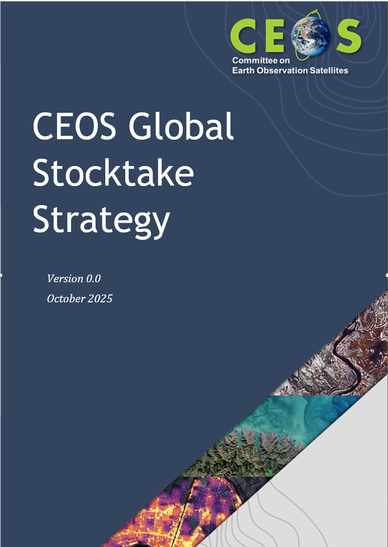
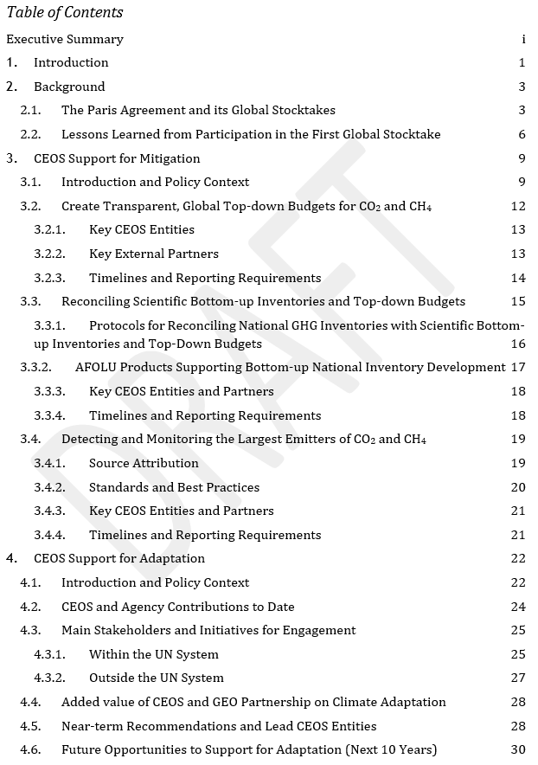
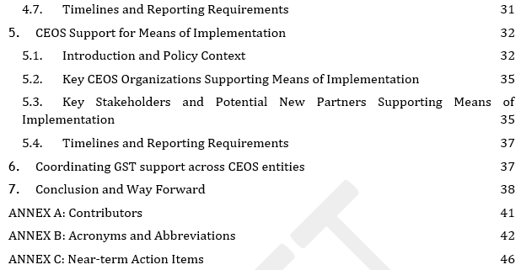
Status and Near-term Plans
An end-to-end draft was completed and was submitted for review prior to the SIT Technical Workshop
If no major issues are identified, feedback received before 20 October will be incorporated and the final version will be submitted to Plenary for endorsement

Slide 9



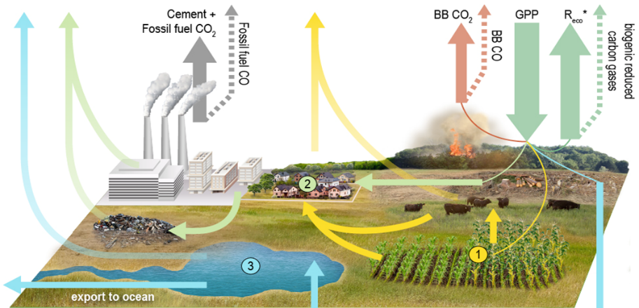
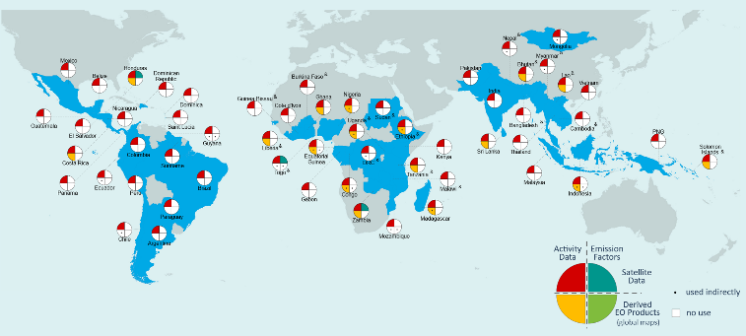
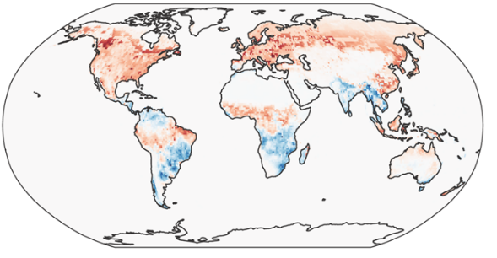
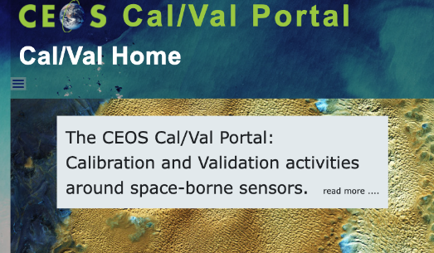







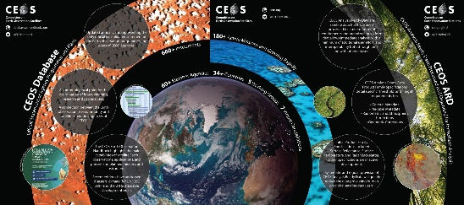

MITIGATION
United Nations
Framework Convention on
Climate Change
WGClimate GHG Task Team
CEOS AFOLU Team
Global Greenhouse Gas Watch (G3W)
Integrated Global Greenhouse Gas Information System (IG3IS)
UNEP IMEO
CEOS WGCV
National GHG Inventory Community
AC-VC GHG Team
WGCapD & Partners
Assessment Reports
Taskforce on Inventories
CEOS SEO

Slide 10
Recommendations for Mitigation
Recommendation: The CEOS GHG-TT should work with its partners on the AC-VC and AFOLU teams and within the scientific community to create global, gridded GHG concentration maps and top-down flux budgets, with uncertainties, at a spatial resolution of 1° x 1° or finer at monthly intervals.
Recommendation: CEOS should work with its partners in the scientific community and with the IPCC-TFI and the NGHGI community to develop commonly accepted tools and protocols for comparing and reconciling bottom-up NGHGI inventories with top-down and bottom-up GHG products derived from space-based EO.
Recommendation: Once the regional-scale bottom-up and top-down GHG products are adequately reconciled, the CEOS AFOLU and GHG-task teams should:
Identify & recommend global, land cover & land use change maps best suited for quantifying land use activity on national scales;
Identify and recommend the best (harmonized) global, space-based products for quantifying changes in above-ground biomass (AGB) stocks reported in BTRs and tracked in NDCs; and
Combine land use change, AGB and GHG products to develop sub-national to regional-scale emission factor databases for land use and land use change emissions estimates for use in developing bottom-up inventories.

Slide 11
Mitigation (Continued)
Recommendation: CEOS should work with its partners in UNEP IMEO to coordinate observations from CH₄ global mappers with those collected by high-resolution plume monitors to support alerts and to monitor emissions from the largest methane point sources.
Recommendation: CEOS should work with its partners (e.g., GCOS, WMO), the IPCC-TFI and members of the scientific community to define standards and best practices collecting, analysing, documenting and delivering high-spatial resolution, space-based observations of CO₂ emissions over large fossil fuel fired power plants and industrial sources to track changes in emissions associated with user demand or emissions reduction policies and regulations.
Recommendation: WGCapD should work with subject matter experts on the AFOLU, GHG TT and AC-VC GHG teams and with the NGHGI community to develop capacity building materials that provide a transparent explanation of the information content and uncertainties of these products.

Slide 12
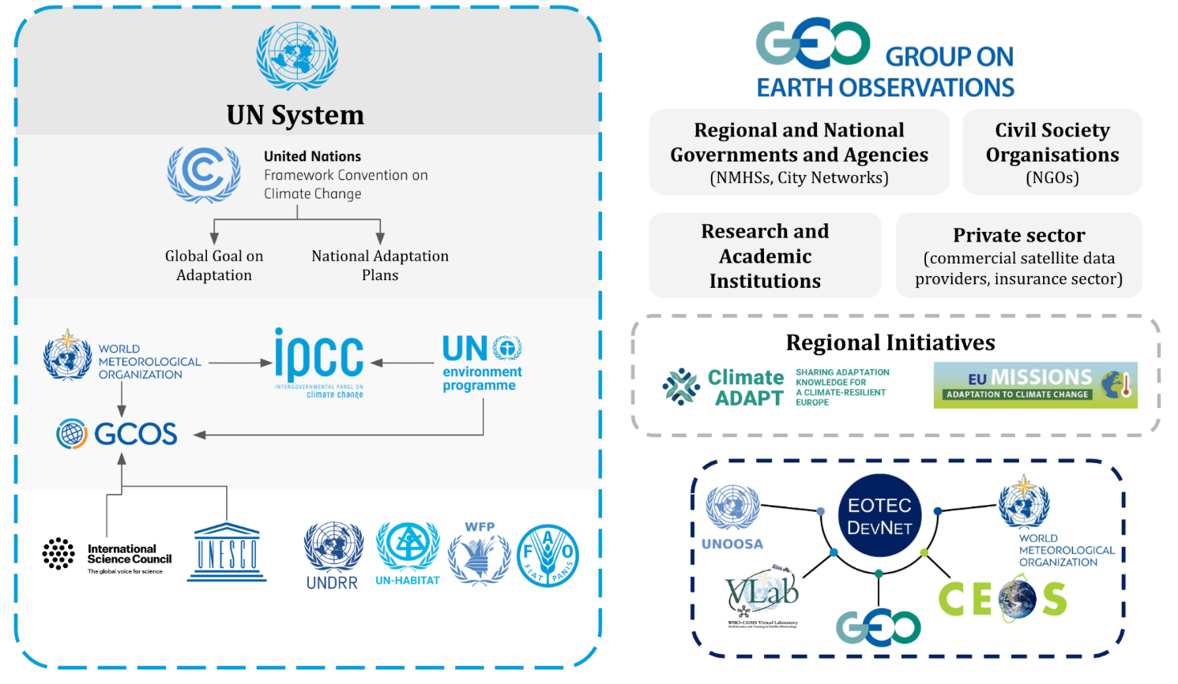




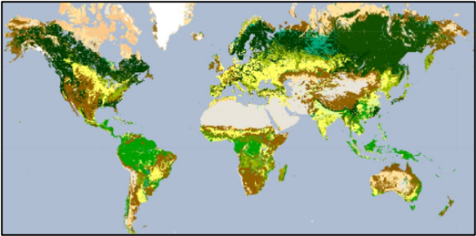
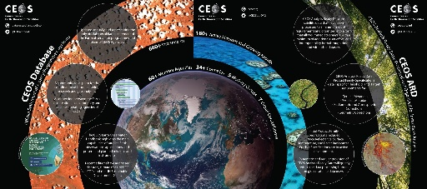
ADAPTATION
WGClimate
The Joint CEOS-CGMS Working Group on Climate
LSI-VC
AC-VC GHG
LSI-VC
SEO
WGCapD

Slide 13
Recommendations for Adaptation
Recommendation: CEOS should map ECVs and other amenable EO products to GGA indicators, documenting potential EO products and services and their links to the indicators being developed and adopted for tracking progress under the Global Goal on Adaptation. This should also promote the use of ARD principles to enhance usability for national reporting systems.
Recommendation: CEOS should enhance discoverability of adaptation-relevant Climate Data Records (CDRs). This involves improving access to information about existing data records, focusing on thematic indicators relevant to climate impacts and resilience. It also includes an adaptation-focused analysis of gaps in the ECV inventory and a focus on attribution science in support of the loss & damage mechanism. These efforts should promote the use of ARD principles to enhance utility of EO products for national reporting systems.
Recommendation: CEOS should explore ways to support the NAP process. For example, CEOS could collaborate with GEO to develop guidance and resources that help countries, particularly LDCs, integrate EO data and information effectively into their National Adaptation Plans, from initial risk assessment and planning to monitoring and evaluation. This ensures that EO capabilities align with UNFCCC reporting needs and national/local contexts.
Recommendation: CEOS should support the IPCC Assessment process (e.g., contribute to the expert review, facilitate an expert meeting with WGII) to ensure the development of the IPCC Adaptation Technical Guidelines reflect EO capabilities.

Slide 14
Adaptation (Continued)
Recommendation: CEOS should showcase adaptation use cases that employ EO data. Establish a repository of successful examples where EO has been applied to support adaptation actions across various sectors (e.g., agriculture, urban planning, disaster risk reduction, ecosystem management). These case studies, potentially drawn from agency-led projects, would demonstrate the value and feasibility of using EO for adaptation and encourage wider adoption.
Recommendation: CEOS should work with WMO, CGMS and other partners to refine space-based observations, derived products and delivery systems to reduce vulnerability to emerging climate threats. Increased support for UN initiatives, such as the UN’s Early Warning for All (EW4All), should be explored.
Recommendation: CEOS should continue to foster its relationship with GEO to identify emerging opportunities where their close collaboration will maximize the benefits of space-based data to support the GGA and the development of NAPs.
Recommendation: CEOS should reinforce its partnership with EOTEC DevNet and engage in the for Climate Adaptation Working Groups (CAWG), to develop and deliver capacity building activities to support the adaptation goals of the Global Stocktake.

Slide 15
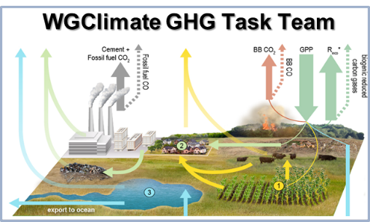









MEANS of IMPLEMENTATION
WGClimate
The Joint CEOS-CGMS Working Group on Climate
United Nations
Framework Convention on
Climate Change
GCF
Green Climate Fund
Fund for responding to
Loss and Damage
LSI-VC
Global Environmental
Facility
CEOS SEO
Climate Investment Funds
WGCapD

Slide 16
Recommendations for Means of Implementation
Recommendation: CEOS should review the lessons learned from the ongoing efforts by individual agencies to support Means of Implementation and climate finance, and identify opportunities for expanding their scope and impact by coordinating efforts across its agencies and partners. It should then work with the development finance community and national institutions to develop fit-for purpose products, tools and services to address these needs.
Recommendation: CEOS should explore opportunities where the products and tools developed to support the Mitigation and Adaptation goals of the PA can be adapted to support the Means of Implementation objectives as well.

Slide 17
Questions
Discussion
Other Feedback

