Slide 1
CEOS Engagement with IPCC
(SIT Chair Team)
Agenda Item 3.4
SIT TW 2025
Darmstadt, Germany
9-11 September, 2025

Slide 2
Purpose
Update on the status of dialogue threads with IPCC
Ensure carriage of the important topics going forward and beyond JAXA SIT Chair Term
Feedback to IPCC TFI on joint expert workshop: CEOS-IPCC

Slide 3
IPCC Roles in the GSTs
❖Products developed by the Intergovernmental Panel on Climate Change (IPCC) play two critical roles in the global stocktakes.
▪The IPCC Assessment reports constitute an open, transparent scientific consensus for tracking climate change and projecting future climate impacts.
▪The Taskforce on Inventories (IPCC-TFI) 2006 IPCC Guidelines for National Greenhouse Gas Inventories (IPCC-2006) establish the good practice methodologies that have been adopted as the basis for compiling national inventory reports by governments reporting under the Paris Agreement.

Slide 4
Context - multiple threads
Importance of IPCC role and inputs to UNFCCC widely recognised, notably for GST1
The IPCC AR7 WG reports will not be completed until after GST2
Multiple CEOS agencies have recognised the importance of better representation of EO satellite data in the Good Practice Guidance provided to countries by IPCC, e.g.:
  Work by the Biomass harmonisation team with IPCC TFI
  JRC team research and events
SIT Chair team engaged with IPCC TFI as part of term Climate Policy Impact efforts
  More systematic representation of CEOS agency datasets in the IPCC Emission Factors Database
  IPCC TFI proposed possible large space agency IPCC Workshops for better strategic alignment in future

Slide 5
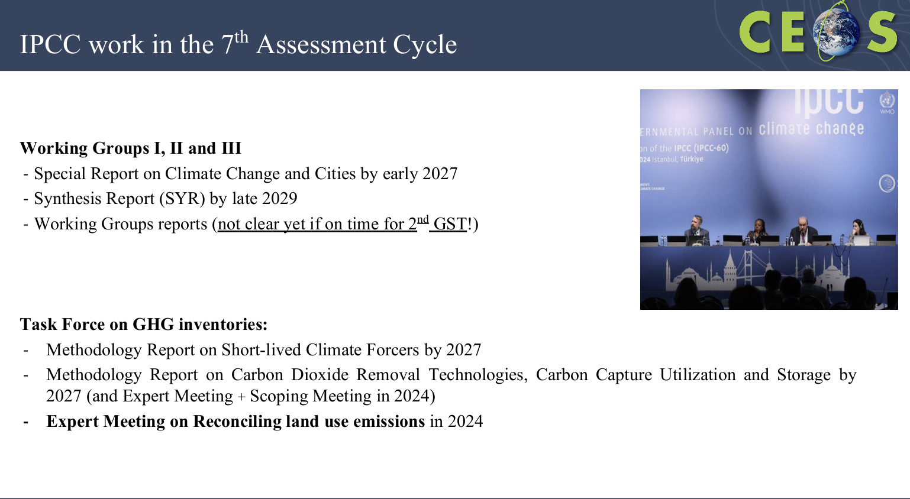
Context

Slide 6
Discussion items
Feedback to TFI on Expert Meeting proposal draft
Systematic representation of CEOS datasets in the IPCC Emission Factors Database

Slide 7
Discussion items – Expert Mtg
❖ IPCC TFI Expert Meeting on use of Atmospheric Observations in national greenhouse gas inventories (Contingency expert meeting)
Expert Meeting objectives
Foster dialogue between IPCC TFI and Earth Observation (EO) practitioners with the aim of identifying:
  potential for uses of EO data in estimation of national inventories;
  issues for improving the QA processes of national inventories using EO data; and
  possibilities for data suppliers to the IPCC TFI Emission Factor DataBase; and
  recommendations on the need for new IPCC methodological guidance on the use of EO data and systems in national GHG inventories.
Draft paper from TFI here.

Slide 8
Discussion items – Expert Mtg
❖ Background
The take up of these EO data for use in the estimation of national greenhouse gas inventories or for quality assurance processes by inventory practitioners has been slow, however.
This Expert Meeting will support TFI core objectives by evaluating these emerging EO data and estimation techniques and making an assessment of the need for the development of future methodology guidance for national GHG inventories on these topics.
❖ Scope
Will build on the IPCC Expert Meeting on Atmospheric Measurements held in 2022 and the Reconciling Land Emissions and sinks in 2024 which identified future work on EO systems in inventories should prioritise methane and F gas emissions and carbon emissions and sinks from AFOLU.
Held in conjunction with the Editorial Board and Data meeting for the IPCC TFI Emission Factor Database, with the aim of developing linkages and relationships between data suppliers of low cost EO data and the EFDB.
Draft paper from TFI here.

Slide 9
Discussion items – Expert Mtg
❖ Steering Cttee
The meeting will be organized by TFI Bureau in cooperation with some members of the IPCC Bureau, and with input from CEOS, UNEP/WMO and FAO, and supported by the TFI TSU.
❖ Details
Timing, location all TBD
Participants: National Greenhouse Gas Inventory practitioners, IPCC Guidelines practitioners, Earth observation data system practitioners (including CEOS and WMO), EFDB Editorial Board members
Budget
Contingency expert meeting workshop (40 travel supports). Editorial Board and EFDB data meeting (21 travel supports).
Draft paper from TFI here.

Slide 10
Discussion items – Expert Mtg
❖ Format
In-person and virtual participation (hybrid mode), with a balanced participation of experts from national GHG inventories and the EO community; geographical and gender balance, as far as possible.
Plenary sessions for invited presentations. Breakout groups that frame, formulate and scope the critical questions. Each breakout group would be solicited to provide concrete recommendations. An end-of-day wrap up plenary would identify key issues and knowledge gaps.
A meeting report summarizing the results will be produced to support the EO community and inform national GHG inventory compilers and to make recommendations:
  on topics that may require future IPCC methodological guidance; and
  on processes that would assist in supporting data supply to the EFDB.

Slide 11
Discussion items – Expert Mtg
❖ Agenda
Stream 1: Atmospheric measurements at facility levels (Methane and F gases)
Stream 2: Quality Assurance at national level (Methane and F gases)
Stream 3: Estimation and Quality Assurance (AFOLU)

Slide 12
Discussion items – Expert Mtg
❖ Feedback last week
1. "Stream 2: Quality Assurance at national level (Methane and F gases)” While this would certainly be a step forward, we wonder why this topic would be limited to Methane and F gases. At the national level, space-based observations of CO2 provide a unique integrated constraint on the net emissions of this gas that would be valuable to include in any QA/QC activity. More specifically, comparisons with a top-down national CO2 budget could be used to assess the completeness of the bottom-up inventories at national levels.
Reply: On topics, we held a workshop in 2022 which identify Methane and F gases as where the most benefits probably lie. On CO2, I agree there might be a QA benefit. And maybe it complements the GFOI interests. If so, let's keep the discussion open.

Slide 13
Discussion items – Expert Mtg
❖ Feedback last week
2. It sounds like a standalone meeting, apart from an IPCC plenary? Is that correct? And IPCC is willing and keen to have CEOS/space agencies involved in the definition and execution?
Reply: We are talking one workshop in the short term. However
(1) Sandro and I aim to use the workshop to try to build a case to take to a later IPCC Plenary for a possible future update to the IPCC Guidelines (post our current work program which is tight until the end of 2027) and which, hopefully, might provide opportunity for continued EO community contributions (so we have a long term vision, but carefully hedged at this point,🙂); and
(2) We hope to build relations with EO data suppliers to help to populate the renewed IPCC Emission Factor Database, so there may be a separate stream of contact for this purpose.

Slide 14
Discussion items – Expert Mtg
❖ Actions
Please provide comments and suggestions to SIT Chair Team by COB this week (jaxa-sit-chair-2024-25@googlegroups.com)
Volunteers welcome, including going forward
SIT Chair team to respond to TFI in time for debate at Sixty-third Session of the IPCC (IPCC-63), Lima, Peru, 27 - 30 October 2025
Consider
  Objectives and scope
  Attendees
  Presenters and presentations
  Carriage of the CEOS-IPCC relationship
  Anyone attending IPCC-63?

Slide 15
Discussion items – EFDB
❖ More systematic representation of CEOS data in the EF database
1. Challenges highlighted by efforts of biomass harmonisation team.
2. Way forward? (expert meeting opportunity)

Slide 16
Next steps
Coordination and ownership of dialogue with IPCC

