Slide 1
SIT Technical Workshop 2025 . Common Practices for Quantifying Methane Emissions from Plumes Detected by Remote Sensing
Paul Green (NPL/UKSA)
John Worden (JPL)
Evan Sherwin (LLBL)
Annmarie Eldering (NIST)
& wider GHG task team
Agenda Item 4.2
SIT TW 2025
Darmstadt, Germany
9-11 September, 2025

Slide 2
Motivation
The Global Methane Pledge (now signed by 155 countries) seeks to reduce methane emissions by 30% between 2020 and 2030
Fugitive emissions / high emitters (emissions t> 100 kg/hr) represent a substantial fraction of fossil and waste emissions. Estimated between 30% and 75% of O&G emissions in some US production basins.
Public and New Space observations of CO₂ and CH₄ are increasingly being used to identify high emitters to improve production efficiency of drilling, support regulation, and are likely needed for a functioning reporting obligations and carbon market. Despite the current geopolitics, the need for data is increasing, not reducing.
Currently there are 3 missions dedicated to facility scale emissions monitoring, with another 10 expected in few years – in addition to the products generated from public data.
We need a set of “common” practices for reporting VVUQ and QA for facility scale emissions so that producers of these data know what is expected by the community and (new) users know how the data should be generated and reported so that it can be trusted

Slide 3
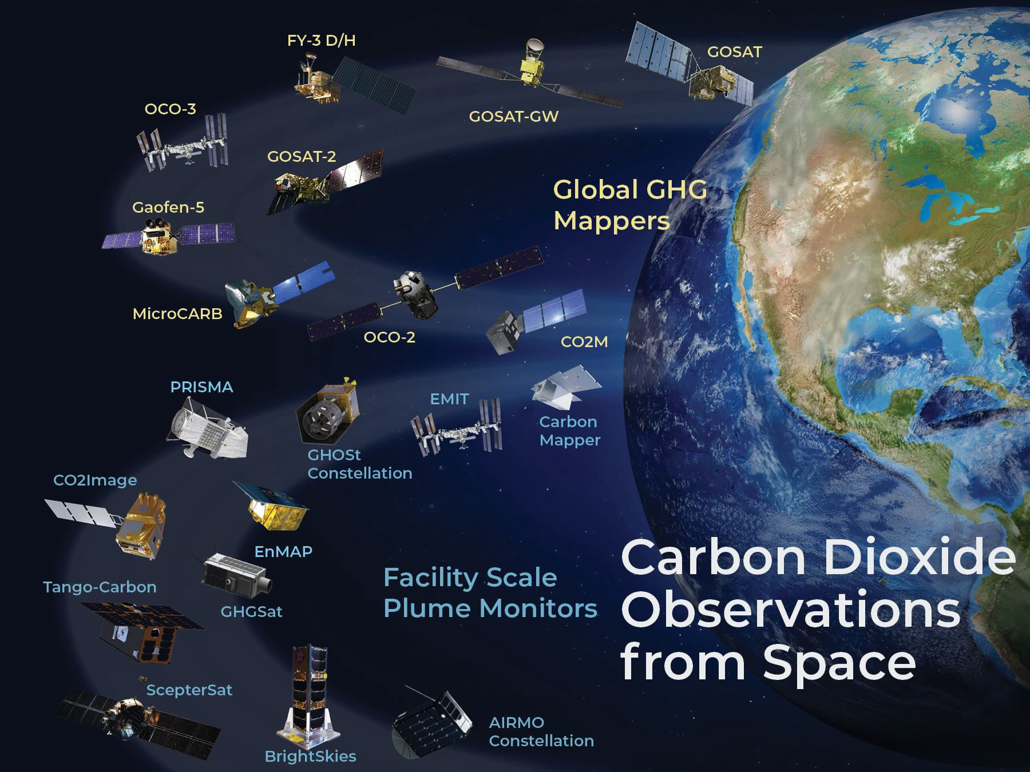
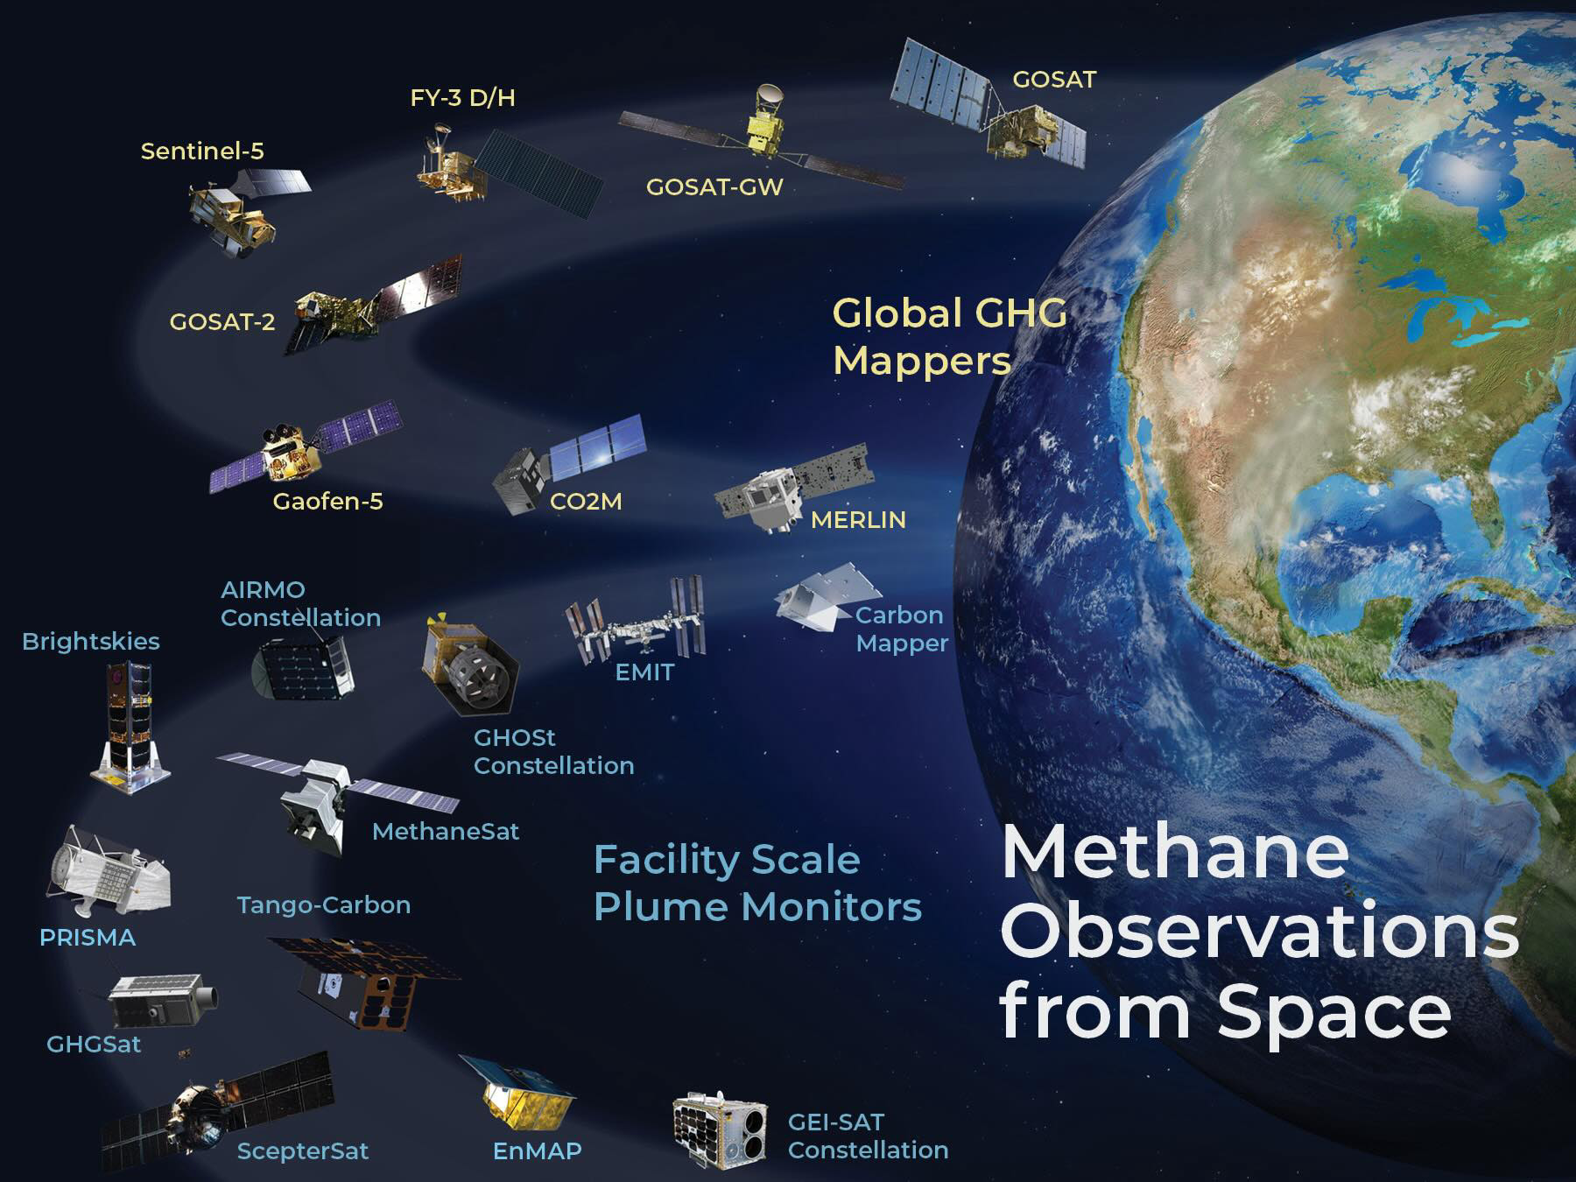
Growing constellation of GHG concentrations observations from the global to the facility scale
These are now being used to derive carbon dioxide and methane emission (flux) estimates on a range of spatial and temporal scales

Slide 4
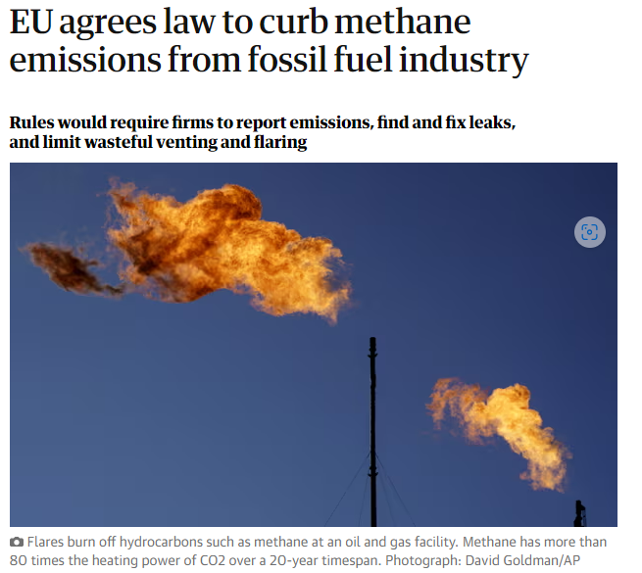
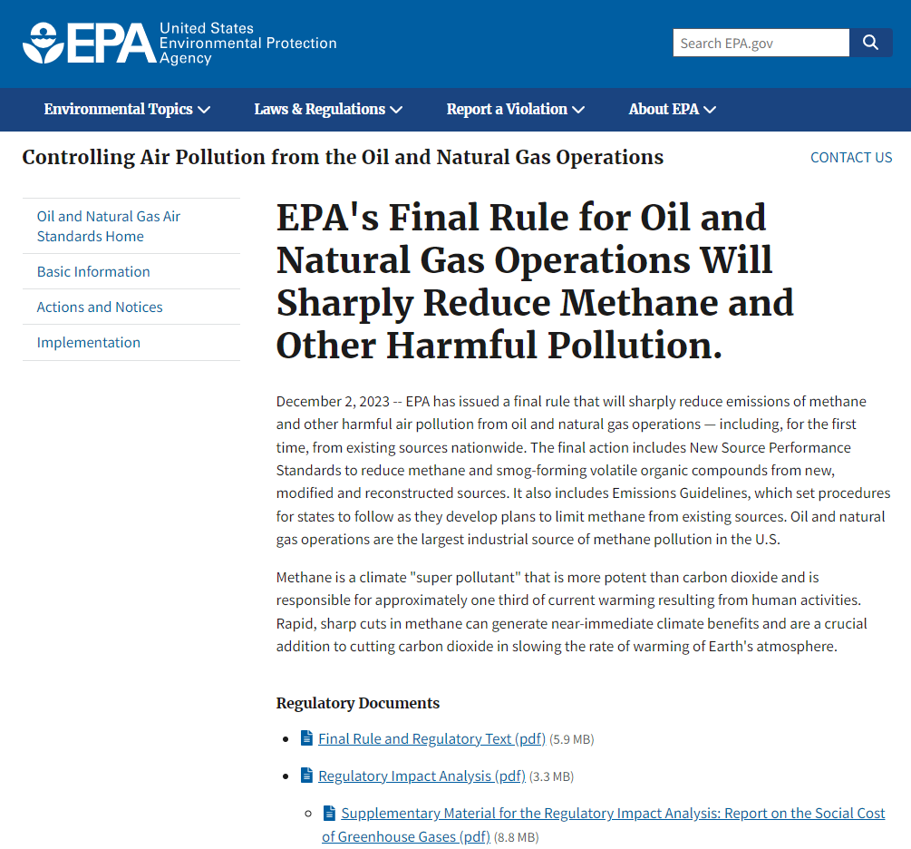
New rules on Energy sector
https://www.epa.gov/controlling-air-pollution-oil-and-natural-gas-operations/epas-final-rule-oil-and-natural-gas
https://oeil.secure.europarl.europa.eu/oeil/popups/ficheprocedure.do?reference=2021/0423(COD)&l=en

Slide 5

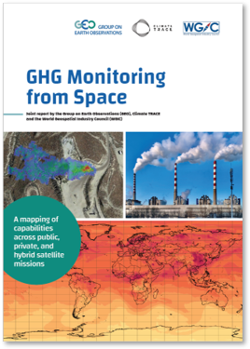
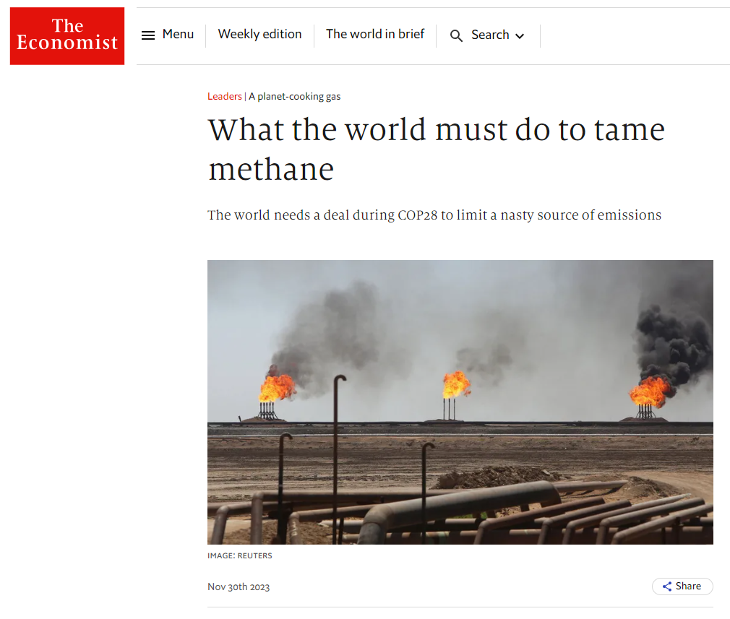
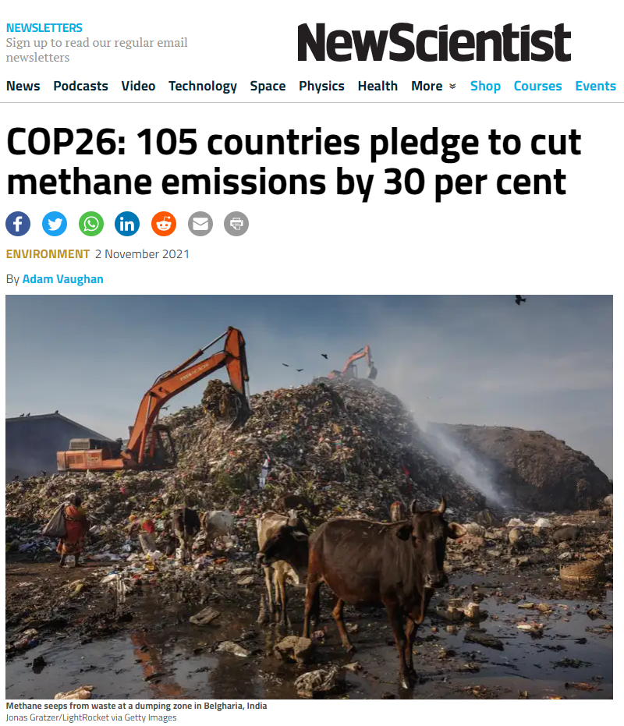
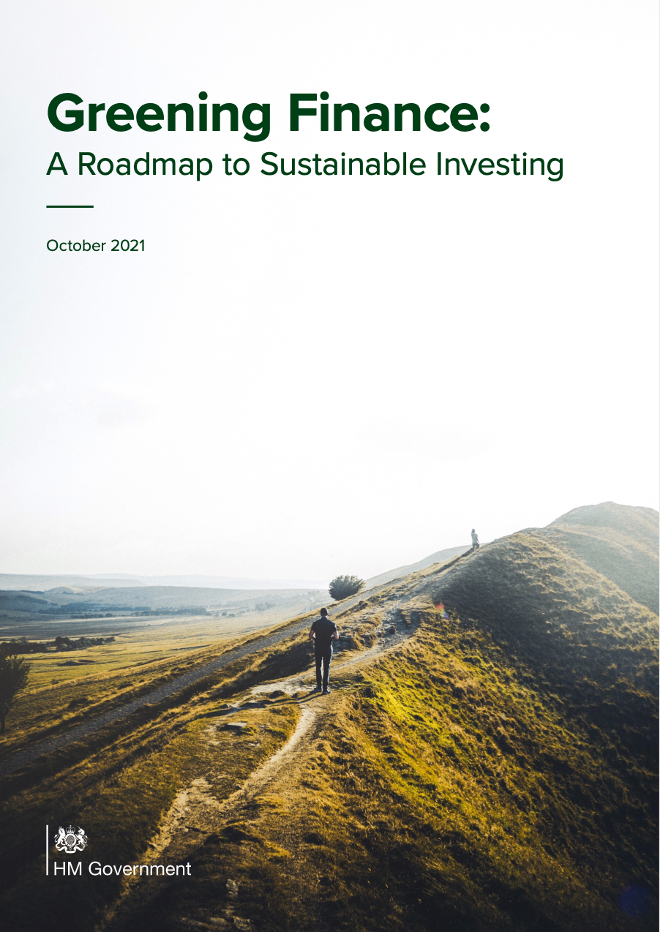
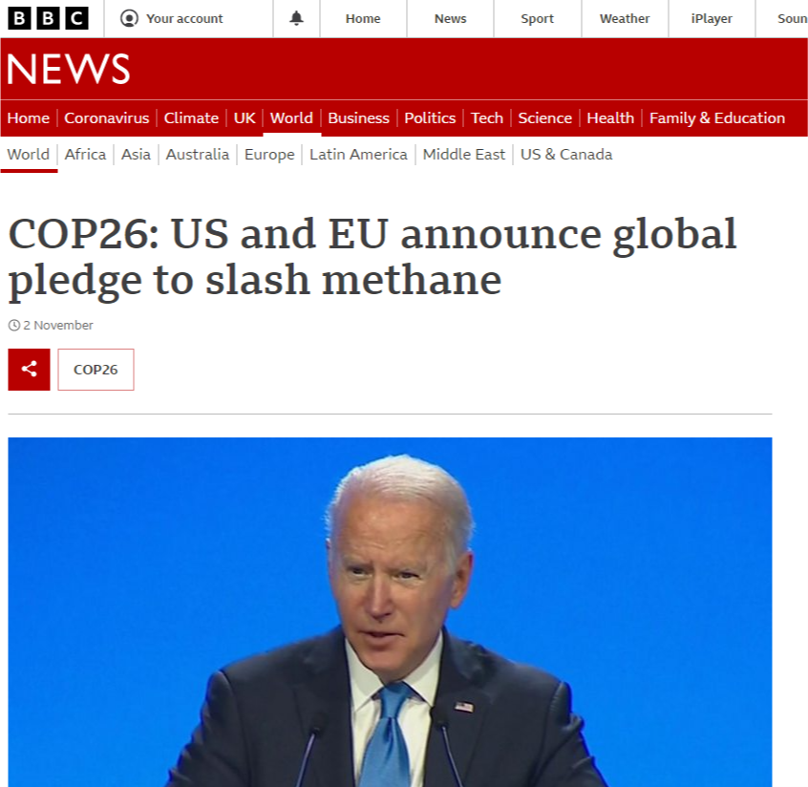
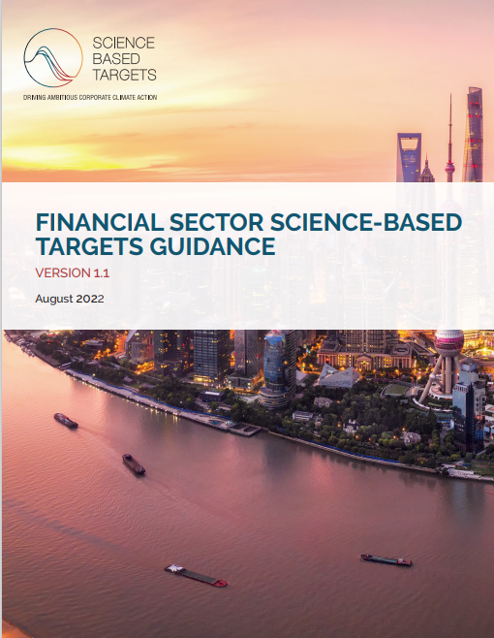
Corporate emissions and climate risk reporting
TCFD
Compulsory emissions & climate risk reporting for listed companies in US and UK, together with voluntary schemes to maintain market competitiveness aligned with customer climate expectations

Slide 6
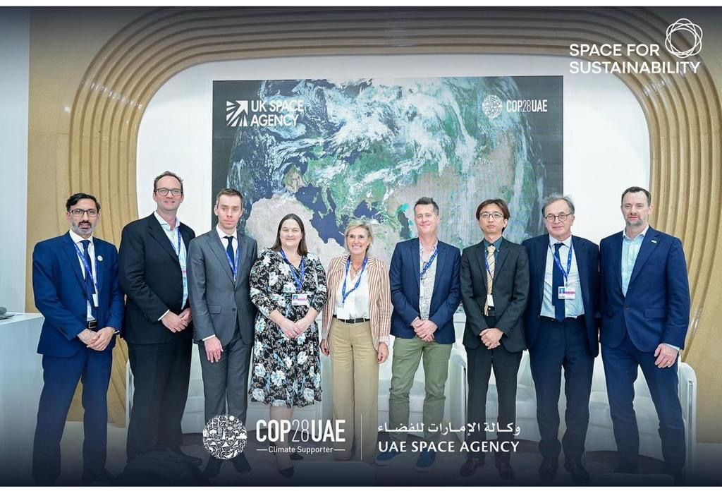

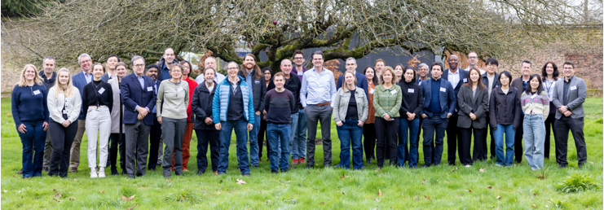
Identified community appetite with international buy-in
COP28 - UKSA-hosted event on the UAE-Space Agency Space Sustainability stand within the first ever COP ‘Space Pavilion’
Monitoring Methane from Space: Towards an Internationally Recognised Standard
NIST-sponsored workshop for L0-L4 common practise – Jan 2024
NPL hosted a UKSA-sponsored methane reporting standards workshop Feb 2024
Representation from CEOS member, commercial suppliers, academia & users

Slide 7
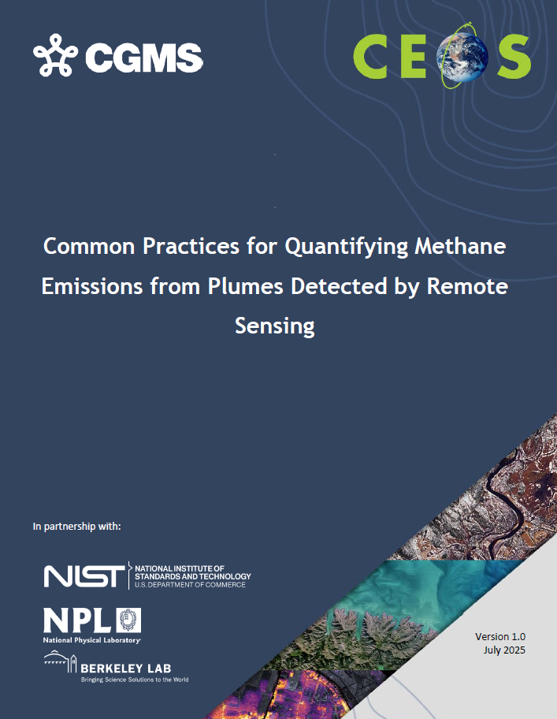
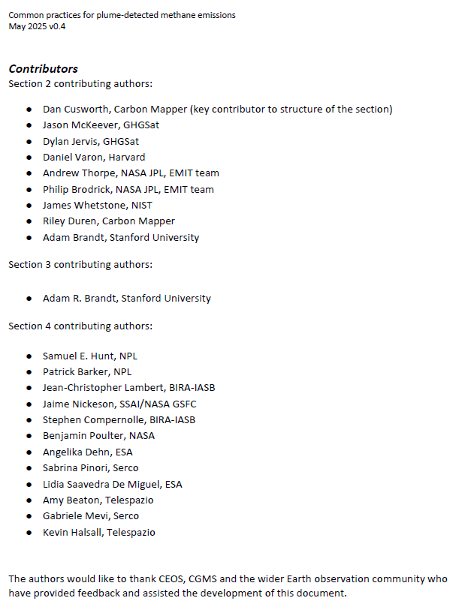
Common practise structure & contributors
Common practices intended users are
producers of these data (to know what is expected by the community)
users of these data (to understand how it should be generated and know how to use)
Overall structure
Motivation, remit and timeliness
Common practise for L0 to L4
Validation current art
Quality assessment framework
Integrates efforts across multiple agencies

Slide 8
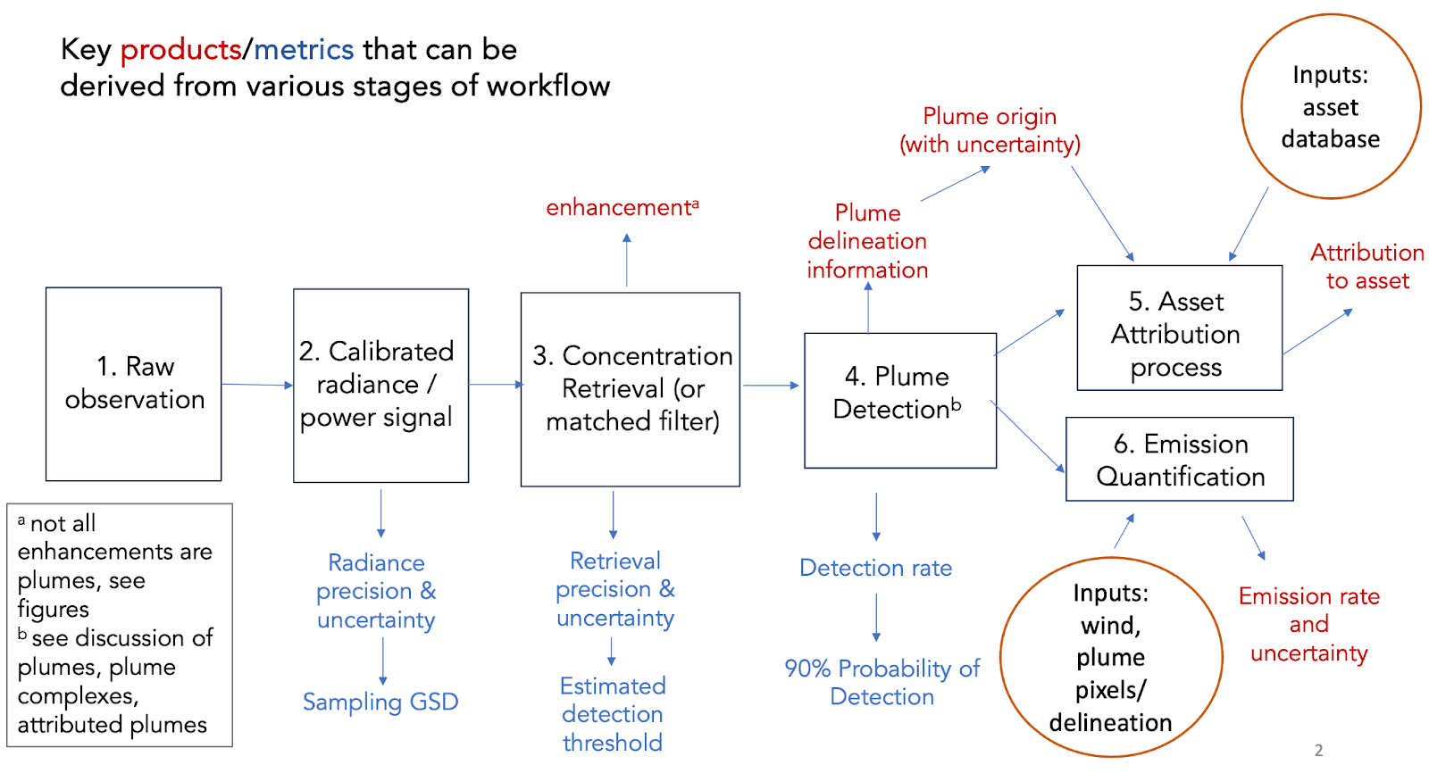
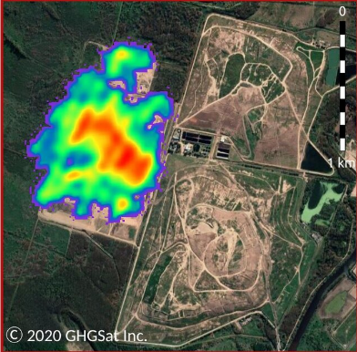
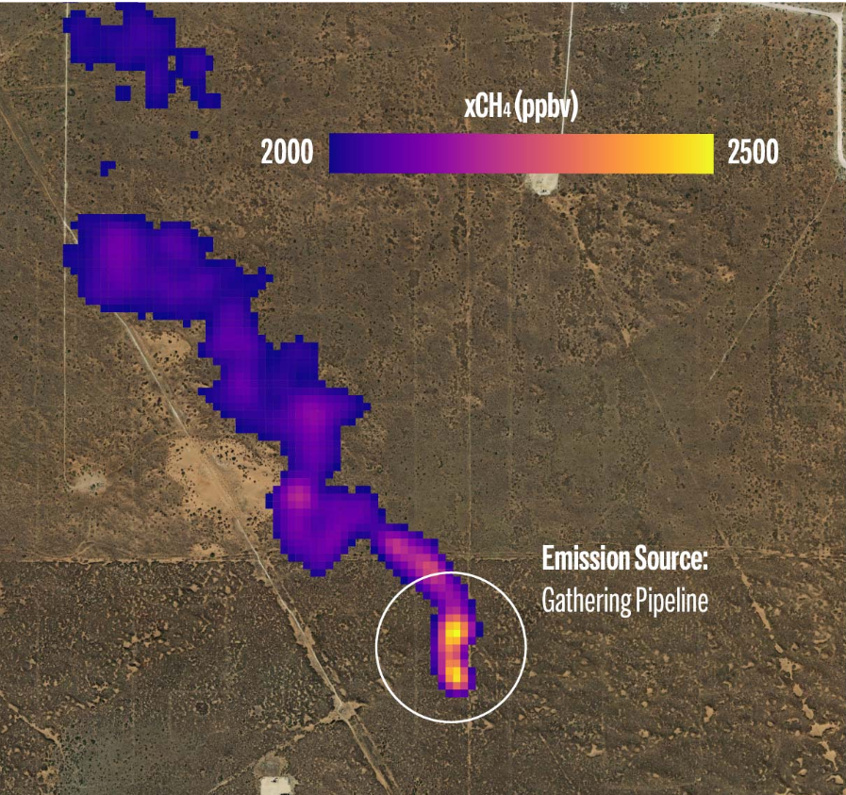
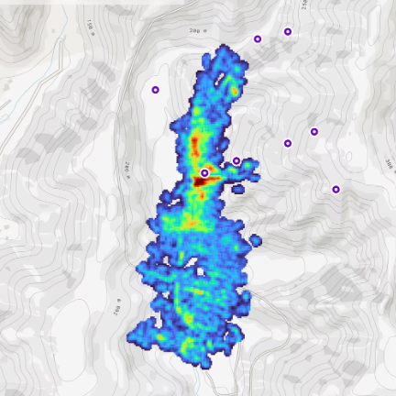
Workflow Common Practice
At a high level, all practitioners use the same sequence of steps in their workflows
The details of implementation vary, increasingly later in the process (from concentration/enhancement to emissions estimates)
Later plume detection, delineation and emission quantification steps require a human in the loop
Credit (L-R):
GHGSat
MethaneSat
CarbonMapper

Slide 9
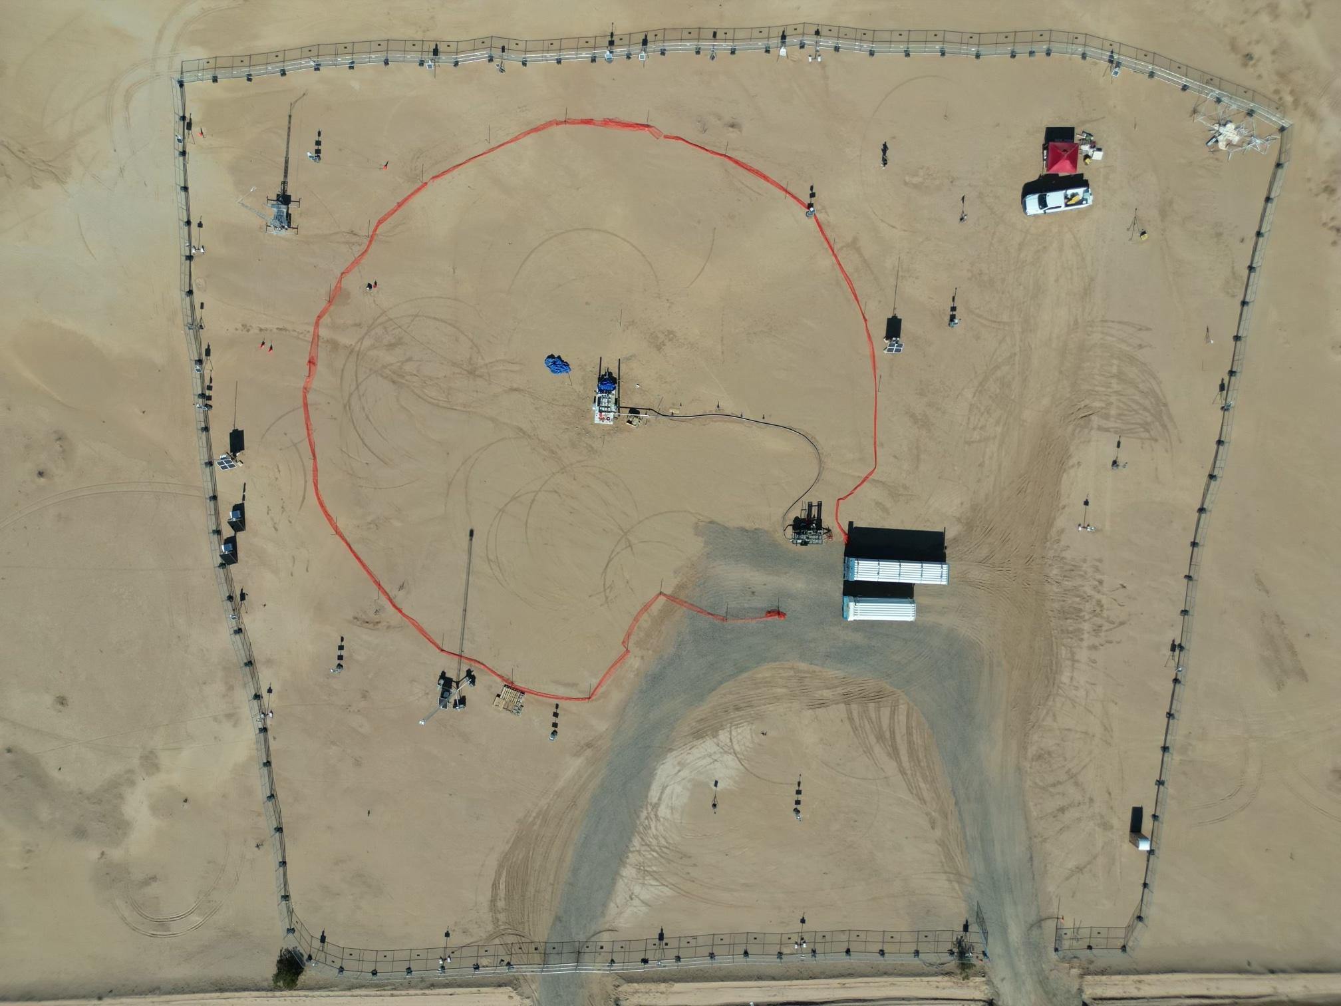
State of Practice for Validation –
controlled release
Independent testing of space-based methane detection needed, including several new satellite programs launched last year
Cooperative and single-blind controlled release tests, building on 5+ years of satellite, airplane and ground sensor tests
Expanded participation to 12+ methane satellite platforms and 15 analysis teams
2024-2025
150 release (10-1500 kg/h) cooperative stage being analysed
First single-blind stage “Phase 1” is ongoing in Q1 2025, data to be unblinded on May 1
Subsequent phases to follow with alternate testing configurations
10 m ultrasonic winds
and meteorological station
Work station
?
Metering and
release point
Gas trailers and
pressure reg
Credit: A Brandt Stanford tinyurl.com/stanford-methane
*Participants know location but not [on/off] or volume flow rate. Coriolis flow metering for leaks between 3 kg/h and 1500 kg/h

Slide 10
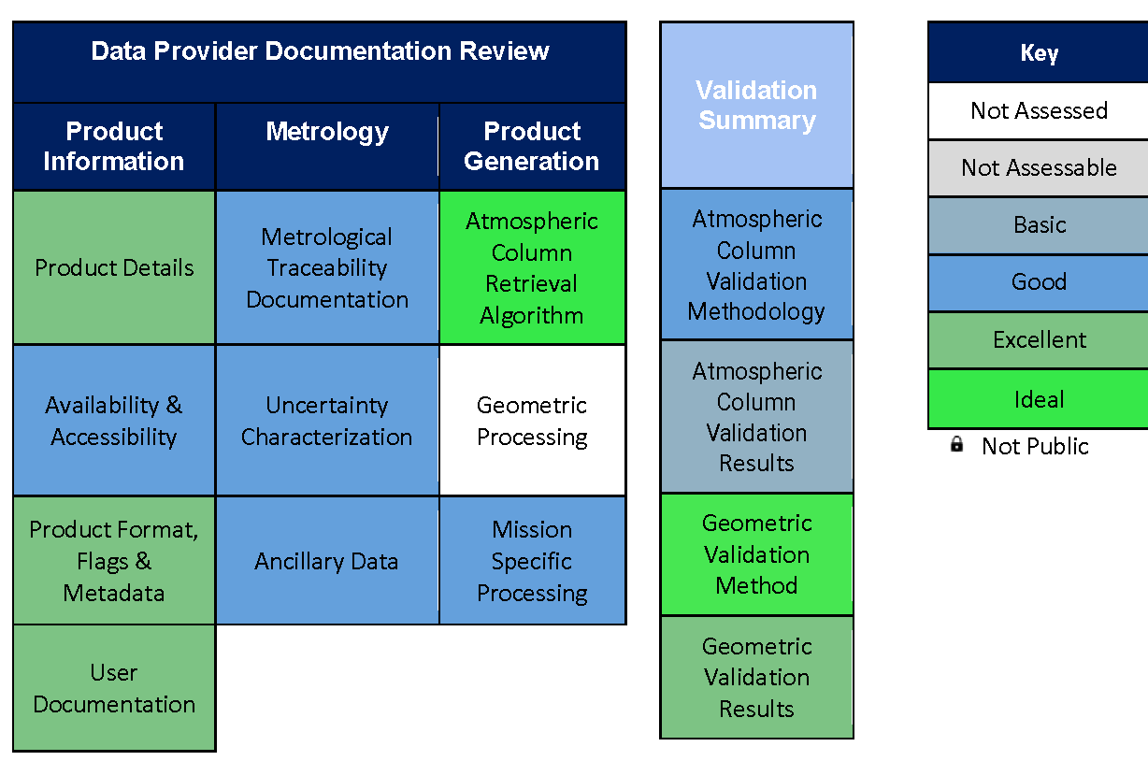
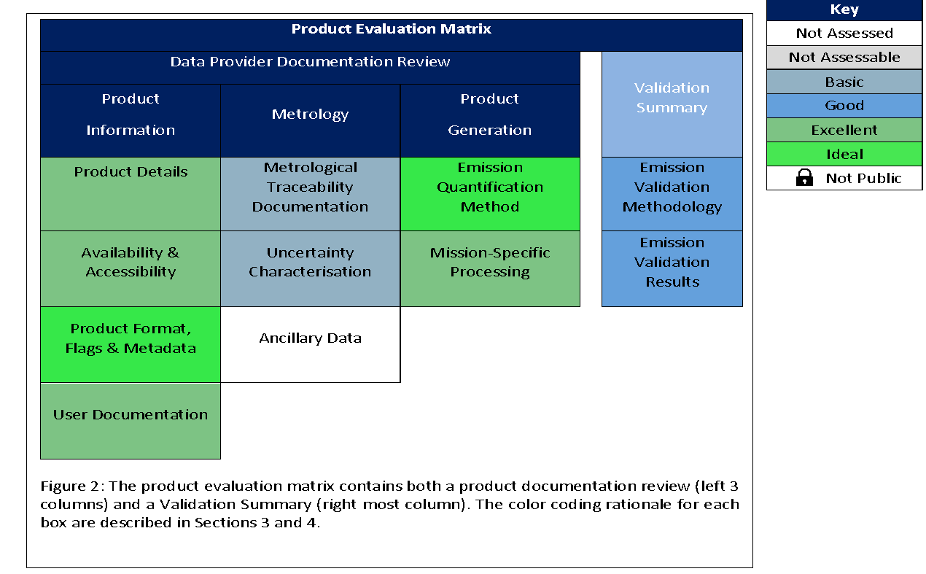
Quality Assessment framework
Quality Assessment framework aligned with that developed within EDAP / CSDA for consistency across GHGs and other ECVs
Column Enhancement
Emissions

Slide 11
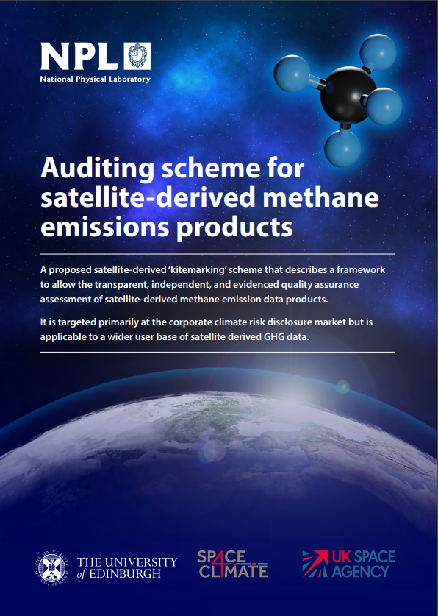
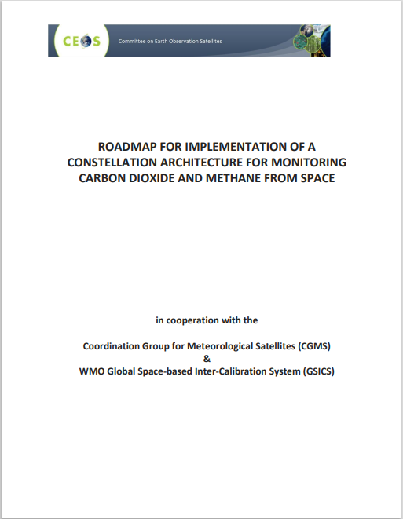

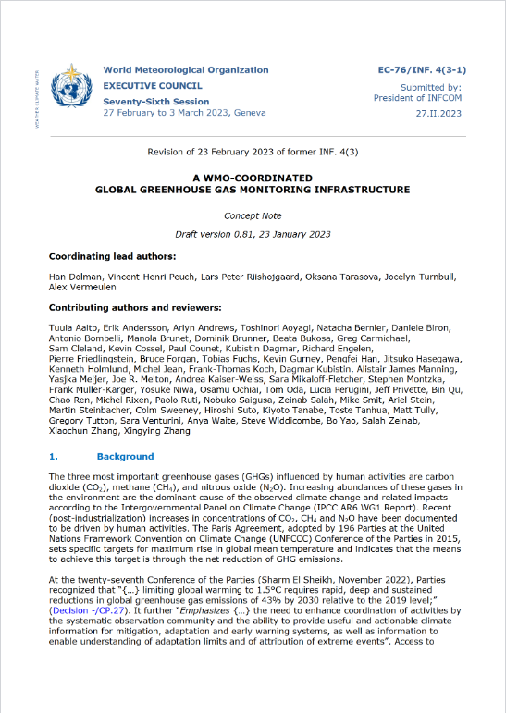
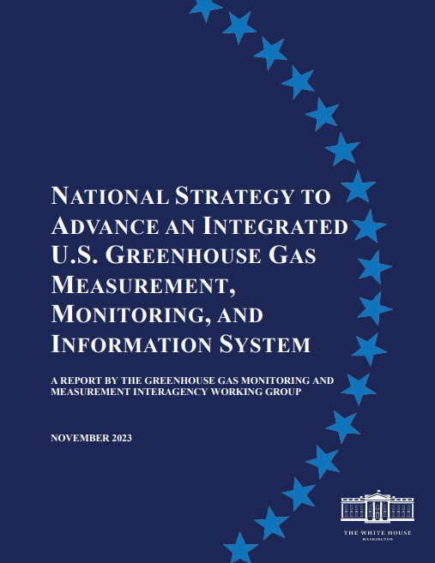
Best practice as an enabler
Build on previous CEOS work on best practises in the public and new space domains and want to partner with key parallel programmes and stakeholders to add value as an underpinning framework to enable reporting in the public and commercial sectors
UNFCCC
CEOS roadmap
UNEP IMEO
WMO G3W
US GHG Centre
UNFCCC

Slide 12
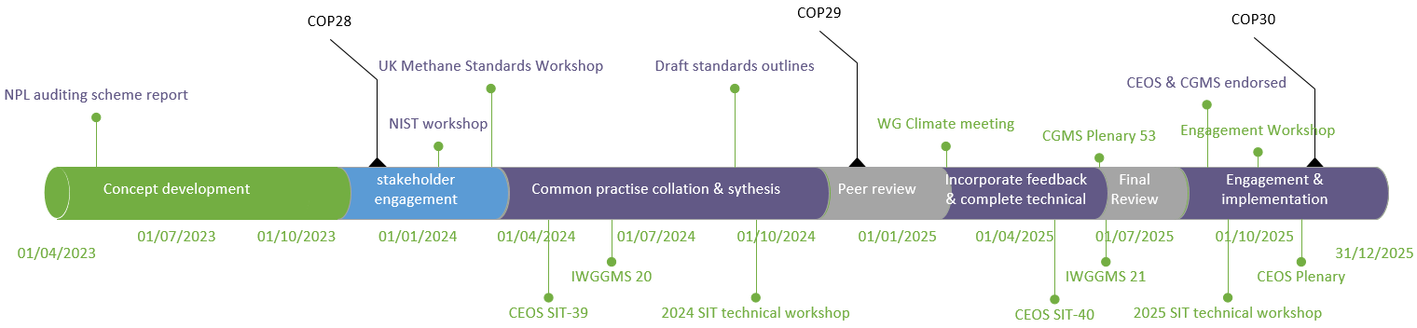
Progress and timeline
2024 – outline development & peer review
2025 – detailed completion, peer review & v1 finalization for Summer 2025
v1.0 endorsed by CEOS & CGMS in August 2025
Available at https://ceos.org/publications-key-documents/ and directly at https://zenodo.org/records/17047789

Slide 13
Next Steps
Facility scale / Plume Detected emissions
Implementation plan to develop first adopters – expected to be two commercial producers (GHGSat and CarbonMapper) – extend to MethaneSat
Continued engagement with UNEP IMEO in their adoption within the MARS program and beyond together with UN Climate & Clean Air Coalition (via short-lived climate pollutants initiative) & Global Methane Pledge – to advance with CCAC, GMP champions and best practices team to advance.
Represented at COP-30 via SA statement, CCAC and user community advocacy (IMEO, O&G and finance users)
Towards v2.0 ‘good practice’ - activity progressed by AC-VC and GHG task team.
Co-ordination of controlled release validation alongside academic partners
Studies to follow up v1.0 recommendations (and identified gaps)
L2 & L4 intercomparison exercises wrapped up
v2.0 (in a few years) to maintain relevance in evolving ecosystem and incorporate on-going studies to more from ‘common practice’ to ‘good practice’.

Slide 14
Next Steps & requests
Area flux mappers
Motivated to provide more useful and accessible routes to use in GST2 (2027), the focus is on a unified offering on country-scale emission estimates.
Draws on existing initiatives OCO-MIP, RECCAP2 etc.
Aim is to quantify, consolidate and (where possible) reduce uncertainties in estimates
Existing finance sector interest alongside academic.
CO2 and CH4 may require slightly different approaches – as start from different levels of agreement and maturity.
Requests
Continued support of effort to define best practices for quantifying and reporting emissions - in time this effort is handed off to an appropriate ”operational” focused organization after agreement between vested parties
Best practices actions added into the wider GHG TT roadmap

