Slide 1
CEOS Greenhouse Gas Mission
Portal
Harvey Jones
JAXA SIT Chair Team
Agenda Item 4.3
SIT TW 2025
Darmstadt, Germany
9-11 September, 2025

Slide 2

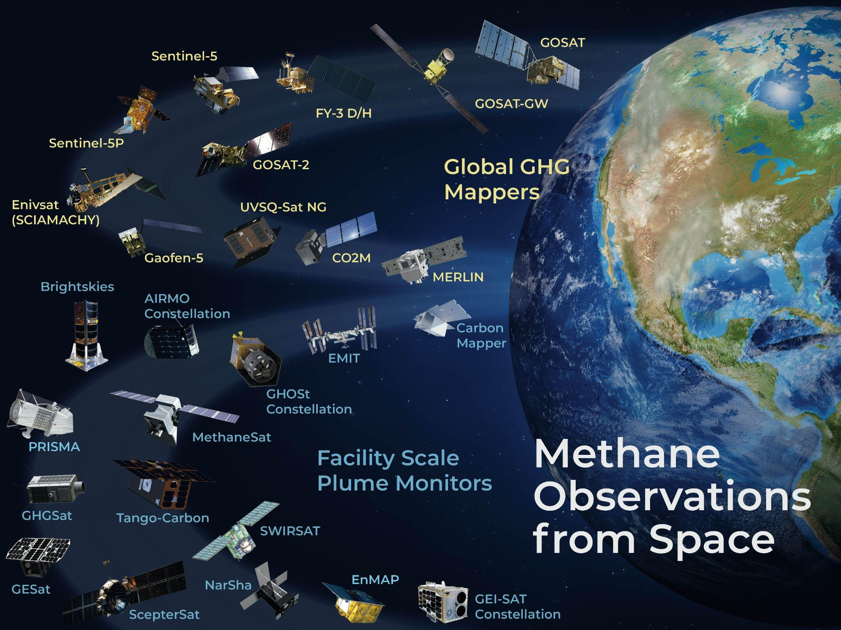
ceos.org/ghg

Slide 3
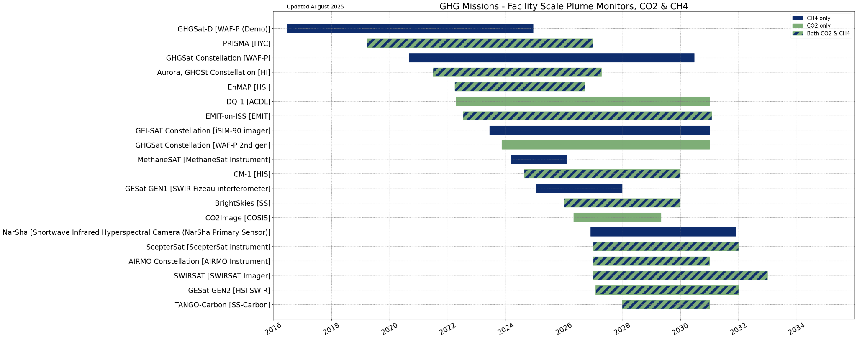
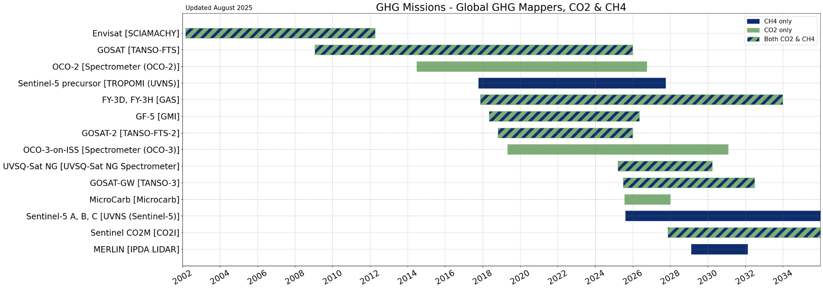
2025 Updates
Contacted all non-CEOS organisations for updates on their GHG programmes and plans
New mission: NarSha Constellation
  Korea Methane Monitoring Microsatellite (K3M)
CEOS Updates included in annual MIM Database Survey

Slide 4
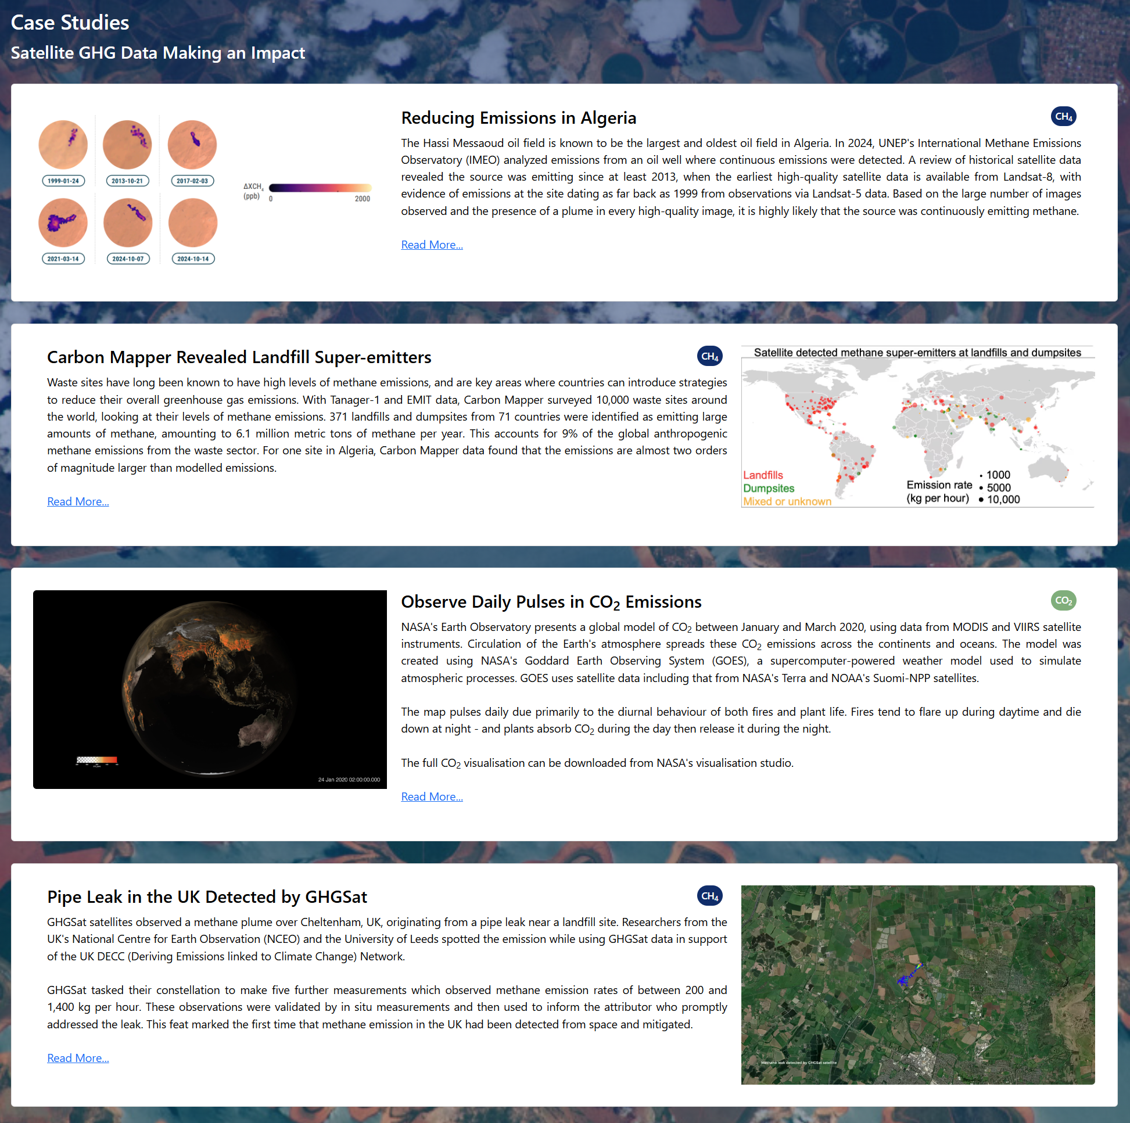
Case Studies
Section added to the portal in 2024
Adding 2 new case studies:
  Reducing Emissions in Algeria (IMEO)
  Carbon Mapper Revealed Landfill Super-emitters
New case studies always welcome

Slide 5
Database of Controlled Release Experiments
Developed following request from IMEO
  Target audience: satellite operators
  Goals:
    Maximise the use of these planned experiments for verifying data from multiple satellites
    Reduce the amount of GHGs deliberately emitted for verification purposes
Three elements:
  Table of past and planned experiments
  Form to submit new experiments
  Automated notifications & mailing list

Slide 6
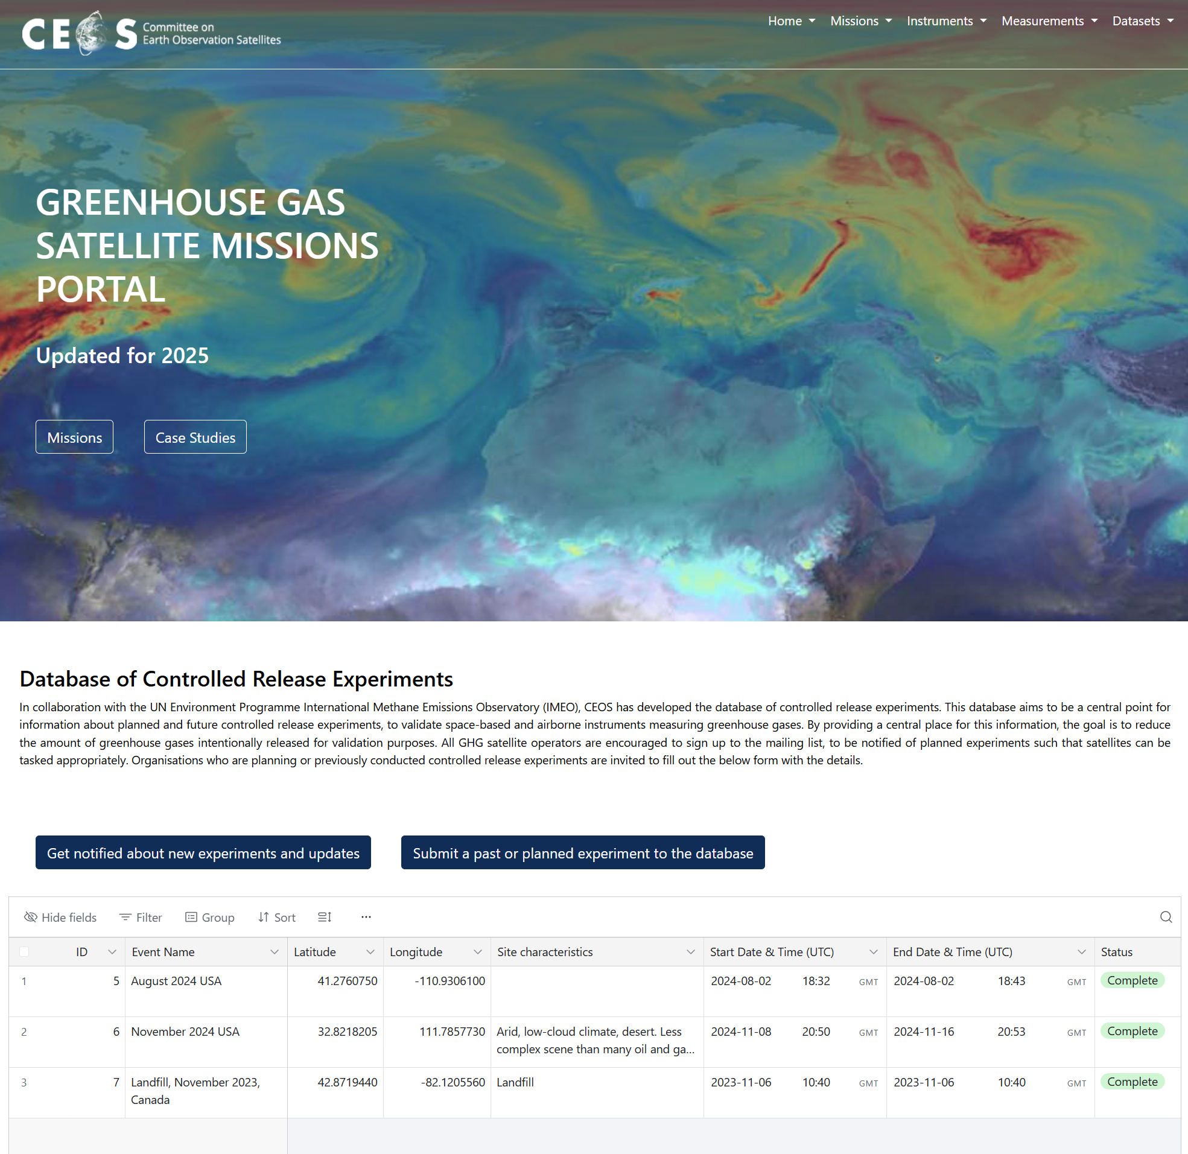
Draft Page

Slide 7

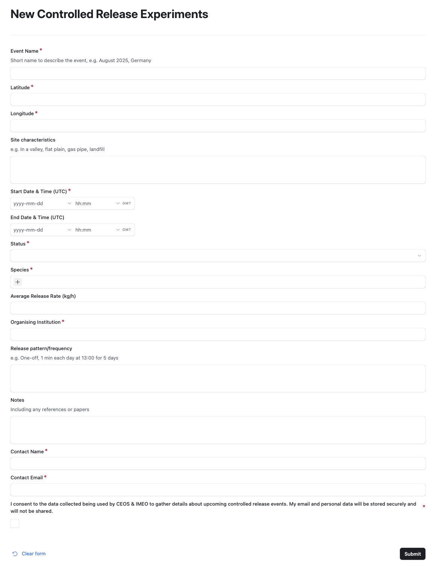

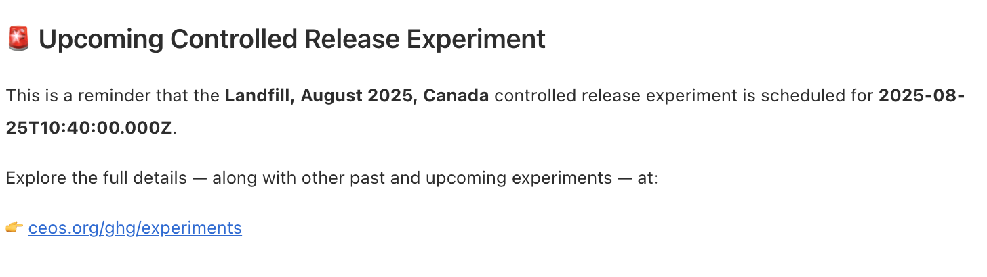
How the notification system works
User submits new experiment via form
Notification sent to database manager
Email notification sent to mailing list
Record approved
Database manager reviews the submission
14 days prior to an event
Email notification sent to mailing list
Record rejected
No further action
7 days after an event
Database manager updates the record with exact data from experiment
Database manager is notified that event has passed
Contacts POC

Slide 8

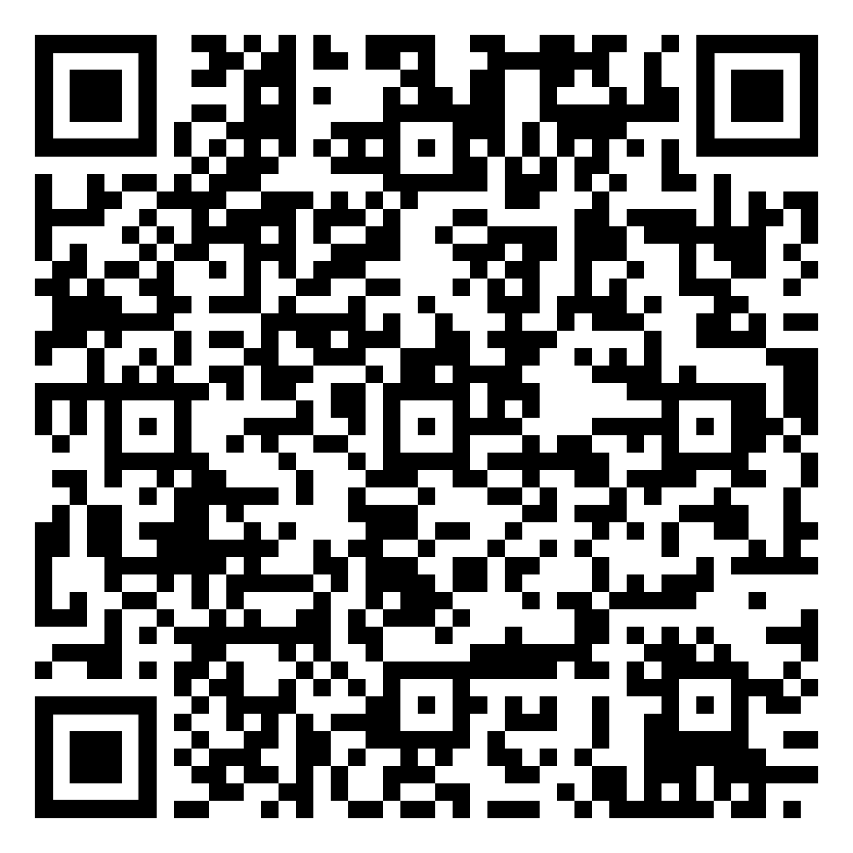
Join in!
Submit a new controlled release experiment (past or planned)
https://airtable.com/apphCiY4iwGxjHS4A/paglzCSssHxohyhMx/form
Join the mailing list to be notified about new additions to the database and upcoming events
Send an email to controlled-release-database+subscribe@googlegroups.com
Suggested Action:
GHG mission managers to review the Database of Controlled Release Experiments, and sign up to the mailing list. Provide any feedback to the JAXA SIT Chair Team. Agency contacts to share the information about the database with their relevant mission managers.

