Slide 1
IMEO Collaboration
Update
JAXA SIT Chair Team & Yasjka Meijer GHG TT
Agenda Item 4.4
SIT TW 2025
Darmstadt, Germany
9-11 September, 2025

Slide 2
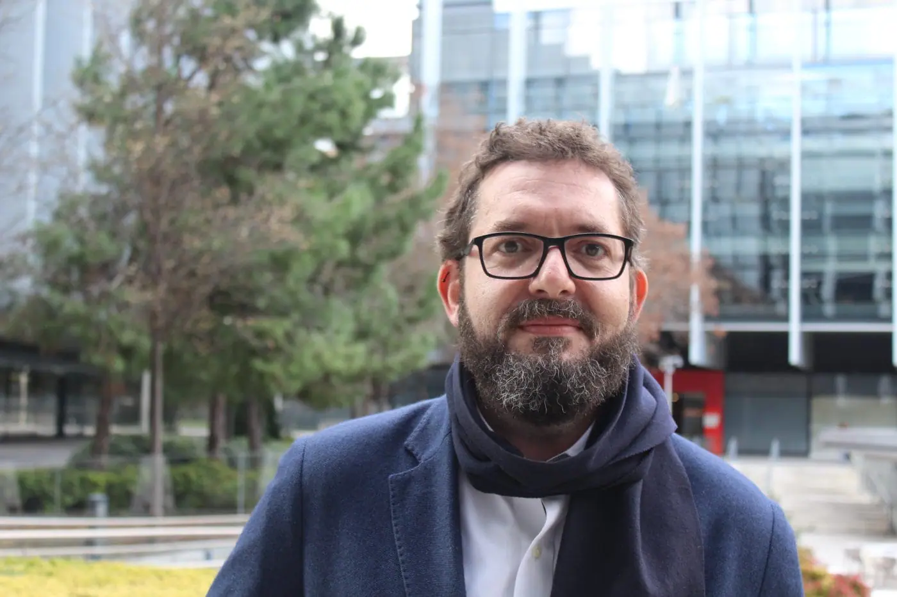
Remembering Manfredi
Manfredi Caltagirone, dedicated founder and leader of IMEO passed away in June
He was a big supporter for the CEOS-IMEO relationship and shared objectives

Slide 3
CEOS-IMEO heritage
UNEP’s IMEO exists to provide open, reliable and actionable information to individuals with the aim to reduce methane emissions
CEOS started to engage with IMEO in 2021, via SIT Chair Team (AU)
Objective is to get CEOS agencies and their data closer to the user – similar to GFOI
In June 2023, we organised a joint CEOS-IMEO Workshop in Harvard “International Coordination Workshop on Detection of Anthropogenic Methane Emissions from High-resolution Satellites”
Five IMEO working groups followed Harvard Workshop. They only met twice & then stalled
IMEO attended SIT-39 in Tokyo in April 2024
GHG TT (led by Yasjka) and SIT Chair Team upped engagement with IMEO in 2025 to push along our various ideas

Slide 4
Objectives today
Update on IMEO activities of interest - and the CEOS-IMEO collaborations in particular
Seeking agencies support and/or participation to progress on (some) of these aspects
Feedback and guidance

Slide 5
Topics
Tip-and-cue system & data requests to CEOS
Controlled release & observations database
IMEO WGs revitalisation
Methane best practices
CEOS-IMEO community workshop
AOB

Slide 6
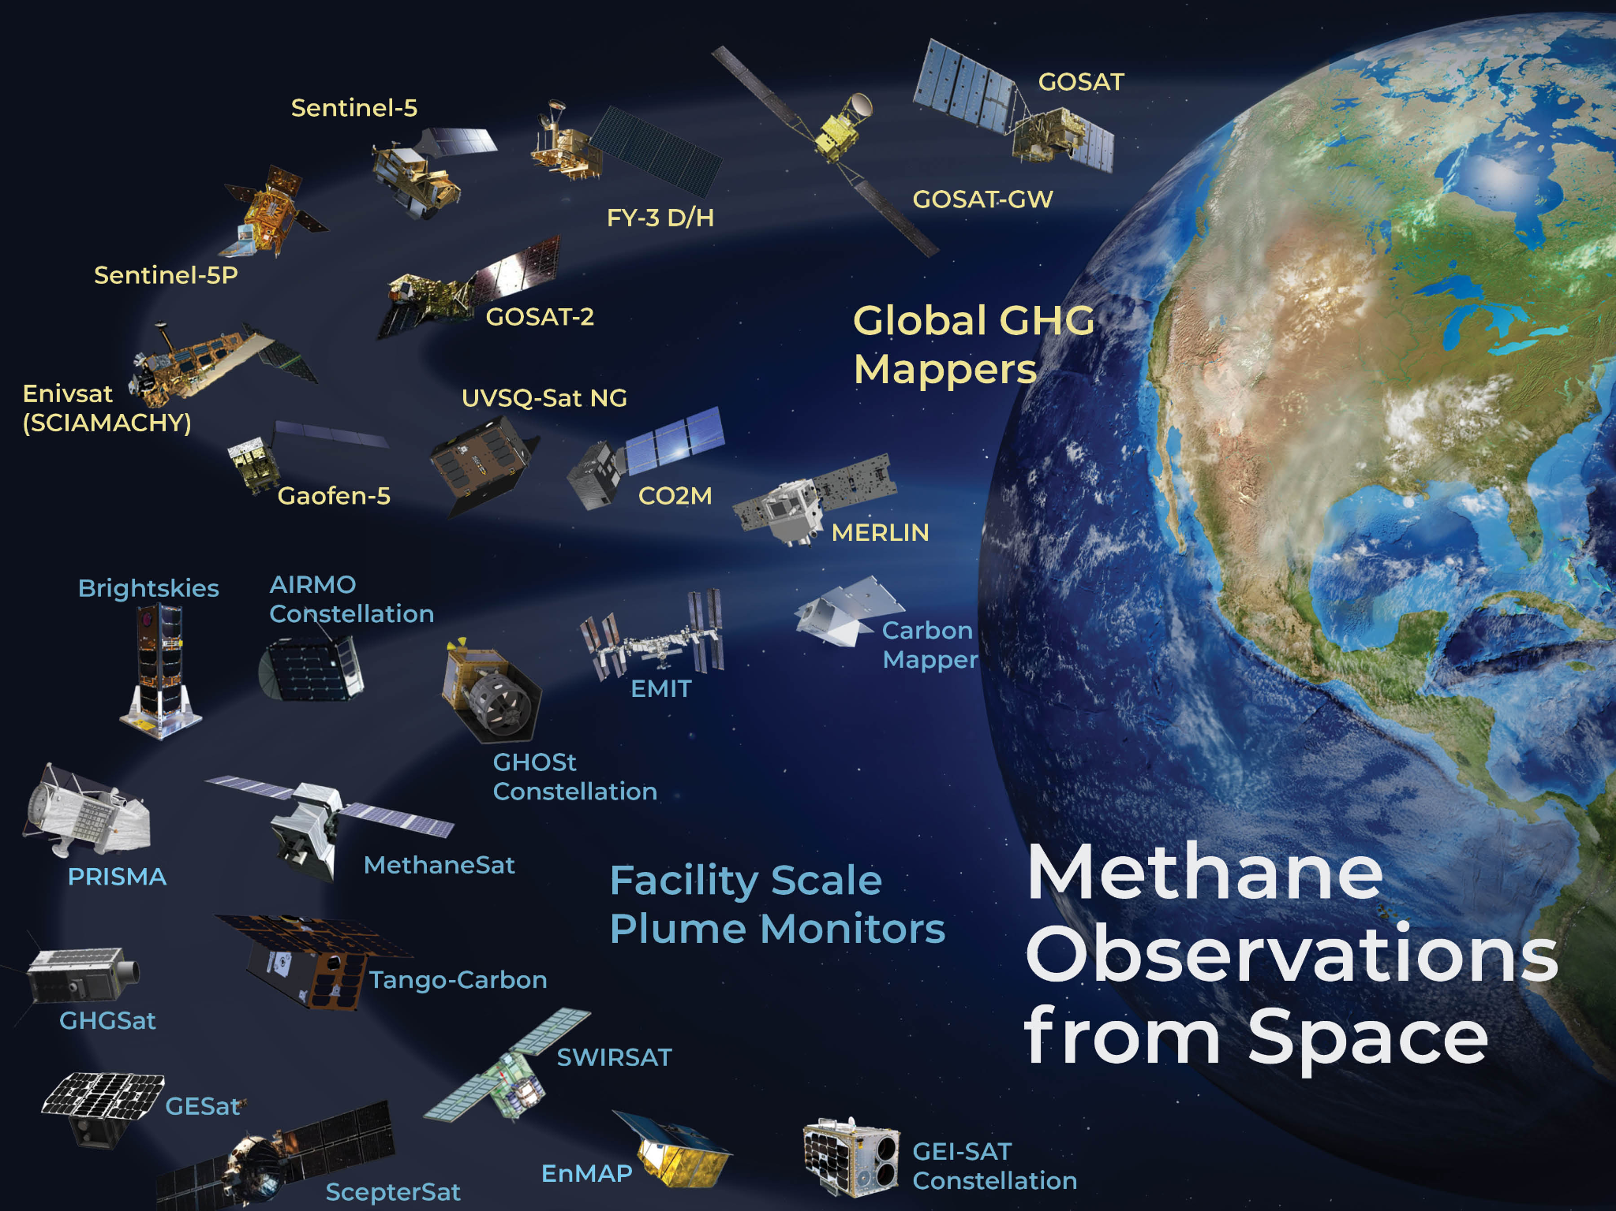
Tip and cue system – requests to CEOS
SIT Chair and GHG TT engaged with ASI and DLR to facilitate access to PRISMA and EnMAP
ASI: In dialogue with IMEO and CEOS SIT Chair team on PRISMA access (see slide 8)
DLR: in close communication with IMEO office
(see next slide)

Slide 7
EnMAP - IMEO
EnMAP has been identified for the provision of methane source information.
Its value has been demonstrated by U. of Valencia during the past.
Exchange between IMEO and EnMAP mission manager works well
Currently, IMEO has defined area of interests which are included in a tasking scenario to serve as best as possible (priority etc.).
Caveat: Some hand-work is needed; some delay between tasking and pick-up.
Work on a semi-automatic solution in cooperation with IMEO:
Pre-requisites /needs of IMEO identified
Discussion with DLR G/S team about the how to implement an effective solution
Baseline is not the official G/S archive, but the DLR-Geoservice platform, which currently allows the access to Level 2a standard products (at present land processor only)
Planning of IMEO extension to pick-up Level 1b is there
Currently, in Germany all budgets are preliminary and do not allow extra contracts
Should be included during mission extension, latest

Slide 8
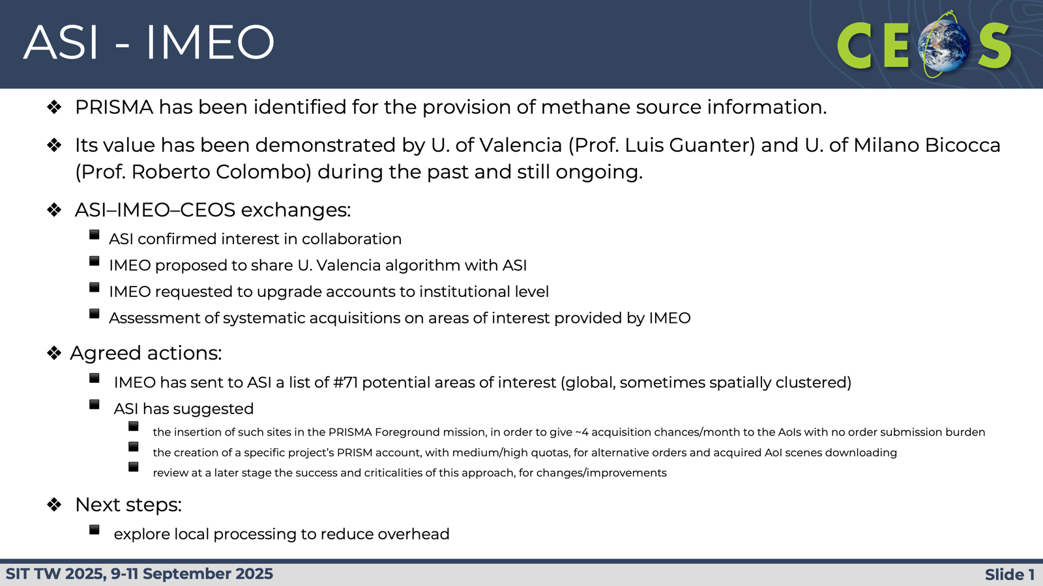
ASI - IMEO
PRISMA has been identified for the provision of methane source information.
Its value has been demonstrated by U. of Valencia (Prof. Luis Guanter) and U. of Milano Bicocca (Prof. Roberto Colombo) during the past and still ongoing.
ASI–IMEO–CEOS exchanges:
ASI confirmed interest in collaboration
IMEO proposed to share U. Valencia algorithm with ASI
IMEO requested to upgrade accounts to institutional level
Assessment of systematic acquisitions on areas of interest provided by IMEO
Agreed actions:
IMEO to send list of all potential areas of interest (global)
ASI to evaluate feasibility and suggest best approach
Possible increase of PRISMA data, subject to the results of feasibility analysis
Next steps:
assessment of IMEO areas of interest list
explore local processing to reduce overhead

Slide 9
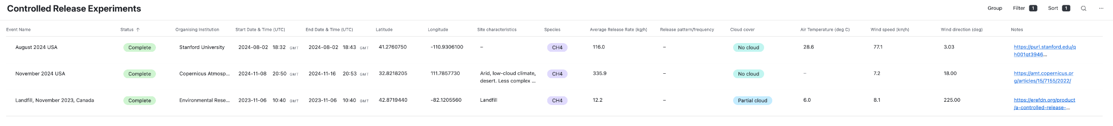
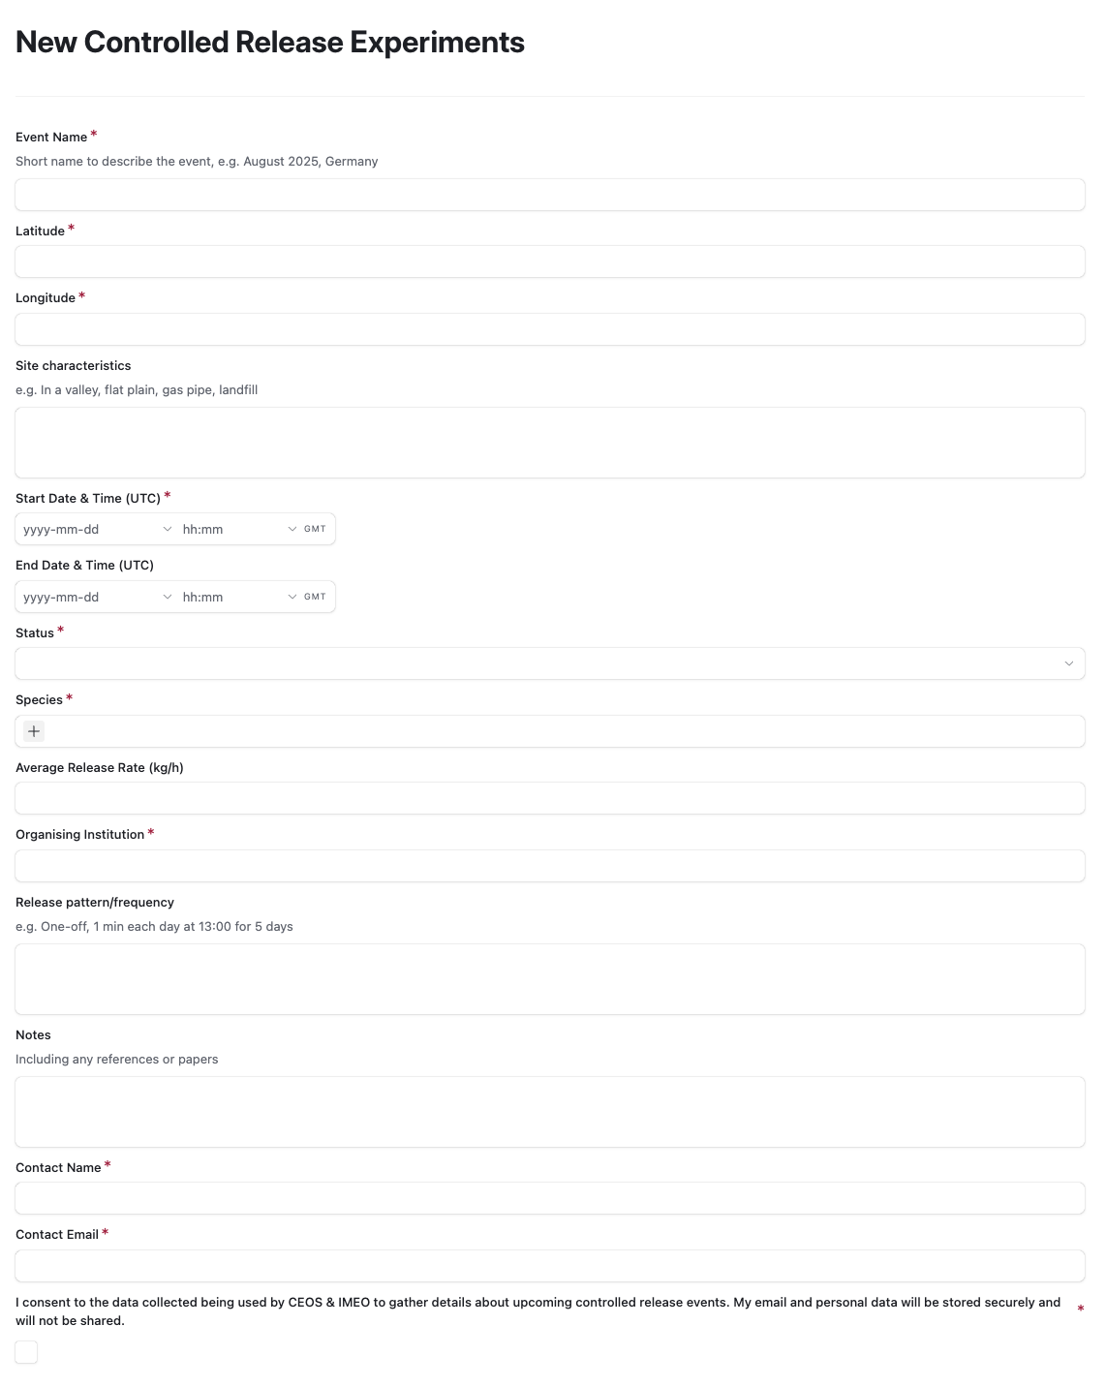
Controlled release experiment database
Online Table of Past & Planned Experiments
Will be hosted at ceos.org/ghg/experiments
Beta table here
Form to submit new experiments
Link here
Anyone can submit, submissions are approved by database managers
Mailing list & automated notifications
controlled-release-database@googlegroups.com (join here)
Once a new experiment is approved, an email is sent to the mailing list to notify satellite operators
A notification is also sent 7 days prior to a planned event
A notification is sent to the database managers 7 days after a planned event, to contact the organisers for updated information on the event

Slide 10
WG Revitalisation (Yasjka)
IMEO WGs from Harvard meeting are considered still very relevant
GHG TT initiative to revitalise under CEOS leadership (co-lead with IMEO)
Stepwise approach: Use Case WG first, Roadmap WG to follow (and other to be assessed later)
Use Case WG output
Detailed use cases showing various source sectors & varying stakeholder needs
Connect these to (current) EO capabilities
KO meeting was held on 11 March (Use Cases)
Most progress will follow through a shared document.
Use Case document will be used to revitalise the Roadmap WG enabling it to set priorities
Roadmap WG to follow around August-September 2025

Slide 11
CH4 best practices (Paul)
IMEO review provided on draft with helpful ideas
Hopes for IMEO roles
Support the publicity effort in Q3-Q4 2025, and align activities towards COP30
Support the engagement with producers and users (for O&G fugitive methane)
Promote into IMEO-funded research projects
Input into roadmap beyond O&G fugitive methane, e.g. area mappers and diffuse sources
IMEO badge?
Next steps

Slide 12
IMEO-CEOS community workshop in 2025
Why, when and where?
Initial idea is to have the workshop to discuss the Use Case WG output and initial Roadmap priority settings.
WG output required to progress beyond Harvard WS →→ in Q4 2025
In Europe, two potential locations are offered (ECSAT/Harwell, SRON/Leiden)
Objectives
Discuss output of WGs
Confirm/agree on priorities and required next steps

Slide 13
Next steps
Proceeding with Use Case WG and initial use cases
Participation still welcome
Finalise best practices and work with IMEO (et al) on adoption
Progress controlled release and obs database with IMEO - link to CEOS GHG Portal
Work with ASI/DLR/JAXA/JMA on tip and cue data access & support
Agencies with active methane detection algorithms invited to notify GHG TT lead (Yasjka Meijer)
Late 2025 CEOS-IMEO workshop arrangements will be advised

