Slide 1
SIT Technical Workshop 2025 CEOS Interoperability Handbook Version 2.0 Update
Tom Sohre & Nitant Dube,
WGISS
Agenda Item #5.1
SIT TW 2025
Darmstadt, Germany
9-11 September, 2025

Slide 2
CEOS Interoperability Handbook V 2.0
Objective
CEOS Interoperability Handbook Version 2.0 should provide guidance to the organizations for development of Interoperable Data and Services and help them in measuring their maturity level
Completed and Plan for Endorsement during CEOS Plenary 2025
Will be taken up as part of WGISS Work Plan for 2026
Will be taken up as part of WGISS Work Plan for 2026 and 2027
Interoperability Handbook V2.0
Maturity Matrix
Interoperability Demonstrators

Slide 3
Interoperability Handbook 2.0
Chronology of Events
Event | Date
Interoperability Handbook Version 1.0 | Feb 2008
Initial Idea/ Recommendation | CEOS Plenary 2022
Discussion on Draft Roadmap and Factors | SIT-38 March 2023
Framework endorsement | Plenary 2023
Identification of Factor Leads and Discussions with CEOS Working Groups | WGISS-57 and WGISS-58 2024
Detailed Discussion of Each Factor | WGISS-59 (March 2025)
Release of Draft Handbook for Public comments | April 2025
Presentation to SIT-TW | Sept 2025
Final Review WGISS-60 | Oct 2025
Endorsement by Plenary (Planned) | Nov 2025

Slide 4
Interoperability Handbook 2.0
Contributors for Factors
Interoperability Handbook Factors | Factor Lead | Linkages to CEOS Work
Quality | Cody Anderson (USGS, WGCV) | CEOS CAL/VAL Portal, RadCalNet and SARCalNet sites, QA4EO, CEOS-FRM
Vocabulary | Peter Strobl (EC-JRC, LSI-VC) | CEOS common Dictionary
Architecture | Alex Leith (Auspatious,SEO) Mirko Albani (ESA, WGISS) | CEOS ARD, Data Preservation and Stewardship, Persistence Identifiers
Interface | Damiano Guerrucci (ESA, WGISS) | CEOS Connected Data Assets, OpenSearch, STAC
Policy | SEO, CEO and WGISS | MIM Database, FAIR, OGC Standards, Open Data, Open Science, Open Source Software
Public comments
OGC
CEOS-COAST
NASA
NPL
DLR
Contributors on Github
30
Overall coordination: Tom Sohre (USGS) & Nitant Dube (ISRO)

Slide 5
Interoperability Handbook on Github
In-line with CEOS recommendation of using Github for publishing documents and code, Interoperability Handbook is completely developed and maintained on Github
Document is Live now and will provide capability for periodic changes and feedback by larger community
Allows users to track changes and replicate the active repositories
Analytics on usage and Activities on the Document

Slide 6
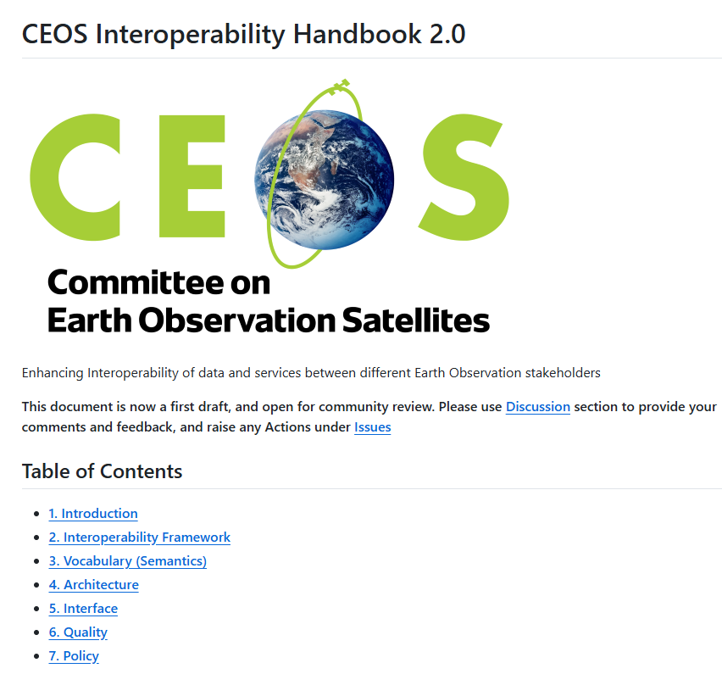
Handbook on github
The Interoperability Handbook 2.0 is now available on github
Chapters
Chapter-1 : Introduction
Chapter-2: Interoperability Framework
Chapter-3: Vocabulary (Semantics)
Chapter-4: Architecture
Chapter-5: Interface (Accessibility)
Chapter 6: Quality
Chapter 7: Policy
Chapter-8: Conclusion
https://github.com/ceos-org/interoperability-handbook

Slide 7
Recommendations

Slide 8
Vocabulary
Major Contribution by: LSI-VC
Promote Development of Community Thesaurus
CEOS Common dictionary (CEOS/KCEO) being developed on github
Controlled Vocabularies with lookup of keywords via Linked Data Principles
Semantic (6)
Vocabulary
Thesaurus(8)
Base, Core, Controversial and High Impact terms
Circular definitions
Explanations with Notes providing reference to Source document
Version Control at Individual Term Level
Contradictory/alternative definitions and explanations

Slide 9
Architecture
Major Contribution by: SEO, WGISS
Open Archival Information System (OAIS) Reference Model
CEOS Data Appraisal Procedure
Shared Collection Lifecycle Management Principles for EO data
Preservation (9)
Architecture
Data and Metadata (11)
CEOS ARD Framework
CEOS EO collection and Granule discovery Best practices with STAC
CEOS Persistent Identifiers Best Practice
Publishing (5)
Discovery and accessibility of data through metadata
STAC geoparquet
ZARR and Cloud Optimized Geotiff
Cloud Interoperability

Slide 10
Interface
Major Contribution by: WGISS
CEOS STAC Collection and Granule Discovery Best Practices
CEOS Open Search Best Practices
CEOS Service Discovery Best Practices
Data Discovery (10)
Interface
Data Access (3)
S3 (Simple Storage Service
HTTPS based access
Cloud Optimized GeoTiff
Authentication and Authorization (3)
OpenID Connect
OpenAPI 3.0

Slide 11
Quality
Major Contribution by: WGCV
Community Calibration through CEOS WGCV, WMO GSICS, JACIE and VH-RODA
CEOS-FRM
CEOS Cal/Val sites RadCalNet and SARCalNet
QA4EO
ESA/NASA/USGS Mission quality Assessment Framework
JACIE Best Practices document
CEOS Cal/Val Portal
Quality
Calibration and Validation (9)

Slide 12
Policy
Major Contribution by: WGISS, CEO, SEO
Engagement with CEOS, GEO and CGMS
Policy Audit
CEOS MIM Database
Open Standards and Specifications
Open Data
Open Source Software
Open Science
Data Licensing
Data Procurement from 3rd Party
Data Preservation
Purge Alert
Policy
Policy (12)

Slide 13
Interoperability Maturity Matrix (2026)
Interoperability Maturity Matrix is an Assessment tool that
Help users to measure how well interoperability factors are implemented in their organization
Monitor progress of interoperability implementation with time
Identify barriers and area of improvement for interoperability of Earth Observation Data and Services

Slide 14
Interoperability Demonstrators (2026-2027)
EOPnP: Development of Plug and Play modules to demonstrate interoperability best practices
Discovery and access of Earth observation data
Data Analytics
Interoperability of Surface reflectance (ARD) ( Joint work with WGCV)
Decision Ready Data (Joint work with WGDisaster)

Slide 15
Thanks nitant@sac.isro.gov.in tsohre@usgs.gov
Feedback and comments if any can be communicated by 30th Sept 2025 for discussions during WGISS-60 from Oct 13th to Oct 17th 2025

