Slide 1
CEOS Common Dictionary An EO community glossary
Dominik Weckmüller Engineering Ingegneria Informatica S.p.A. for the Knowledge Centre on Earth Observation
European Commission -JRC
Agenda Item 5.2
SIT TW 2025
Darmstadt, Germany
9-11 September, 2025

Slide 2
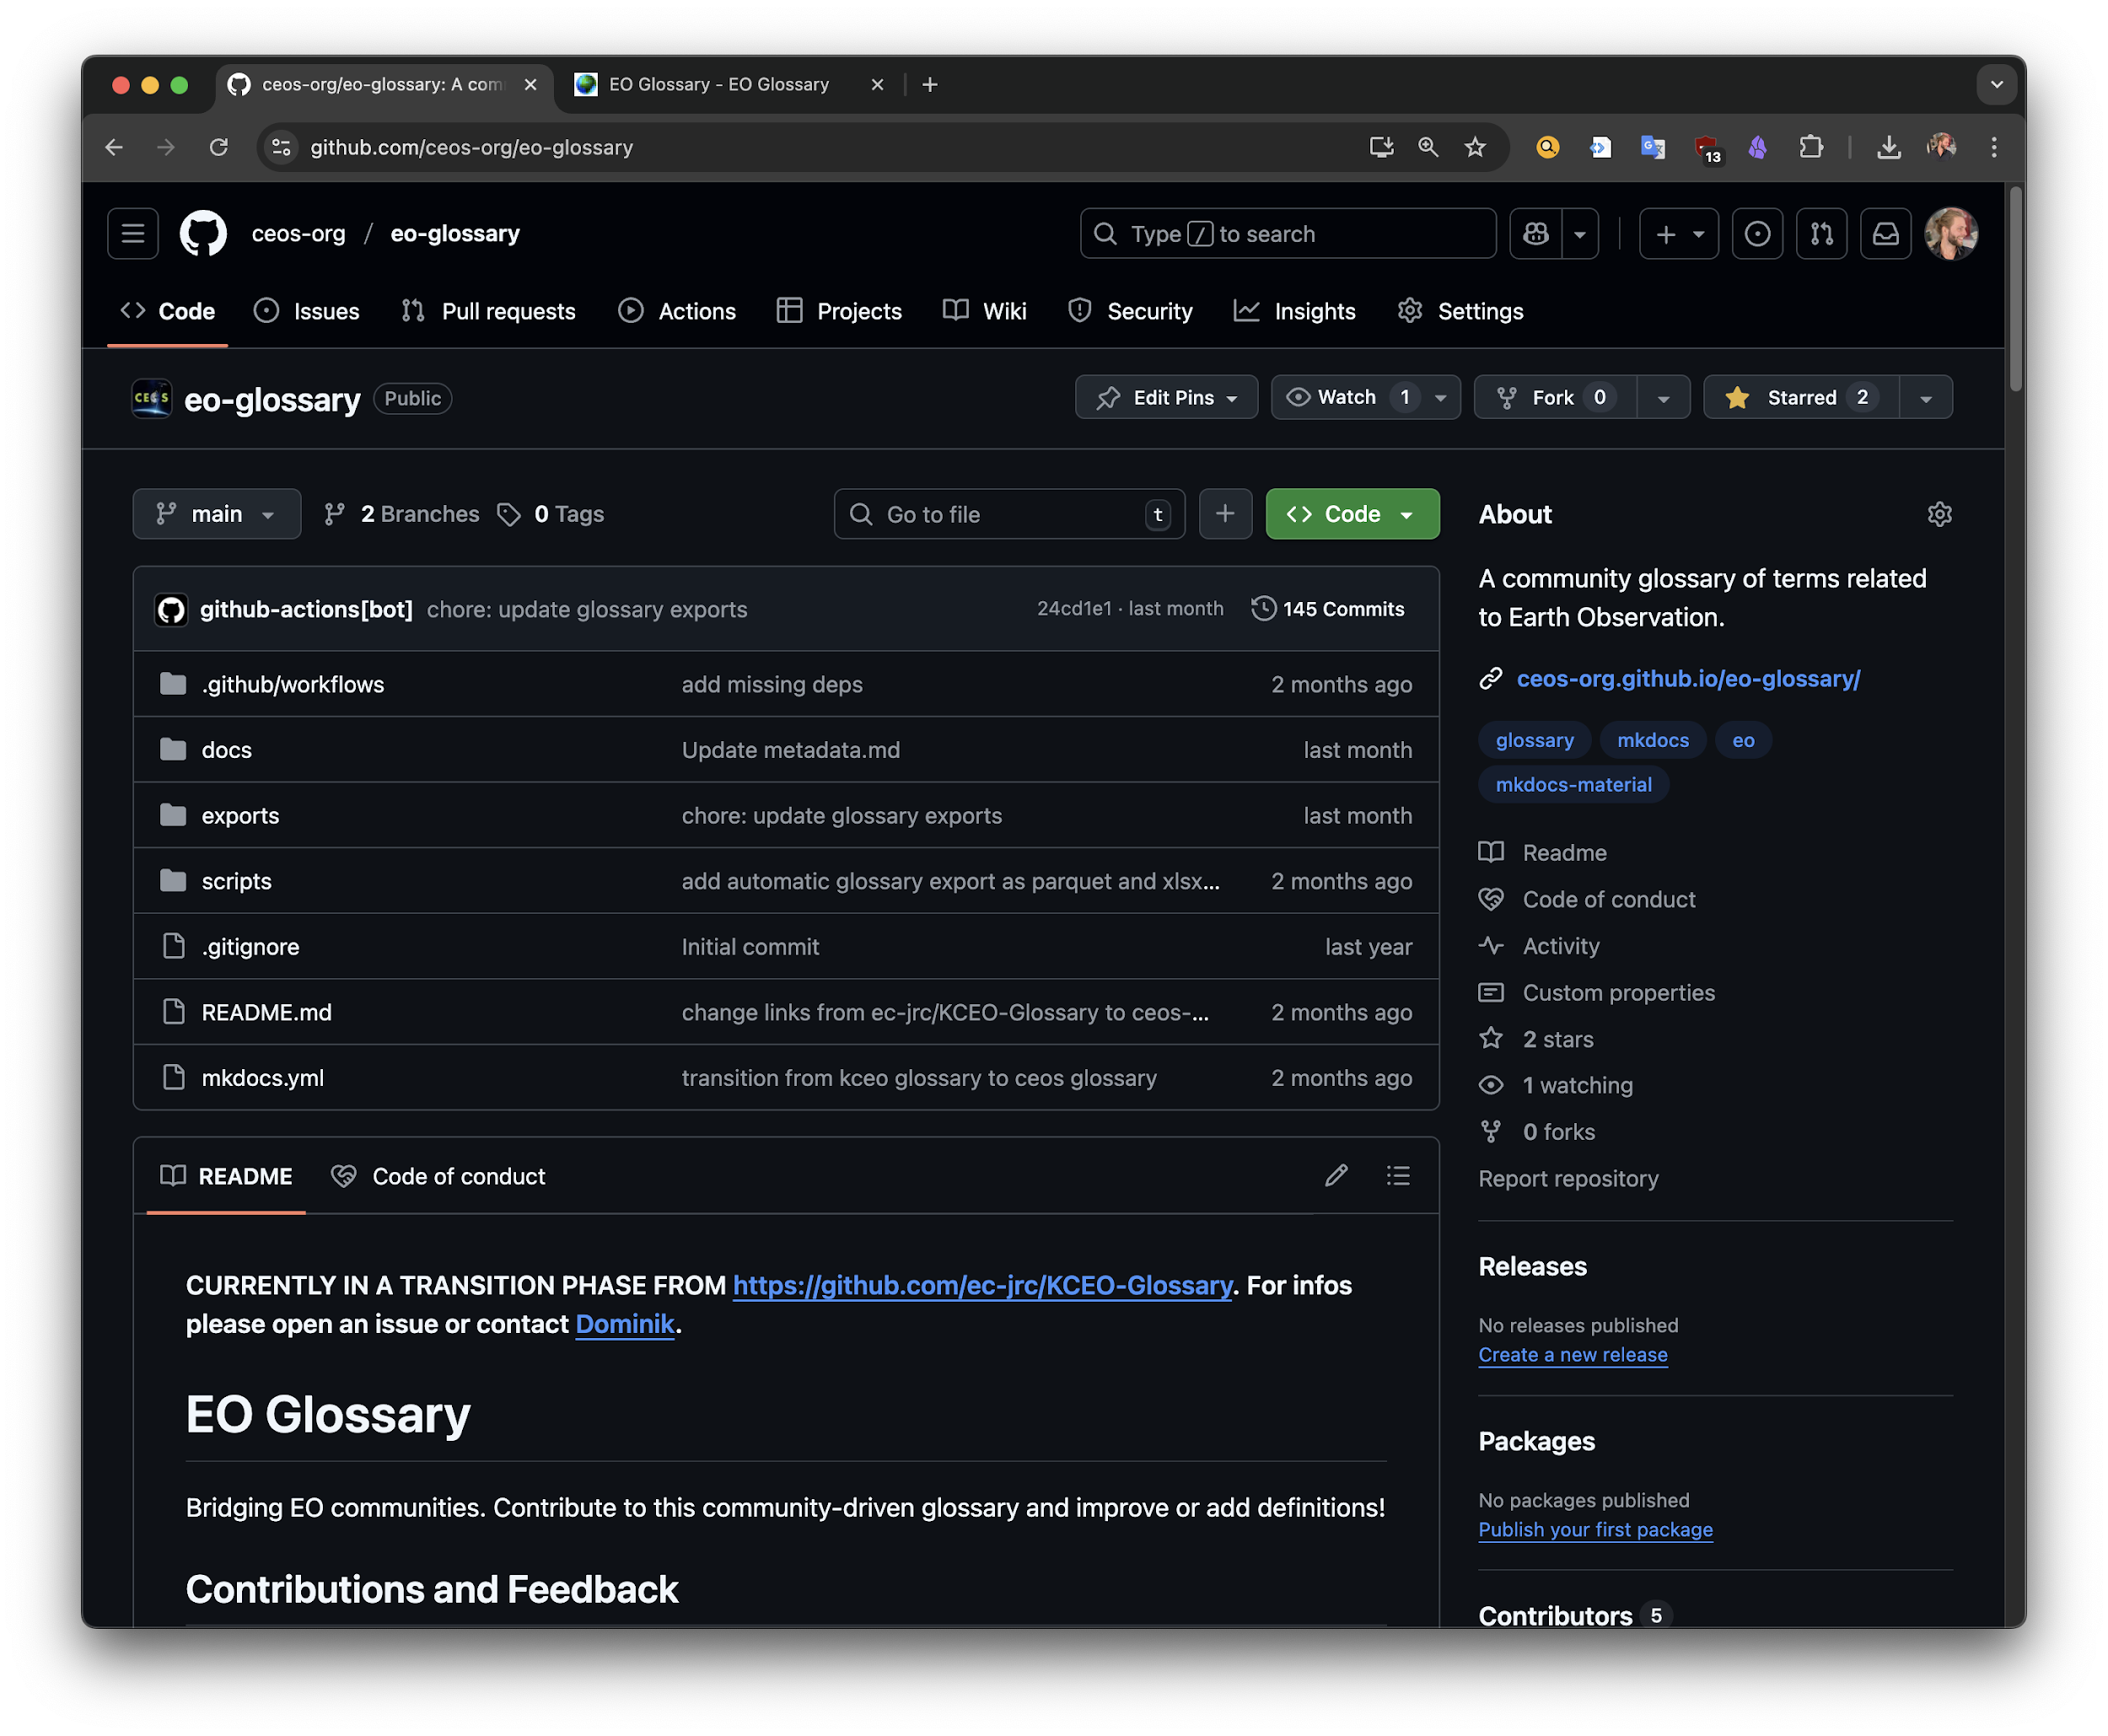
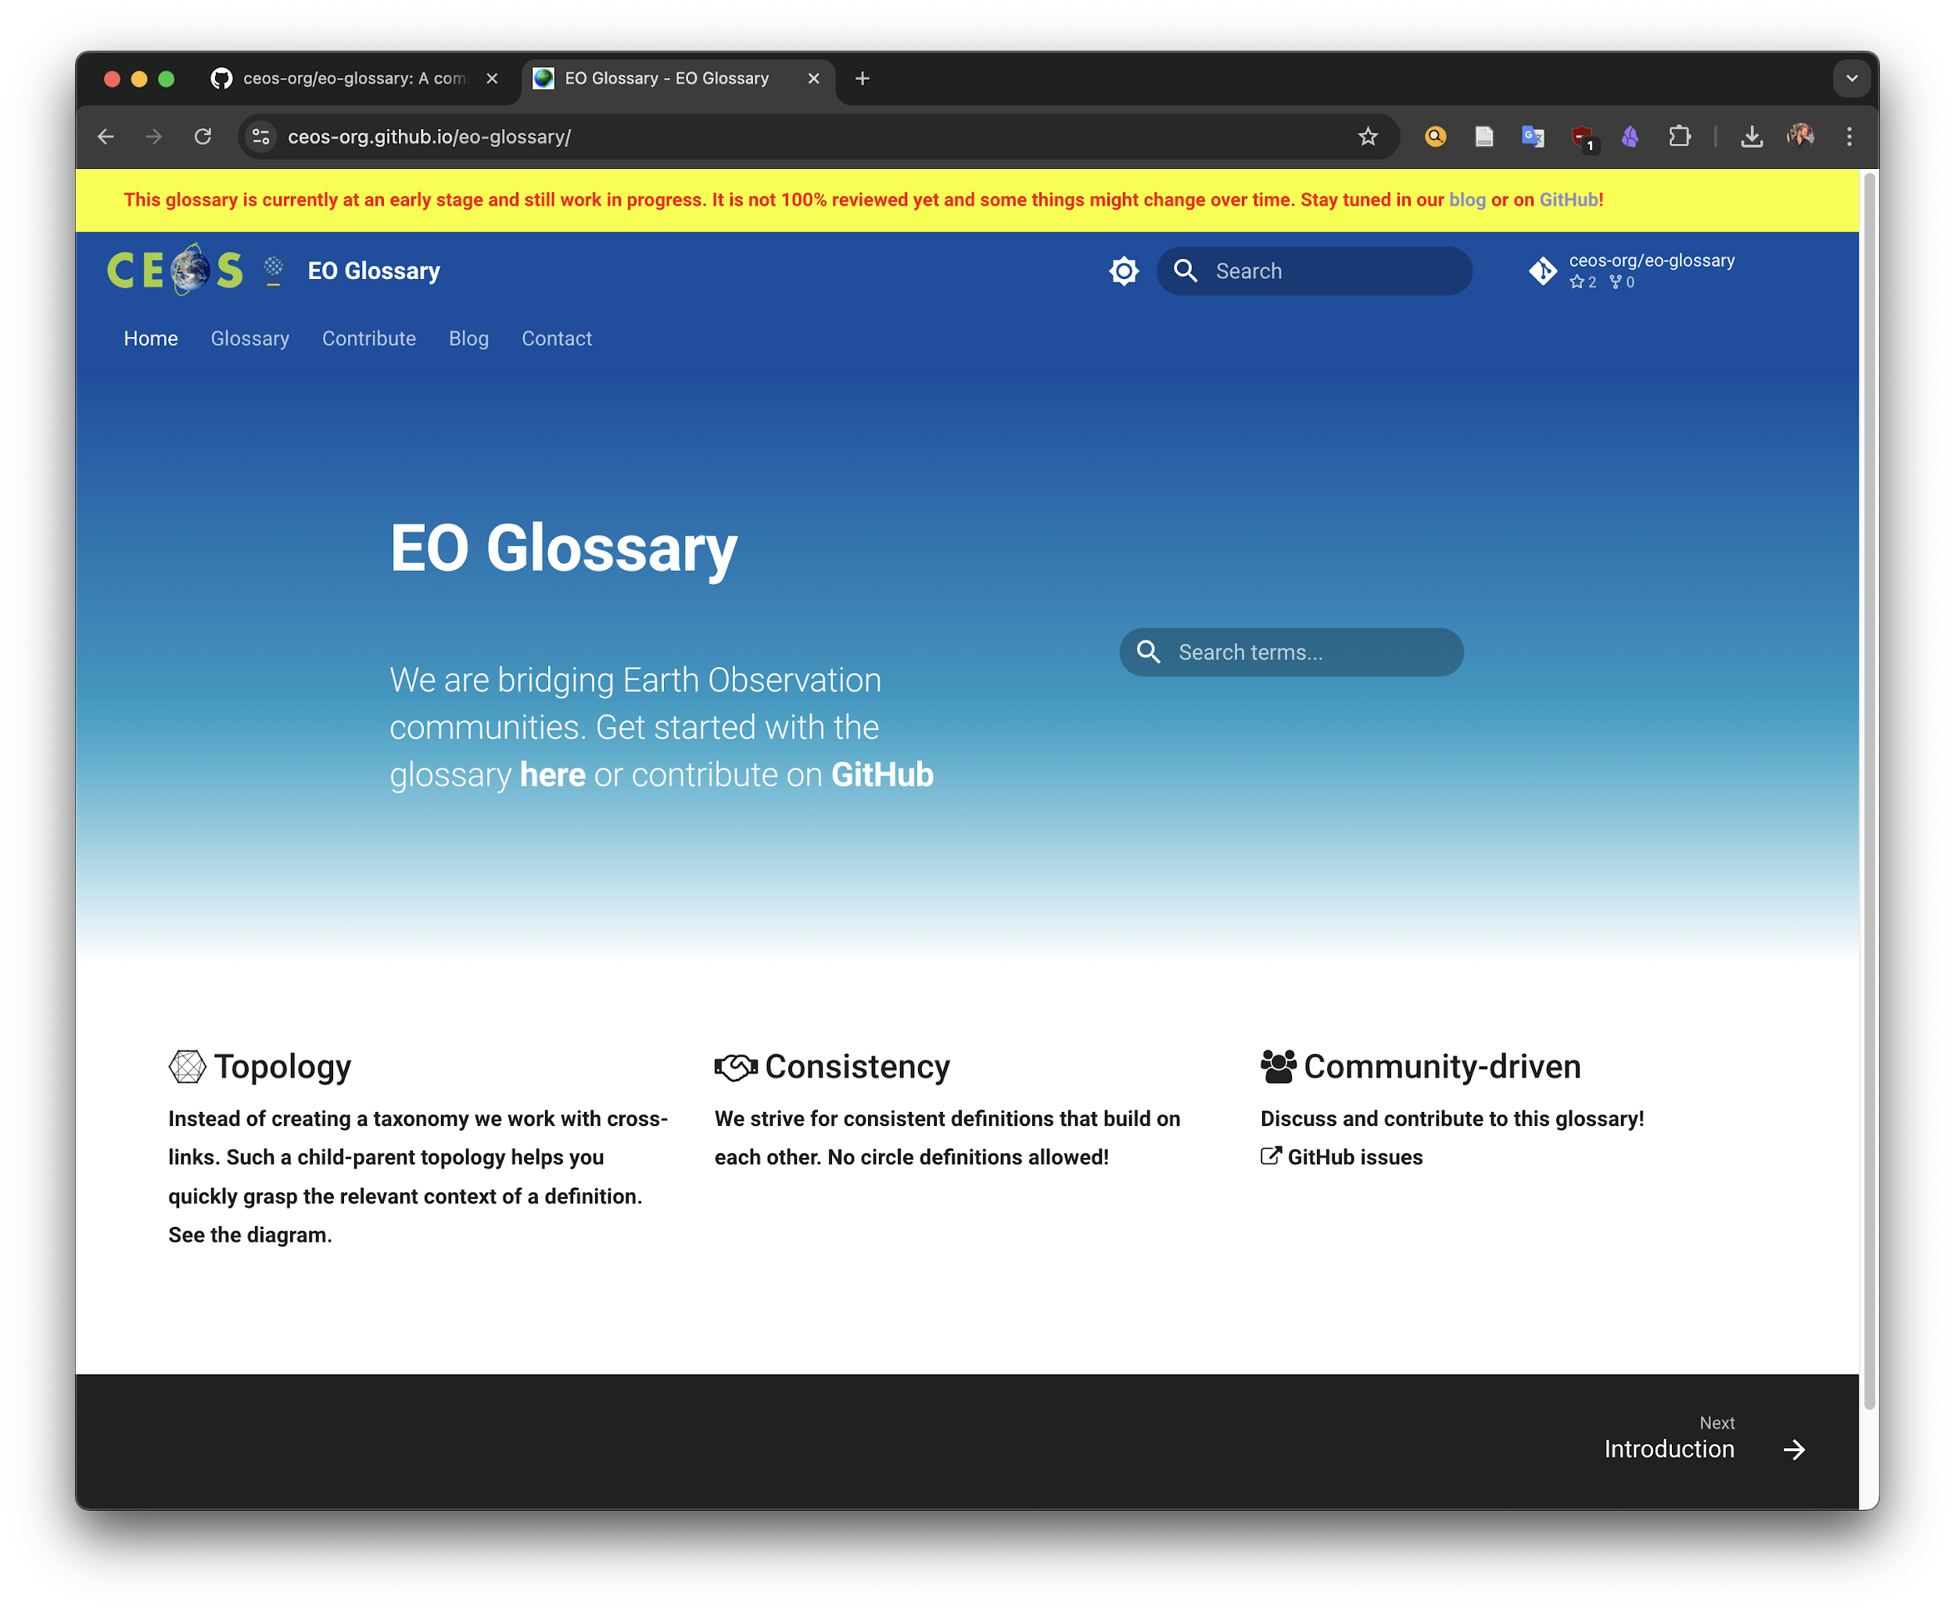
It’s live!
https://ceos-org.github.io/eo-glossary/

Slide 3
Outline
Principles
Technicalities
Connection to the Interoperability Handbook
Workflow
Action Points / Discussion

Slide 4
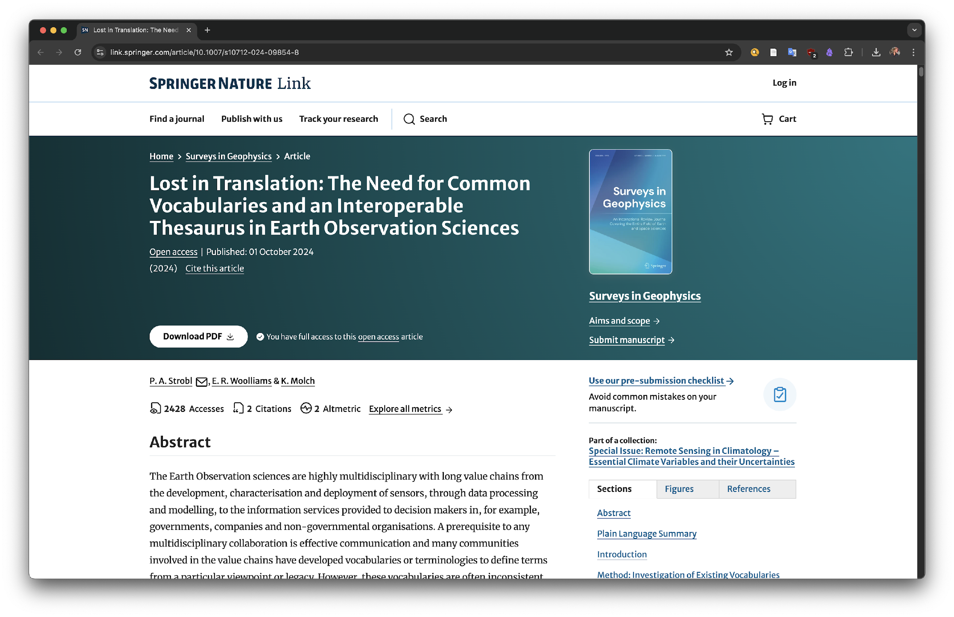
1.1) Principles: Origin
Strobl, P. A., Woolliams, E. R., & Molch, K. (2024). Lost in Translation: The Need for Common Vocabularies and an Interoperable Thesaurus in Earth Observation Sciences. Surveys in Geophysics, 1-29. https://link.springer.com/article/10.1007/s10712-024-09854-8

Slide 5
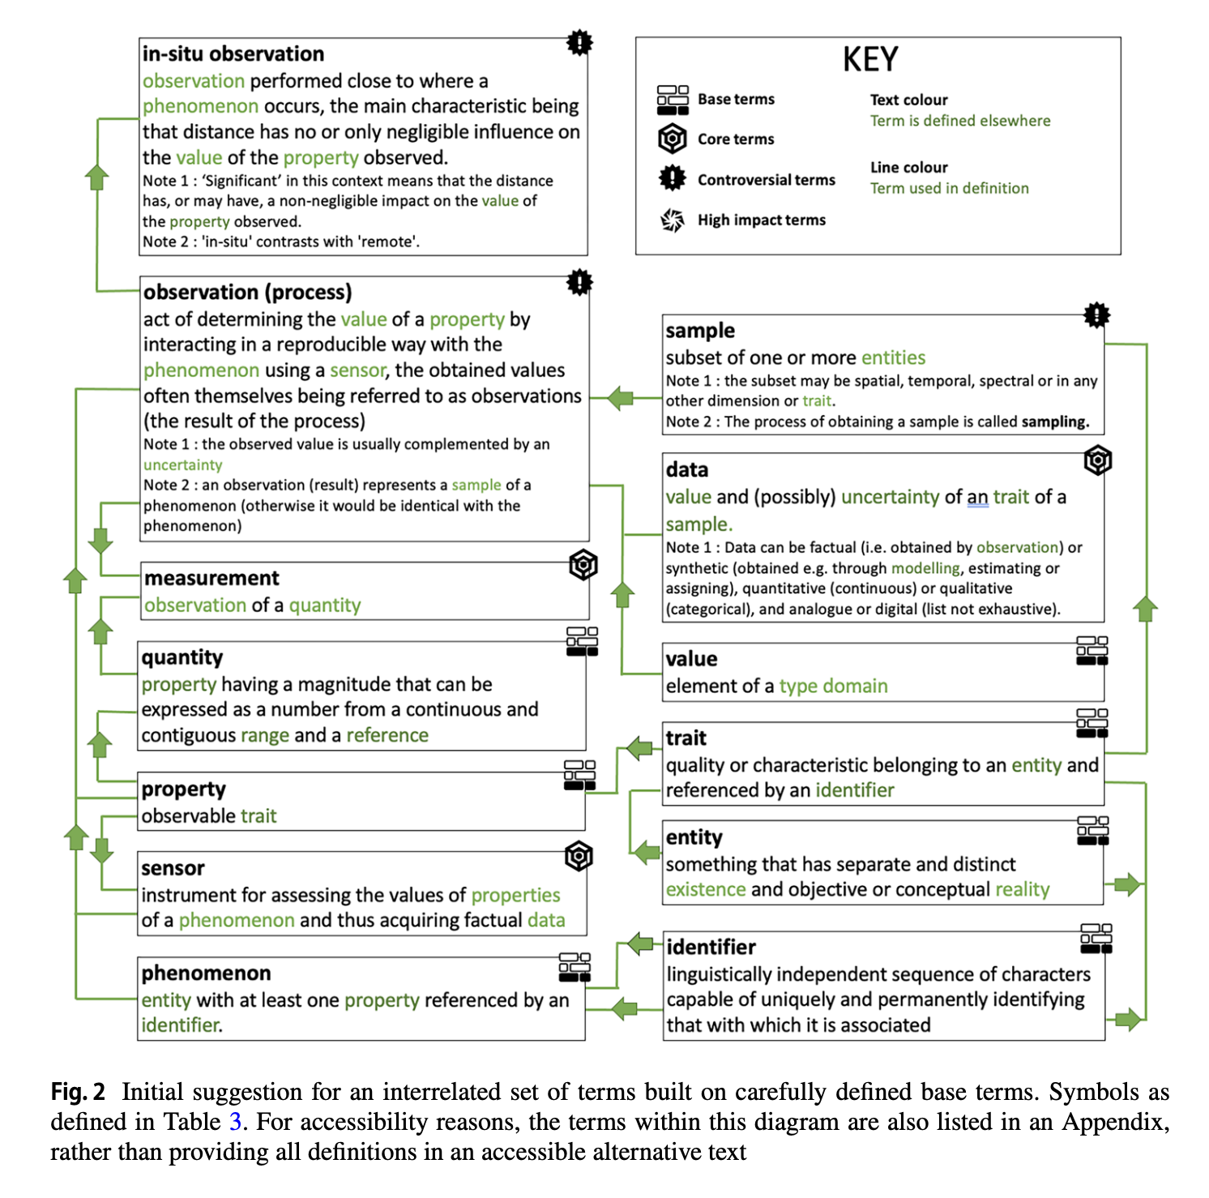

1.2) Principles: No circle definitions
1. Avoid circular definitions at all cost.
Instead, build on well-defined base terms.
Strobl, P. A., Woolliams, E. R., & Molch, K. (2024). Lost in Translation: The Need for Common Vocabularies and an Interoperable Thesaurus in Earth Observation Sciences. Surveys in Geophysics, 1-29. https://link.springer.com/article/10.1007/s10712-024-09854-8

Slide 6
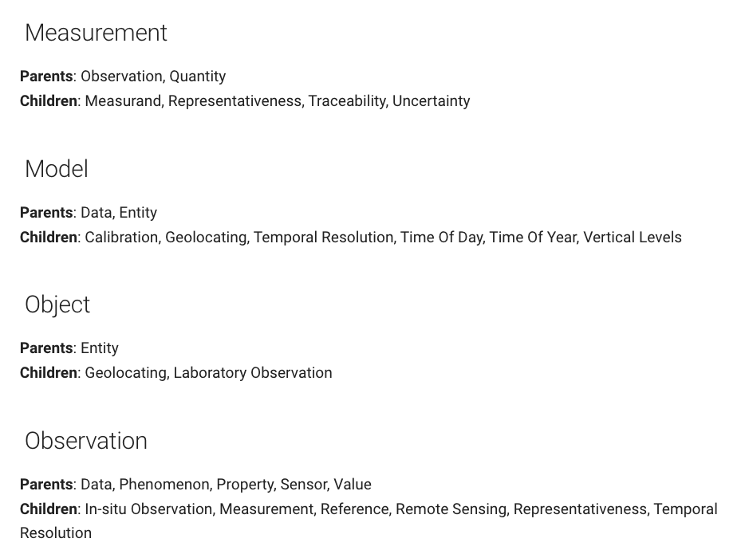
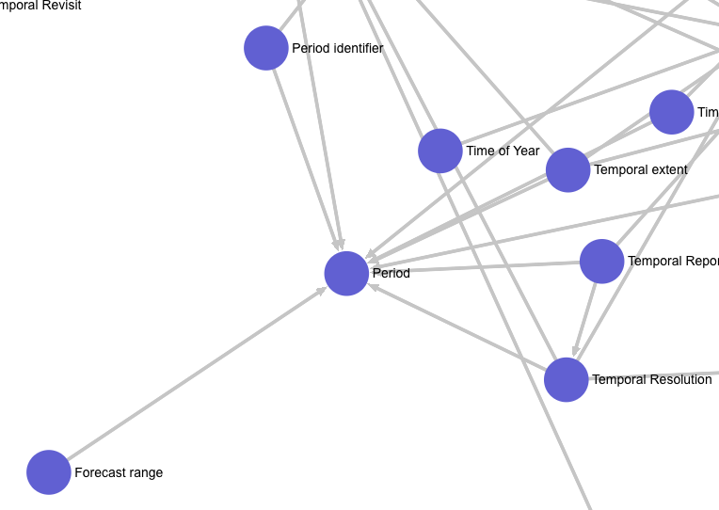
1.2) Principles: No circle definitions
Instead: Parent-Child relations
https://ceos-org.github.io/eo-glossary/glossary_topology/#measurand

Slide 7
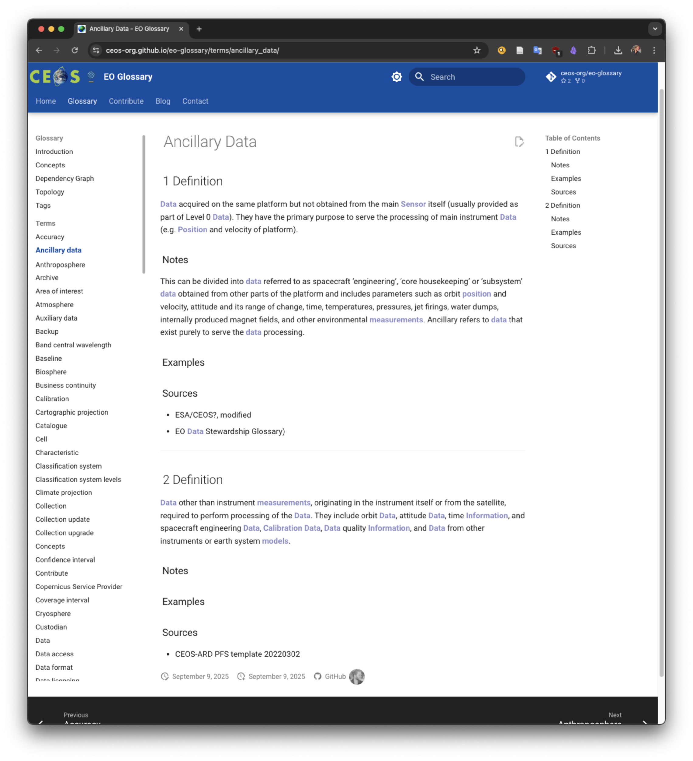
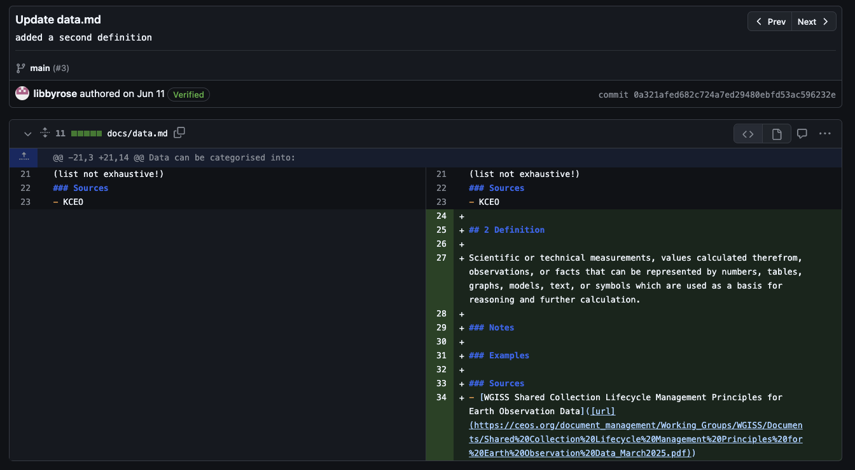
1.3) Principles: Diff. Definitions
Multiple different definitions are allowed if needed. The first definition is the most important one.
https://github.com/ec-jrc/KCEO-Glossary/pull/3/commits/0a321afed682c724a7ed29480ebfd53ac596232e https://ceos-org.github.io/eo-glossary/terms/ancillary_data/

Slide 8
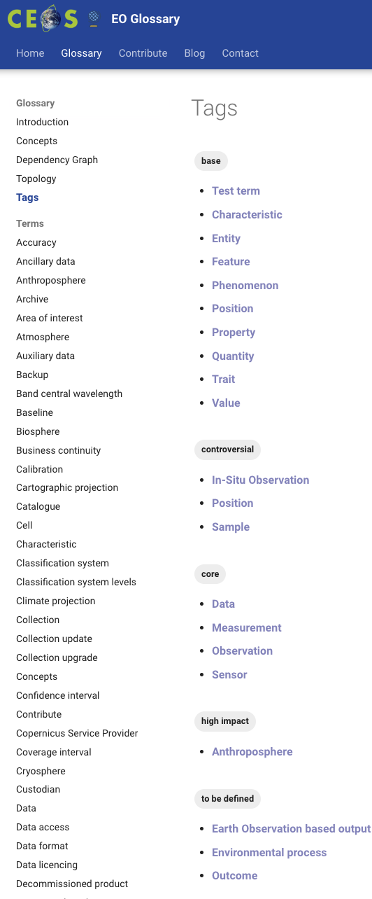
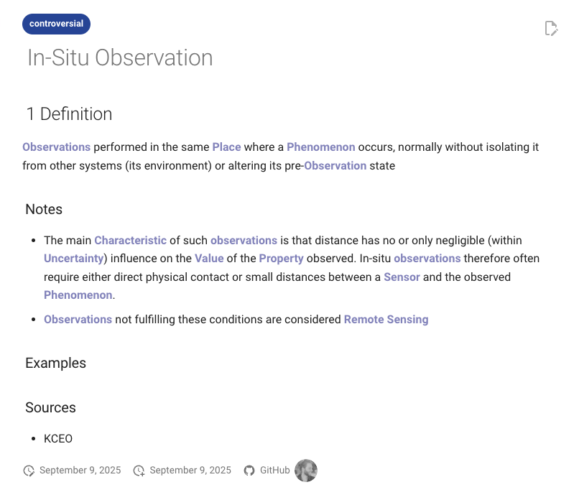


1.3) Principles: Tagging System
3. Tagging System
base term
core term
controversial term
high impact term
https://ceos-org.github.io/eo-glossary/tags/ https://ceos-org.github.io/eo-glossary/terms/in-situ_observation/

Slide 9
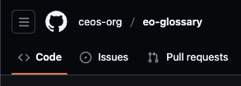

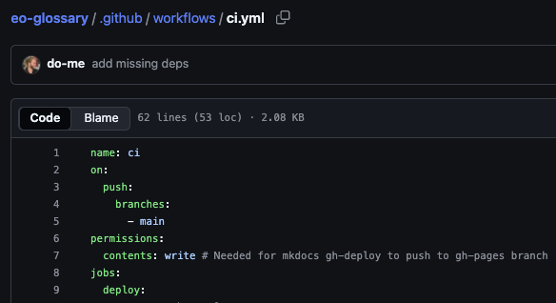
2) Technicalities
Hosted on GitHub & GitHub Pages for free
Mkdocs-Material (Python): markdown 🡪 html
CI workflows with custom scripts for extracting parent-child relations

Slide 10
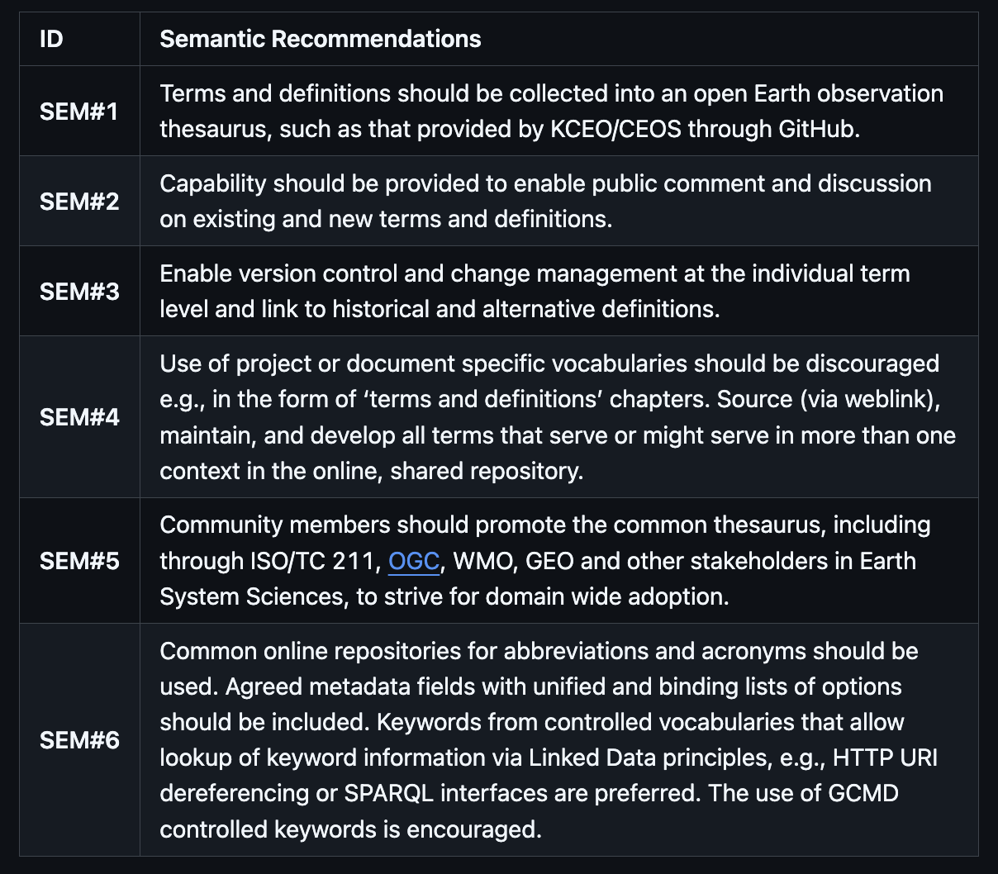
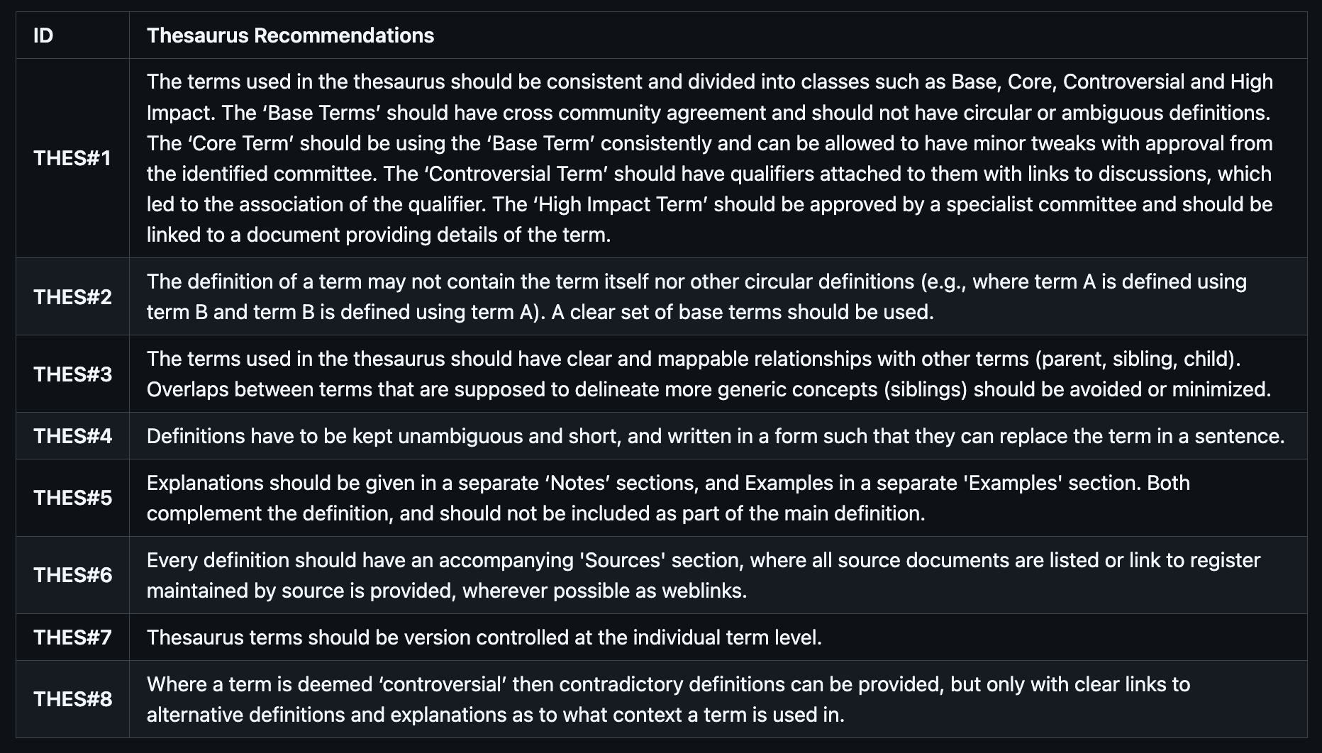
3) CEOS Interoperability Handbook 2.0 Vocabulary (Semantics)
https://github.com/ceos-org/interoperability-handbook/blob/main/Vocabulary.md

Slide 11
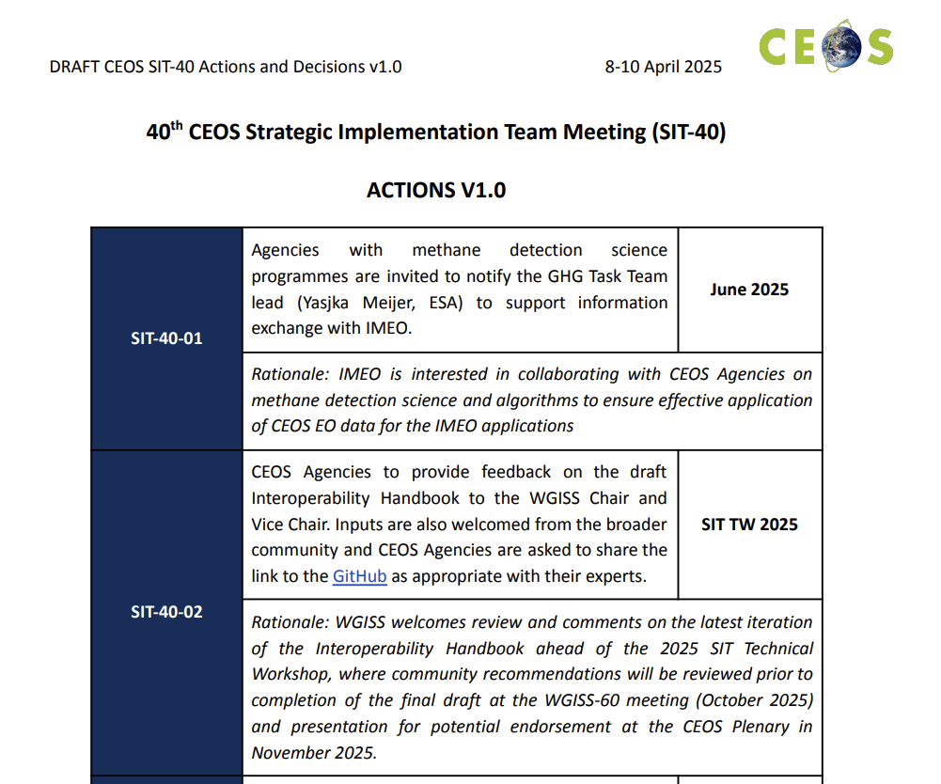

3) CEOS Interoperability Handbook 2.0 Vocabulary (Semantics)
40th CEOS Strategic Implementation Team Meeting (SIT-40)
“7. Review the update of the CEOS Interoperability Handbook (v2.0) before its presentation for potential endorsement at the 2025 CEOS Plenary. Discuss the long-term vision for implementation and actions for community uptake.“
Action Point: Endorsement!
https://ceos.org/document_management/Meetings/SIT/SIT-40/Minutes/CEOS%20SIT-40%20Actions%20and%20Decisions%20V1.0.pdf

Slide 12
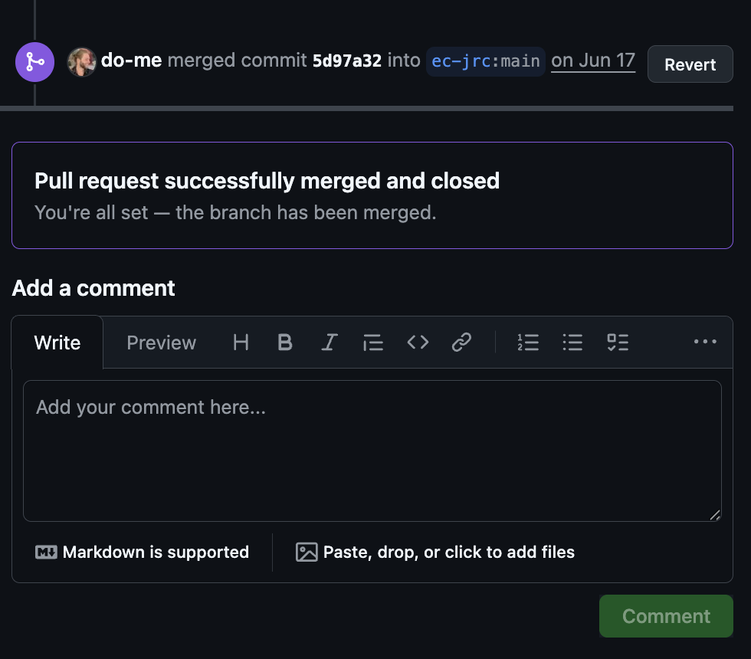
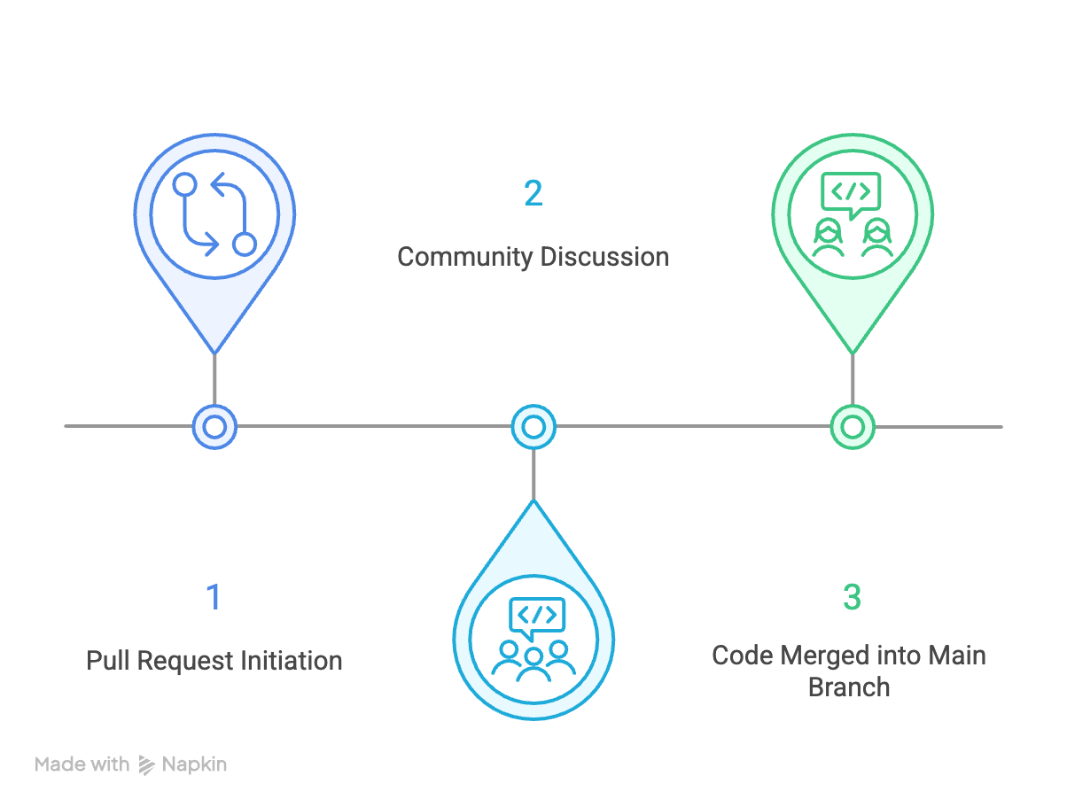
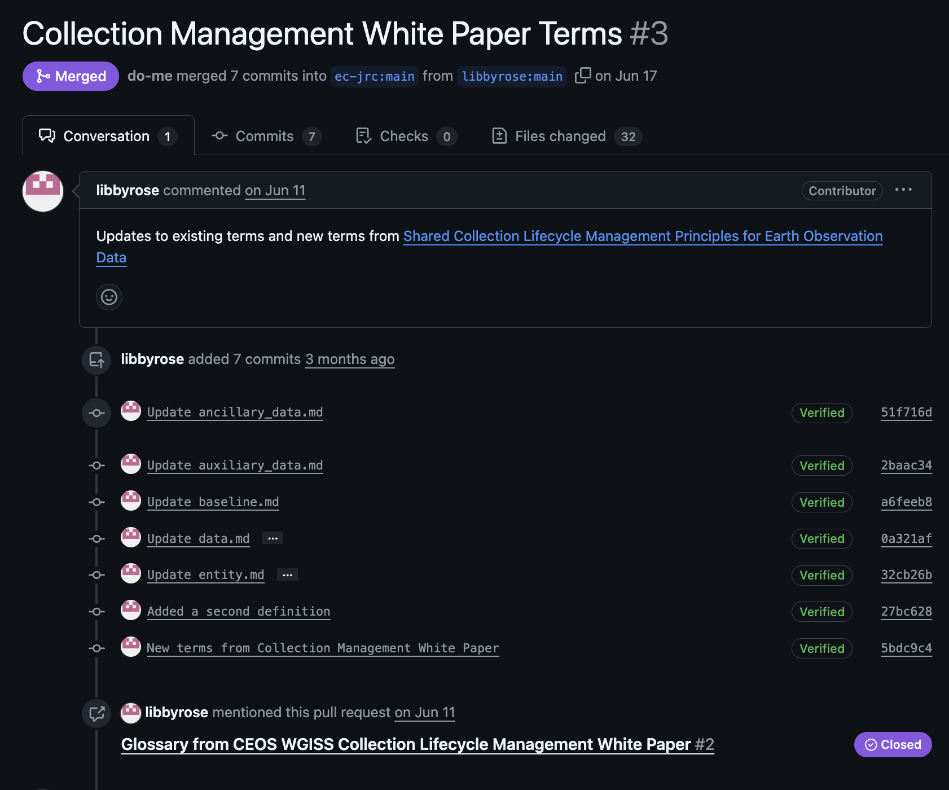
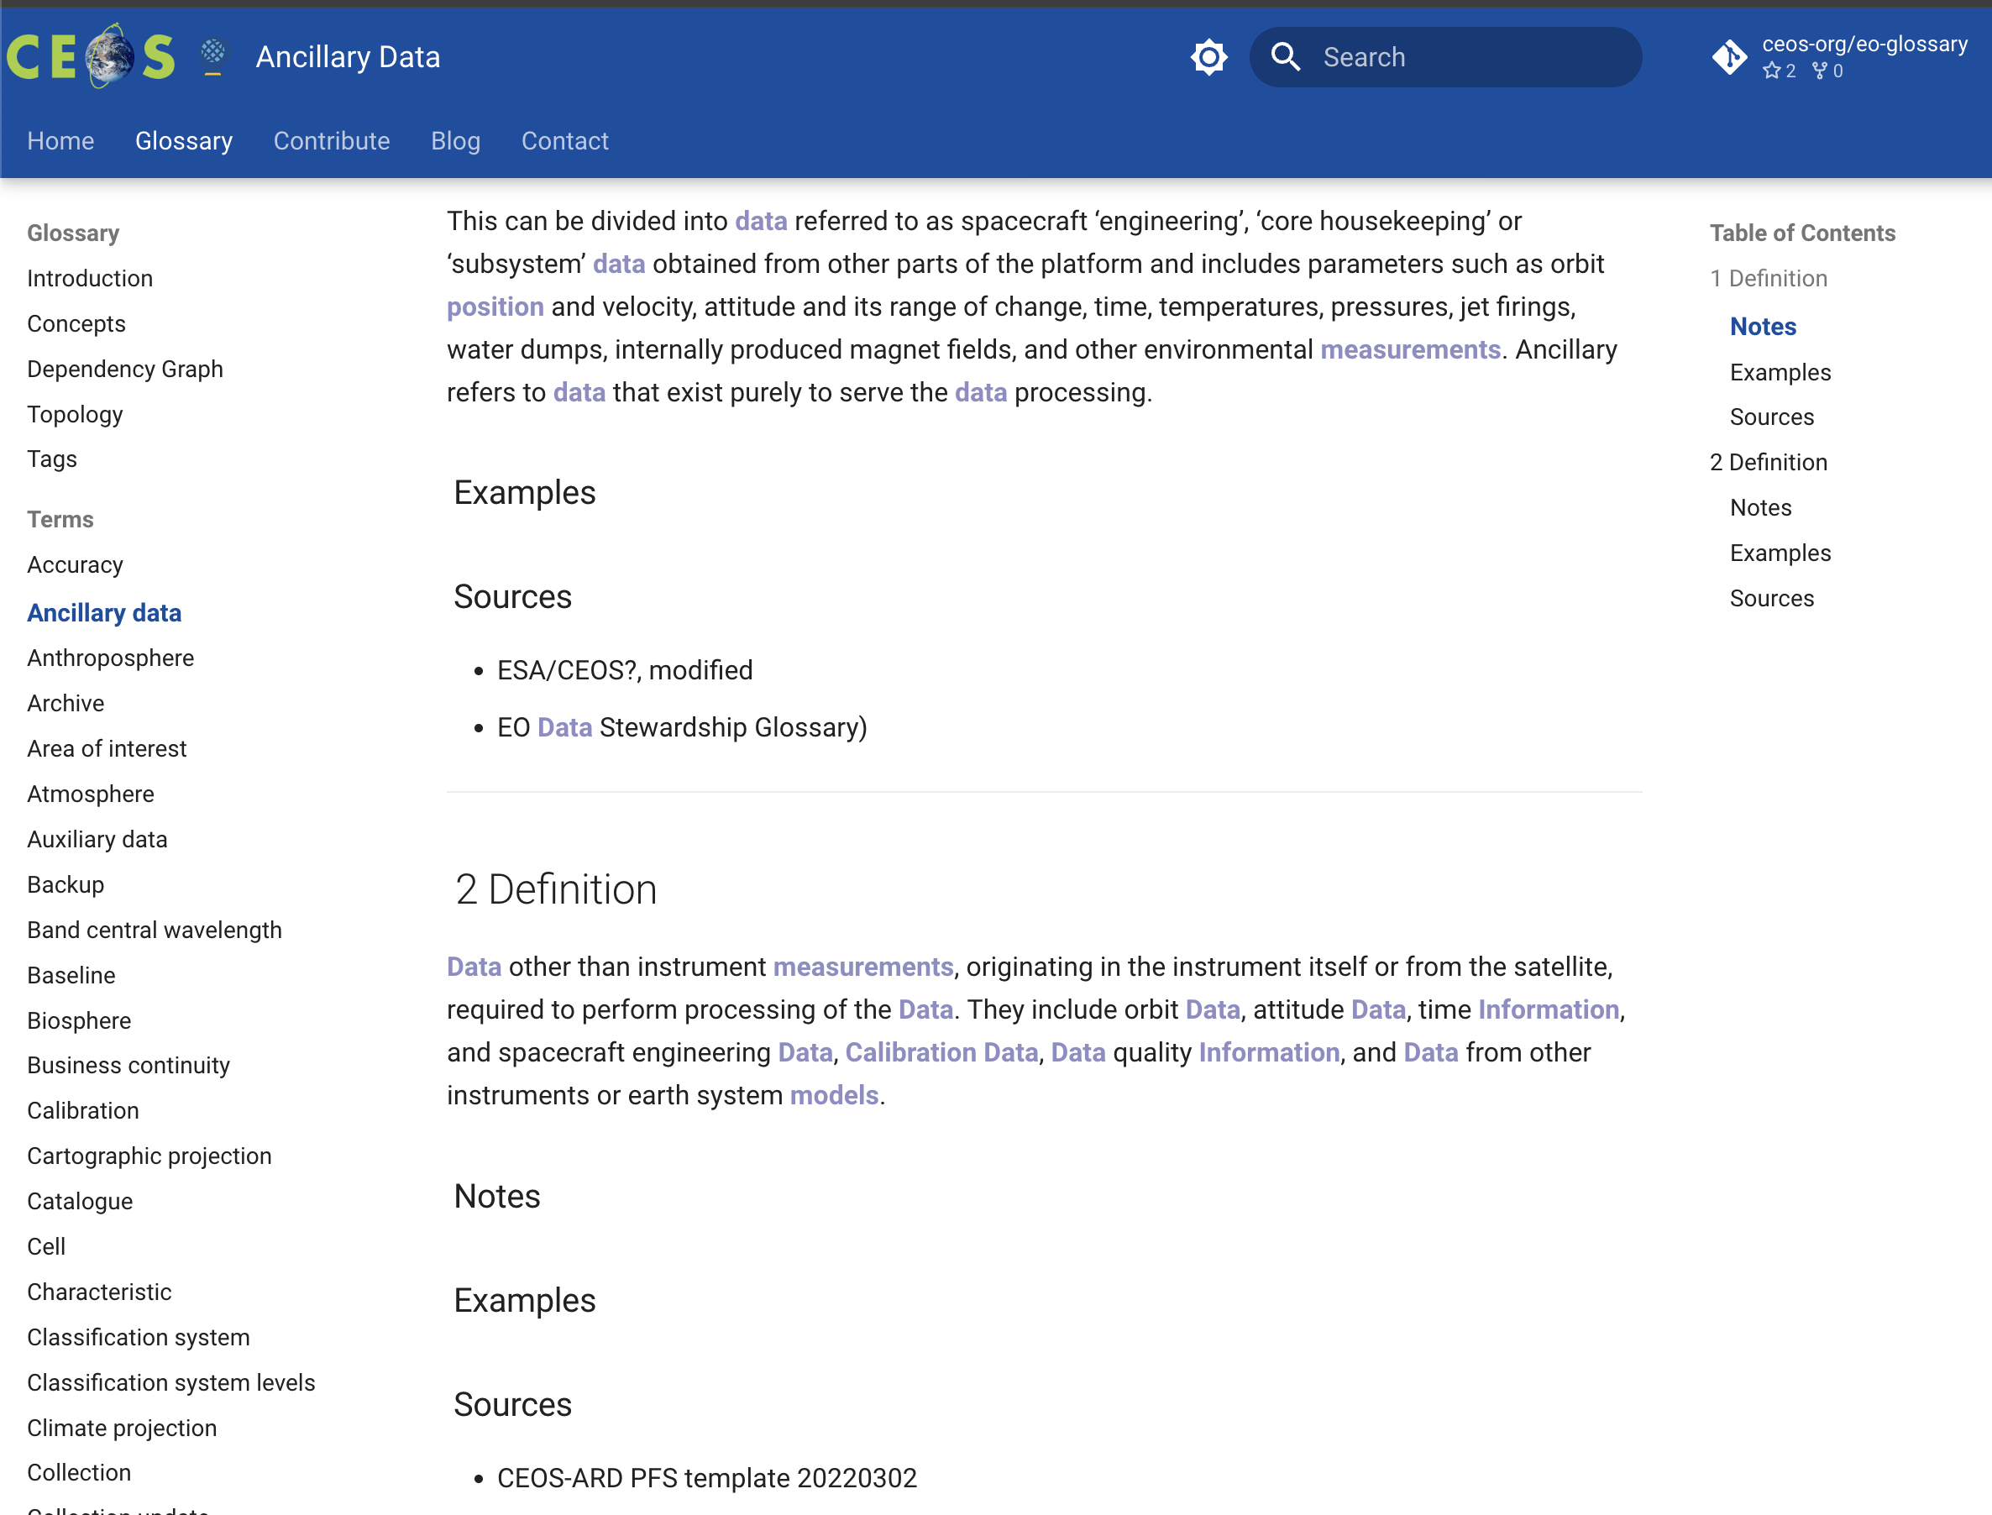
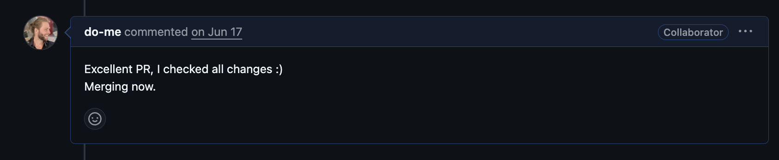
4) Workflow

Slide 13

5) Action Points / Discussion
Who will be in charge, WGISS?
How often should terms be discussed and merged?
How to encourage organisations to engage in discussions?
What to do in case of conflicts? Outcome: Structured Plan

Slide 14
Thanks!
Links
https://github.com/ec-jrc/KCEO-Glossary
https://github.com/ceos-org/eo-glossary
https://knowledge4policy.ec.europa.eu/earthobservation_en

