Slide 1
CEOS WGCV CEOS-PVP incorporating CID & RadVAL
Product Validation Platform
(previously known as 'matchup Database')
(Comparison Image Database) &
(Radiometric Validation & AnaLytics tool)
Endorsed by SIT-40 (April)
Reminder and Update
Nigel Fox, NPL/UKSA
Agenda Item 5.3
Notes:
Full overarching name

Slide 2
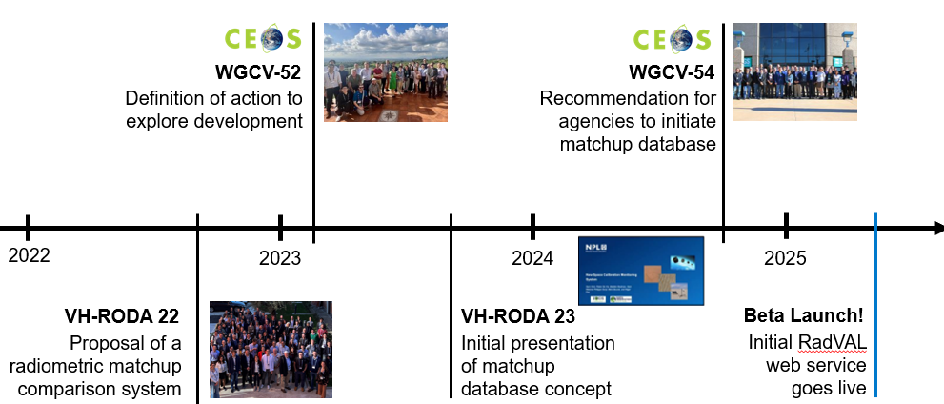
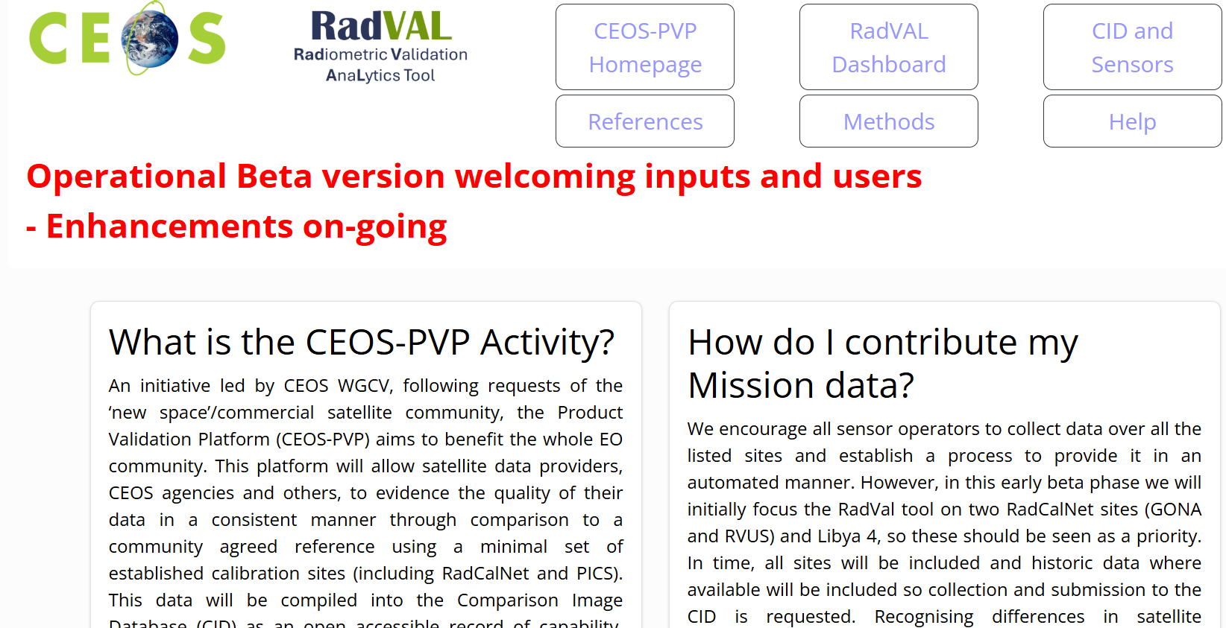
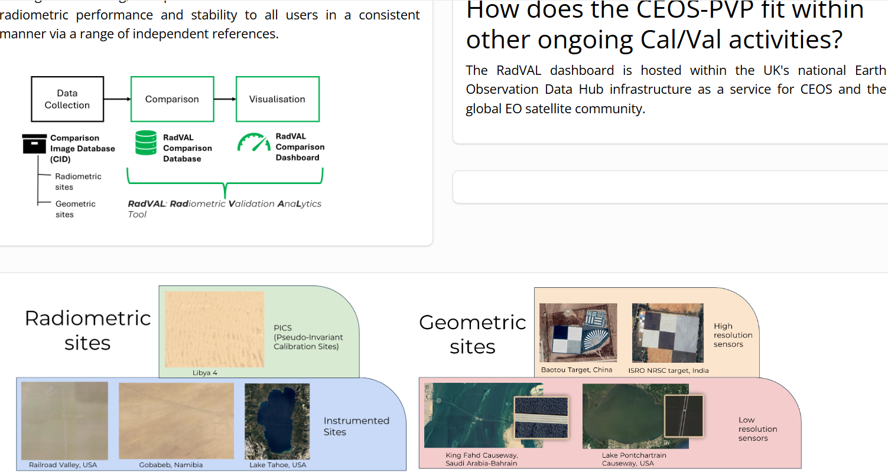

Background / Timeline
Supporting the CEOS New Space Task Team white paper generally, including recommendations (R3) and deliverables (D4)
VH-RODA 2023 slides here
Noting recent CEOS Commercial Engagement guidance
CEOS-PVP.org

Slide 3
WGCV’s recommendation
(CEOS plenary 2024)
CEOS WGCV’s recommendation to facilitate interoperable global satellite imagery for both public and commercial agencies
CEOS Agencies should regularly collect and provide free access to Level 1 satellite imagery and metadata against a common ‘CEOS reference’ (representing radiometric and spatial properties)
A combination of CEOS calibration sites will be integrated together into a virtual reference
Commercial data providers are encouraged to also provide similar imagery
Imagery should be made available through an API or a dedicated CEOS archive offered to be hosted by the UK Earth Observation Data Hub (EODH).
CEOS will provide QA feedback to support satellite operators and data users via an NPL developed web app

Slide 4

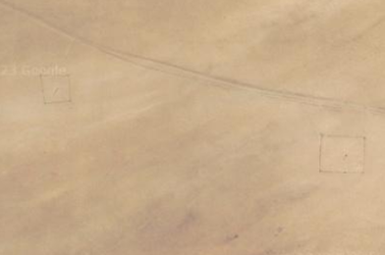
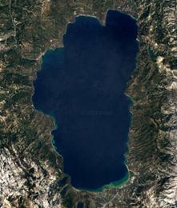


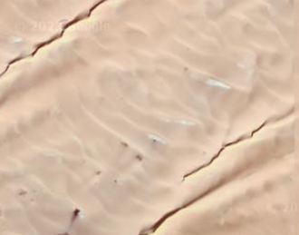
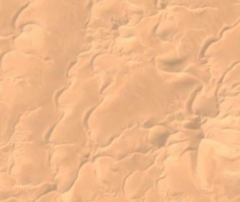

Selected: Radiometric Sites
Instrumented Sites
(RadCalNet +)
Railroad Valley, USA
Gobabeb, Namibia
Lake Tahoe, USA
Natural Pseudo-Invariant Calibration Sites
(PICS)
Libya 4
Libya 1
Algeria 3

Slide 5
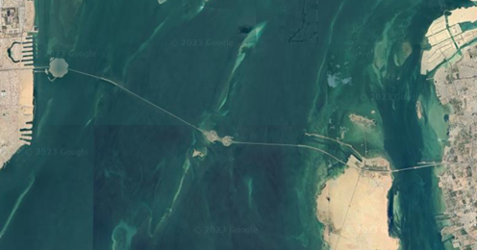
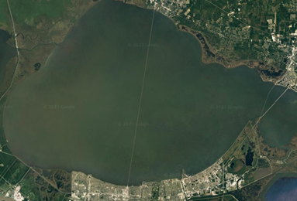
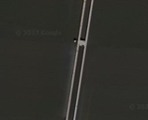
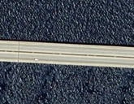
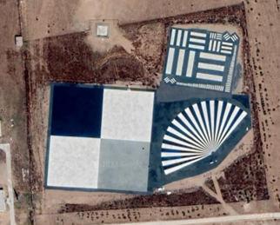
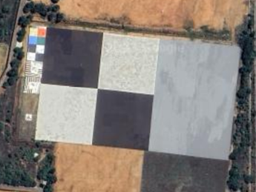
Selected: Spatial Sites
Medium resolution sensors
King Fahd Causeway, Saudi Arabia-Bahrain
Lake Pontchartrain Causeway, USA
High resolution sensors
Baotou Target, China
ISRO NRSC target, India

Slide 6

PVP
Concept to develop a CEOS “Product Validation Platform” – to host services that provide information mission performance
First PVP service – RadVAL – radiometric performance monitoring of participating missions vs. CEOS references now operational in Beta form CEOS-PVP
see press release: Facilitating trust in EO data and derived information – NPL
- (some follow-up news items)
- request from a ‘data intermediary’ to explore an API they can use to link output direct to their ‘data catalogue’
- Used together with electronic version ESA/NASA/USGS QA matrix (EDAP) within UK EODH
Provide users with actionable information on the performance of different mission products
– is data fit for purpose? Means to harmonise? Interoperability
(Consistency of gain/bias (within constellation and between other missions, Temporal stability)
2. Provide vendors with an independent mechanism to demonstrate the quality of their products.
Nb: Support Future CEOS ARD – QA evidence tool

Slide 7
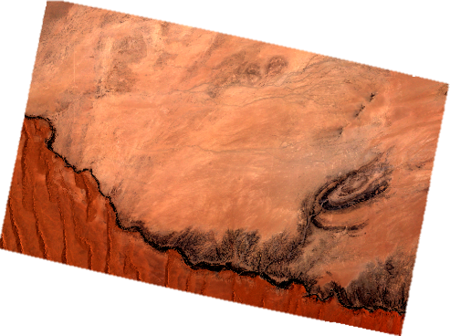
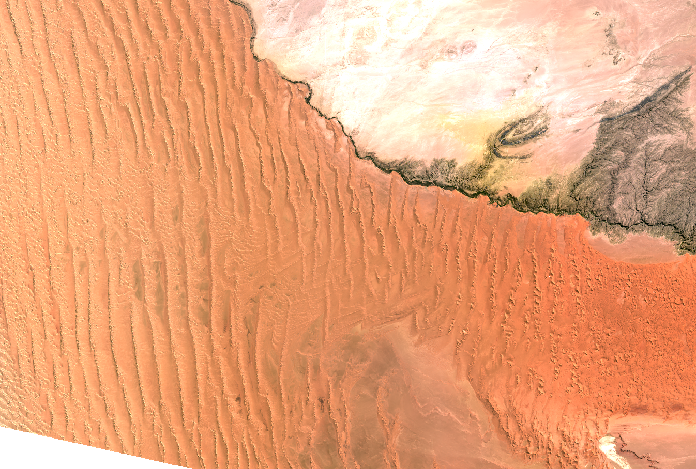
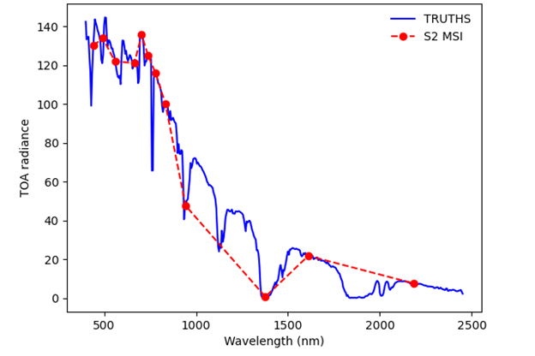
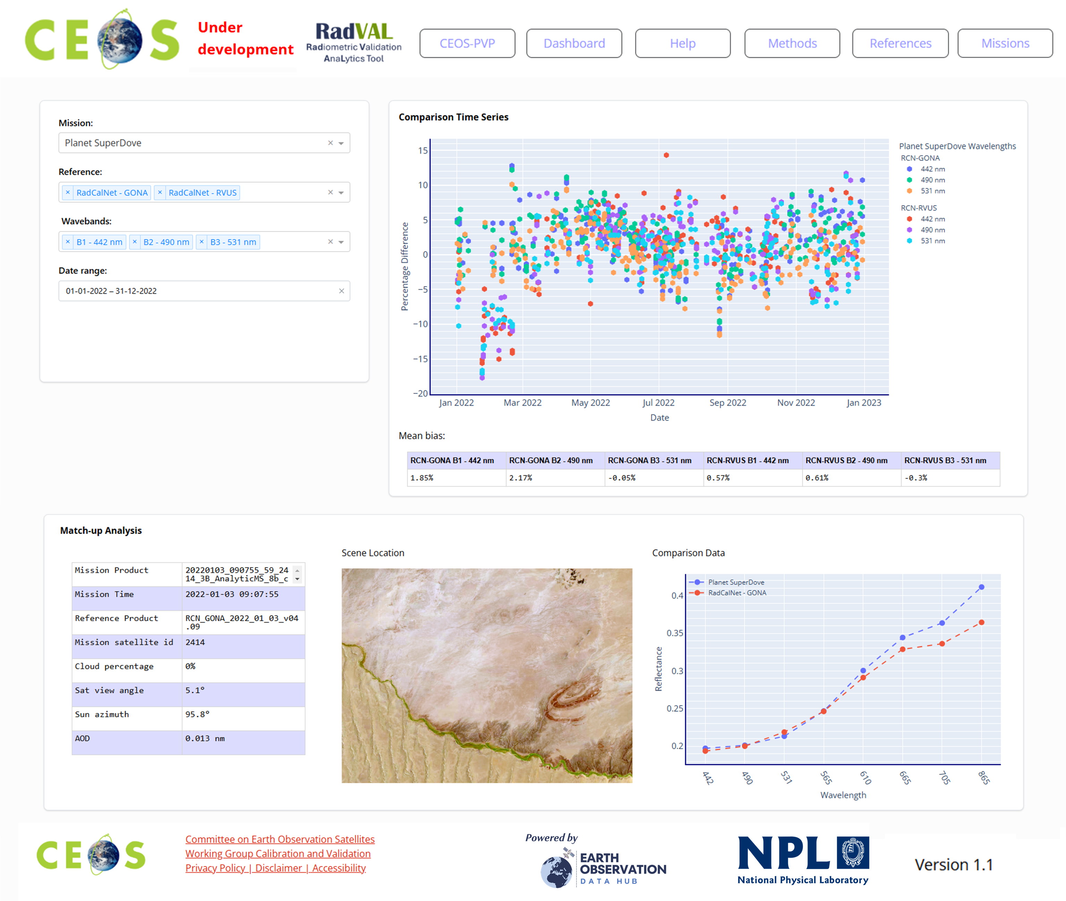
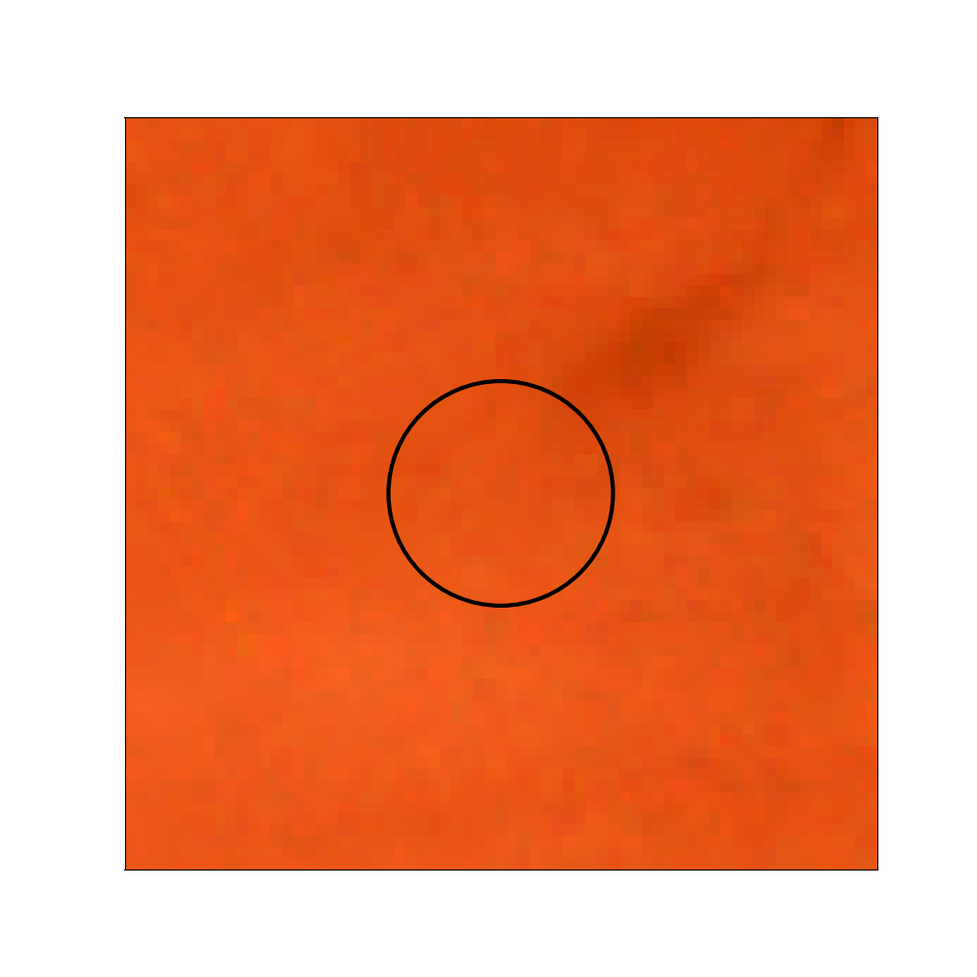
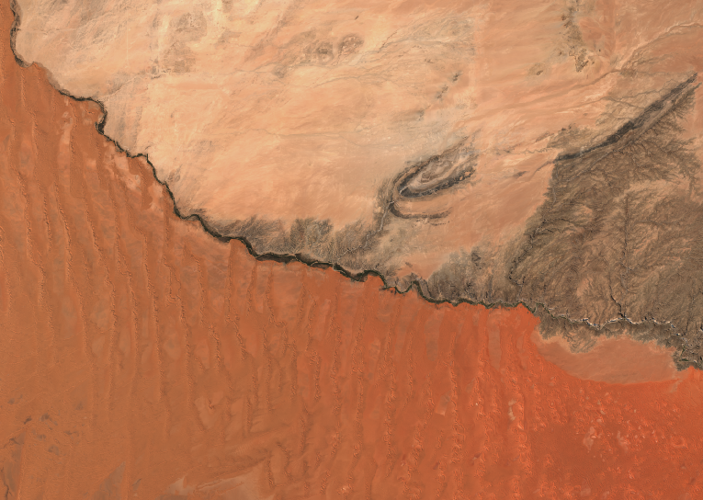


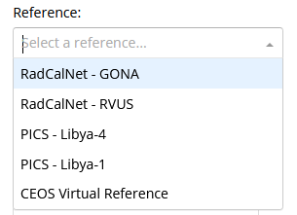
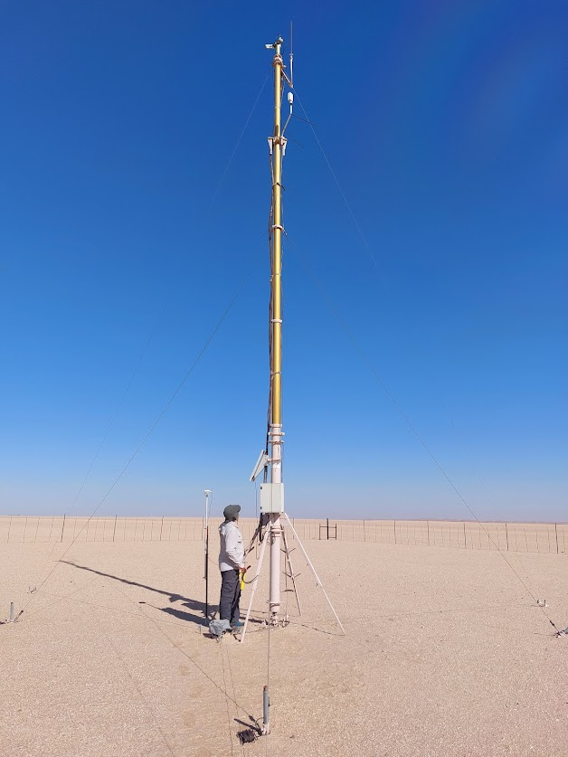

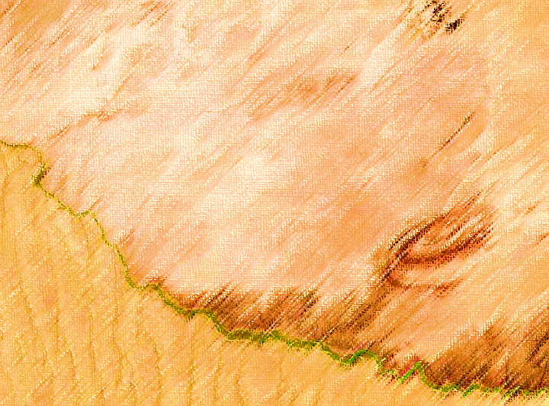

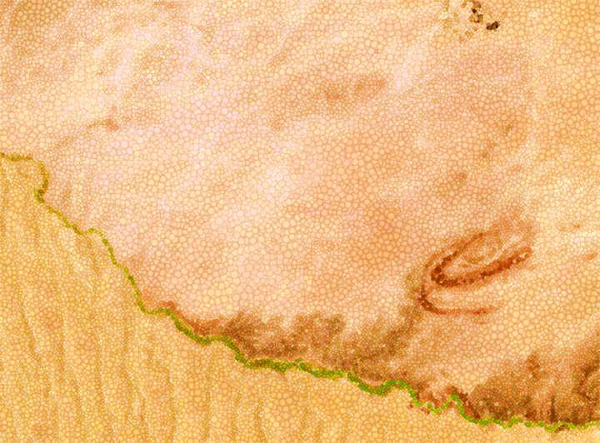



Product Validation Platform: PVP
PVP: Product Validation Platform
Data Collection
Comparison
Visualisation
Comparison Image Database (CID)
RadVAL Comparison
Database
RadVAL
Comparison
Dashboard
& future contributing missions…
Radiometric sites
Spatial
sites
RadVAL: Radiometric Validation AnaLytics Tool

Slide 8


Comparison Image Database (CID)
The UK’s Earth Observation Data Hub (EODH) infrastructure hosts the archive of satellite imagery over CEOS references:
Intended to be open access as a STAC catalogue
Initial mechanism of data transfer via direct contact with NPL and completing a form with the required information: Samantha.Malone@npl.co.uk
Mission/sensor details (product description/reader) and performance specification
SRFs for sensors will be needed (not necessarily made publicly accessible)

Slide 9

RadVAL Comparison Dashboard
Radiometric Validation AnaLytics Tool
Built from NPL’s Cal/Val toolkit (to be open source)
Beta version, now live including:
Sensors – Sentinel-2, Landsat, Planet SuperDove* and Airbus Pléiades* (* via EODH)
CEOS References – RCN GONA, RCN RRV, with PICS coming soon & 'virtual'
Landing page describing the activity and how to contribute
Find at: ceos.org/pvp – (URL agreed at SIT 40)
Allows Satellite operator to demonstrate radiometric performance and stability in a consistent manner via a range of independent references
'Virtual reference' an approximation of truth and aid to harmonisation
Can provide feedback to sensor operators

Slide 10
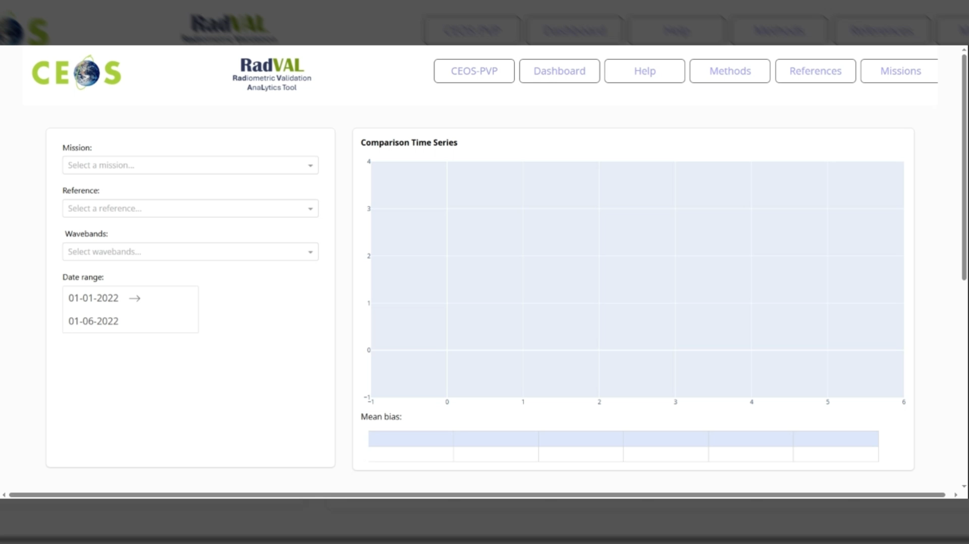
RadVAL tool demo

Slide 11
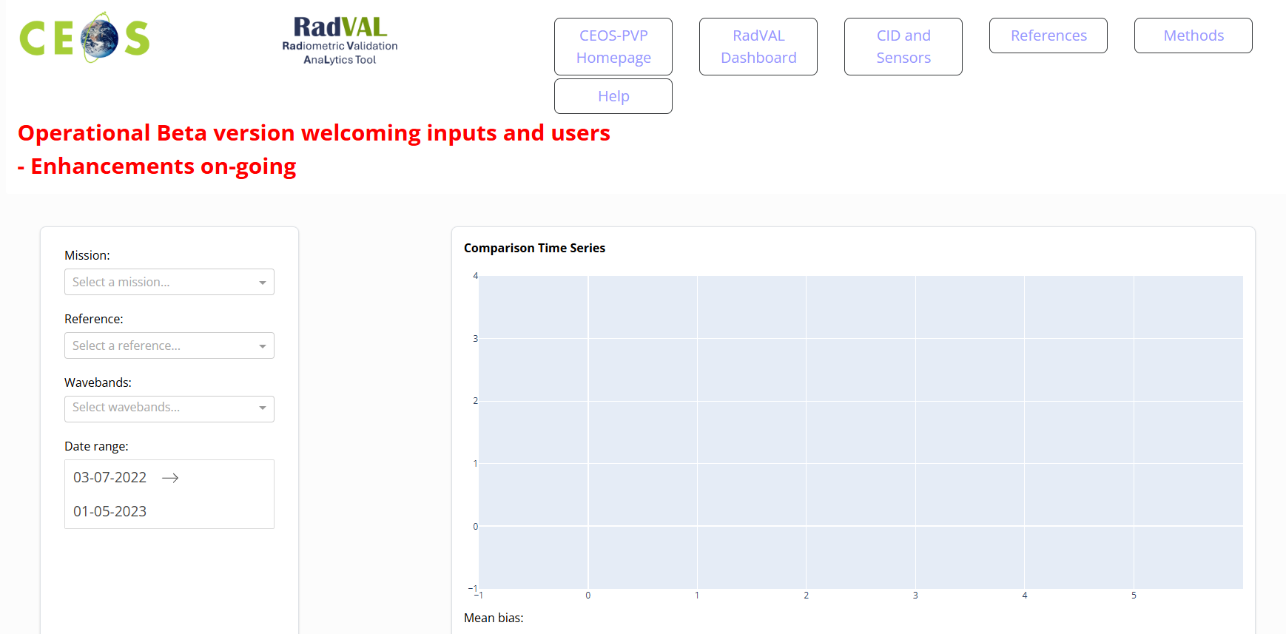
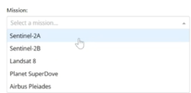
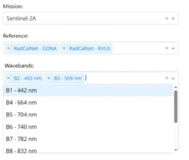
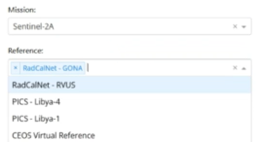
RadVAL tool demo

Slide 12
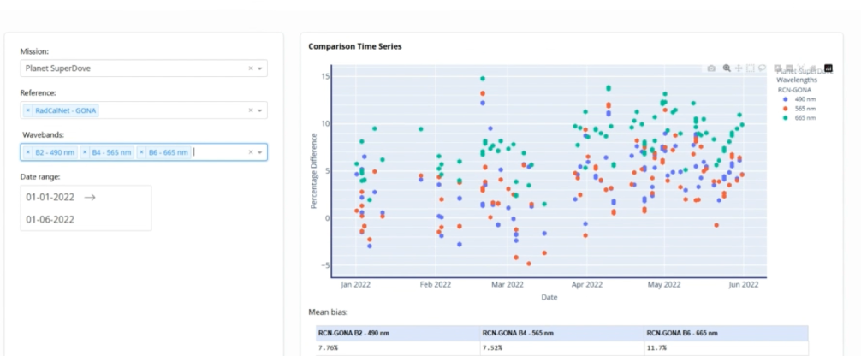
Planet superDove screen shot

Slide 13
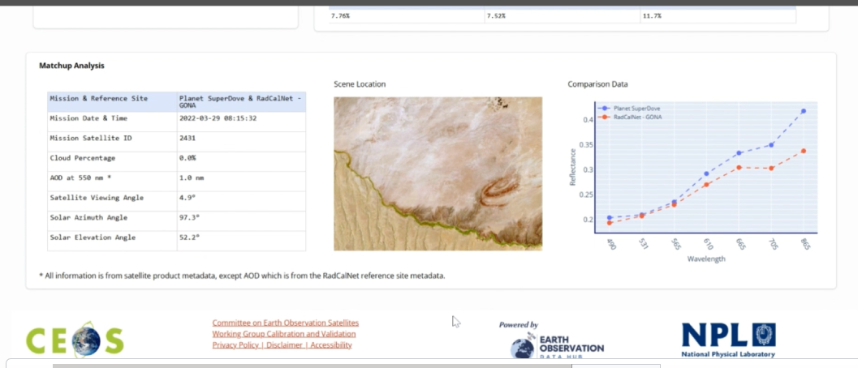
Screenshot summary page example

Slide 14
Next Steps (also supported by ESA)
Active Interaction with commercial missions to encourage delivery of imagery over reference sites
Release of submission form for missions to provide their data
Pro-active contacting before VH-RODA
Direct media articles
Encouragement via SIT of CEOS agencies to start to populate with imagery (historic and current) and of their commercial contacts (REQUEST TO SIT 41)
Update of PVP Site via commercial software developer (completion Oct 25)
including pages currently under-development:
e.g. Participating sensors basic info/contacts, method overview, user feedback
Refinement of the CEOS ‘virtual reference’ concept (uncertainty information)
Evaluate within WGCV on broadening PVP landing page to include other product validation services (SIT-40 suggestion)
Contribution to 2026 Team Australia priorities

